Slide 1

Mall Customer Segmentation App
Using KMeans Clustering to Identify Target Marketing Segments Presented by: [Your Group Name] Date: July 2025 Institution: [Insert Logo]
Notes:
Introduce the project and its relevance to marketing teams.

Slide 2
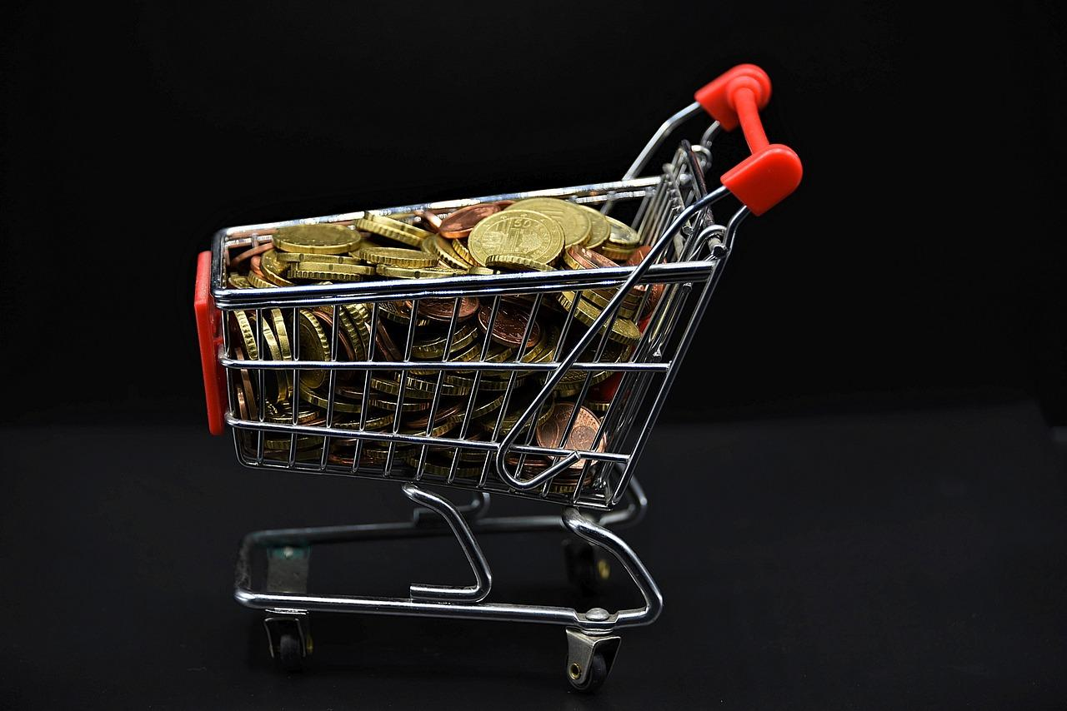
Background / Case Study
Client: UrbanEdge Living – operates furniture stores in urban malls Business Challenge: - Distinguish customer types - Launch targeted promotions - Personalize marketing campaigns Objective: Use machine learning to cluster customers based on data
Notes:
Explain the client background and why segmentation matters.

Slide 3

Dataset Description
Source: Kaggle Mall Customer Dataset Size: 200 rows, 5 columns Key Features: Age, Gender, Annual Income, Spending Score
Notes:
Walk through key dataset features: age, gender, income, spending score.

Slide 4
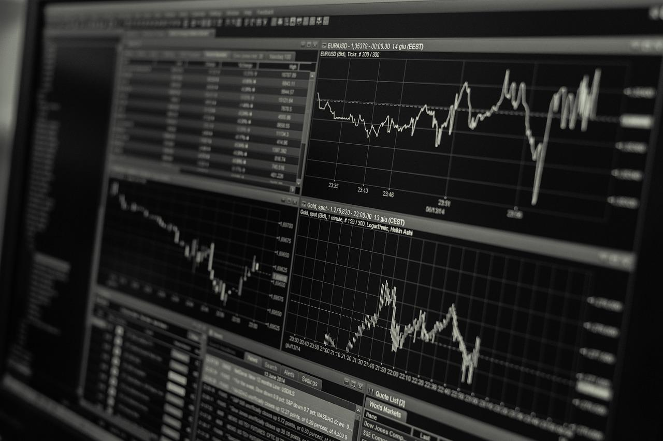
Data Cleaning & Preprocessing
Dropped CustomerID (non-informative) Encoded Gender: Male=0, Female=1 Scaled features using StandardScaler No missing values found
Notes:
Discuss preprocessing steps: encoding, scaling, and outlier removal.

Slide 5

Modeling Approach
Algorithm: KMeans Clustering Validation: Elbow Method selected k=5 clusters Visual confirmation of clusters
Notes:
Present KMeans clustering approach and elbow method for k determination.

Slide 6
Application Demo
Platform: Python & Streamlit Features: - Enter new customer info - Predict customer segment - Recommend marketing strategy - Visualize customer among clusters
Notes:
Showcase the Streamlit app functionality and user interface.

Slide 7
Segment Profiles
Cluster 0: Low Income & Low Score → Low engagement group Cluster 1: High Income & High Score → VIP shoppers Cluster 2: Mid Income & High Score → Trendy young spenders Cluster 3: Mid Income & Mid Score → Average customers Cluster 4: Low Income & High Score → Bargain seekers
Notes:
Highlight segment characteristics and marketing insights.

Slide 8
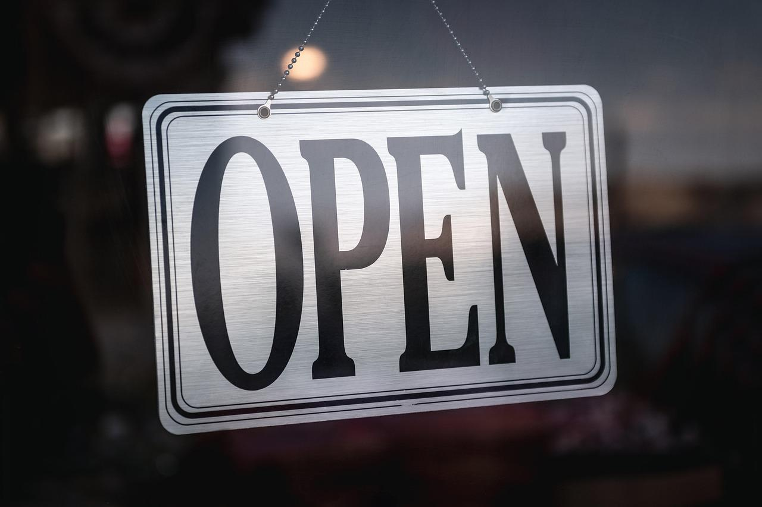
Business Conclusion
Achievements: - Customer segmentation for smarter targeting - Personalized campaigns - Avoided ineffective mass marketing Future Ideas: - Real-time POS input - Feedback metrics - Loyalty program integration
Notes:
Summarize business outcomes and future roadmap.

Slide 9

Q&A / Thank You
Thank you for your attention Questions and feedback welcome Team: [Your Names] Course / Instructor: [Insert Here]
Notes:
Thank the audience and open for Q&A.

