Slide 1

Customer Shopping Behavior Analysis
Data Analysis Report — Kesar Deaulkar
PYTHON
SQL SERVER
POWER BI

Slide 2
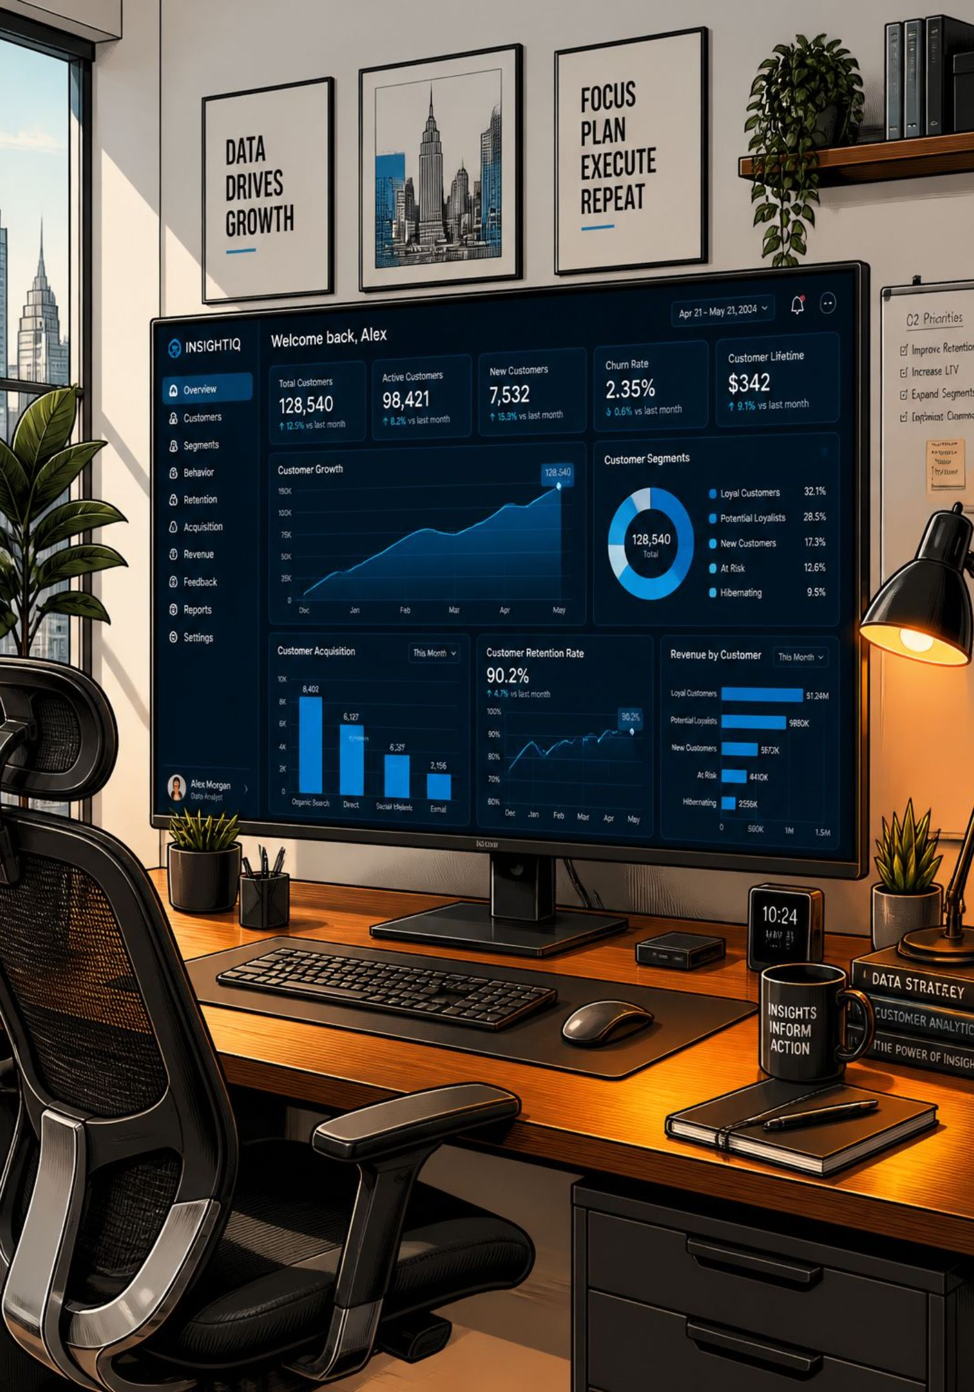
Executive Summary
Purpose
Approach
Analyze purchasing trends, revenue, discounts, subscriptions & product performance
Python cleaning → SQL querying → Power BI dashboards
Impact
Improve marketing, optimize inventory, personalize experiences, grow revenue

Slide 3
Project Objectives
01
02
03
Analyze purchasing behavior
Revenue by customer segment
Discount impact evaluation
04
05
06
Subscriber vs non-subscriber spend
Top-rated & frequent products
Customer loyalty patterns
07
Interactive dashboard

Slide 4
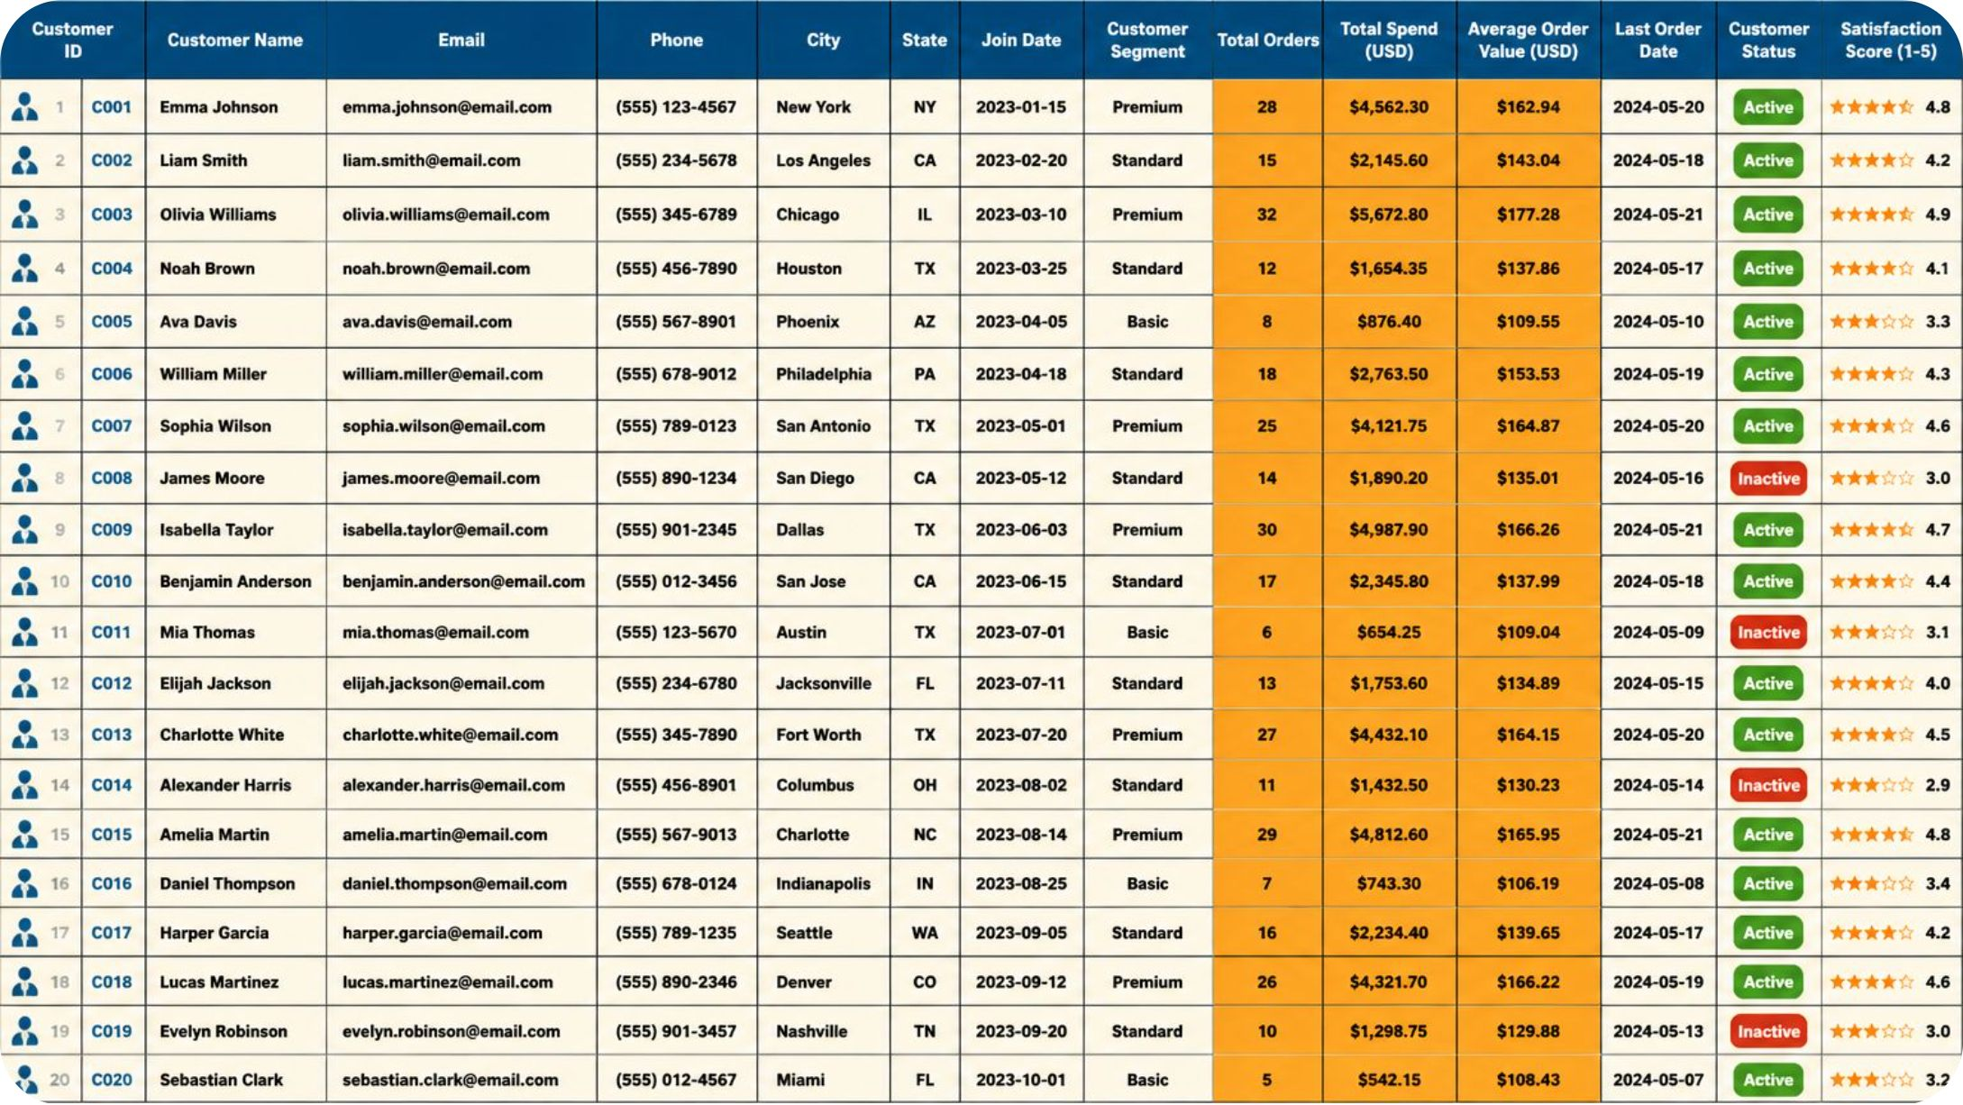
DATASET
3,900 Records · 18 Attributes
Demographics
Age, Gender, Location
Purchase
Amount, Category, Item
Behavior
Frequency, Reviews, Subscription

Slide 5
Data Preprocessing (Python)
Data Cleaning
Feature Engineering
Loaded via Pandas, checked structure & missing values
Age Group
Frequency (Days)
Young Adult · Adult · Middle-aged · Senior
Weekly=7 · Fortnightly=14 · Monthly=30
Median-filled Review Ratings by category
Lowercase columns, replaced spaces with underscores
Removed redundant Promo Code Used column

Slide 6
SQL Business Analysis
Revenue by Gender
High-Spending Discount Customers
Top 5 Rated Products
Shipping Analysis
Subscriber vs Non-Subscriber
Customer Segmentation
Top Products by Category
Repeat Buyer Subscription
Revenue by Age Group

Slide 7
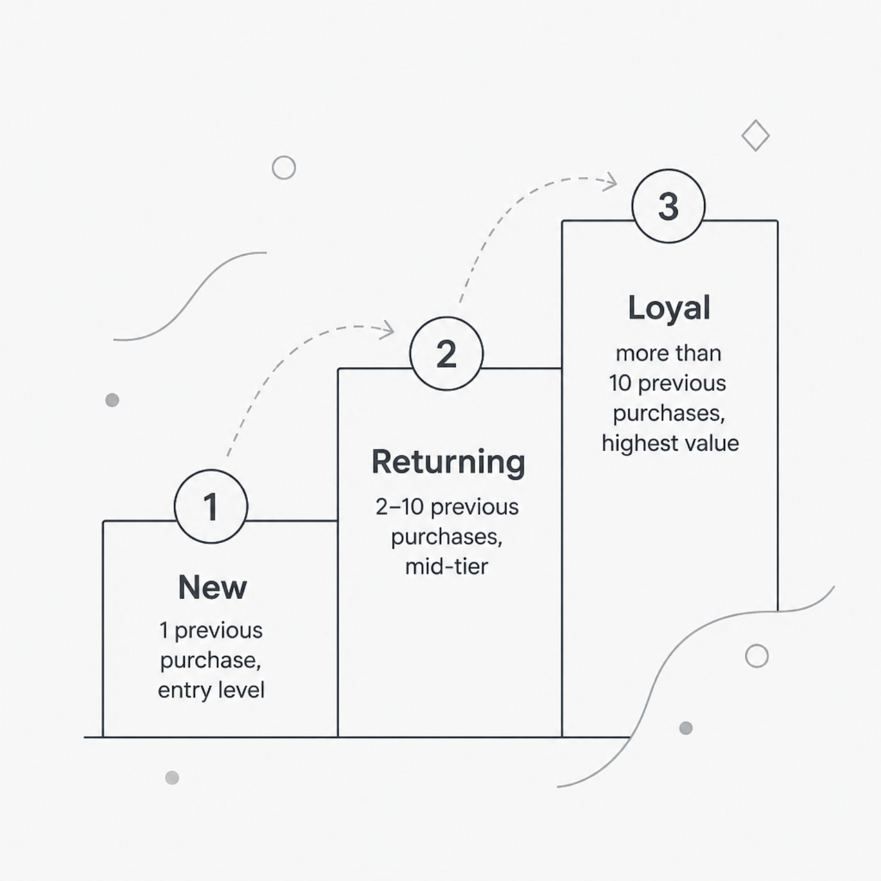
Customer Segmentation
Customers classified by previous purchase count to support targeted marketing.

Slide 8
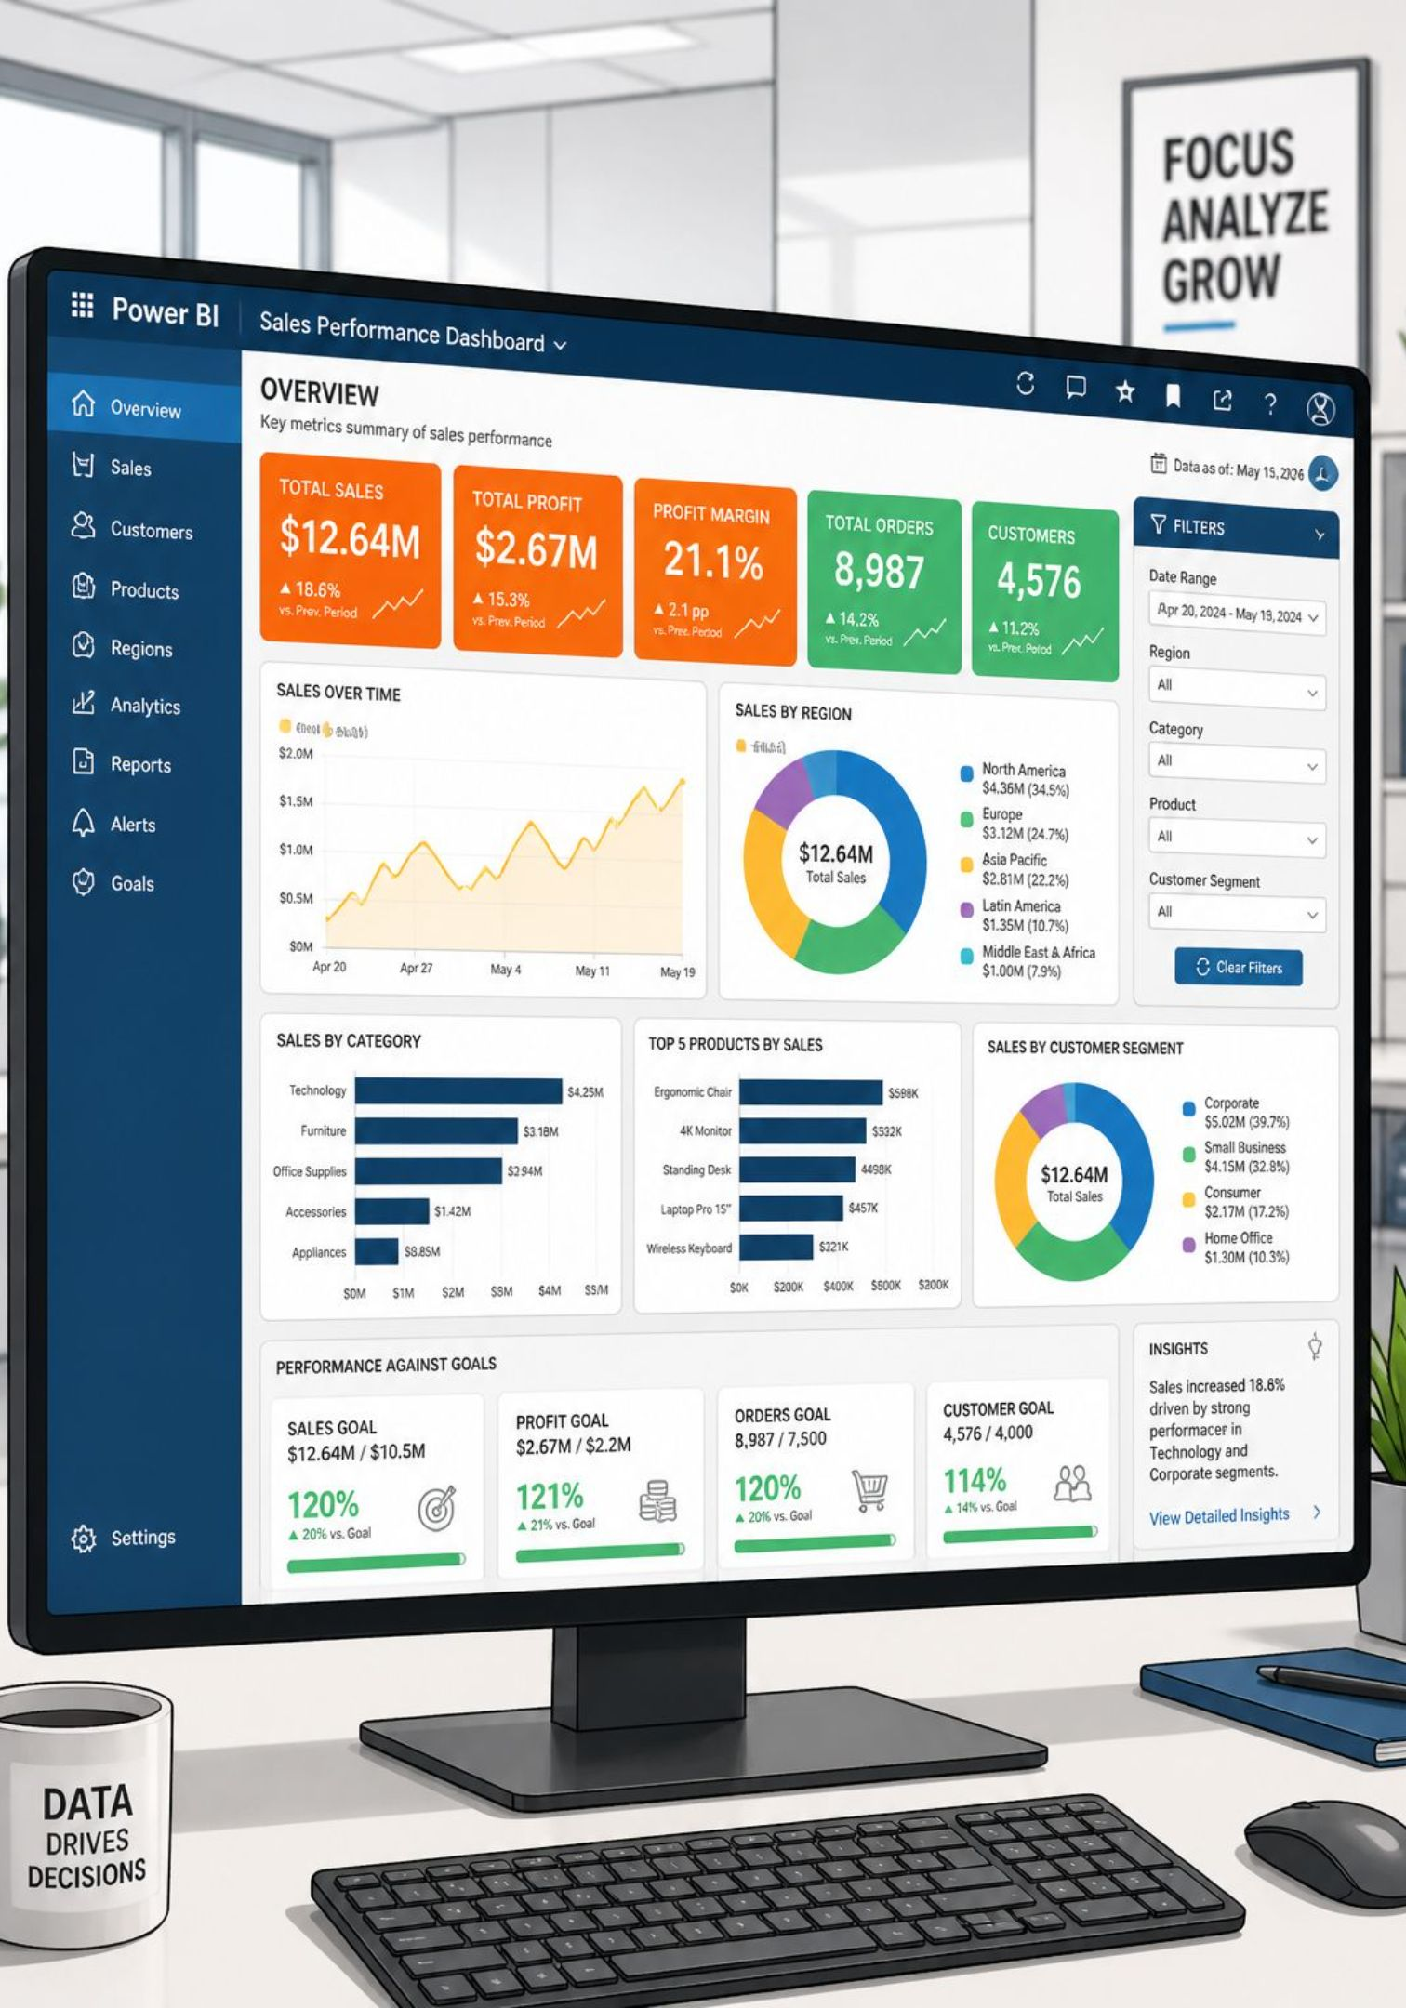
Power BI Dashboard
Revenue
Overview, by Gender, by Age Group
Customers
Distribution, Segmentation, Subscription
Products
Category Performance, Ratings
Transactions
Shipping & Discount Analysis

Slide 9
Key Insights & Recommendations
Key Insights
Recommendations
Spending differs across demographics
Subscribers drive significant revenue
Target loyal & returning customers
Expand subscription programs
Loyal customers account for major purchases
Discounts influence select products only
Personalize by age & history
Reduce discounts on high-demand products

Slide 10
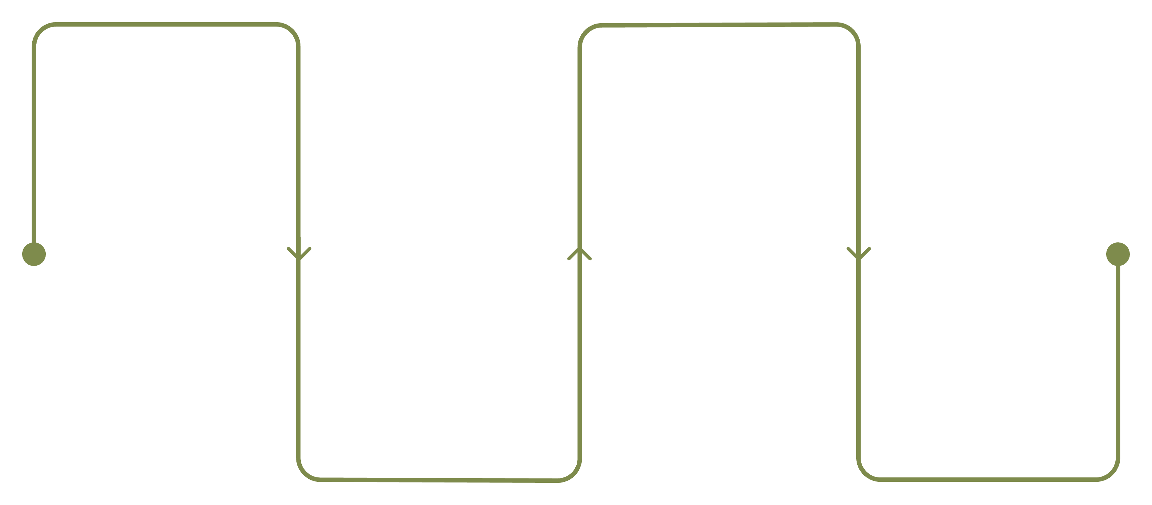
Project Workflow & Tech Stack
Data Preparation
Power BI Dashboard
Python cleaning and feature engineering
Interactive visualization and reports
Business Insights
SQL Analysis
Business queries and segmentation
Recommendations and decisions
End-to-end analytics pipeline from raw data to actionable business recommendations.
Python · Pandas · NumPy
SQL Server (SSMS)
Matplotlib · Power BI
Cleaning & engineering
Business queries
Visualization & dashboards

