Slide 1
Trends Analysis & Sales Prediction for Cars and Two-Wheelers Across Fuel Types
A Data-Driven Approach to Fuel Transition and Market Analysis
Hyper-Local Vehicle Market Analysis
Bareliwala Kesar | Baria Paresh
Guide : Mr. Ankit Vyas
Department: B.Tech/CSE
11/04/2025

Slide 2
Introduction
The Indian automotive industry is experiencing a major shift, influenced by changing consumer behavior, government regulations, and the speed of technological progress. Environmental issues, increasing fuel prices, and the need for sustainable transportation have hastened the transformation to cleaner options.
Electric vehicles or EVs and compressed natural gas or CNG cars are fast emerging as strong environment-friendly alternatives for conventional petrol and diesel automobiles. Its high demand significantly changing the India automotive scenario.
The project seeks to analyze and predict fuel-wise vehicle sales patterns with the help of machine learning methodologies. Analyzing multi-source data for ten large Indian states such as Maharashtra and Delhi, it provides evidence-based trends on fuel shift, sales patterns, and policy effectiveness.

Slide 3
Problem Statement
The rapid evolution of the automotive market, driven by technological innovation, environmental concerns, and shifting consumer preferences, presents a significant challenge for accurate vehicle sales forecasting and resale price estimation. Traditional methods often fail to capture nonlinear patterns and dynamic market influences, especially with the rise of Electric Vehicles (EVs), CNG vehicles, and government policies promoting sustainable transport.
There is a pressing need for an intelligent system that can:
Predict vehicle sales trends across different fuel types and regions.
Estimate resale values accurately using machine learning techniques.
Support policymakers and manufacturers in understanding market dynamics and planning accordingly.
Provide insights into the transition toward green mobility through data-driven projections.
This project addresses these challenges by developing a predictive analytics model using machine learning, integrating multiple datasets, and offering a user-friendly interface to aid in decision-making.

Slide 4
Objectives
India's automobile industry is transitioning towards cleaner fuel options due to environmental concerns and government policies.
EV & CNG adoption is rising, while Petrol & Diesel demand is declining.
Forecast vehicle sales trends (Petrol, Diesel, EV, CNG) for Maharastra & Delhi till 2030.
Predict fuel station growth trends for different fuel types.
Analyze the impact of government policies on fuel sales & market shifts.

Slide 5
Key Objectives:
Analyze vehicle sales trends across fuel types (Petrol, Diesel, CNG, EV).
Predict future sales and decline trends for each fuel category.
Assess the impact of government policies (subsidies, tax cuts, and incentives) on sales and fuel transitions.
Forecast EV and CNG adoption rates at the state and city levels.
Analyze resale market trends, depreciation rates, and future resale values.
Predict the expansion of EV and CNG fuel stations using machine learning models.
Estimate charging station utilization trends to optimize future infrastructure planning.
Develop an interactive Tableau dashboard to visualize key insights.
This study aims to provide data-driven recommendations for manufacturers, policymakers, and consumers regarding the future of vehicle sales and fuel transitions in India. 🚀

Slide 6
Datasets Used
Vehicle Information Dataset → Vehicle specs, pricing, running cost
Vehicle Sales & Trends Data → Historical sales trends (India/Mumbai/Delhi)
Charging & Fuel Station Growth Data → EV, CNG, Petrol/Diesel station growth
State-wise Fuel Stations Dataset → Fuel station distribution
State-wise Fuel Sales & Decline Data → YoY fuel sales trends
Government Policy Impact Dataset → EV subsidies, Petrol/Diesel bans, incentives

Slide 7
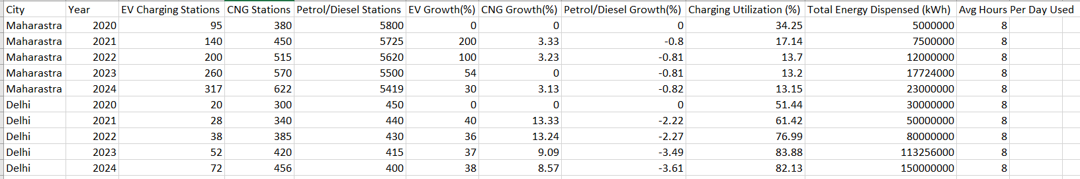
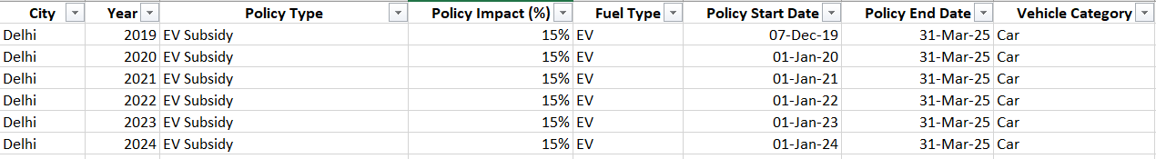
Fuel Stations (Maharashtra & Delhi)
Policy Data (Maharashtra & Delhi)

Slide 8
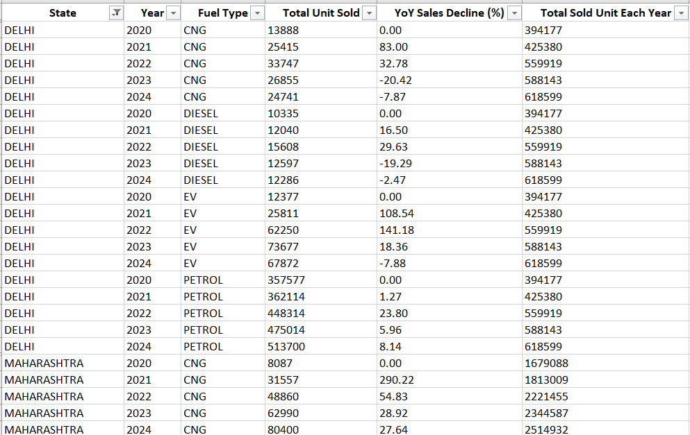
State Wise Fue Sales and Decline Data

Slide 9
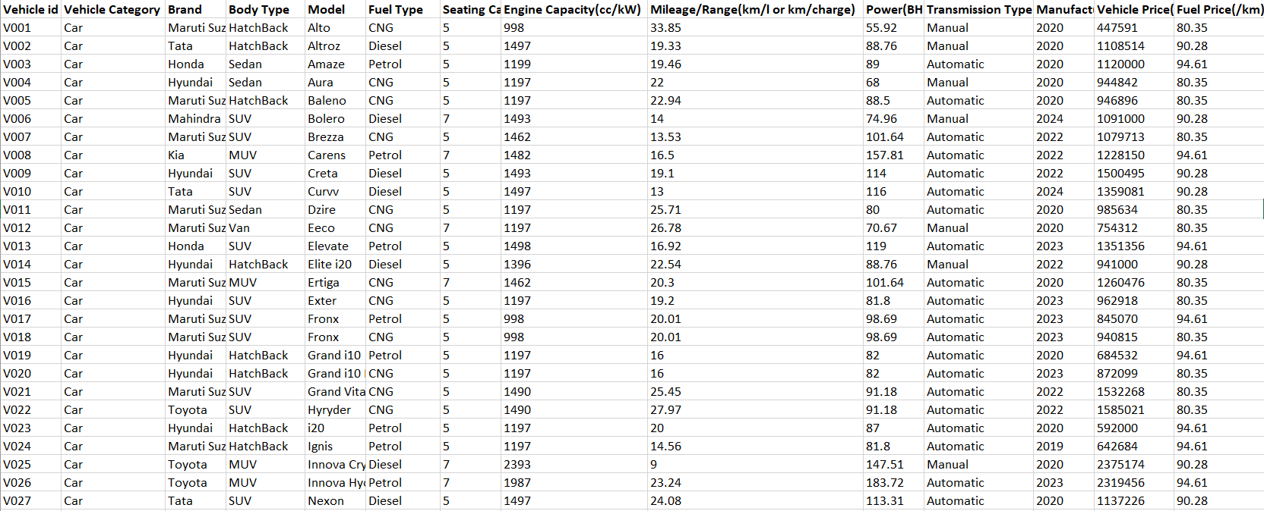
Vehicle Information Data

Slide 10
Key Features & Variables
Core Variables:
Sales Trends → Monthly/Yearly sales for each fuel type
Fuel Prices & Running Costs → Impact on consumer preference
Market Share (%) → Shift from Petrol/Diesel to EV/CNG
Government Policies → Subsidies, bans, tax incentives
Charging Utilization (%) → EV charging station efficiency
Target Predictions:
Future sales trends of each fuel type
Market share crossover year (EV+CNG > Petrol+Diesel)
Impact of government policies on adoption rate

Slide 11
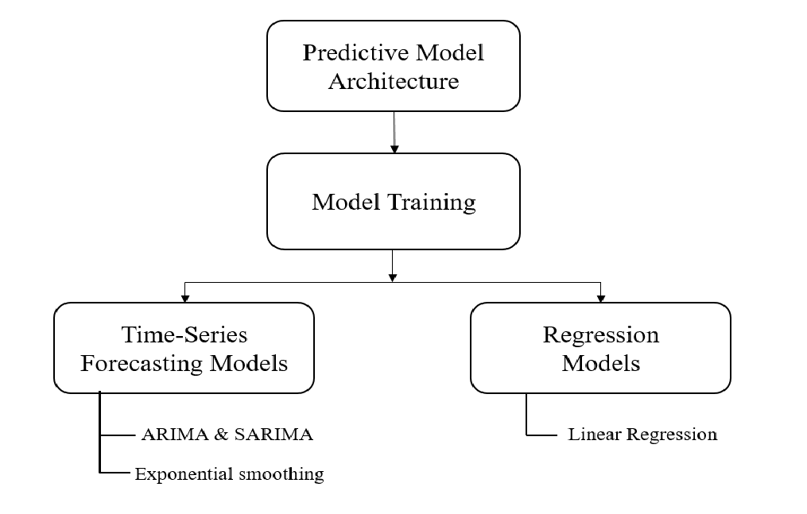
Methodology / Modeling Plan
Prediction Models Used: 1️⃣ Time Series Forecasting (SARIMAX) → Monthly vehicle sales trends 2️⃣ Regression Models (Linear Regression) → Fuel station growth & sales decline 3️⃣ Causal Inference (Diff-in-Diff, Regression Discontinuity) → Policy impact analysis 4️⃣ Logistic Growth Model → EV adoption curve & market transition prediction
Implementation Approach:
Clean & preprocess dataset
Train models on historical data (2020-2024)
Predict future sales & trends (2025-2030)

Slide 12
Fuel Type Sales Trends Over Time (2023–2024)
This graph shows monthly sales trends for Petrol, Diesel, CNG, and Electric vehicles.
Petrol (Red Line) has the highest sales but shows fluctuations and a visible decline near the end of 2024.
Diesel also sees a dip in late 2024.
CNG and Electric (EVs) show steady or slightly rising trends, especially toward the end.
Why this is important for the project:
This helps visualize how fuel-type preferences are shifting. The decline in Petrol and Diesel after mid-2024 highlights the impact of new policies or incentives promoting EVs and CNG — supporting your project's goal of analyzing fuel transitions.

Slide 13
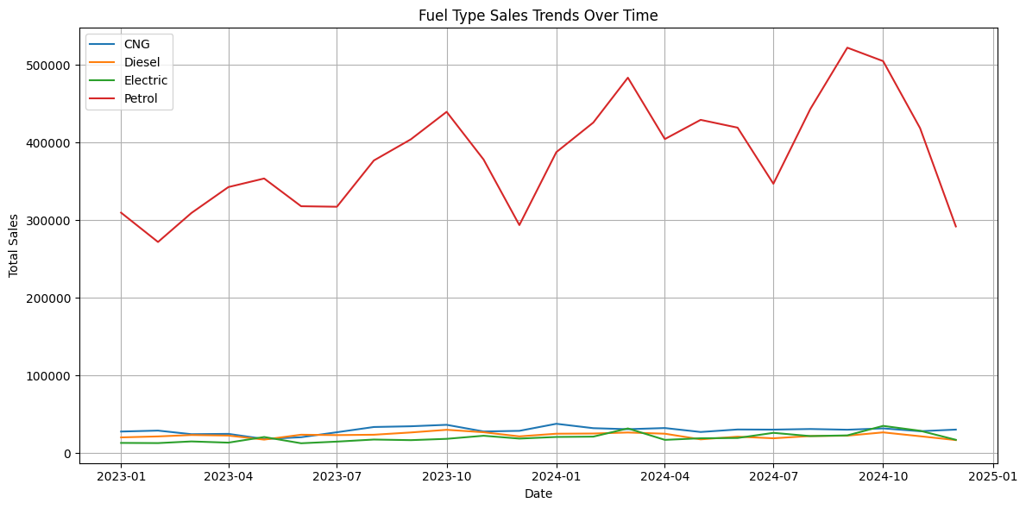
Fuel Type Sales Trends Over Time (2023–2024)

Slide 14
Forecast Results – Sales Trends
Data Preparation:
Reads sales data from a CSV file.
Filters by year, fuel type, and Delhi-specific sales.
Forecast Logic:
Electric Vehicles (EV): Grow at 15% yearly; boosted early by policy (up to 2025).
CNG: Grows with fixed policy incentives (18% in 2023, 20% in 2024).
Petrol & Diesel: Decline gradually before the policy ban year (2024 for Delhi), then fall sharply:
Petrol: −7% yearly post-ban
Diesel: −10% yearly post-ban
Visualization:
Plots all four fuel types on a time-series line chart (2023–2030).
Highlights the shift in dominance from fossil fuels to EVs & CNG.
Overview: It forecasts vehicle sales by fuel type in Delhi from 2023 to 2030, factoring in government policy interventions and market trends.

Slide 15
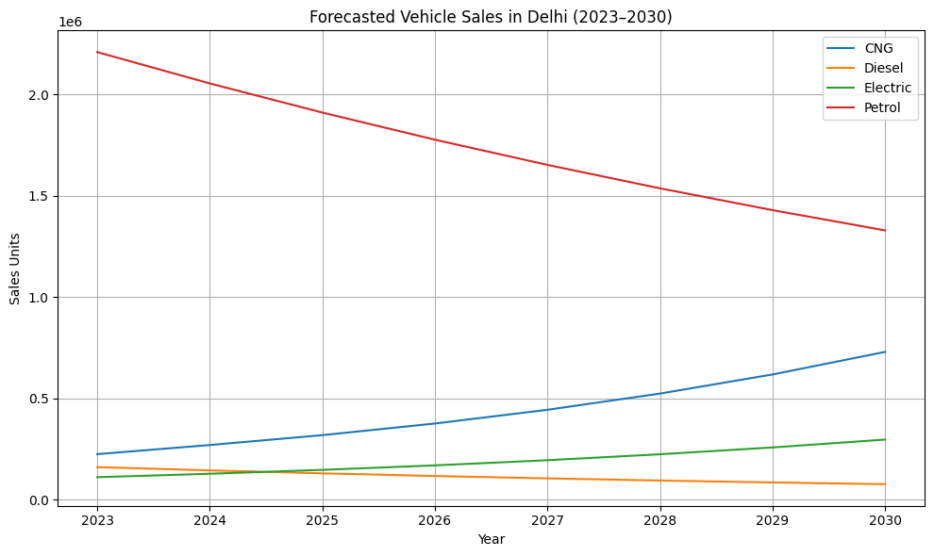
EV & CNG sales are projected to grow exponentially by 2030.
Petrol & Diesel sales decline sharply due to policy restrictions.

Slide 16
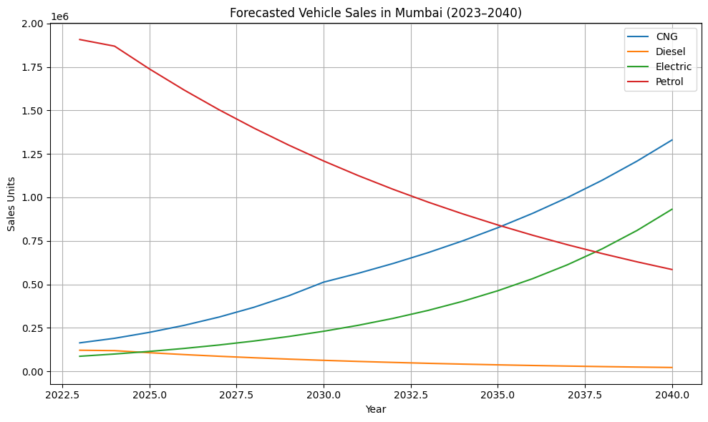
EV & CNG sales are projected to grow exponentially by 2030.
Petrol & Diesel sales decline sharply due to policy restrictions.

Slide 17
Data Preprocessing:
Loads sales data from CSV.
Converts month and year into proper datetime (ds).
Filters rows for only CNG fuel type.
Aggregates monthly CNG sales.
Logistic Model Definition:
Defines the logistic growth formula:
f(t)=K1+e−r(t−t0)f(t) = \frac{K}{1 + e^{-r(t - t_0)}}f(t)=1+e−r(t−t0​)K​
where:
K = Carrying capacity (maximum sales saturation)
r = Growth rate
t₀ = Inflection point (peak growth)
t = Time(usually months or years)
Curve Fitting:
Uses scipy.optimize.curve_fit() to estimate parameters K, r, t₀ from historical data.
Input x = timeline index; y = observed sales values.
Forecast Generation:
Projects future t values till 2030.
Uses fitted model to predict monthly CNG & EV sales.
Combines historical + predicted data into a timeline.
Visualization:
Plots actual vs. forecasted CNG sales.
Highlights growth curve using matplotlib.
Forecast for 2030 is also printed as a preview.

Slide 18
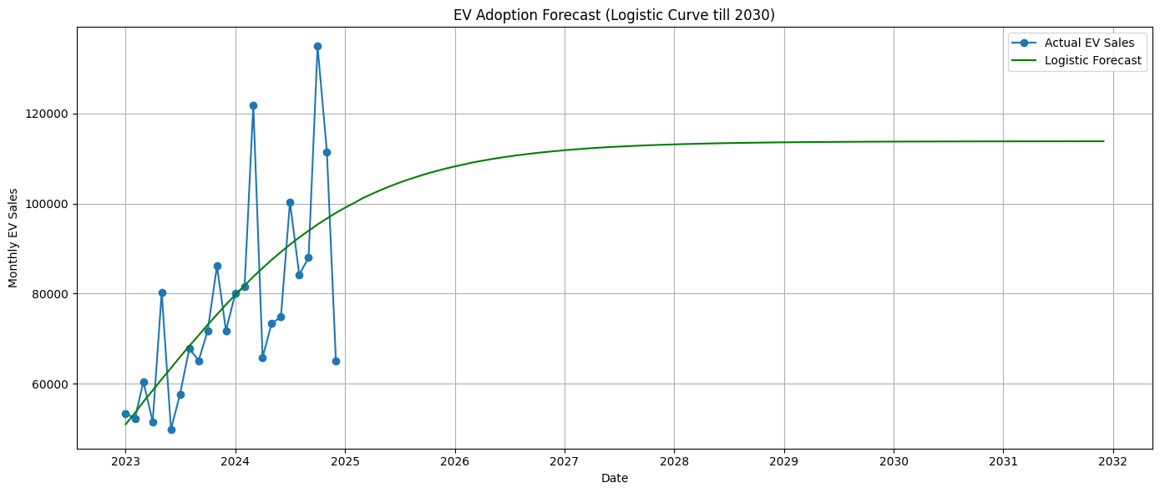
EV adoption follows a S-shaped (sigmoid) curve
(slow start, then rapid growth).

Slide 19
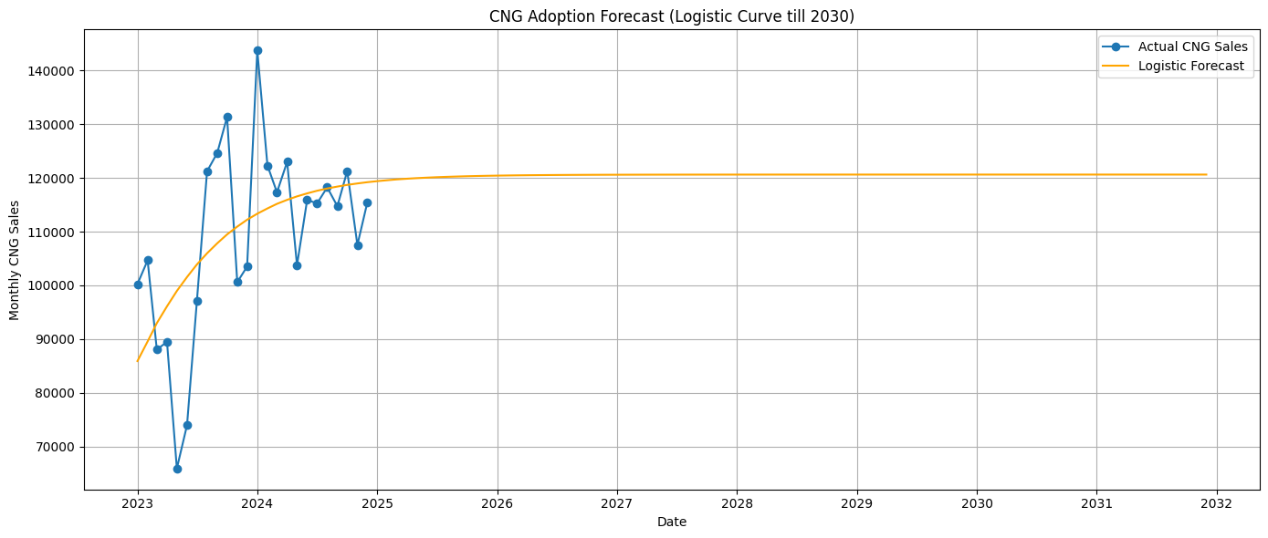
CNG adoption follows a S-shaped (sigmoid) curve
(slow start, then rapid growth).

Slide 20
Station Growth Prediction
Linear Regression
Each forecasted line is based on scikit-learn’s LinearRegression, which fits a straight line to the actual historical data.
Formula: y=mx + c
where:
yyy: Predicted number of stations
xxx: Encoded year (e.g., 0 for 2020, 1 for 2021...)
mmm: Slope (growth/decline rate)
ccc: Intercept
Overview: The curves in both graphs represent linear trends fitted using Linear Regression, and each is extended to forecast the future number of fuel stations (EV, CNG, Petrol/Diesel) for Maharashtra and Delhi.
Linear Regression was chosen due to:
Simplicity & interpretability
Consistent year-over-year change in historical trends
Adequate for short- to mid-term projections (6 years in this case)

Slide 21
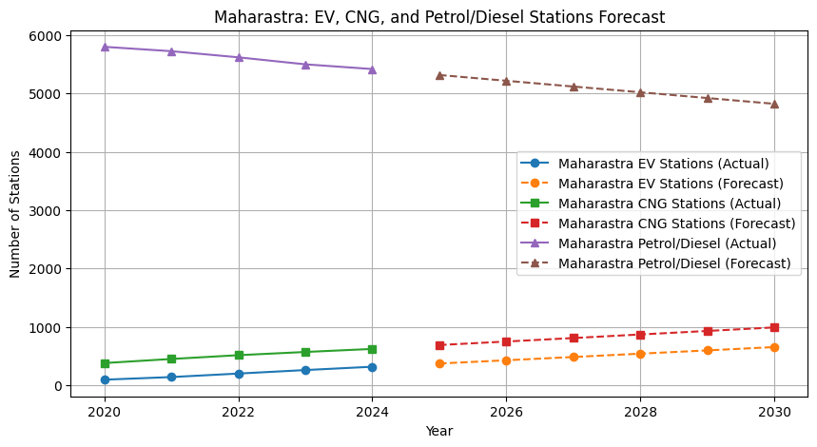

Slide 22
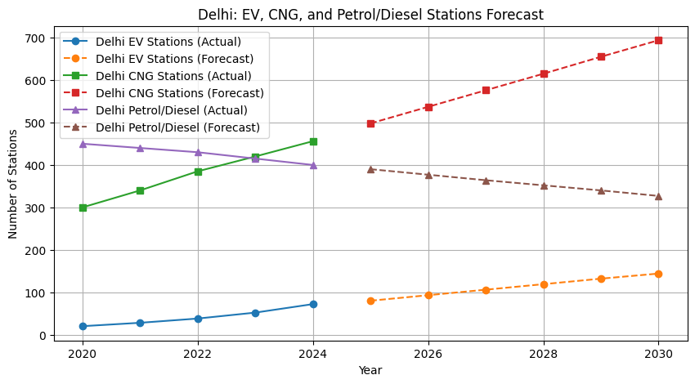

Slide 23
Station Growth Prediction
ARIMA Forecasting
Model Used: ARIMA (p=1,d=1,q=0)(p=1, d=1, q=0)(p=1,d=1,q=0) from statsmodels
Purpose: Predict the future number of EV stations based on historical time series trends (post-2015)
ARIMA Parameters:
p (Auto-Regressive part): 1 lag of the past values is considered.
d (Differencing): Data is differenced once to ensure stationarity.
q (Moving Average): 0, so no moving average component is used.
Key Advantages of Using ARIMA:
Captures trends and seasonality in time series data.
Useful for small datasets (like yearly EV stations).
Outperforms simple linear models when data shows non-constant growth rates.

Slide 24
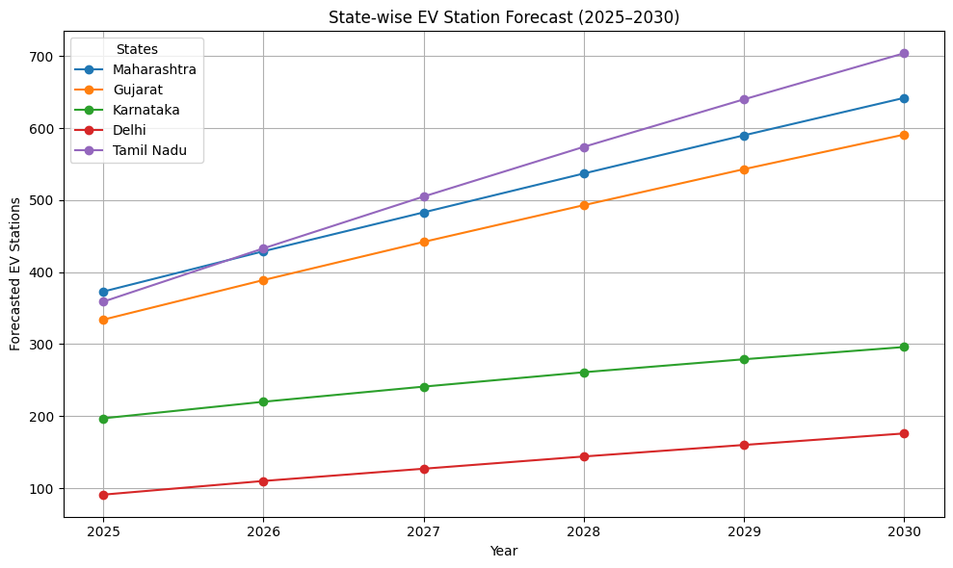

Slide 25
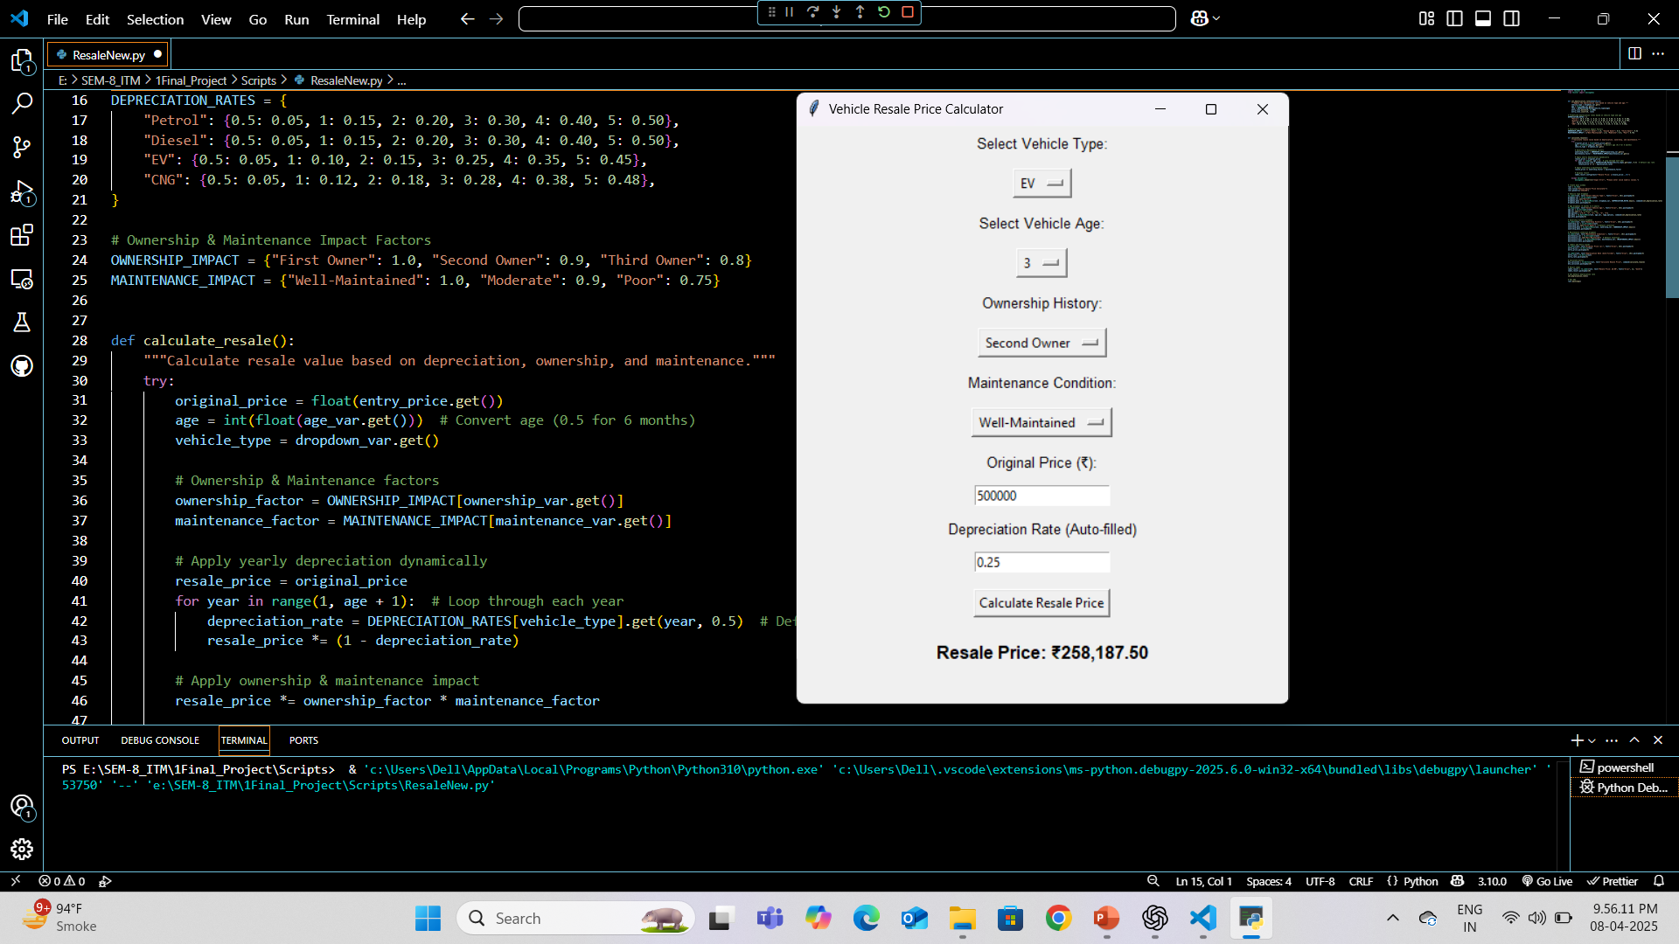
Vehicle Resale Price Calculator
This tool estimates resale value based on fuel type, age, ownership, and condition. It’s important because it helps evaluate the long-term value of a vehicle, which supports our project’s goal of comparing total ownership costs across fuel types.

Slide 26
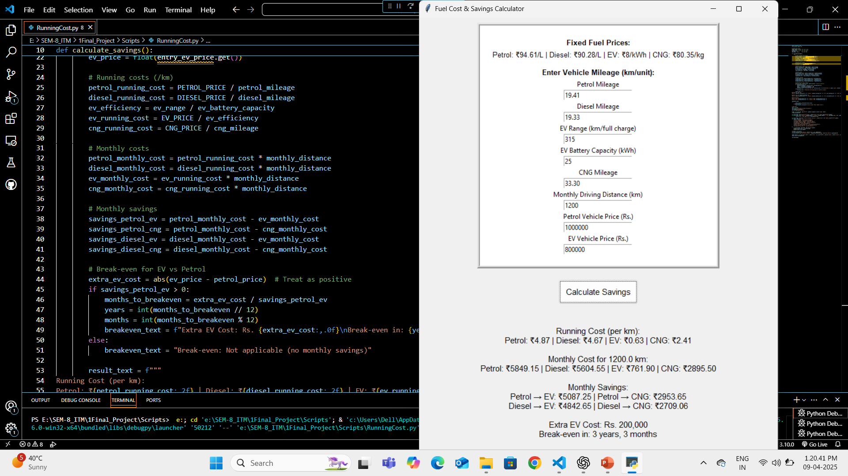
Fuel Cost & Savings Calculator
This tool calculates monthly fuel expenses and savings when switching between fuel types. It’s essential for showing the financial benefits of EVs and CNG, supporting our analysis of consumer shift and fuel transition trends. It also estimates the break-even point—how long it takes to recover the higher upfront cost of Evs through fuel savings.

Slide 27
Conclusion & Key Takeaways
The current research gives strong insights into Maharashtra and Delhi’s vehicle market shift.
With the right policies and tech improvements, India can lead in alternative fuel vehicle adoption.
Findings can guide: Policymakers, Automakers, Consumers
EV & CNG adoption is accelerating, driven by policy & fuel prices.
Petrol & Diesel sales declining rapidly, phase-out expected by 2030.
Government policy plays a crucial role in shaping fuel trends.

Slide 28
Future Work
Real-time Data Integration: The system can be extended to pull live vehicle sales data from APIs or government dashboards for real-time forecasting.
More Advanced Models: Incorporating deep learning techniques (like LSTM ) could improve long-term trend prediction accuracy.
Environmental Impact Analysis: The model can be expanded to estimate CO₂ savings from EV/CNG adoption, enhancing sustainability insights.
Web-Based Interface: Deployment of the system as a full web application (using Flask or Streamlit) for broader accessibility to policy makers and the public.

Slide 29
Data Sources
Marklines.com
CEIC Data
GoodCarBadCar.net
Government EV Policy Documents(NITI Aayog, State Transport Portals)
Vahan Parivahan
CarDekho.com
BikeDekho.com
TATA AIG (Insurance Policy)

Slide 30
Thank You

