Slide 1
Introduction to the Skip List Data Structure
Skip lists are an efficient probabilistic data structure that provide fast search, insertion, and deletion operations. They are a powerful alternative to balanced binary search trees, offering similar performance with simpler implementation.

Slide 2
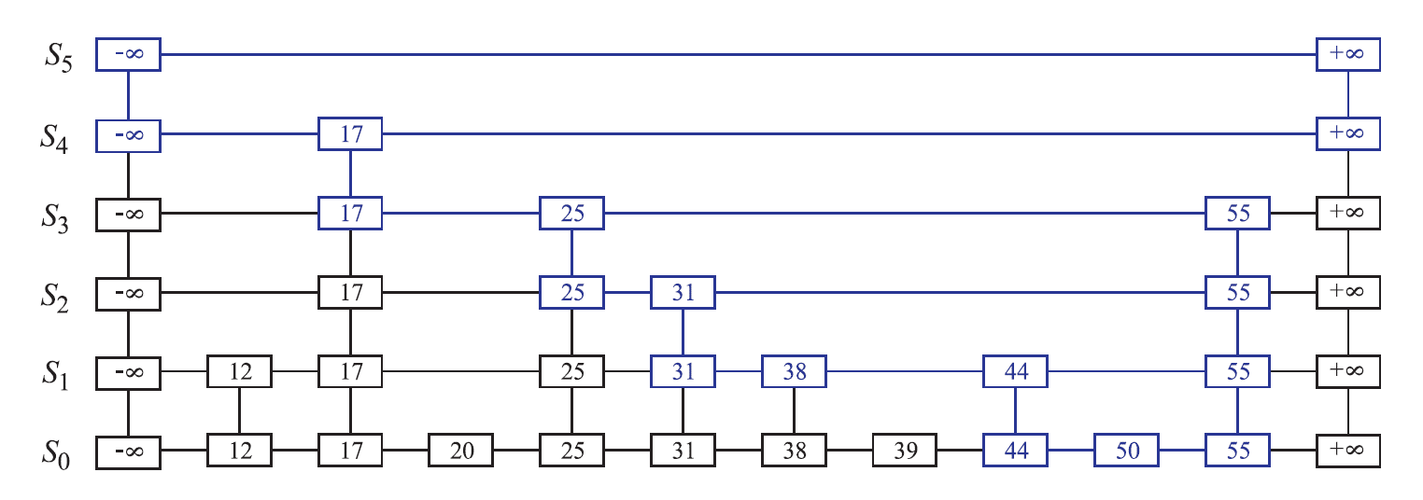
Basic Idea behind Skip Lists
Skip lists are a probabilistic data structure that maintain a hierarchy of sorted linked lists. Each node in the list contains a key-value pair and a set of pointers, or "express lanes", that allow it to skip ahead by multiple nodes at a time. This structure enables efficient search, insertion, and deletion operations with an average time complexity of O(log n).

Slide 3
Demonstration

Slide 4
Data Members and Structure
A skip list consists of multiple linked lists of different levels,
forming a hierarchy.
Each node in the skip list contains integer data and four pointers corresponding to each direction, allowing it to "skip" ahead by multiple levels.
The number of levels a node is stored in, is determined probabilistically, and thus, higher-levels have fewer nodes.

Slide 5
Insertion and Deletion Algorithms
Insertion
To insert a new node, we first find the appropriate position in the skip list by traversing the hierarchy from top to bottom. Then, we create a new node with a random number of forward pointers and insert it into the list.
Deletion
Deleting a node from a skip list involves finding the node and removing it from all the linked lists it appears in. This is done by traversing the hierarchy and updating the forward pointers of the surrounding nodes.
Search
The search algorithm in a skip list is designed to take advantage of the hierarchical structure. It starts at the topmost list and progressively moves down the levels, skipping ahead at each step until the target node is found or the search reaches the bottom level.

Slide 6
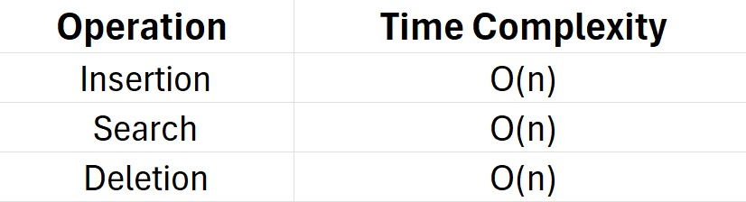

Time Complexity Analysis
Skip lists offer exceptional time complexity for fundamental operations, matching the performance of balanced binary search trees. The average time complexity for search, insertion, and deletion is O(log n), where n is the number of nodes in the data structure.But, in the worst cases, due to its probabilistic nature, the worst case tends to O(n)

Slide 7
Advantages of Skip Lists
Simple Implementation
Efficient Operations
Skip lists have a simpler implementation compared to balanced binary search trees, making them easier to understand and maintain.
Skip lists offer O(log n) average time complexity for search, insertion, and deletion, on par with balanced binary search trees.
Parallelizable
The probabilistic nature of skip lists allows for concurrent operations, making them suitable for parallel processing.

Slide 8

Disadvantages of Skip Lists
Probabilistic Nature
Memory Overhead
The probabilistic structure of skip lists can lead to suboptimal performance in some cases, as the number of levels and forward pointers is determined randomly.
Skip lists require additional memory to store the multiple levels of linked lists and the forward pointers, which can be more than some simpler data structures.
Potential for Unbalanced Structure
Difficulty in Parallelization
While skip lists are somewhat parallelizable, the coordination and synchronization required for concurrent operations can be more complex compared to other data structures.
If the distribution of node heights is not well-balanced, the skip list may become skewed, leading to decreased performance for certain operations.

Slide 9
Applications of Skip Lists
Skip lists find widespread use in real-world applications due to their efficient search, insertion, and deletion capabilities. They are commonly employed in database indexing, Web search engines, and network routing tables, where fast lookups are crucial.
Additionally, skip lists are leveraged in multimedia streaming services, caching systems, and distributed systems to maintain dynamic, probabilistically-balanced data structures that can handle frequent updates and queries effectively.

Slide 10
Conclusion and Key Takeaways
Skip lists are a powerful probabilistic data structure that offer efficient search, insertion, and deletion operations with an average time complexity of O(log n).
Their hierarchical structure with multiple linked lists and express lanes allows for fast traversal and navigation through the data.
Skip lists trade off some memory overhead for their performance advantages compared to simpler data structures, making them a versatile choice for many real-world applications.

Slide 11
Contributions
Devs: Kesavram VS, Hariesh R, Sanjivan N, Akshara V, Kannappan V
Tester: Krishna S, Amitesh M, Selva M
Business Analyst: Abhijit S
Project Manager: Aaditya Shah S

