Slide 1
Introduction to the Trie Data Structure
A Trie is a tree-like data structure used to store a dynamic set of strings. Each node in the Trie represents a single character, and paths from the root to leaf nodes form unique strings. Tries excel at string retrieval operations, such as searching for specific strings and finding all strings with a common prefix. They are commonly used in applications like dictionary and spell-checking systems, auto-completion features, and IP routing tables for fast lookups

Slide 2
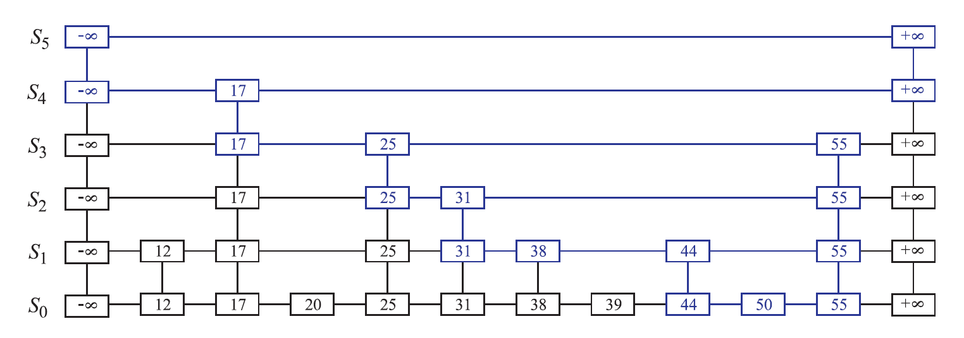
Basic Idea behind Trie
The basic idea behind a Trie is to efficiently store and retrieve a set of strings by organizing them in a tree-like structure. Each node in the Trie represents a single character, and paths from the root node to leaf nodes represent strings. The Trie structure allows for fast searching, insertion, and deletion operations on strings, particularly when there are common prefixes among them. By storing characters along paths and using links between nodes to represent prefixes, Tries provide an efficient way to manage and manipulate string data

Slide 3
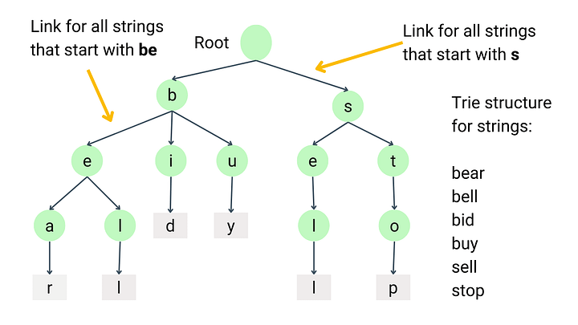
Demonstration

Slide 4
Data Members and Structure
A skip list consists of multiple linked lists of different levels,
forming a hierarchy.
Each node in the skip list contains integer data and four pointers corresponding to each direction, allowing it to "skip" ahead by multiple levels.
The number of levels a node is stored in, is determined probabilistically, and thus, higher-levels have fewer nodes.

Slide 5
Insertion and Deletion Algorithms
Insertion
The time complexity of inserting a string into a Trie is O(n), where n is the length of the string.
This is because inserting a string involves traversing the Trie from the root to the leaf node, creating new nodes as necessary, which takes time proportional to the length of the string
Deletion
Deletion operation in a Trie also has a time complexity of O(n), where n is the length of the string to be deleted.
Deleting a string may require removing nodes from the Trie and potentially restructuring the Trie to maintain its integrity
Search
The time complexity of searching for a string in a Trie is also O(n), where n is the length of the string being searched for.
Searching involves traversing the Trie from the root to the leaf node along the path corresponding to the characters of the string being searched.

Slide 6
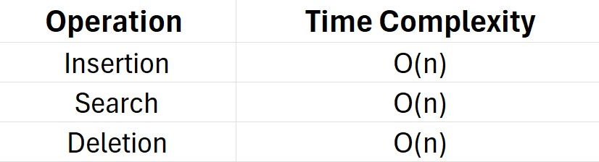

Time Complexity Analysis
Overall, the time complexity of Trie operations is proportional to the length of the strings involved. Tries offer efficient performance for operations such as searching for strings, especially when there are common prefixes among them. However, the space complexity of Tries can be a concern, especially if the Trie contains a large number of strings with long common prefixes.

Slide 7
Advantages of Skip Lists
Dictionary and spelling
Efficient prefix searching
Tries are well-suited for dictionary implementations and spell-checking systems. They allow for fast lookup of words and efficient detection of misspelled words by checking for their existence in the trie.
Tries excel at prefix-based searching. Finding all strings with a common prefix can be done efficiently by traversing down the trie from the root along the prefix path.
Space Efficiency
Tries can be memory efficient, especially when storing a large number of strings with common prefixes. Instead of storing each string separately, Tries share common prefixes among strings by storing them only once in the data structure.

Slide 8

Disadvantages of Skip Lists
Complexity of implementation
Memory Overhead
Implementing Tries can be more complex compared to other data structures. Handling insertion, deletion, and searching operations may require careful management of nodes and pointers, especially to maintain the integrity of the Trie structure.
Tries can have high memory overhead due to the need for pointers or references to child nodes at each level. This overhead can be particularly significant when storing large numbers of short strings, as each character requires a separate node.
Slow Performance in sparse datasets
In datasets where the strings have few common prefixes or are relatively sparse, Tries may not offer significant advantages over other data structures. The overhead associated with storing individual characters in nodes can lead to slower performance and higher memory usage compared to alternatives like hash tables or binary search trees.

Slide 9
Applications of Trie
IP Routing: In computer networking, Tries are used in IP routing tables. They provide fast lookup of IP addresses by organizing them in a hierarchical structure, where each level represents a part of the IP address.
Autocompletion and Predictive Text: Tries power autocompletion features in text editors, search engines, and messaging applications. By traversing down the trie from the root along the prefix entered by the user, suggested completions can be efficiently generated

Slide 10
Conclusion and Key Takeaways
Tries are a powerful probabilistic data structure that offer efficient search, insertion, and deletion operations with an average time complexity of O(n).
Tries excel at string retrieval operations, such as searching for specific strings and finding all strings with a common prefix.
Tries trade off some memory overhead for their performance advantages compared to simpler data structures, making them a versatile choice for many real-world applications.

Slide 11
Contributions
Devs: Kesavram VS, Hariesh R, Sanjivan N, Akshara V, Kannappan V
Tester: Krishna S, Amitesh M, Selva M
Business Analyst: Abhijit S
Project Manager: Aaditya S Shah

