Slide 1
PRESENTATION TITLE 2
Sub-topic

Slide 2
DIVIDER SLIDE TITLE 1
Sub-topic

Slide 3
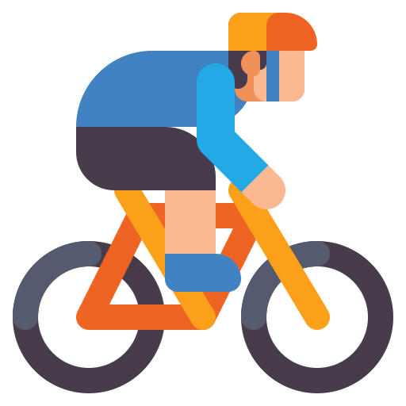
Motivation
Why do cyclists need this?
  Lack of easy heart rate/speed monitoring for cyclists
  Manual signaling is unsafe
  Lack of integrated GPS + health tracking at low cost

Slide 4
Solution
A Smart Cycle Dashboard with:
Heart Rate, Temperature Monitoring
Speed Tracking
Auto Left/Right Turn Indicators
Mobile App Integration for Live Data + History

Slide 5
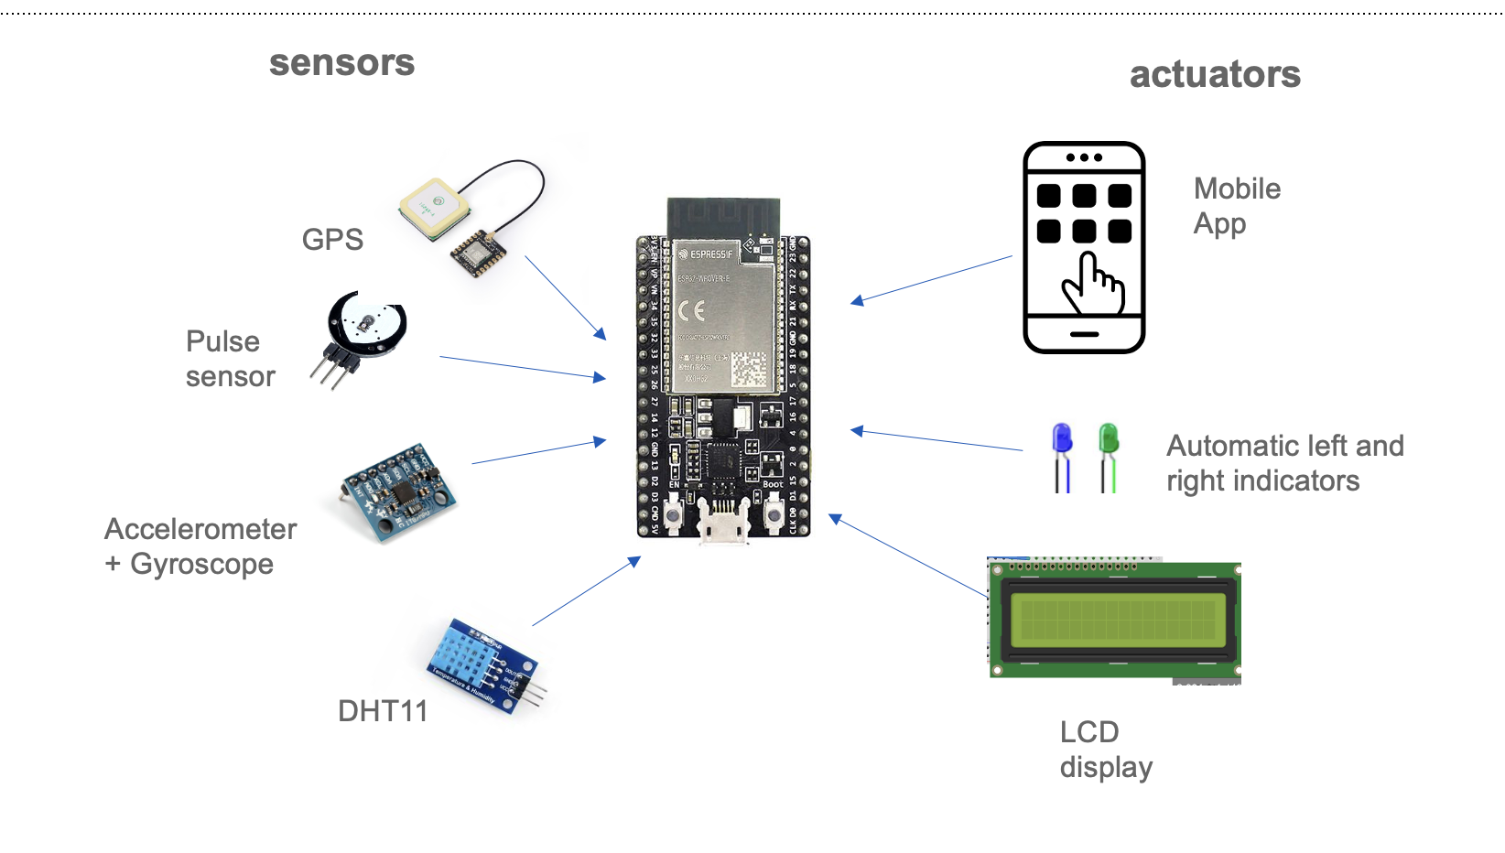
Schematic

Slide 6
Hardware Components
ESP32 Microcontroller (Bluetooth Enabled)
GY-521 (MPU6050) Accelerometer + Gyroscope
Pulse Sensor for Heart Rate
GPS Module (NEO-6M)
Temperature Sensor (Dummy / DHT11)
16x2 LCD Display
LEDs for Indicators
Battery
Bluetooth Communication to App

Slide 7
Mobile App
Connect to ESP32 over Bluetooth
Display live:
  Heart Rate ❤️
  Speed 🚴
  Temperature 🌡️
  Tilt/Turn Direction ↔️
Show GPS Coordinates (Future update)
Simple Button to Connect/Disconnect Bluetooth

Slide 8
Schematic

Slide 9
Software Architecture
Sensor Initialization and Data Reading
Processing for Speed and Tilt Detection
LCD Display Output
Bluetooth Transmission to Mobile App
Serial Monitor for Debugging

Slide 10
Components cost
Component | Unit Price (USD) | Quantity | Total Cost (USD) | Notes
ESP32 Development Board | 5.00 | 1 | 5.00 | The microcontroller that drives the entire system.
Pulse Sensor | 10.00 | 1 | 10.00 | For heart rate monitoring.
MPU6050 (Accelerometer/Gyro) | 5.00 | 1 | 5.00 | For speed calculation and tilt detection.
Bluetooth Module (ESP32) | Integrated (ESP32) | 1 | 0 | Bluetooth capability is included with ESP32.
Temperature Sensor (DHT22) | 8.00 | 1 | 8.00 | For temperature sensing.
16x2 LCD Display | 3.00 | 1 | 3.00 | For displaying data.
Power Supply (Battery) | 6.00 | 1 | 6.00 | Rechargeable battery for mobile use.
Cables and Connectors | 2.00 | 1 set | 2.00 | Basic wires/connectors for setup.
Miscellaneous (Enclosure, Mounts, etc.) | 5.00 | 1 | 5.00 | Miscellaneous cost for housing and mounting components.

Slide 11
Testing Strategy
Stage 1: Simulate random dummy values
Stage 2: Hardware-Sensor Integration
Stage 3: Bluetooth App Testing
Stage 4: Real-world cycle mounting and road testing

Slide 12
Future Improvements
Live GPS tracking and route recording
SOS system on crash detection
Solar charging integration
App Notifications for Speed Limits
Community Challenges inside the App

Slide 13
Thank you!
Any questions?

