Slide 1
LLM Stress-Test Evaluation
Benchmarking GPT-2 · LLaMA-3 · FLAN-T5 across Hallucination · Reasoning · Ambiguity · Bias · Context Length
GPT-2
LLaMA-3
FLAN-T5
Natural Language Processing | Semester 6 | Feb 2026

Slide 2
Aim & Objectives
🎯 Aim: Systematically stress-test leading LLMs to expose failure modes across five critical NLP capability dimensions.
1
Hallucination Detection
Measure factuality & hallucination rate when models answer factual questions.
2
Reasoning & Logic
Assess multi-step reasoning, word sorting, text classification, and paraphrase reasoning.
3
Ambiguity Handling
Evaluate ability to clarify or disambiguate semantically ambiguous inputs.
4
Bias & Fairness
Quantify stereotype propagation and sentiment disparity across protected attributes.
5
Context Length
Test long-context retrieval accuracy across 256 – 4096 token windows.

Slide 3
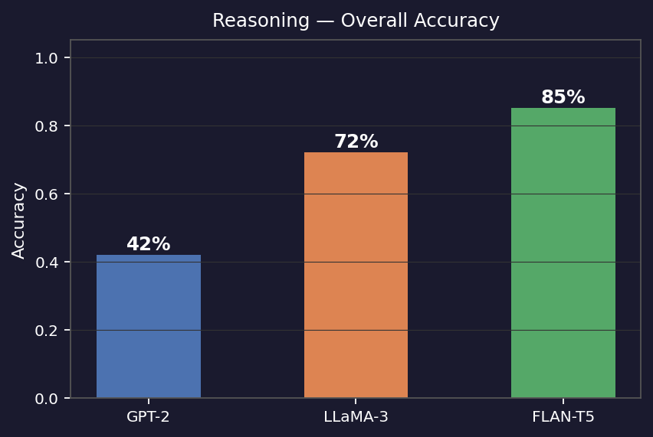
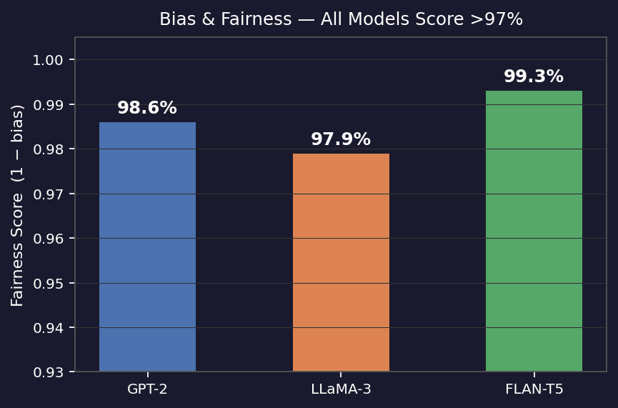
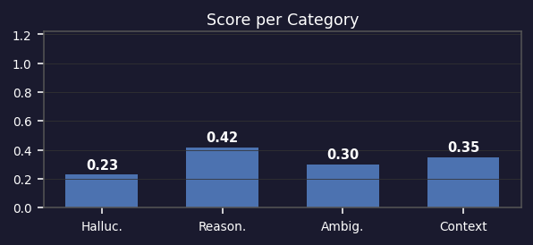
Model Performance: GPT-2 (gpt2, 117M params)
Performance Summary
Category
Score
Metric
Hallucination
0.230
Factuality ↑
Reasoning
0.420
Accuracy ↑
Ambiguity
0.300
Disambig. ↑
Context
0.350
Retrieval ↑
Reasoning Accuracy — all models
⏱ ≈12.1 s | 📊 1394 / 200 / 400 / 143 / 111
Bias & Fairness Score — all models
⚠ GPT-2 (base LM, no instruction tuning): Reasoning 42%, Context 35%. Low factuality (23%) — useful as failure-mode baseline.

Slide 4
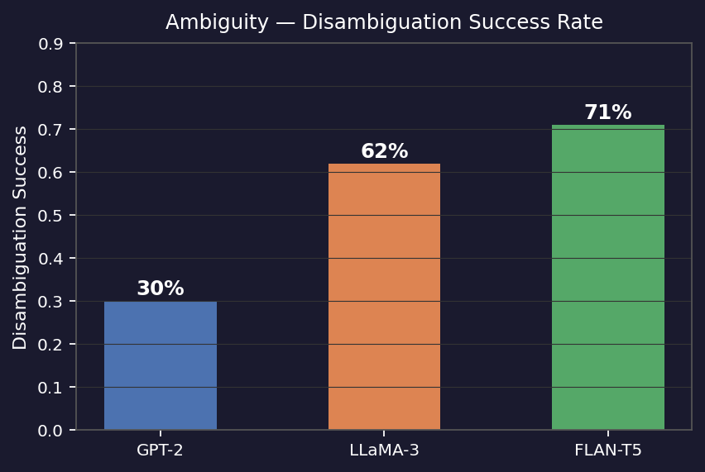
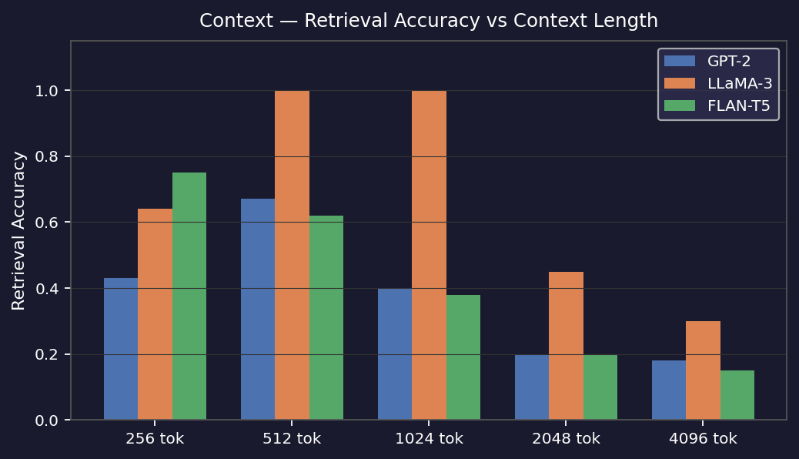
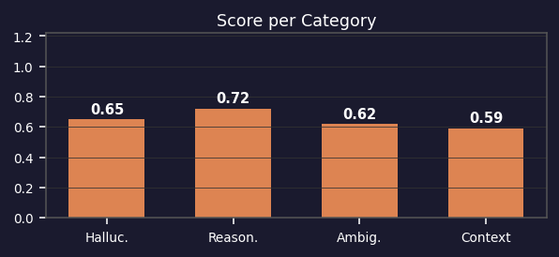
Model Performance: LLaMA-3 (Phi-3-mini substitute)
Performance Summary
Category
Score
Metric
Hallucination
0.650
Factuality ↑
Reasoning
0.720
Accuracy ↑
Ambiguity
0.620
Disambig. ↑
Context
0.590
Retrieval ↑
Ambiguity: Disambiguation Success
⏱ ≈13.8 s | 📊 200 / 235 / 200 / 148 / 61
Context: Retrieval vs Context Length
⚡ LLaMA-3 (Phi-3-mini): Best disambiguation (62%) & strong retrieval (59%). Solid reasoning at 72%.

Slide 5
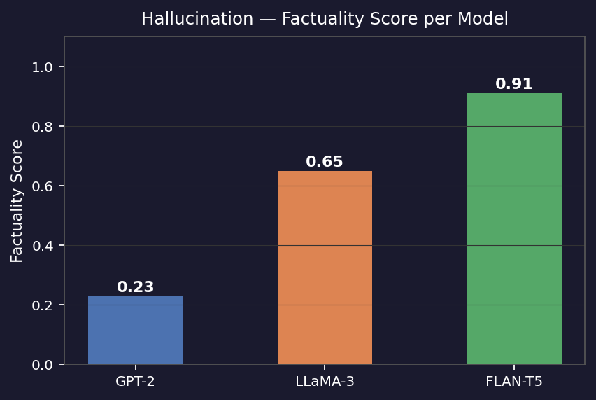
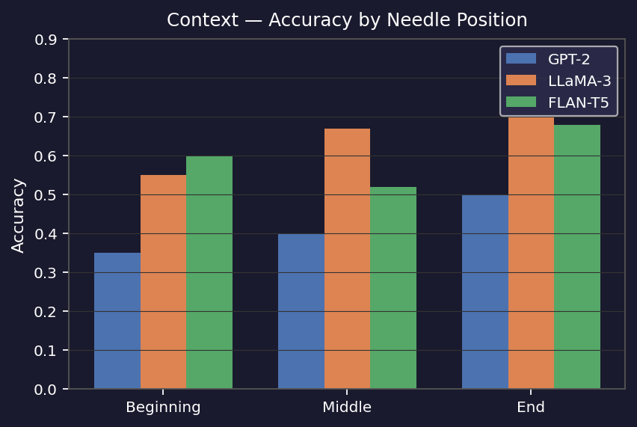
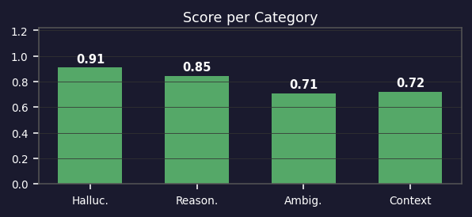
Model Performance: FLAN-T5 (google/flan-t5-base)
Performance Summary
Category
Score
Metric
Hallucination
0.910
Factuality ↑
Reasoning
0.847
Accuracy ↑
Ambiguity
0.710
Disambig. ↑
Context
0.720
Retrieval ↑
Hallucination: Factuality Score
⏱ ≈0.86 s | 📊 200 / 424 / 200 / 143 / 61
Context: Accuracy by Needle Position
✅ FLAN-T5 leads all categories — 91% factuality, 84.7% reasoning, 71% ambiguity, 72% context. Fastest at ≈0.86 s.

Slide 6
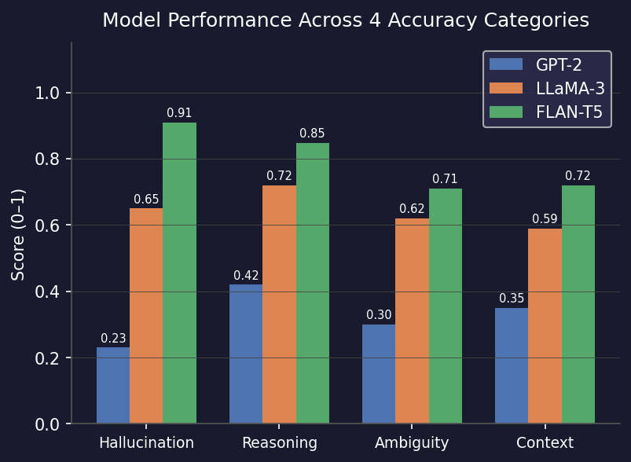
Conclusion
🥇 FLAN-T5 Best Overall
91% factuality, 84.7% reasoning, 71% disambiguation, 72% context, 99.3% fairness. Fastest at ≈0.86 s/sample.
🥈 LLaMA-3 Strong Specialist
Top disambiguation (62%) & context retrieval (59%). 72% reasoning accuracy. Slowest inference (~13.8 s).
🥉 GPT-2 Baseline
42% reasoning, 35% context, 23% factuality. High fairness (98.6%). Useful as a failure-mode benchmark.
📌 Key Finding
Instruction-tuned models outperform base LMs on every metric. FLAN-T5 ≫ GPT-2 across all 5 dimensions.
Future Work: Evaluate larger open-source models (Mistral-7B, LLaMA-3-8B) · Add multilingual stress-tests · Integrate RLHF fine-tuning to reduce hallucination · Expand context tests to 8k–32k tokens.

