Slide 1
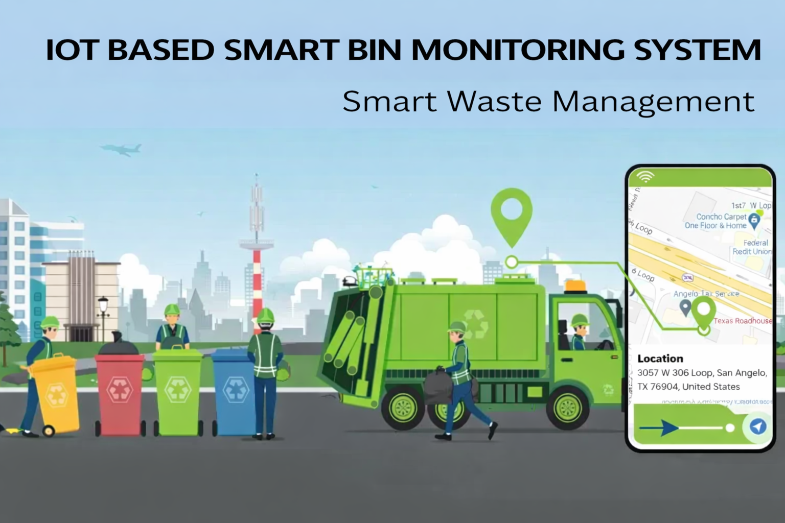

Slide 2
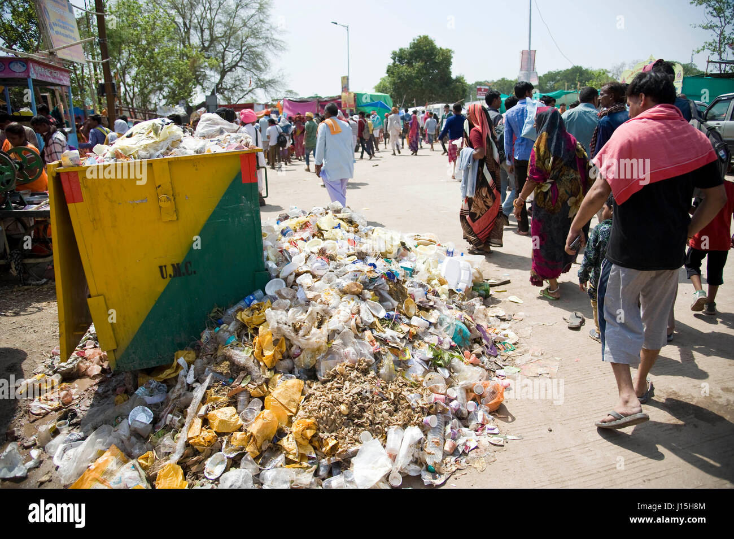
INTRODUCTION
MODERN CITIES STRUGGLE WITH:
  Overflowing street bins
  Irregular waste collection
  Lack of real-time monitoring
  Our IoT solution eliminates:
manual checking
enables intelligent waste management
using automation, sensors, and
cloud technology.
01

Slide 3

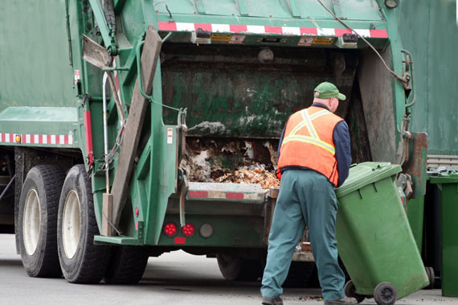

PROBLEM STATEMENT
Inefficient Collection
Manual garbage monitoring leads to unnecessary trips to empty bins or missed overflowing ones, wasting fuel and time.
Overflowing Bins
Unmonitored bins overflow, creating public inconvenience, unpleasant odors, and attracting pests.
Environmental Risks
Spilled waste and hazardous gas emissions from decomposing trash pose significant health and environmental risks.

Slide 4
OBJECTIVES
Real-time Detection
Continuously detect the real-time fill level and hazardous gas status of every bin in the city.
Instant Alerts
Optimized Planning
Reduce unnecessary trips, save fuel, and support dynamic, optimized route planning for collection vehicles.
Send instant alerts to the central dashboard and collection teams when a bin is almost full or detects high gas levels.

Slide 5
WORKING PRINCIPLE
Sensor sends an ultrasonic wave to detect the distance to the trash.
Microcontroller calculates the fill percentage (e.g., 85% full).
Data packet (Fill %, Gas, GPS) is sent to the cloud at set intervals.
Dashboard shows bin status: Green (Empty), Yellow (Half-full), Red (Full).
Alerts are sent for 'Red' bins, and collectors attend only to full bin

Slide 6

SYSTEM ARCHITECTURE
  ULTRASONIC SENSORS FOR FILL DETECTION,GAS SENSORS FOR HAZARDOUS EMISSION.
  MICROCONTROLLER (E.G., ESP8266/ESP32/Arduino uno) WITH WI-FI OR GSM
  GPS MODULE FOR GEO-TAGGING BIN LOCATIONS.
  CLOUD SERVER/WEB DASHBOARD FOR DATA AGGREGATION AND VISUALIZATION.

Slide 7
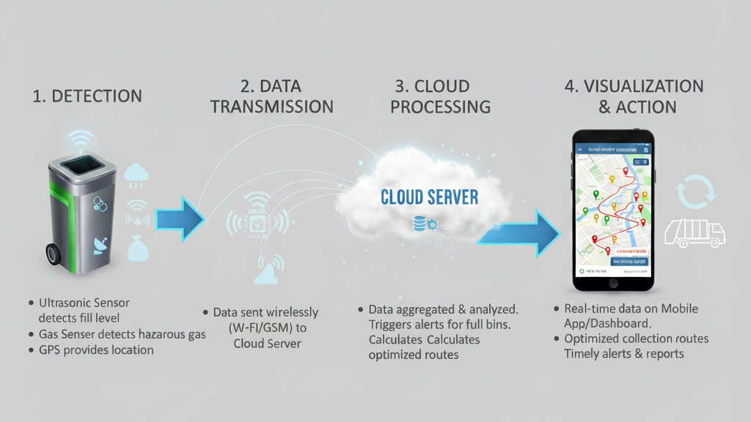
End to End Data Flow:

Slide 8
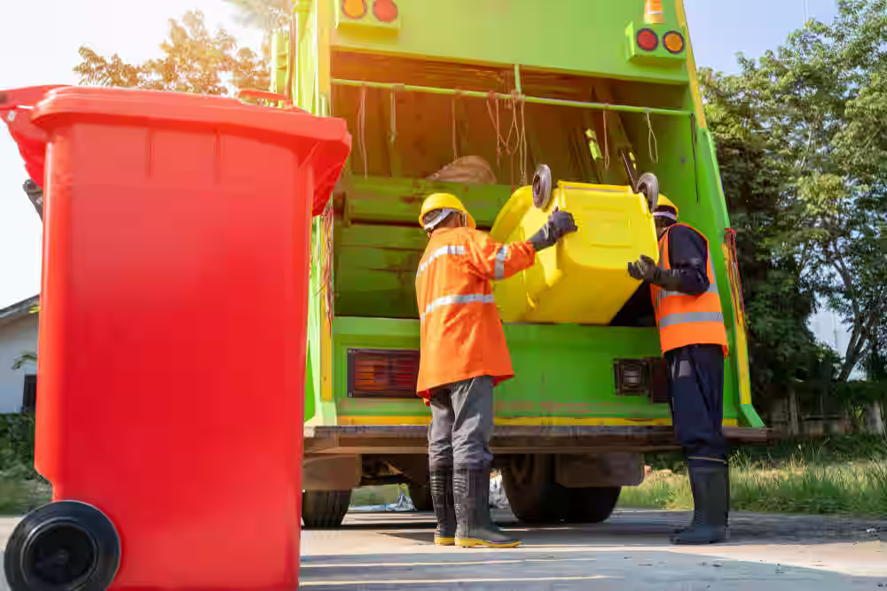
FEATURES AND BENEFITS
  Live Status Of All City Bins With Color-coded Capacity Indication .
  Route Optimization For Collection Teams, Reducing Fuel Consumption And Trip Frequency.
  Early Alerts For Hazardous Emissions, Preventing Health Risks.
  Public Access To Bin Status And Nearest Available Bin Through Mobile Apps.

Slide 9

KEY INNOVATIONS:
  End-to-end Iot Automation
  Real-time Monitoring & Instant Alerts
  Scalable And Low-cost Deployment
IMPACT:
  Reduced Manpower Hours And Fuel
  Data-driven Route Optimization
  Cleaner Streets And Better Public Health

Slide 10
CONCLUSION:
  Improves Waste Collection Efficiency.
  Reduces Manual Labour And Prevents Overflows.
  Supports Smart City Goals.
FUTURE ENHANCEMENTS:
AI-BASED ROUTE OPTIMIZATION
  SOLAR-POWERED UNITS.
  MOBILE APP FOR COLLECTORS, MULTI-SENSOR SUPPORT.

Slide 11
THANK YOU
Done By:
SUJITHRA.K- 710023106035
JAISRI.B - 710023106036
HEMANTHA.N-710023106037
KESAVAN.S-710023106038

