Slide 1



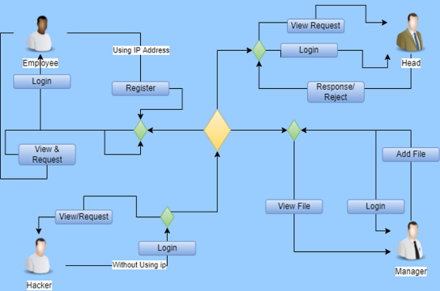

Discovering Suspicious File Migration with AWS Cloud
KIRUBA SHANKAR AP
312319104075
KESAVAN PR
312319104072
ABSTRACT
Discovering suspicious file migration is a critical task for organizations to ensure the security of their data. With the increasing adoption of cloud computing, AWS Cloud provides tools and services to help organizations detect and respond to file migration activity. This paper explores the methods and techniques for discovering suspicious file migration using AWS Cloud, including analyzing logs and metadata from sources such as Amazon S3 and AWS CloudTrail, as well as leveraging services such as Amazon Macie. The paper also highlights the benefits of using these tools and services to enhance the security of an organization's data and respond more quickly to security incidents.
Discovering suspicious file migration with AWS Cloud refers to using cloud-based services provided by Amazon Web Services (AWS) to monitor and detect any unauthorized movement of files or data within an organization's AWS environment. This type of monitoring is crucial for maintaining data security and preventing data breaches, which can have serious consequences for businesses.
WORKING MODEL OF APPLICATION:
INTRODUCTION
MATERIALS AND METHODOLOGY
AES-ALGORITHM:
AES (Advanced Encryption Standard) is a symmetric-key encryption algorithm used to protect sensitive data. AES is known for its strong security and high speed. It has been adopted by many government agencies, financial institutions, and security-conscious organizations as their preferred encryption standard.
Amazon RDS:
Amazon RDS (Relational Database Service) is a web service provided by Amazon Web Services (AWS) that makes it easy to set up, operate, and scale a relational database in the cloud.
RESULT
CORE FUNCTIONALITY:
We have proposed a system that is used to track the authorized user’s IP address by checking the IP address manually and then giving authorization and privileges based on their need and role, Then the authorized users request the uploaded encrypted file which is uploaded by the managers, Then the requests are received by the managers and after reviewing the IP address, role and their access and privilege to the file, they accept the request and users can access the file and decrypt the file using private and public file key which decrypts the encrypted file, we use QRcode scanner for getting the key. This encryption and decryption technique is based on one of the most secured algorithms called the AES-Algorithm.
This model increased visibility and control over an organization's data, which in turn enhances the security of that data. By leveraging AWS Cloud's tools and services, organizations can detect and respond to anomalous file access patterns.
CONCLUSION
Therefore, it can be concluded that we have done this work with One of the Best Encryption and decryption Algorithms used to encrypt and decrypt the file and security enhancement to provide security and protect against suspicious file migration, and better storage for the database is applied by using (Aws Cloud-RDS).we have provided the best way to authorized user activity .
ARCHITECTURE DIAGRAM
OUTPUT
Department of Computer Science and Engineering, St.Joseph’s College of Engineering, OMR, Chennai – 119.
- Dr. PANDEESWARAN M.Tech, Ph.D., (Project Guide)

