Slide 1



TITLE :
KONGU ENGINEERING COLLEGE
PERUNDURAI ERODE-638060
DEPARTMENT OF CT-UG
E-COMMERCE WEBSITE FOR TEXTILE INDUSTRY.
BATCH NO:09
GUIDED BY: Ms.N.KAYA
Team Members:
GURU PRASATH R (23BSR014)
KESAVANAND JS (23BSR023)
VISHAL S (23BSR058)

Slide 2
Abstract
The aim is to create a website for the Textiles specializes in tape and wick manufacturing but lacks an online presence to showcase products and interact with clients..
The absence of a digital platform leads to inefficient operations due to manual processes.
A full-stack web application is developed using the MERN stack (MongoDB, Express.js, React.js, Node.js) to modernize the business's online operations.
Replaces the traditional kinds of method and improves customer outreach, branding, and operational efficiency, offering a responsive, secure, and user-friendly platform to manage and grow the business digitally.

Slide 3
Problem Definition
Lack of online presence.
Direct customer Inaccessibility.
Manual Operations.
Lack of brand Visibility.
No Real-Time Customer Interaction.

Slide 4
Existing system
In-person Visits
Required Agent as a mediators
Offline Customer Communication
Only sale as wholesale
Time- Consuming Process
No Online Portal
Lack of Availability Updates

Slide 5
Feasibility study of the proposed one
User-friendly Interface
Efficient Online Booking
Secure Payment System
Filter option
Enhanced Customer Interaction
Quick Booking Processing
Detailed Product Information
Detailed product list

Slide 6
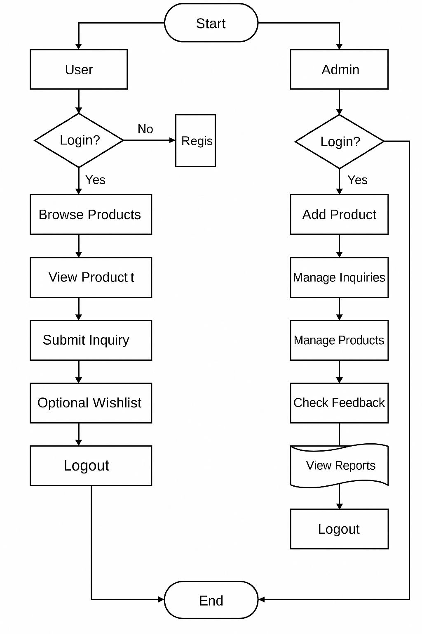
SYSTEM FLOW DIAGRAM

Slide 7
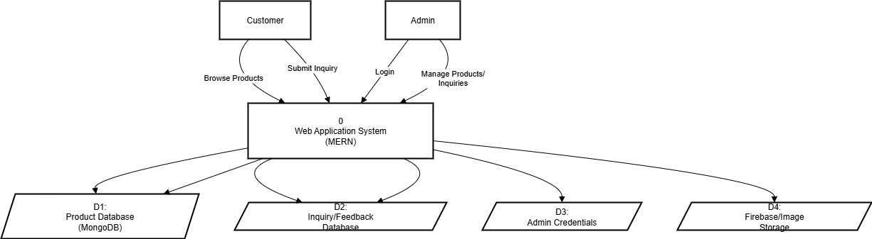
DATA FLOW DIAGRAM
LEVEL 0

Slide 8
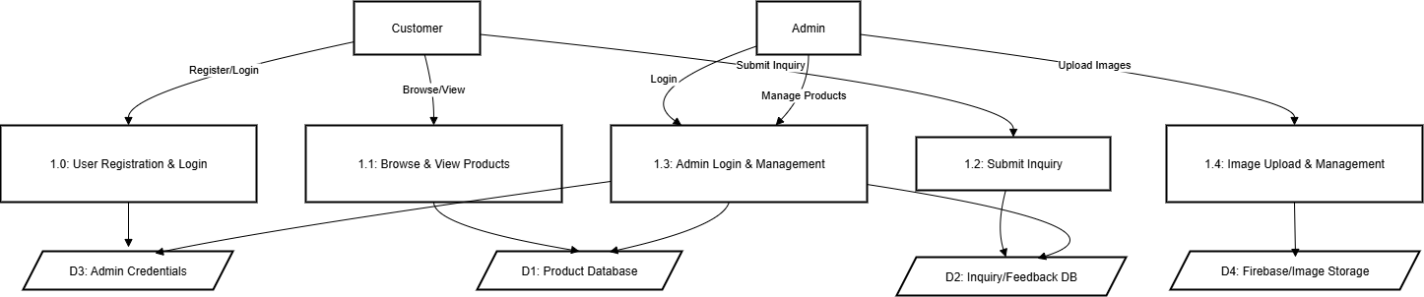
LEVEL 1

Slide 9
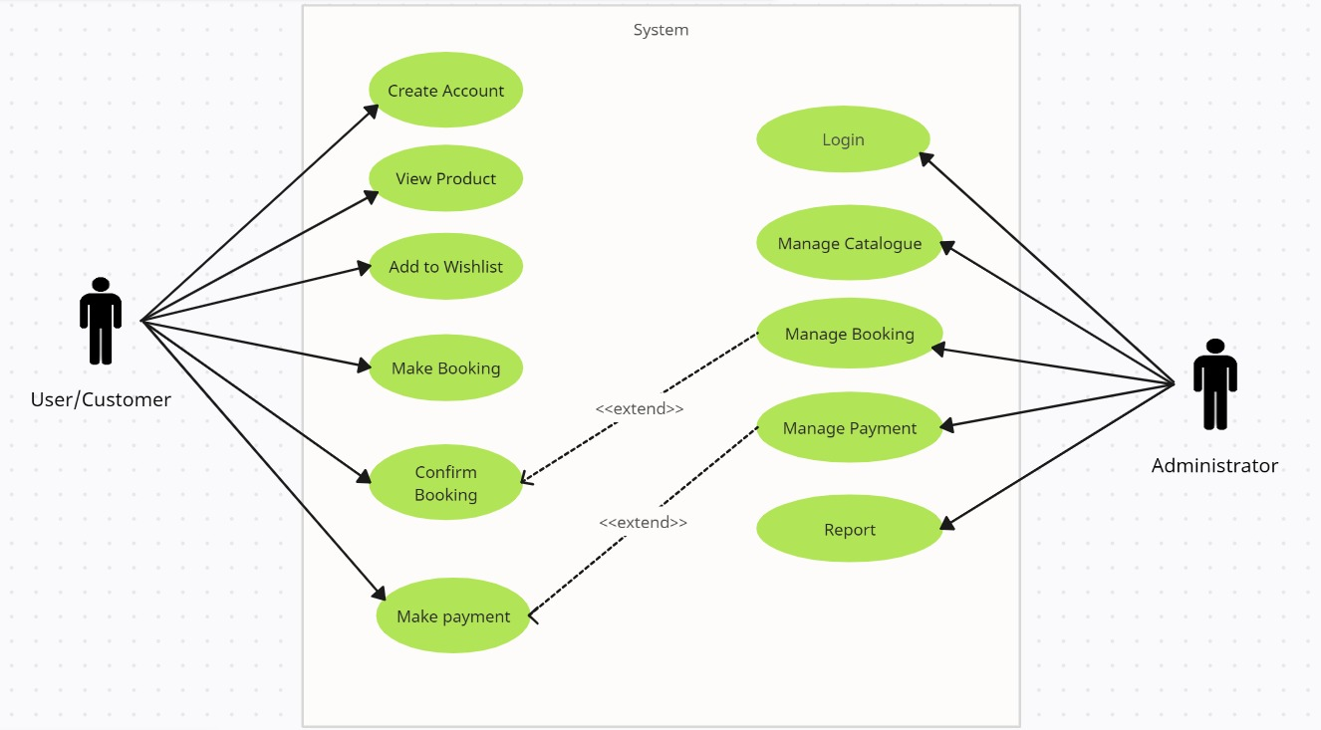
USE CASE DIAGRAM

Slide 10
Modules
Authentication and Authorization
Admin Control Panel
Product Catalog
Booking Management
Payment
ChatBot

Slide 11
AUTHENTICATION AND AUTHORIZATION
User Registration: Allow users to create accounts with secure authentication mechanisms
Login and Logout: Implement secure login and logout functionality
Role-Based Access Control: Assign different roles (customer, admin) with specific permissions
Security Measures: Implement encryption and other security measures to protect user data

Slide 12
PRODUCT CATALOG
Categorization: Organize products into relevant categories and subcategories
Search and Filters: Implement robust search functionality and filters for easy product discovery
Product Details: Display detailed product information, including images, descriptions, and specifications

Slide 13
ADMIN CONTROL PANEL
User Management: Allow administrators to create, modify, and deactivate accounts with varying levels of access
Product Management: Enable administrators to add, edit, or remove products, and manage inventory levels
Manage Booking: Allow admins to monitor and track bookings, view booking history, and manage customer interactions

Slide 14
BOOKING MANAGEMENT
Booking Processing: Enable administrators to process and fulfill bookings efficiently
Invoice Generation: Automatically generate invoices for completed bookings
Partial or full payment: Integrate payment method according to the client’s convenience

Slide 15
PAYMENT
Payment Gateway Integration : Integrate secure payment gateway with RAZORPAY to facilitate smooth and secure transactions.
Checkout Process : Ensure a streamlined checkout process, allowing users to easily review their bookings and proceed to payment with minimal friction.
Booking Confirmation : Provide immediate order confirmation to users upon successful payment, along with relevant details and tracking information.

Slide 16
THANK YOU!!

