Slide 1
ARUNAI ENGINEERING COLLEGE
CODE :5104
DEPARTMENT OF
INFORMATION TECHNOLOGY

Slide 2
Group no: 04
PRESENTED BY:
D. KESAVAN
N.VIJAYAN
M. GNANASABARINATHAN
K. HAFIZULLAH
S.DHINESHRAJ
GUIDED BY
MRS.HARIPRIYA

Slide 3
E-COMMERCE APPLICATION ON IBM FOUNDRY
INTRODUCTION
APP DO
EXAMPLE OF E-COMMERCE APP
THE PROBLEM DEFITION
THE SOLUTION

Slide 4
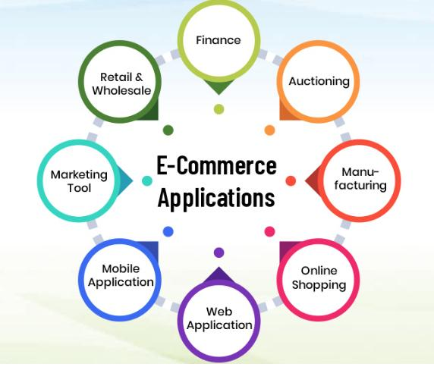
introduction
IBM WEBSPHERE commerce is an on premise E-Commerce platform that empowers B2C and B2B organization to rapidly innovate and drive their omnichannel business.

Slide 5
WHAT DOES E-COMMERCE APP DO:
An Ecommerce app allow user to shop online ,browses product catalogs , create wish lists, add Items to a cart wish lists ,add items to a cart , and complete purchases. It also provides payments processing ,shipping, and order management capabilities
Additionally ,some apps let users review and rate product and engage with others customers in forums ,product reviews , and social media

Slide 6
Example of Ecommerce application
An example of an E-commerce app is Amazon . Amazon is an online marketplace where customers Can buy a variety of product from seller all over the world Customer can purchase item from the app and have them delivered to their home or office.
Amazon to offers assess to free today shipping and other benefits such as prime video and music.

Slide 7
The problem definition:
While e-commerce has become increasingly popular and convenient
For consumers and business alike, it also come with several issues and challenges
That must be addressed to ensure its success.
Advantages
Convenience
Increased sales
Disadvantage
Technical issues
Competition

Slide 8
Solutions:
E-commerce solution refers to a set of software and technology tools
That’s help business sells product and services online.
These solution typically include a website or online store front, a shopping cart, Payment processing system, and inventory management tools.

Slide 9
Thank you

