Slide 1
Rise in Electric Vehicles
Self-Balancing EV
HARIRAM K KESHAVAN S ANUVARSHINI J H

Slide 2
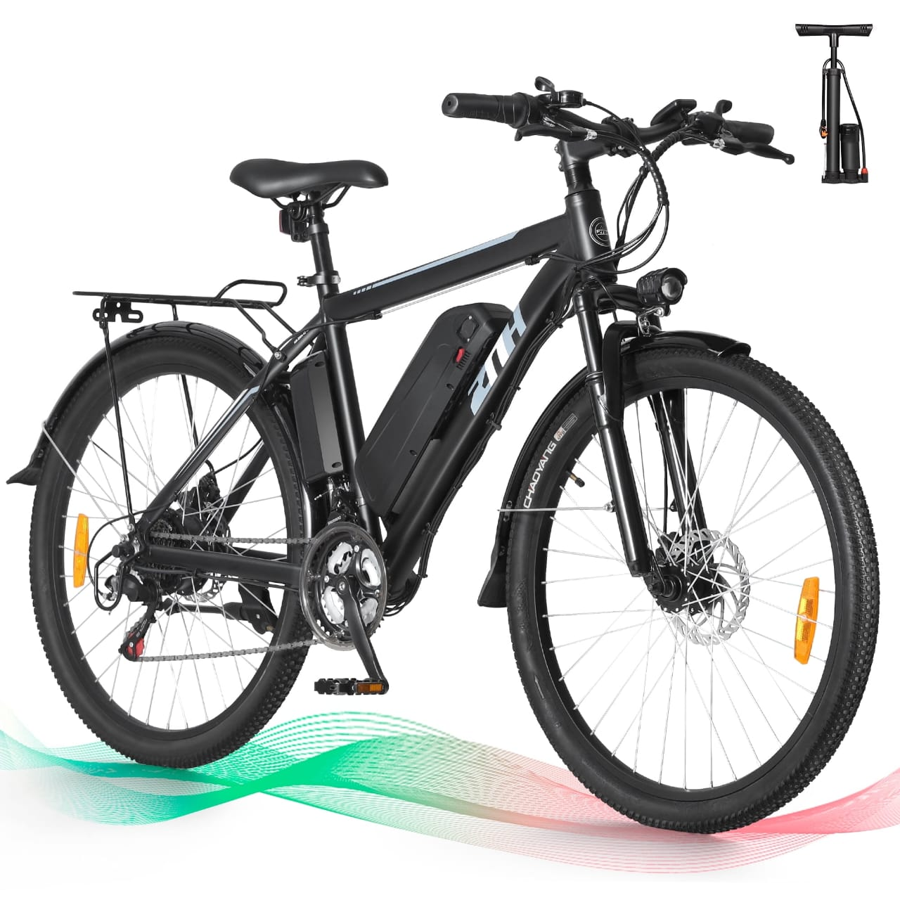
Self-balancing Electric Vehicle
Route Masters
INTRODUCTION
WHAT IS SELF BALANCING VECHICLE?
A self-balancing vehicle is a type of vehicle that uses gyroscopic sensors and accelerometers to automatically maintain its balance without falling over.
It continuously adjusts its position using motors, allowing it to stay upright and stable, even with movement or changes in terrain.
It adjusts the motor movements in real time to prevent falling and stay upright.
07-05-2025
1

Slide 3

Self-balancing Electric Vehicle
Route Masters
PROBLEM STATEMENT & OBJECTIVE
Traditional vehicles require manual balance.
Need for compact and stable mobility solutions.
To design and implement a vehicle that can balance itself using a gyroscopic model and PID control system.
07-05-2025
2

Slide 4
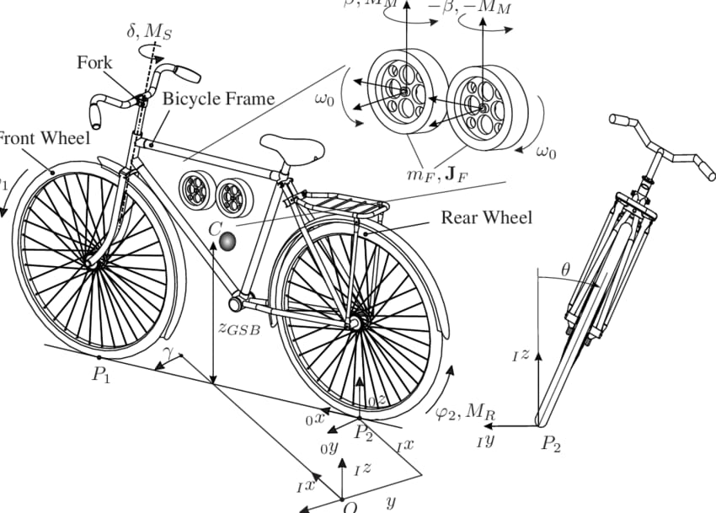
Self-balancing Electric Vehicle
Route Masters
PRINCIPLE OF OPERATION
Basics of gyroscopic effect.
Conservation of angular momentum in balancing.
How feedback systems use this data?
WORKING
Gyroscope detects tilt angle.
Microcontroller processes data.
Appropriate motor action corrects the imbalance.
07-05-2025
3

Slide 5
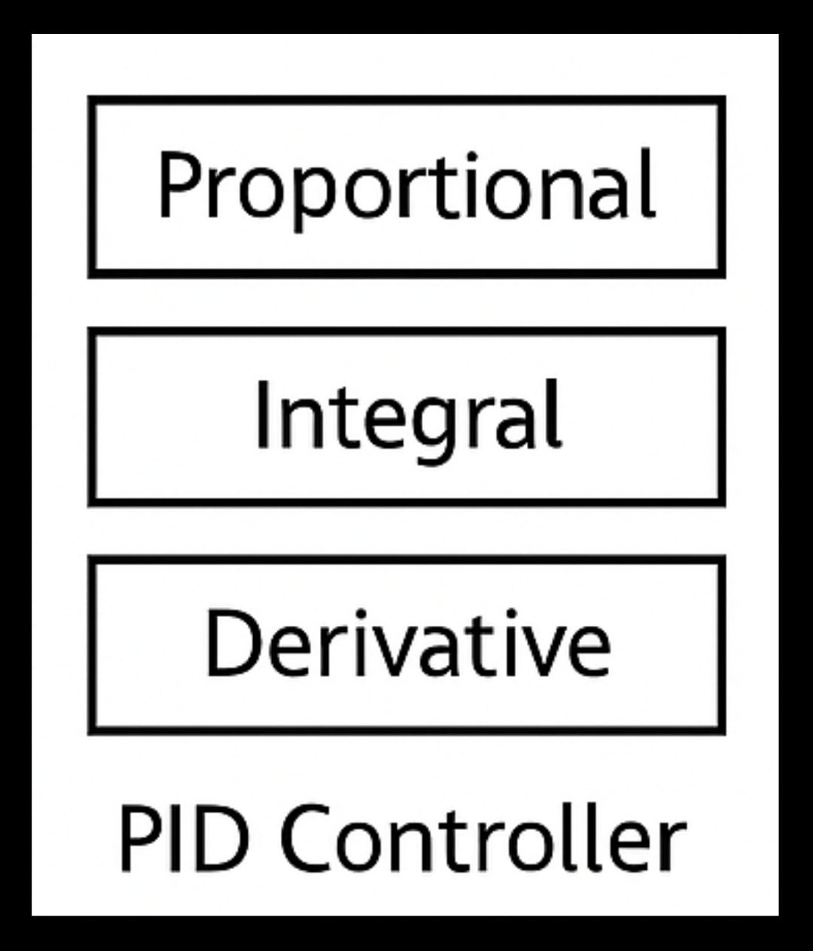
Self-balancing Electric Vehicle
Route Masters
PID CONTROL SYSTEM
PID Control (Proportional-Integral-Derivative) is a control algorithm used in automation systems to maintain the desired output by minimizing error. It continuously calculates an error value as the difference between a desired setpoint and a measured process variable and applies correction using three terms:
P (Proportional): Reacts to the current error
I (Integral): Accounts for past errors
D (Derivative): Predicts future error based on the rate of change.
Helps to maintain balance dynamically.
Real time correction of deviation are available.
07-05-2025
4

Slide 6
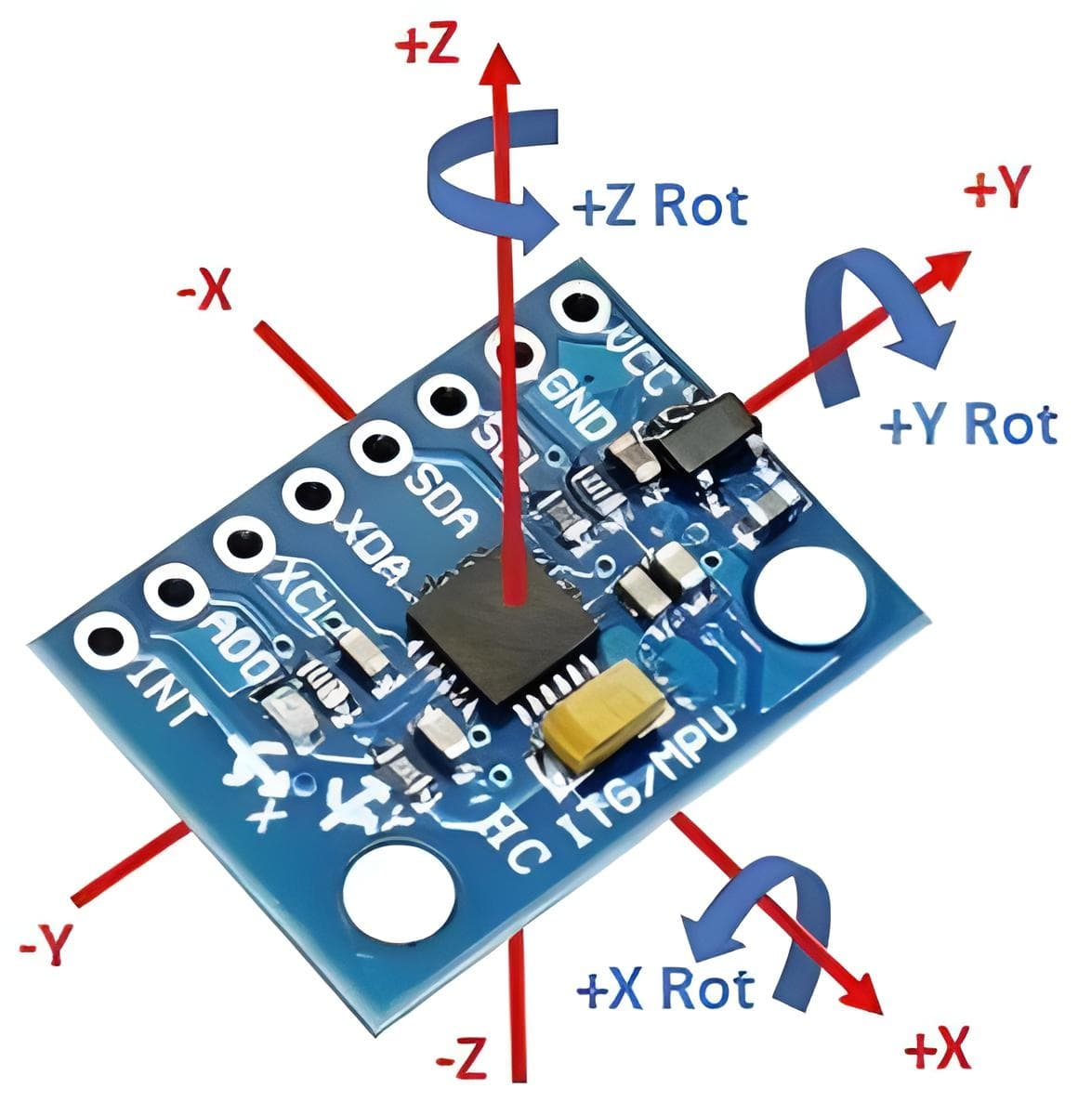
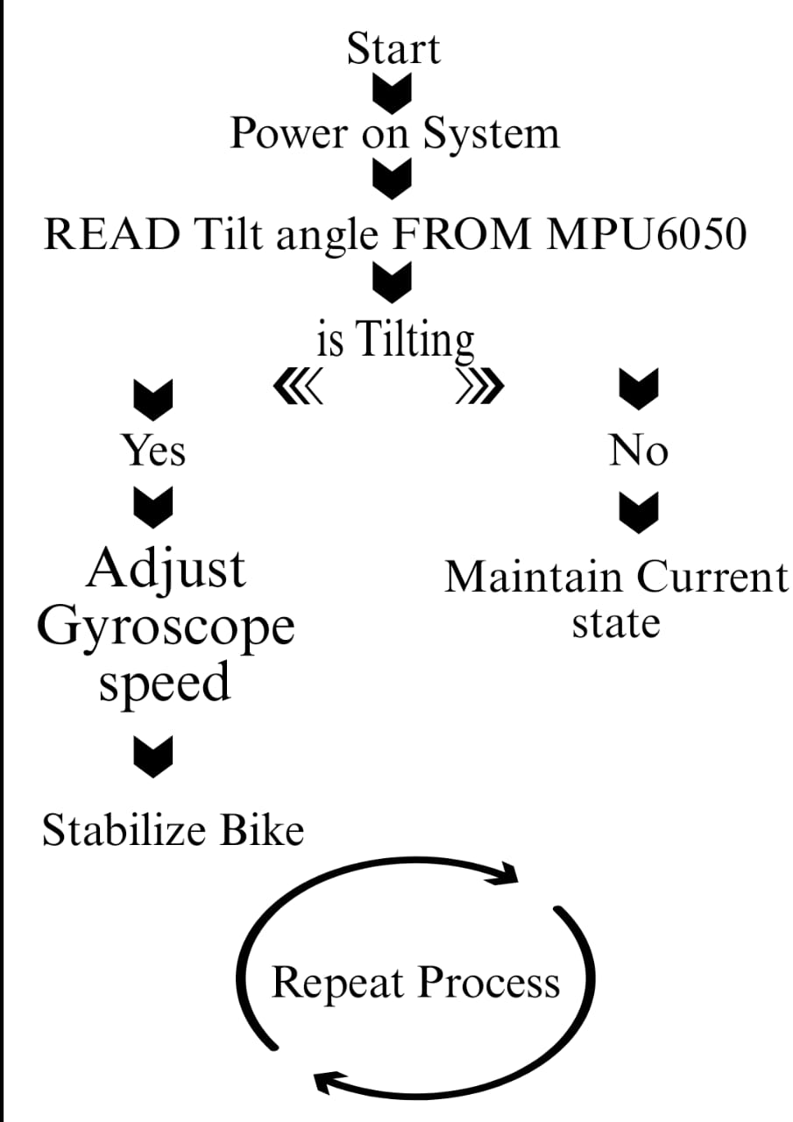
Self-balancing Electric Vehicle
Route Masters
FLOW CHART
07-05-2025
5

Slide 7
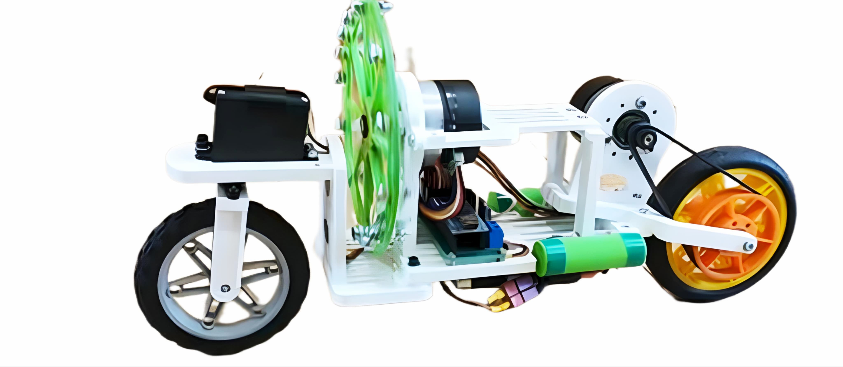

Self-balancing Electric Vehicle
Route Masters
ADVANTAGES
Compact and smart design.
Less human effect to maintain balance.
Easily customizable.
CHALLENGES
Precise timing of PID values.
Calibration issues.
Battery limitations.
07-05-2025
6

Slide 8
Self-balancing Electric Vehicle
Route Masters
CONTRAST
Existing Self-Balancing Vehicle
Innovated Self-Balancing Vehicle
Sensors - Accelerometer , IR , Ultrasonic.
Accuracy - Moderate
Speed of Response - Slower
Stability - Less Stable
Ideal - Basic Balance
Cost - Lower
Sensors - Accelerometer and Gyroscope.
Accuracy - High
Speed of Response - Faster
Stability - Very Stable
Ideal - Dynamic Real-time Balance
Cost - Slightly Higher
07-05-2025
7

Slide 9


Self-balancing Electric Vehicle
Route Masters
MARKET OPPORTUNITIES
Smart City Projects – Good for clean, modern transport.
Brand Deals – Partner with tech or fashion brands.
Eco-Friendly – No gas, no pollution.
Delivery Use – Fast and small for city deliveries.
Tourist Rentals – Fun to rent and ride in cities.
07-05-2025
8

Slide 10
Object Oriented Programming Language
Self-Balancing Electric Vehicle
THANKYOU

