Slide 1






Smart Sanitation Monitoring System for Public Washrooms
Organized by
Supported by
Knowledge Partners
A biotech pre-incubation center of Biotechnology Industry Research Assistance Council (BIRAC), Department of Biotechnology (DBT), Government of India
Proposal Reference No.:
Presented by
Presenter’s Name Keshab Sharma Affiliation with the full address : GIET University Gunupur Odisha
BIRAC E-YUVA CALL 3.0
Date: 09/02/2026

Slide 2

Applicant Profile
I Keshab Sharma Pre Final Year B.Tech Computer Science and Engineering student (AIML) at Gandhi Institute of Engineering and Technology University, Odisha, with strong interest in IoT, artificial intelligence, and smart infrastructure solutions.
I am having hands-on experience in sensor-based systems, embedded platforms, and cloud-based application development, and has actively worked on technology-driven projects addressing real-world problems.
I am motivated to develop scalable, privacy-preserving solutions for public infrastructure and has the technical capability to design, implement, and validate the proposed Smart Sanitation Monitoring System under academic mentorship. Through this fellowship, the applicant aims to translate an innovative idea into a deployable and commercially viable solution with societal impact.
BIRAC E-YUVA CALL 3.0
[1]

Slide 3
Problem Statement
In India, the sanitation infrastructure has expanded under schemes like Swachh Bharat Mission, but maintenance gaps mean many public toilets remain unusable.
Investigations reveal that without proper upkeep there is a “functionality gap” – facilities exist on paper but are broken or dirty in reality toiletboard.org.
For example, Chennai spent over ₹621.5 crore on building 3,000+ public toilets, yet most lie abandoned: toilet doors are damaged, seats are covered in waste, and taps are broken timesofindia.indiatimes.com.
Even large maintenance contracts (rising from ~₹14 lakh to ₹6 crore per zone) failed to improve cleanliness timesofindia.indiatimes.com.
These failures are often blamed on weak real-time monitoring and accountability - without sensors or performance-based tracking, authorities lack timely feedback and toilets deteriorate
BIRAC E-YUVA CALL 3.0
[2]

Slide 4
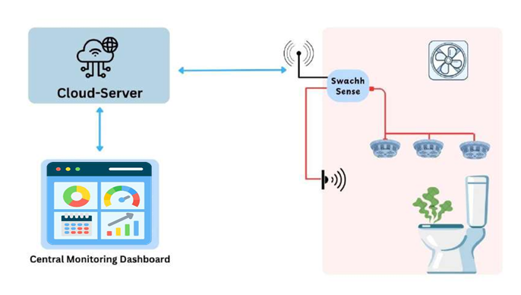
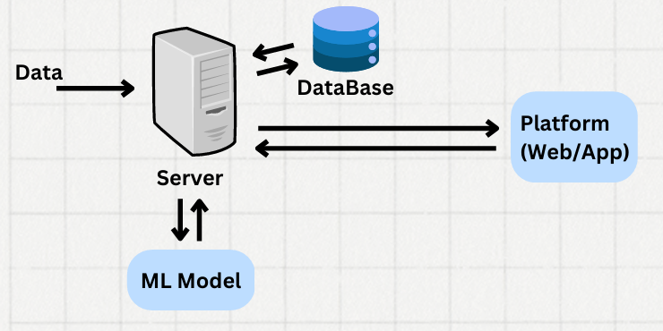
Proposed Solution (Concept and Technical Rationale)
We propose an IoT-driven sanitation monitoring system for public washrooms.
Each unit plugs in bio-gas sensors such as the MQ-135 and MQ-136, which detect common malodors and harmful gases.
These sensors continuously measure air quality inside a toilet cubicle.
The sensor module connects to an edge-computing node (e.g. an ESP32 or Raspberry Pi), which preprocesses the data and transmits it via Wi-Fi or cellular network
A central cloud-based AI dashboard collects these data streams and applies machine learning to identify sanitation issues (e.g. detecting high odor or ammonia indicating an unclean stall).
The dashboard then generates real-time alerts to facility managers or cleaning staff (e.g. via SMS/app notification) so they can respond immediately.
BIRAC E-YUVA CALL 3.0
[3]

Slide 5
Novelty & Opportunity
Privacy-first smart sanitation monitoring – Uses odor and air-quality sensors with AI instead of cameras to assess cleanliness in real time.
Proactive, data-driven maintenance – Instant alerts and analytics replace manual inspections, closing the sanitation accountability gap.
High-scale government & institutional adoption – Strong fit for Smart Cities, railways, campuses, and public facilities with recurring SaaS potential.
Recurring SaaS revenue model – Hardware + subscription dashboard ensures long-term, predictable income.
BIRAC E-YUVA CALL 3.0
[4]

Slide 6
Competitive landscape
Solution Type | Key Approach | Limitations | Our Solution Advantage
Manual / Contract-based Cleaning | Fixed cleaning schedules, human inspection, paper or call-based reporting | No real-time monitoring, delayed response, poor accountability | Real-time automated monitoring with instant alerts
Camera-based Smart Restroom Systems | Cameras, occupancy sensors, video analytics | Privacy concerns, high cost, limited acceptance in public toilets | Privacy-first odor and air-quality sensing (no cameras)
Basic IoT Toilet Monitoring Solutions | Water flow, usage counters, occupancy sensors | Does not measure actual cleanliness or odor conditions. | Direct hygiene assessment using gas sensors + AI
Proposed AI-based Odor Monitoring System | Gas sensors (NH₃, H₂S), IoT, edge AI, cloud dashboard |  | Proactive, privacy-preserving, scalable, and data-driven sanitation management
BIRAC E-YUVA CALL 3.0
[5]

Slide 7
Commercialization Potential
Large unmet market in public sanitation due to lack of real-time monitoring.
Target customers: municipalities, smart cities, railways, airports, hospitals, campuses.
Strong policy alignment with Swachh Bharat Mission and Smart City initiatives.
Hybrid business model: low-cost hardware + recurring SaaS subscription.
Scalable deployment across cities, transport hubs, and public facilities.
Privacy-first design increases acceptance and regulatory compliance.
BIRAC E-YUVA CALL 3.0
[6]

Slide 8
Work Plan
S. No. | Milestones | Deliverables | Estimated Time (Months)
 |  |  | 1 | 2 | 3 | 4 | 5 | 6 | 7 | 8 | 9 | 10 | 11 | 12
1 | Hardware Design & Prototype Development | Sensor module (MQ-135, MQ-136) integrated with microcontroller
 |  | Bench-tested IoT prototype with data transmission
2 | Software, Cloud & AI Dashboard Development | Cloud backend and database setup
 |  | Web/mobile dashboard for real-time monitoring
 |  | Initial AI-based alert thresholds
3 | Pilot Deployment & Field Testing | Deployment in 1–2 public washrooms
 |  | Live monitoring and alert system
 |  | Feedback from users and maintenance staff
4 | System Optimization & Commercial Readiness | Optimized AI models and alert accuracy
 |  | Final prototype and documentation
 |  | Commercialization and scale-up proposal
BIRAC E-YUVA CALL 3.0
[8]

Slide 9
Budget Distribution
Sl. No. | Budget Head | Budget Allocation (in INR) * | Justification (*)
01. | Consumables | ₹45,000 | Gas sensors (MQ-135, MQ-136), wires, PCBs, connectors, power supplies, enclosure materials, and miscellaneous electronics required for prototype development and testing.
02. | Small Equipment's | ₹75,000 | Microcontrollers (ESP32/Raspberry Pi), GSM/Wi-Fi modules, development boards, calibration tools, and basic testing instruments for system integration
03. | Outsourcing | ₹40,000 | Cloud services, dashboard UI development support, AI model assistance, and fabrication support for enclosures if required.
04. | Travel & Accommodation | ₹25,000 | Field visits for pilot deployment, coordination with municipal bodies, testing at public washrooms, and review meetings.
05. | Contingency | ₹15,000 | Buffer for unforeseen expenses such as sensor replacement, repair, logistics, or additional testing needs
06. | Total | ₹2,00,000
BIRAC E-YUVA CALL 3.0
[9]

Slide 10
Proposed Road Map
Ideation & Prototype Setup
(Software & AI Development)
(Pilot Deployment & Validation)
(Optimization & Commercial Readiness)
1st Quarter
2nd Quarter
3rd Quarter
4th Quarter
(Slide contacting information about background works if any)
BIRAC E-YUVA CALL 3.0
[10]

Slide 11
Thank you
Contact detail:
Name: Keshab Sharma Email ID: 23CSEAIML116.KESHABSHARMA@GIET.EDU
Mobile Number: 6371775670
BIRAC E-YUVA CALL 3.0
[11]

