Slide 1
Introduction to Project Management
Many organizations today have a new or renewed interest in project management.
Computer hardware, software, networks, and the use of interdisciplinary and global work teams have radically changed the work environment

Slide 2
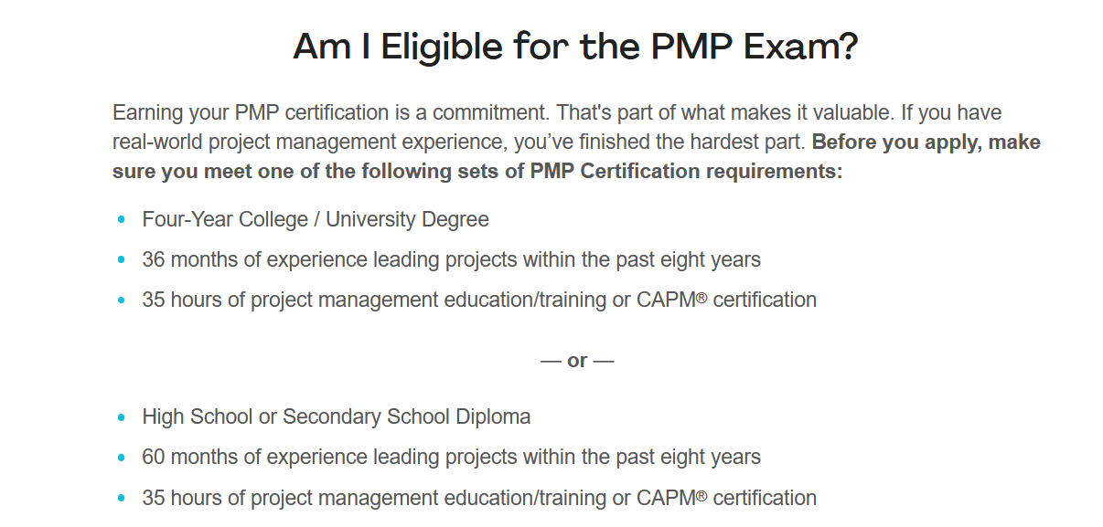
Project Management Professional (PMP)
What is PMP Certification?
The PMP acknowledges candidates skilled at managing the people, processes, and business priorities of professional projects. PMI, the world’s leading authority on project management, created the PMP to recognize project managers who have proven they have project leadership experience and expertise in any way of working.

Slide 3
Project Management Statistics
70% of all projects fail.
42% of companies don’t understand the need or importance of project management.
55% of project managers cite budget overrun as a reason for project failure
The project management industry is set to grow by $6.6 trillion by the end of 2020
Stakeholder engagement is the most valuable PM process.
62% of completed projects had supportive sponsors.

Slide 4
Project Attributes
A project:
▪ Has a unique purpose.
▪ Is temporary.
▪ Is developed using progressive elaboration.
▪ Requires resources, often from various areas.
▪ Should have a primary customer or sponsor.
▪ The project sponsor usually provides the direction and funding for the project.
▪ Involves uncertainty.

Slide 5
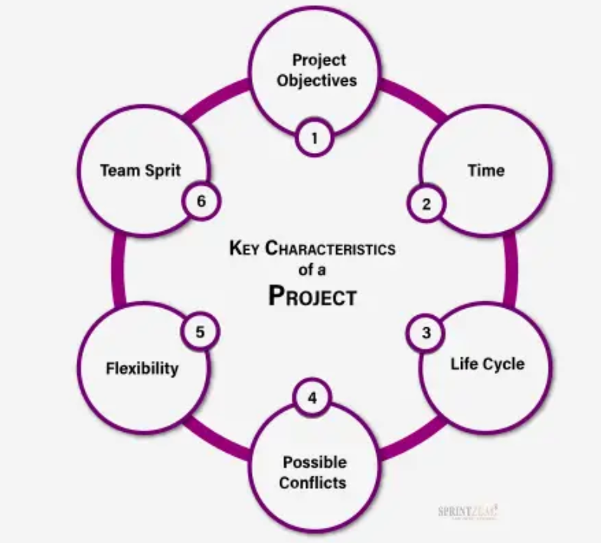
Key Characteristics of a Project

Slide 6

Project Objectives

Slide 7
Project Objectives (Cont.)
It is important for any project to first have its goals and objectives decided.
Defining project objectives gives project team members a clear idea of how to proceed and what to achieve with the project tasks and activities.
Objectives are the key characteristics of any project that help you analyze the progress of the project.
Tracking the progress and regularly analyzing the results shows how much of the project has been accomplished.

Slide 8

Time
Every project is assigned or designed with certain deadlines and milestones.
No matter the type of project, every project is indiscriminately time-bound.
To ensure that the project team works independently on necessary project tasks, project managers plan out the tasks and activities based on the resources available and the capabilities of the team and team members.

Slide 9
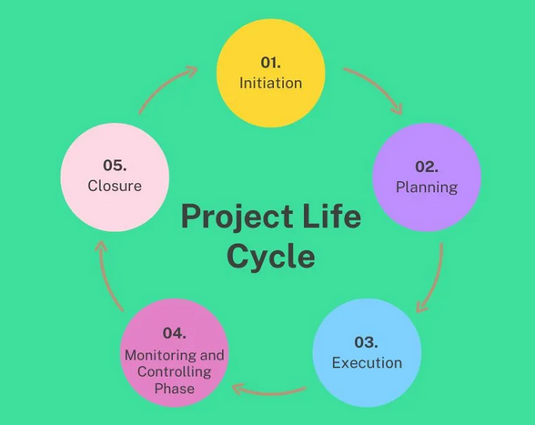
Life Cycle

Slide 10
Life Cycle (Cont.)
Every project has its Lifecycle for completion, such as Initiation (Beginning), Planning, Execution, Growth, Controlling, and Closing.
These stages perfectly describe how the project must be executed.
Depending on the type of project, characteristics of project life cycle phases may vary.
Defining these phases for a project depends on how the goals and objectives of the project are derived.
Project objectives help in carrying out the tasks and activities towards the succession of the project, while its lifecycle phases keep the project tasks actively moving towards succession.

Slide 11
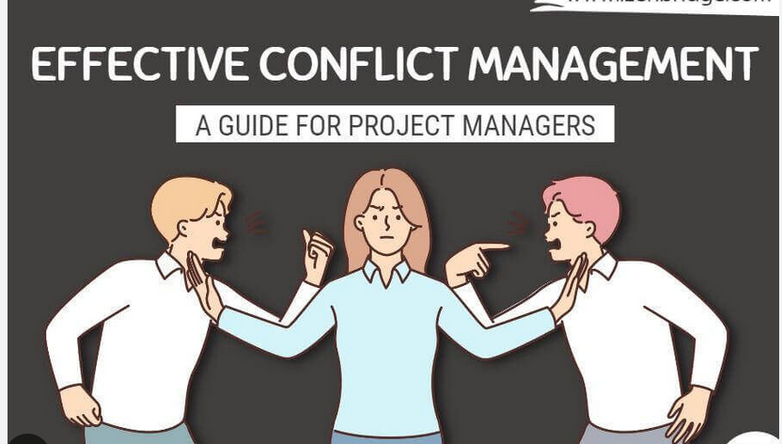
Possible Conflicts

Slide 12
Possible Conflicts (Cont.)
For becoming a project manager, one of the key skills required is Conflict Resolution.
Irrespective of the project type or its field, the occurrence of Conflicts and Risks is uncontrollable.
Not properly defining the project results in high risks and conflicts.
Utilizing the information available can help reduce the occurrence of risks and conflicts.
With this, project managers can ensure every project team and its members work more productively and present more effectively.

Slide 13
Flexibility
To make any project work as intended, it is important to take part in the changes that occur within its lifecycle.
Project managers must also ensure to schedule every project task as flexibly as possible to give team members enough time to adapt to changes and cope with the tasks as scheduled.
The more flexibility in the schedule, the better the results concerning the changes.

Slide 14
Team Spirit
Just like the project is comprised of different characteristics, the same goes for the team.
Every team member is capable of different project characteristics. With the help of a team with good team spirit, the project can reciprocate according to the objectives set for each project.
This also helps in reducing the time taken to process the tasks and activities since every project team member is working cumulatively.
D:\ITUM\TM2.mp4
D:\ITUM\TM1.mp4

Slide 15
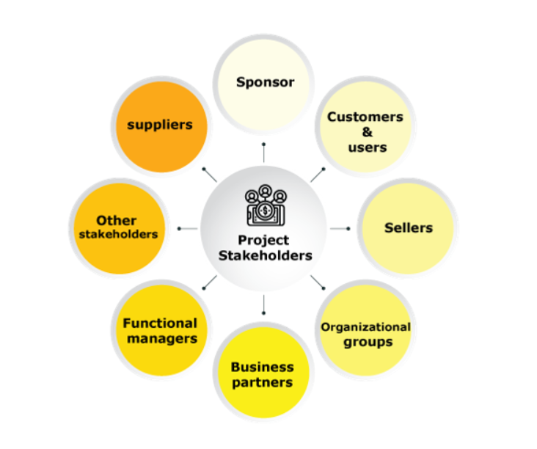
Stakeholders in a Project

Slide 16
Stakeholders in a Project (Cont.)
Sponsor: A sponsor is a person or group who provides supplies and support for the project and is liable for assisting success. He may be external or internal to the organization.
Customers and Users: Customers are the people or organizations who will approve and manage the project’s product, service, or result. Users, as clear from the name, use the product.
Sellers: Sellers, also known as vendors, are external companies that enter into a contractual agreement to provide services or resources necessary for the project.

Slide 17
Stakeholders in a Project (Cont.)
Business Partners: They are external organizations that have a special relationship or partnership with the enterprise.
Organizational Groups: Organizational groups are internal stakeholders who are influenced by the actions of the project team. For example, human resources, marketing, sales, legal, finance, operations, manufacturing, etc.

Slide 18
Stakeholders in a Project (Cont.)
Functional Managers: They are key individuals who play the role of management within an administrative or functional area of the business. For example, human resources, finance, accounting, etc.
Other Stakeholders: They are additional stakeholders which include financial institutions, government regulators, subject matter experts, consultants, and others, who have a financial interest in the project, contribute inputs to the project, or have in the outcome of the project

