Slide 1
Project Integration Management
Prabath Jayathilaka

Slide 2
Learning Objectives
Describe an overall framework for project integration management as it relates to the other project management knowledge areas and the project life cycle.
Explain the strategic planning process and apply different project selection methods.
Explain the importance of creating a project charter to formally initiate projects.
Discuss the process of creating a preliminary project scope statement.
Describe project management plan development, including content, using guidelines and templates for developing plans, and performing a stakeholder analysis to help manage relationships.
Explain project execution, its relationship to project planning, the factors related to successful results, and tools and techniques to assist in project execution.
Describe the process of monitoring and controlling project work.

Slide 3
The Key to Overall Project Success:
Good Project Integration Management
Project managers must coordinate all of the other knowledge areas throughout a project’s life cycle.
Many new project managers have trouble looking at the “big picture” and want to focus on too many details.
▪ Project integration management is not the same thing as software integration.

Slide 4
Project Integration Management Processes
Develop the project charter: Work with stakeholders to create
the document that formally authorizes a project— the charter.
Develop the preliminary project scope statement: Work with
stakeholders, especially users of the project’s products, services,
or results, to develop the high-level scope requirements and
create a preliminary project scope statement.
Develop the project management plan: Coordinate all
planning efforts to create a consistent, coherent document—the project management plan.

Slide 5
Project Integration Management Processes – (Cont)
Direct and manage project execution: Carry out the project management
plan by performing the activities included in it.
Monitor and control the project work: Oversee project work to meet
the performance objectives of the project.
Perform integrated change control: Coordinate changes that affect
the project’s deliverables and organizational process assets.
Close the project: Finalize all project activities to formally close
the project

Slide 6
Strategic Planning and Project Selection
Strategic planning involves determining long-term objectives,
predicting future trends, and projecting the need for new products and services.
▪ Organizations often perform a SWOT analysis:
Strengths, Weaknesses, Opportunities, and Threats
As part of strategic planning, organizations should Identify
potential projects.
▪ Use realistic methods to select which projects to work on.
▪ Formalize project initiation by issuing a project charter

Slide 7
Identifying Potential Projects
Many organizations follow a planning process for selecting IT projects.
It’s crucial to align IT projects with business strategy.
Research shows that:
Supporting explicit business objectives is the number one reason cited for investing in IT projects.
Companies with consolidated IT operations have a 24 percent lower operational cost per end user.
The consistent use of IT standards lowers application development costs by 41 percent per user.

Slide 8
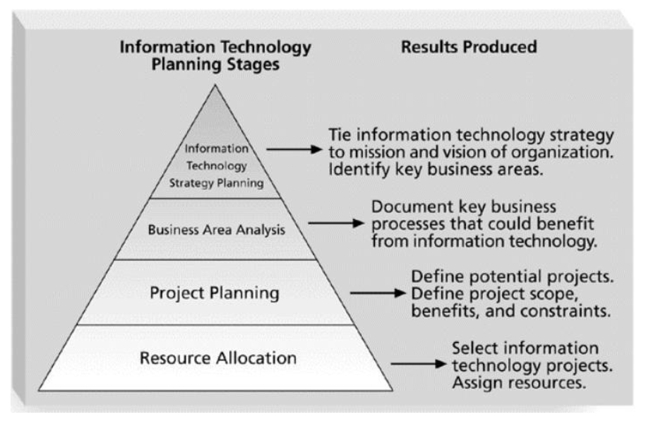
Information Technology Planning Process

Slide 9
Methods for Selecting Projects
There is usually not enough time or resources to implement all projects.
Methods for selecting projects include:
Focusing on broad organizational needs.
Categorizing information technology projects.
Performing net present value or other financial analyses.
Using a weighted scoring model.
Implementing a balanced scorecard.

Slide 10
Categorizing IT Projects
One categorization assesses whether the project provides a response to:
A problem
An opportunity
A directive
Another categorization is based on the time it will take to complete a project or the date by which it must be done.
Another categorization is the overall priority of the project.

Slide 11
Financial Analysis of Projects
Financial considerations are often an important aspect of the project selection process.
Three primary methods for determining the projected financial value of projects:
Net present value (NPV) analysis
Return on investment (ROI)
Payback analysis

Slide 12
Net Present Value Analysis
Net present value (NPV) analysis is a method of calculating the expected net monetary gain or loss from a project by discounting all expected future cash inflows and outflows to the present point in time.
Projects with a positive NPV should be considered if financial value is a key criterion.
The higher the NPV, the better.

Slide 13
Return on Investment
Return on investment (ROI) is calculated by subtracting the project costs from the benefits and then dividing by the costs.
ROI = (total discounted benefits - total discounted costs) / discounted costs
The higher the ROI, the better.
Many organizations have a required rate of return or minimum acceptable rate of return on investment for projects.
Internal rate of return (IRR) can by calculated by setting the NPV to zero.

Slide 14
Project Scope Management

Slide 15
What is Project Scope Management?
Scope refers to all the work involved in creating the products of the project and the processes used to create them.
A deliverable is a product produced as part of a project, such as hardware or software, planning documents, or meeting minutes.
▪ Project scope management includes the processes involved in
defining and controlling what is or is not included in a project

Slide 16
Project Scope Management Processes
▪ Scope planning: Deciding how the scope will be defined, verified, and controlled.
▪ Scope definition: Reviewing the project charter and preliminary scope statement and adding more information as requirements are developed and change requests are approved.
Creating the WBS: Subdividing the major project deliverables into smaller, more manageable components.
Scope verification: Formalizing acceptance of the project scope.
Scope control: Controlling changes to project scope.

Slide 17
Scope Planning and the Scope
Management Plan
The scope management plan is a document that includes descriptions of how the team will prepare the project scope statement, create the WBS, verify completion of the project deliverables, and control requests for changes to the project scope.
Key inputs include the project charter, preliminary scope statement, and project management plan.

Slide 18
Project Time Management

Slide 19
Project Time Management Processes
Activity definition: Identifying the specific activities that the project team members and stakeholders must perform to produce the project deliverables.
Activity sequencing: Identifying and documenting the relationships between project activities.
Activity resource estimating: Estimating how many resources a project team should use to perform project activities.

Slide 20
Project Time Management Processes – (Cont)
Activity duration estimating: Estimating the number of work periods that are needed to complete individual activities.
Schedule development: Analyzing activity sequences, activity resource estimates, and activity duration estimates to create the project schedule.
Schedule control: Controlling and managing changes to the project schedule.

Slide 21
Activity Definition
An activity or task is an element of work normally found
on the WBS that has an expected duration, cost, and resource requirements.
Project schedules grow out of the basic documents that initiate a project.
The project charter includes start and end dates and budget information.
The scope statement and WBS help define what will be done.
Activity definition involves developing a more detailed WBS and supporting explanations to understand all the work to be done, so you can develop realistic cost and duration estimates.

Slide 22
Activity Lists and Attributes
▪ An activity list is a tabulation of activities to be included on a project schedule. The list should include:
▪ The activity name
▪ An activity identifier or number
A brief description of the activity
▪ Activity attributes provide more information about each activity, such as predecessors, successors, logical relationships, leads and lags, resource requirements, constraints, imposed dates, and assumptions related to the activity.

Slide 23
Milestones
A milestone is a significant event that normally has no duration.
It often takes several activities and a lot of work to complete a milestone.
Milestones are useful tools for setting schedule goals and monitoring progress.
Examples include completion and customer sign-off on key documents and completion of specific products.

