Slide 1

AI Chatbot
for
Digital Services
INTELLIGENT MULTILINGUAL ASSISTANT WITH ENHANCED PRIVACY & SECURITY FOR INTELLIGENT INFORMATION ACCESS

Slide 2


Problem Statement
Information Accessibility → Manual browsing through irrelevant pages is time-consuming.
Data Security Concerns → Public LLMs, DBs risk exposing private data and customer information.
Language Barriers → Websites mostly in English; excludes Sinhala and Tamil users.
Inefficient Search → Poor natural language understanding and irrelevant results.
Limited Multilingual Support → Few solutions support Sri Lankan linguistic diversity.

Slide 3
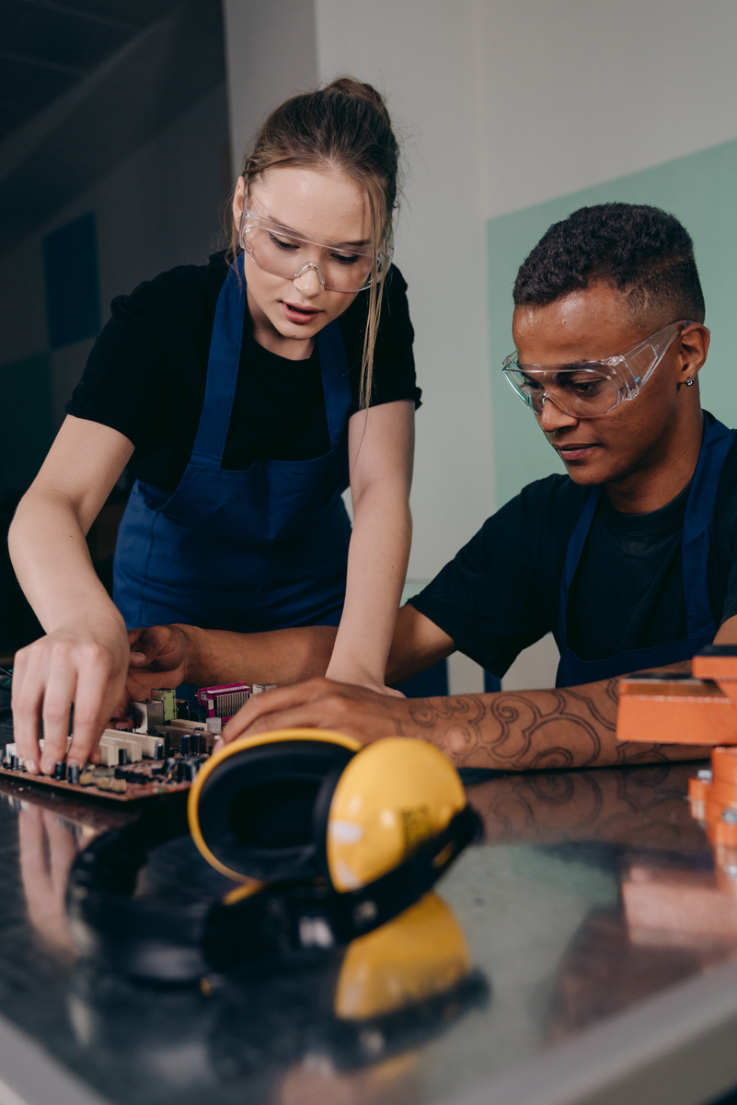
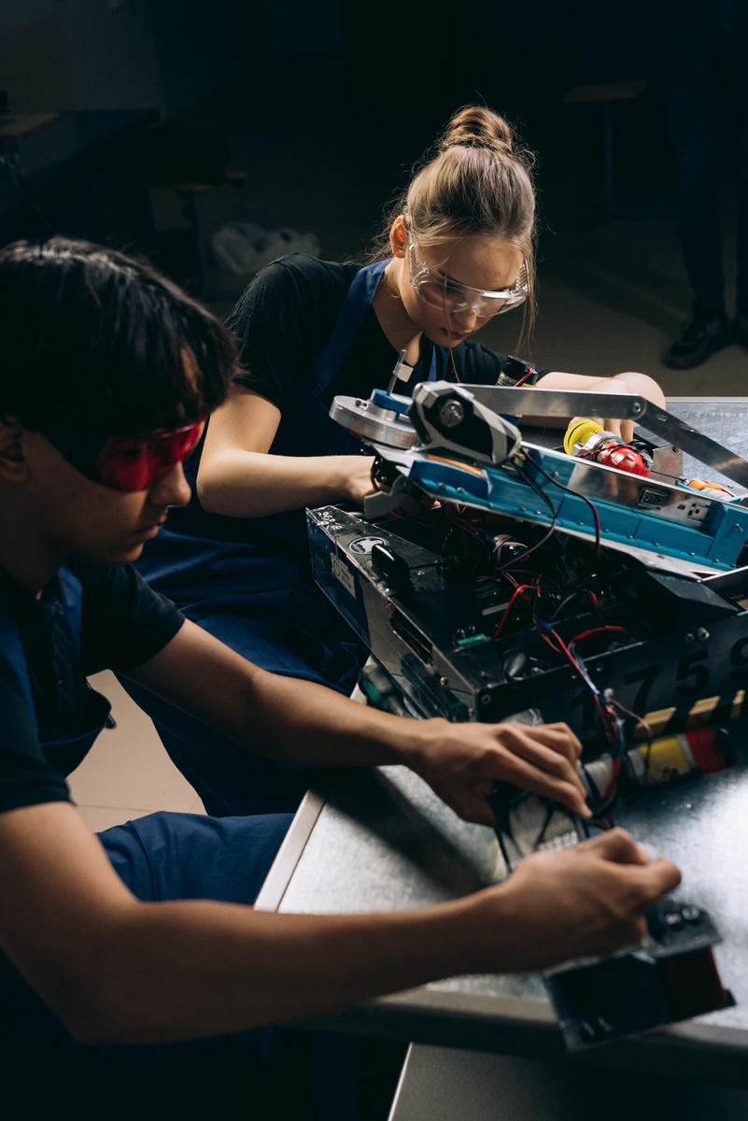

Market Value & Potential
Data Security & Privacy
Time Saving & Efficiency
Reduce Human Agents & Call Center Load
Instant Updated Data Delivery
24/7 Service Availability
For Citizens
Faster, trustworthy, and accessible answers in their preferred language
For Government
Reduced call center load, improved transparency, and better public service delivery
For Businesses
Reliable information access for informed decision-making and improved customer experience

Slide 4
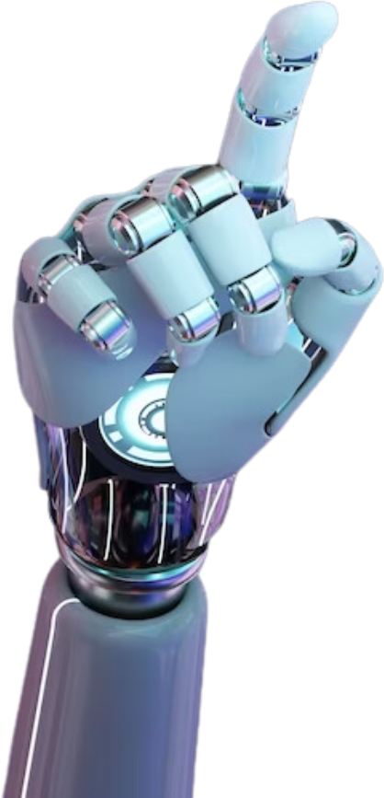

Our Objectives
Develop an intelligent multilingual chatbot (English, Sinhala, Tamil).
All services run on private servers, ensuring complete data protection and customer confidentiality.
Reduce information discovery time.
Enable natural language queries in local languages.
Deliver accurate, context-aware responses from website/given data.
Improve user experience & accessibility.

Slide 5


Implementation: SLT.lk Website Solution
Content Ingestion Layer
Automated web scraping system extracts and processes all SLT website content, ensuring comprehensive coverage. Additional updated data not available on the website can be integrated separately for real-time accuracy.
2. Vector Database Storage
Advanced vector database implementation stores processed content with semantic understanding, enabling efficient similarity-based retrieval of relevant SLT service information.
3. Multilingual Query Processing
Natural language processing capabilities understand and interpret customer questions in English, Sinhala, and Tamil.
4. Local LLM Integration
Deployment of local large language models generates contextually appropriate responses based on SLT website content, ensuring customer data privacy and fast response times.

Slide 6

Technology Stack & RAG Architecture
Frontend Development
Database Systems
Web Crawl & Process
React + Vite: Modern, fast, and responsive user interface with hot reload capabilities
PostgreSQL:
Robust relational database for structured data management
BeautifulSoup / Crawl4AI & Tesseract OCR:
Data extraction and Intelligent web crawling and Text extraction from images and documents
Backend Framework
Milvus:
High-performance vector database for semantic search and similarity matching
Python Flask: Lightweight, flexible web framework for API development and request handling
AI & Language Models
LLaMA : Advanced language models via Ollama for local deployment

Slide 7
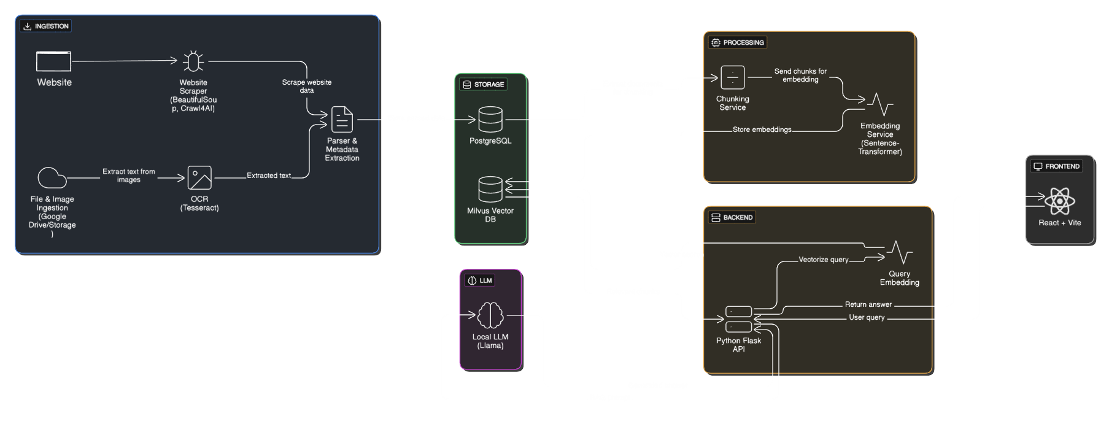
System Architecture

Slide 8




Project Impact
Our AI chatbot represents a paradigm shift from frustrating manual navigation to intelligent, instant, and secure digital assistance in users' preferred languages
Privacy-First Approach
Local server deployment ensures data sovereignty and builds public trust in digital services
Inclusive Technology
Breaking language barriers to make digital services accessible to all Sri Lankan communities
Efficiency Revolution
Reducing service delivery time from minutes to seconds while maintaining accuracy and relevance

Slide 9
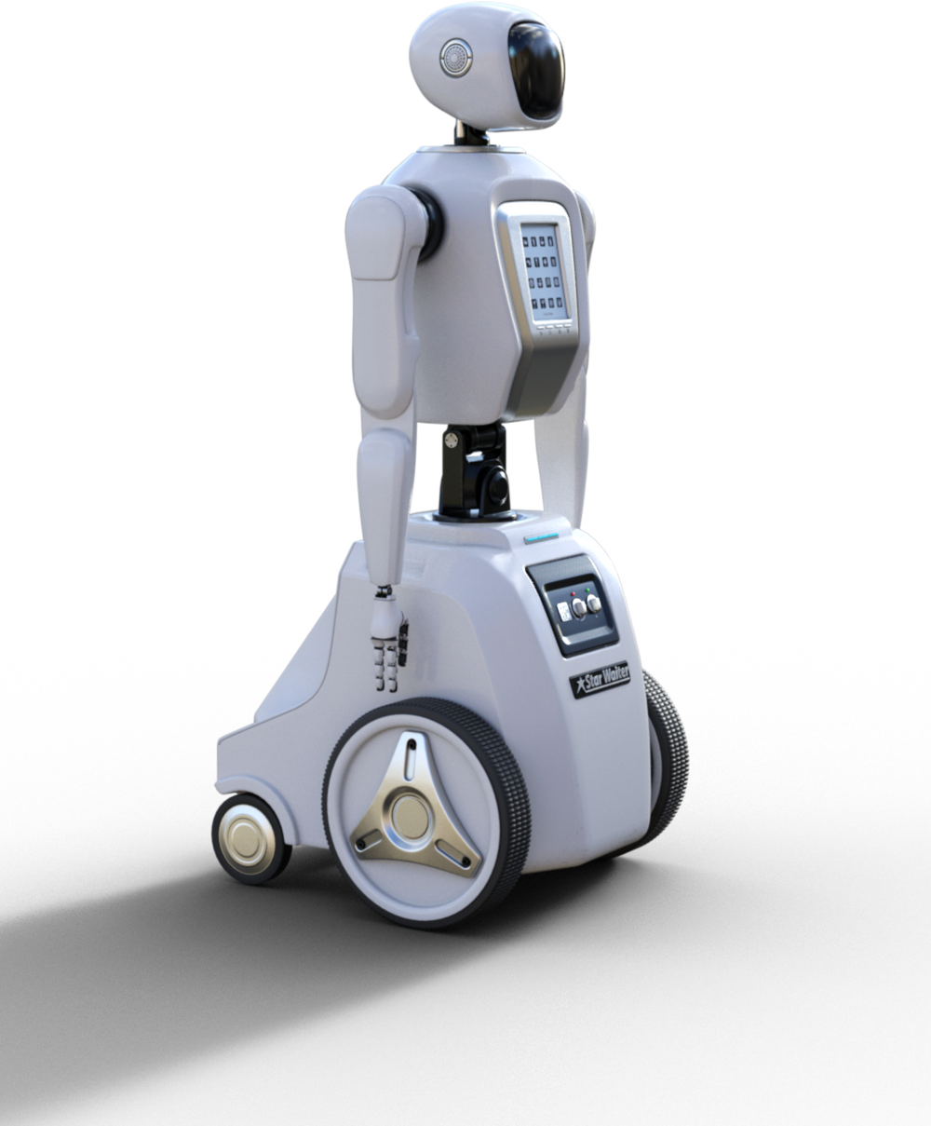
Features & Future Scope for Digital Services
Auto-update system for content.
Feed database with external service-provider data.
Answers with live data (news, weather, trends).
Explainable AI layer.
Comprehensive insights into user interactions, popular queries, and system performance metrics
Continuous Learning and Feedback Loops.
Voice integration for accessibility.
Human escalation (connect to real agents).

Slide 10
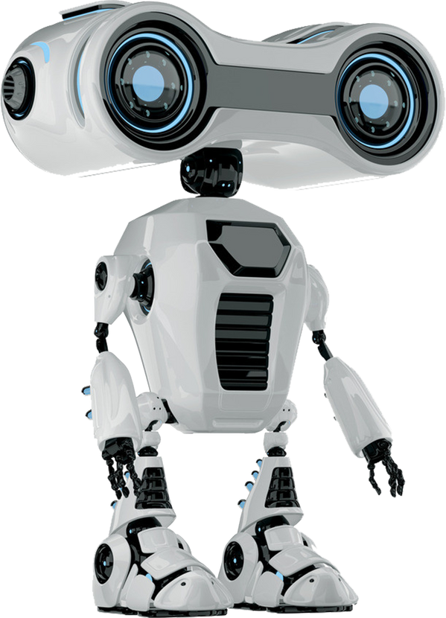
Thank You
READY TO REVOLUTIONIZE DIGITAL SERVICE DELIVERY IN SRI LANKA
Developed by SLT AI Interns
Team:
KESHARA GUNATHILAKA - gpkhgunathilaka@gmail.com
THINULA HARISCHANDRA - thinula.haris@gmail.com
MEVINU GUNARATNE - silonminakven@gmail.com
RANDIL JAYASINGHE - udantharandil@gmail.com

