Slide 1

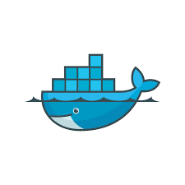
Docker Fundamentals

Slide 2
Agenda
What is Docker?
How it works?
Basic terms
Basic commands
Conclusion

Slide 3
Docker Introduction
Docker is advanced version of virtualization.
Docker is a tool it design to make easier to create, ship, run & deploy any software using containers. Containers allow a developer to package up an applications with all of the parts it needs, such as libraries and other dependencies, and ship it all out as one package.
Founded by Kamel Founadi , Solomon Hykes , and Sebastien Pahl during the Y Combinator Summer 2010.
Initial release for Publicly in 13th March 2013.
Platform independent & Open source.
It written in ‘Go’ language.
We can install docker on any O.S but docker engine runs natively on Linux Distribution
It provide the functionality of PaaS.

Slide 4
Virtualization
It's the process of creating a virtual (rather than physical) version of something, including hardware, software, storage, or networks.
Types:
1. Server Virtualization: It allow us to
create multiple virtual machine on single physical machine.
It allow us to easily manage the resources such
as RAM, ROM, Processers etc.
2. Desktop Virtualization: Running desktop
environments on a central server rather than on local machines.
Ex – EC2(AWS), Virtual Machine(GCP)

Slide 5
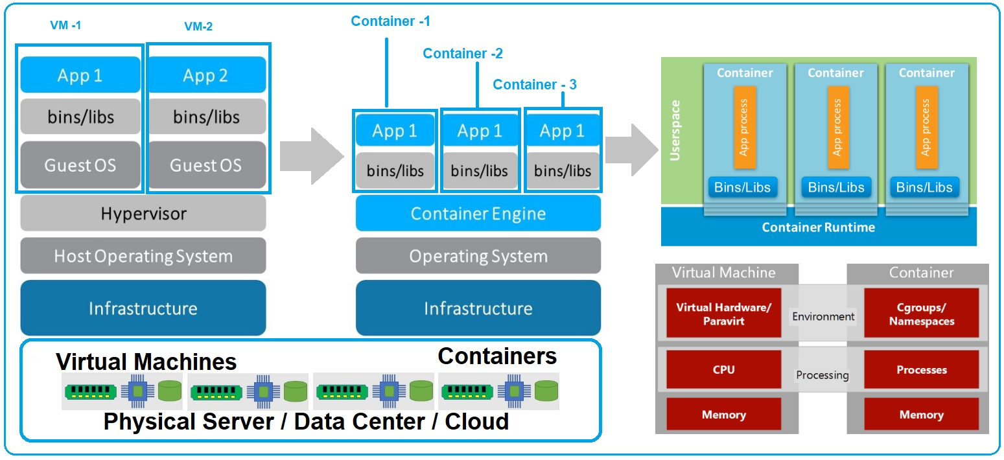
Why we need Docker?

Slide 6
Advantage
No-pre allocation of RAM.
Continuous integration(CI) Efficiency: It enable us to continuously build run and deploy to any software in every department such as Development, Testing & Deployment.
Less-cost.
It is Light weight.
It can run on physical machine, Virtual machine or on Cloud.
It takes very less time to create a container.
Reuse the images.

Slide 7
Disadvantage
Platform dependent.
Not reach GUI.
Docker does not provide cross-platform compatibility, mean if any application is designed to run in a container on window then it can’t run on Linux or vice-versa.
Difficult to manage large amount of container.
No solution for data recovery or backup.

Slide 8
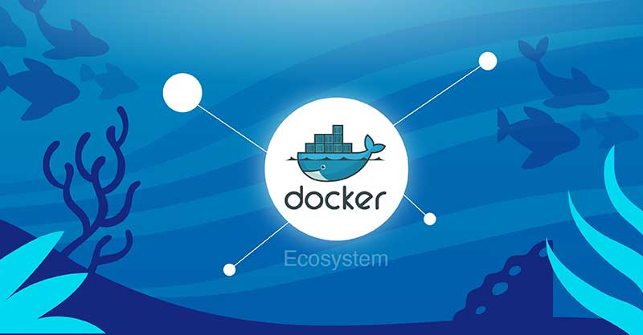
Docker Ecosystem
Docker
Server/Daemon
Docker Client
Docker Images
Docker Compose
Docker Container
Docker Hub or Registry
Ecosystem

Slide 9
Docker Client
Docker users can Interact with docker through a client.
Docker client uses command line interface to communicate with the docker daemon or server.
It can communicate with one or more than one daemon.
When user run any server command on the client terminal, then client terminal send these docker commands to the docker daemon.

Slide 10
Docker Daemon/Engine
Docker daemon runs on the Host O.S
It is responsible for running containers to manage docker services.
It can communicate with other daemons
Docker Host
Docker Host is use to provide an environment to execute and run applications. It contain the docker daemon, images, container, networks.

Slide 11
Docker Hub/Registry
It is centralized placed for store and manage docker images.
Types:
1. Public registry – Use for all
2. Private registry – Used in organization
Docker Images
It is read only binary templates that use for create containers.
It is single file with all dependencies require to run any program.
Each images contains metadata providing information about the images and it’s dependencies.

Slide 12
Way to create images
By Pulling from Docker hub
By Dockerfile
By existing images
By Docker compose

Slide 13
Docker Container
It is just like a Virtual Machine.
It hold all the packages to run any software.
Images becomes container when run any image.
It is lightweight than VM.
It can run across different environment to make deployment and scaling easier.
Each containers operates itself to maintain their file system, CPU, Memory, and Network resources.
It takes very less time to start and stop.
It is layer file system.

Slide 14
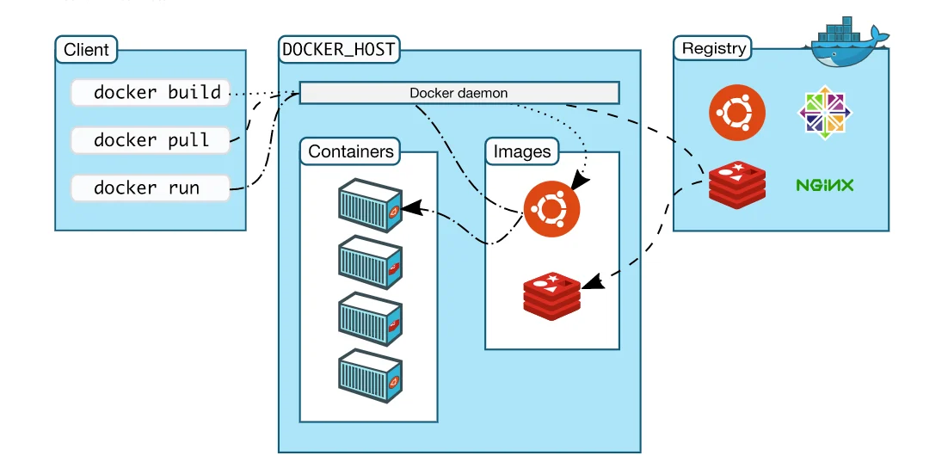
Dockerfile
Dockerfile is a text file that contain set of instruction to create image as our requirement.
It operates by the layer file system.

Slide 15
Basic syntax of Dockerfile
FROM :- For base image, this command must be on top of the Docker file.
_{RUN :- To execute command.}
MAINTAINER :- Author/Owner/Description(tag for identification)
COPY :- Copy file from Host system to image.
Syntax :- (/home/CDAC/cine.txt:/root/CDAC_CINE/)
ADD :- Similar to copy but, it provides a feature to download files from internet, also we extract file at docker image side.
EXPOSE :- To expose ports such as port 8080 for tomcat, port 80 for nginx etc.
WORKDIR :- To set working directory for a container.
CMD :- Execute commands but during image creation.
ENTRYPOINT :- Similar to CMD(High priority comparison to CMD), Execute command when start the container.
ENV /ARG:- Environment variables.(for change in future)
VOLUME :- For create sharable directory.

Slide 16
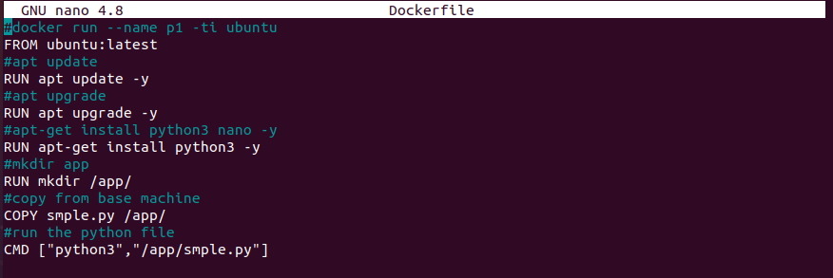
Sample Dockerfile
_{FROM ubuntu:latest}
_{RUN apt update -y}
_{RUN apt upgrade -y}
_{RUN apt-get install}
_{RUN mkdir /app/}
_{COPY sample.py /app/}
VOLUME [“/myvolume”]
CMD ["python3","/app/smple.py"]

Slide 17
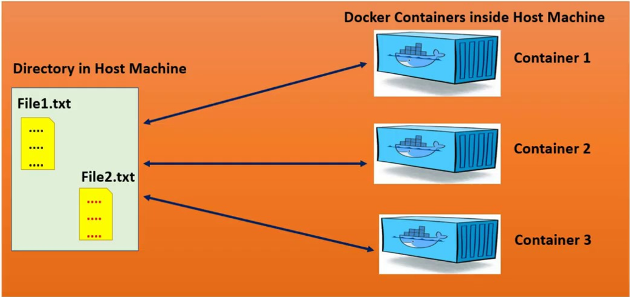
Docker VOLUME

Slide 18
Docker VOLUME
Docker volume is a ‘Shareable Directory’ that allow us to share any file from one docker container to other container or with Host OS
If we update anything in one container then it will automatically update in all container or where I shared.
Firstly, We need to declare the directory as a volume.
Even if we stop container, still we can access volume
We can’t create volume in running container only create while creating images.
We can share the volume across any no of container.
Host to container, Container to container.
On deleting container volume does not delete.

Slide 19
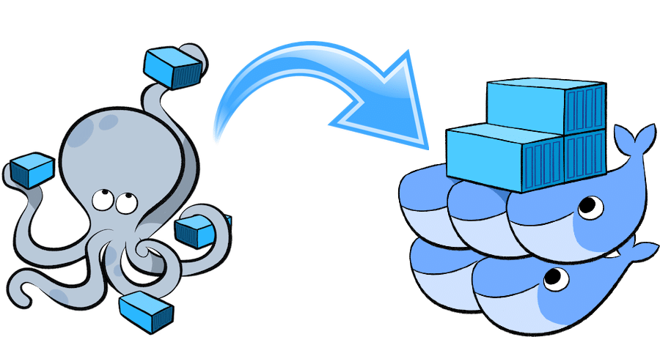
Docker Compose
Docker compose is a tool that use for create multi-container at a time.
It use a YAML file to configure the services, networks, and volumes required for an application.

Slide 20
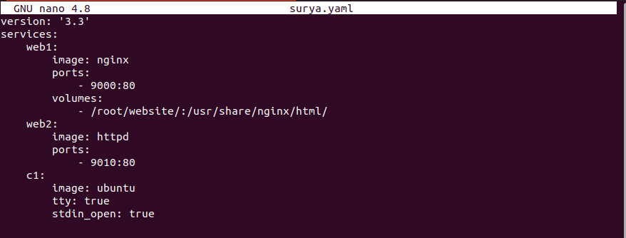
Sample of YAML file
Version: ‘3.3’
services:
web1:
image: nginx
ports:
- 9000:80
volumes:
-/root/website/:/usr/share/nginx/html
web2:
image: httpd
ports:
- 9010:80
c1:
image: ubuntu
tty: true
stdin_open: true

Slide 21
Docker Commands
Basic commands:-
# Find image in docker hub
Docker search ‘image_name’
# For download image
docker pull ‘image-name’
# install docker
apt-get install docker* -y
# check version
docker --version
# check docker in your system
which docker
# create image of container
docker commit ‘old_container_name’ ‘new_container-name’
# check changes under image after build container
docker diff ‘container_name’ updateimage

Slide 22
# start docker service
systemctl start docker
# Enable docker service
systemctl enable
# check status of service
service docker status
# For show running containers
docker ps
# start docker service
systemctl start docker
# Enable docker service
systemctl enable
# check status of service
Service docker status
# For show running containers
docker ps
# For show running and stop container
docker ps -a
# For login docker account
docker login
user name:**************
password:************
# For login docker account
docker login
user name:**************
password:************
# Download image on docker
docker pull ‘image name’
# Download image on docker by version
docker pull ‘image name’:’version name’
# For show list of images
docker images
# For delete images
docker rmi ‘ image id’
# For download and create image command
Docker run -ti ‘application name’
run :-download image and create container
-ti :-Intractive terminal

Slide 23
# For download and create image command and set name
Docker run –name surya -ti ‘application name’
# For start any container
docker start ‘container id’
# For enter the container
docker attach ‘container id’
# For delete container
docker rm ‘container id’
docker rm ‘container name’
# For stop container
docker stop ‘container name’

Slide 24
Command for docker compose
# For create/start the container
docker-compose -f surya.yaml up
# For stop and delete the container
docker-compose -f surya.yaml down
# For create without network
docker-create create
# For start , stop containers
docker-compose start
# For stop , start containers
docker-compose stop
# For remove/delete the containers
docker-compose rm

Slide 25
Dockerfile
# systemctl error shutout
docker run -d -ti –name ‘Container name’’ –privileged ‘container id’ /usr/sbin/init
# For show IP-address
docker inspect ‘container name’
# Hide for logs
-d
# For download reposetory from github
git clone ‘repository link’
# Convert in tar file of any docker image
docker save ptf:1.0 > ptf.tar
# Convert in docker image from tar file
docker load < ‘tar_file’

Slide 26
Commands for Docker VOLUME
# show all docker volumes
docker volume ls
# create volume
docker volume create ‘volume_name’
# delete volume
docker volume rm ‘volume_name’
# delete all unused docker volume
docker volume purne
# check information of volume
docker volume inspect ‘volume_name’
# check information of container
docker container inspect ‘container_name’

Slide 27
THANK YOU

