Slide 1


NRI INSTITUTE OF INFORMATION
SCIENCE & TECHENOLOGY
Submitted by
Student Name – KESHAV
Enrollment No. – 0115CA231053
Semester – THIRD (3RD)
Under the Guidance of
Prof. DEV NAGAR
DEPARTMENT OF MASTER OF Computer APPLICATION
MCA
NRI INSTITUTE OF INFORMATION SCIENCE AND TECHNOLOGY ,BHOPAL

Slide 2
PRESENTATION ON MINOR PROJECT
EMPLOYEE MANAGEMENT SYSTEM
MCA
NRI INSTITUTE OF INFORMATION SCIENCE AND TECHNOLOGY ,BHOPAL
MCA

Slide 3
CONTENTS
Content | Slide number
Introduction | 4
Objective | 5
Front end | 6
Back end | 7
Database connectivity | 8
SDLC | 9
ER Diagram | 10
Flowchart | 11
Data flow diagram | 12
Screen shot | 13-15
Testing | 16
Feasibility study | 17
Hardware | 18
Software | 19
Future scope | 20
Limitations | 21
NRI INSTITUTE OF INFORMATION SCIENCE AND TECHNOLOGY ,BHOPAL

Slide 4
INTRODUCTION
This chapter gives a brief theoretical preview upon the database information systems and goes through the essence of the problem that should be resolved.
Background Most of the contemporary Information systems are based on the Database technology as a collection of logically related data, and DBMS as a software system allowing the users to define, create, maintain and control access to the database. The process of constructing such kind of systems is not so simple. It involves a mutual development of application program and database. The application program is actually the bridge between the users and the database, where the data is stored. Thus, the well-developed application program and database are very important for the reliability, flexibility and functionality of the system. The so defined systems differentiate to each other and their development comprises a great variety of tasks to be resolved and implemented.

Slide 5
Objective
To Create Web based online Employee Management system.
Track and find out the availability of employee and manage all employee related information.
Establishment of paperless environment.

Slide 6
Front end
Html
CSS
Java script

Slide 7
Back end
Java
Python

Slide 8
Data base connectivity
SQL
MySQL

Slide 9

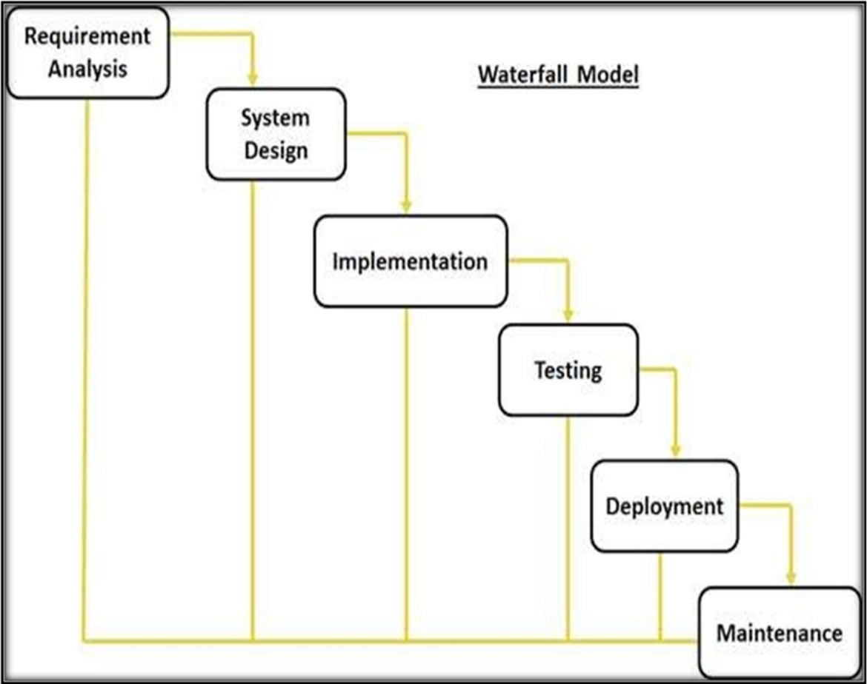
SDLC
Waterfall Model

Slide 10
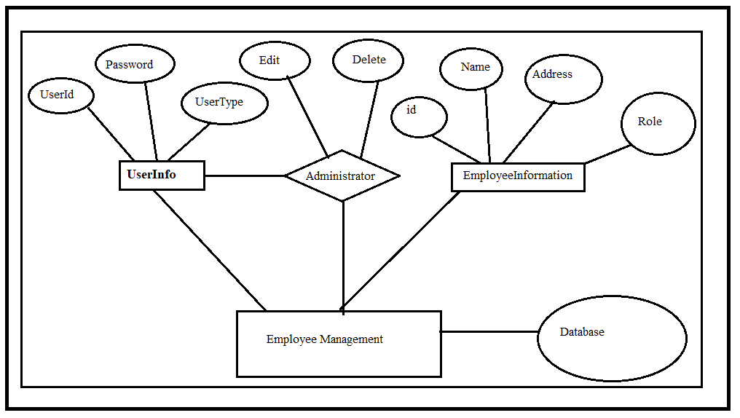
E – R diagram

Slide 11
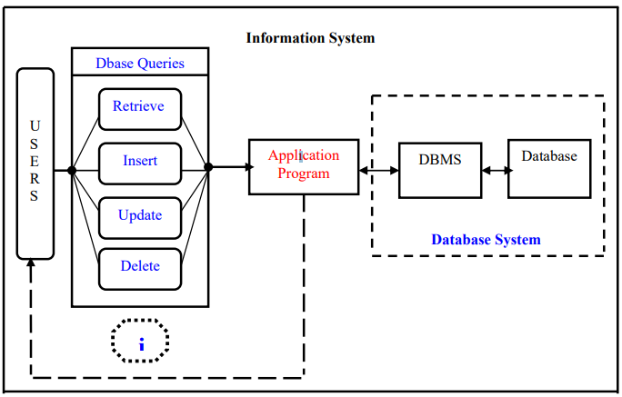
EMPLOYEE FLOWCHART

Slide 12
DATA FLOW DIAGRAM

Slide 13
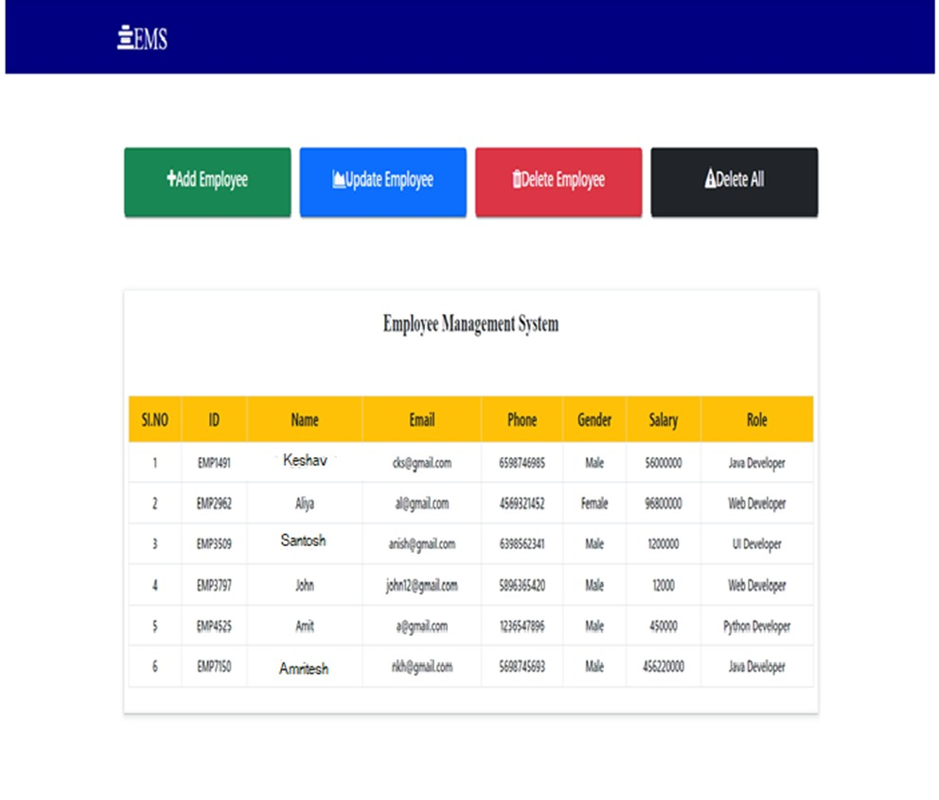
Table screenshot

Slide 14
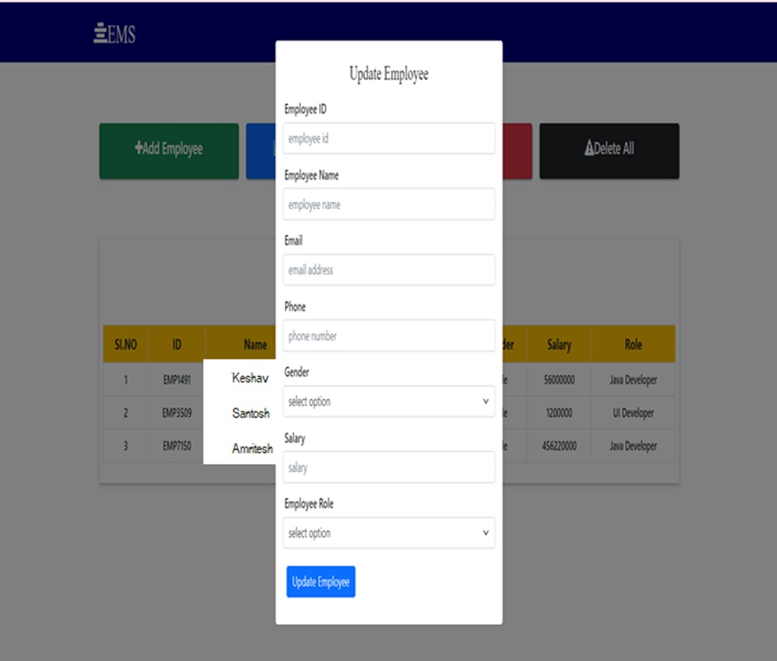
Update record screenshot

Slide 15
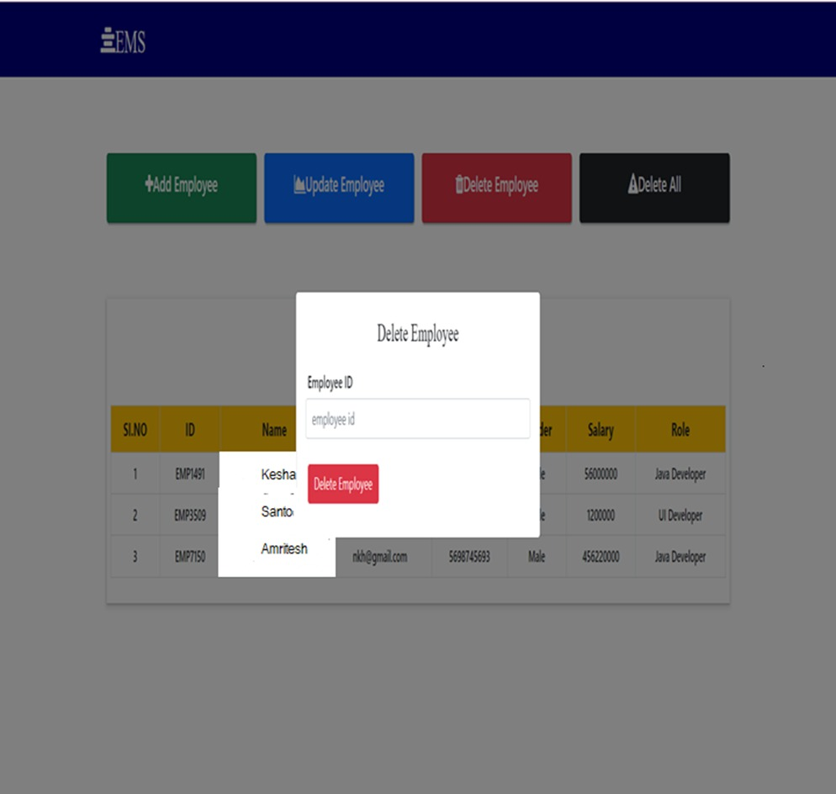
Delete record screenshot

Slide 16
Testing used
Functional Testing
Usability Testing
Performance Testing
Security Testing
Acceptance Testing

Slide 17
Feasibility Study:
Economical Feasibility
This is every important aspect to be considered while developing a project. We decided the technology based on minimum possible cost factor.
Technical Feasibility
This included the study of function, performance and constraints that may affect the ability to achieve an acceptable system.
Operational Feasibility
No doubt the proposed system is fully GUI based that is very user friendly and all inputs to be taken all self-explanatory even .

Slide 18
Hardware required
01 Processor 2.4 GHz Processor speed
02 Memory 2 GB RAM
03 Disk Space 500 GB

Slide 19
Software required
01 Operating System Windows Server 2008,Windows7,10,11
02 Database Management System MySql 8.0.0G
03 Runtime Environment STS-4 IDE
04 Server Tomcat-09

Slide 20

Future scope
Whether you’re reserving a table at your favorite restaurant or ensuring that you have a set time to visit a busy fine arts museum, online employee scheduling continues to become further ingrained in our daily lives.
The same should be said about the way employees schedule a visit to the employee’s office.
Speaking of online employee booking
21st-century employees expect 21st-century employee IT technology at their fingertips. healow® Open Access® lets employees request or book employees online, anytime and from any device.
Having a tool like this could mean fewer phone calls for your staff and give them more time to work directly with employees.

Slide 21
Limitation
Higher cost efficiency
Data security risk
Training requirement
Higher Maintenance and Updates
Higher dependency

Slide 22
THANKS
MCA
NRI INSTITUTE OF INFORMATION SCIENCE AND TECHNOLOGY ,BHOPAL
MCA

