Slide 1

IILM UNIVERSITY
Greater Noida, U.P. • School of Computer Science and Engineering
INTERNSHIP PRESENTATION
AI–ML VIRTUAL INTERNSHIP
Artificial Intelligence & Machine Learning — Learning, Workflow and Outcomes
STUDENT
Keshav Narayan
ROLL NO.
CS-23411020
PROGRAM
B.Tech CSE • Batch 2023–27
PERIOD
Apr–Jun 2026
AICTE–EduSkills National Internship Portal • 8 Weeks

Slide 2
01 / OVERVIEW
Internship at a glance
A structured eight-week learning experience focused on practical AI and Machine Learning fundamentals.
8 WEEKS
APR–JUN 2026
AICTE–EDUSKILLS
GOOGLE FOR DEVELOPERS
Internship duration
Completion period
National Internship Portal
Program support / learning resources
CORE FOCUS
WHY IT MATTERED
• AI and ML fundamentals
• Data preparation and preprocessing
• Model training and evaluation
• Practical problem-solving with datasets
• Connected academic concepts with practical workflows
• Improved programming and analytical understanding
• Introduced real-world AI/ML applications
• Built familiarity with the complete ML lifecycle
AI-ML VIRTUAL INTERNSHIP • 2026
02

Slide 3
02 / OBJECTIVES
What the internship aimed to build
The report defines seven core objectives covering concepts, workflow, algorithms and evaluation.
01
AI & ML fundamentals
02
Types of ML
Understand the fundamental concepts of Artificial Intelligence and Machine Learning.
Understand supervised and unsupervised learning.
03
ML workflow
04
Data preprocessing
Learn the basic steps involved in a Machine Learning workflow.
Understand data preparation, cleaning and transformation techniques.
05
Algorithms
06
Training & testing
Study important algorithms used for prediction and classification.
Understand how models are trained and tested.
07
Evaluation
Learn how models are evaluated using appropriate performance metrics.
AI-ML VIRTUAL INTERNSHIP • 2026
03

Slide 4
03 / LEARNING
AI–ML foundations covered
The internship emphasized how data becomes a model, and how a trained model becomes a usable prediction.
CONCEPTUAL FOUNDATION
APPLICATION AREAS IDENTIFIED IN THE REPORT
ML is a subset of AI that learns patterns from data.
Healthcare
Finance
AI
ML
Education
E-commerce
Cybersecurity
Recommendation Systems
Learning emphasis: data → features → model → evaluation → prediction
Predictive Analytics
Image & Text Processing
Automation
Business Intelligence
AI-ML VIRTUAL INTERNSHIP • 2026
04

Slide 5
04 / TECHNOLOGY
Technology and tools used
The report lists a practical Python-based stack for data work, visualization, machine learning and collaboration.
Python
NumPy
Pandas
Matplotlib
Programming and ML implementation
Numerical computations
Data manipulation and analysis
Data visualization
Scikit-learn
Jupyter / Colab
Git
GitHub
ML algorithms and evaluation
Development and experimentation
Version control
Code and project management
Together, these tools support the workflow from data preparation and analysis to model development, evaluation and project management.
AI-ML VIRTUAL INTERNSHIP • 2026
05

Slide 6
05 / SYSTEM ARCHITECTURE
End-to-end Machine Learning workflow
The report describes a sequential workflow that moves from raw data to evaluated predictions.
01
DATA COLLECTION
→
02
PREPROCESSING
→
03
DATA ANALYSIS
Gather relevant data
Clean, transform and prepare
Understand patterns and structure
04
FEATURE SELECTION
→
05
MODEL SELECTION
→
06
MODEL TRAINING
Select relevant features
Choose an appropriate algorithm
Train using training data
07
MODEL TESTING
→
08
MODEL EVALUATION
→
09
PREDICTION / OUTPUT
Test on unseen data
Measure model performance
Use the model for predictions
PREDICTION / OUTPUT
AI-ML VIRTUAL INTERNSHIP • 2026
06

Slide 7
06 / METHODOLOGY
Eight-week learning roadmap
A module-wise progression from fundamentals and Python to practical applications, assessment and final learning.
WEEK 1
WEEK 2
WEEK 3
WEEK 4
INTRODUCTION TO AI & ML
PYTHON FOR AI/ML
DATA PREPROCESSING
SUPERVISED LEARNING
AI, ML, types of ML and real-world applications
NumPy, Pandas and basic data visualization
Cleaning, missing values, feature selection and transformation
Regression, classification and common algorithms
WEEK 5
WEEK 6
WEEK 7
WEEK 8
UNSUPERVISED LEARNING
TRAINING & EVALUATION
PRACTICAL APPLICATIONS
PROJECT & ASSESSMENT
Clustering and pattern discovery in unlabeled data
Model training, testing and performance measures
Problem-solving exercises and real-world scenarios
Practical work, assessments and overall ML workflow review
AI-ML VIRTUAL INTERNSHIP • 2026
07

Slide 8
07 / OUTCOMES
Learning outcomes and practical value
The internship strengthened technical understanding while connecting classroom concepts with practical AI/ML workflows.
01
Understanding of AI and ML fundamentals
02
Knowledge of supervised and unsupervised learning
03
Improved Python programming skills
04
Understanding of data preprocessing and analysis
05
Familiarity with Machine Learning algorithms
06
Understanding of model training and testing
07
Knowledge of ML model evaluation
08
Improved analytical and problem-solving abilities
09
Better understanding of real-world AI/ML applications
Key takeaway: the internship helped bridge academic knowledge and practical AI/ML application.
AI-ML VIRTUAL INTERNSHIP • 2026
08

Slide 9
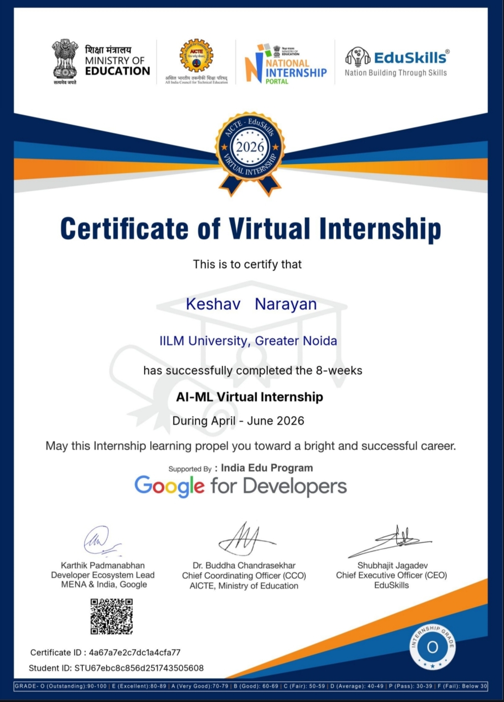
08 / CERTIFICATION
Internship completion certificate
Certificate issued for successful completion of the 8-week AI-ML Virtual Internship during April–June 2026.
CERTIFICATE DETAILS
PROGRAM SUPPORT
• Name: Keshav Narayan
• Program: AI-ML Virtual Internship
• Duration: 8 weeks
• Period: April–June 2026
• Issued through AICTE–EduSkills
• EduSkills
• AICTE / Ministry of Education ecosystem
• National Internship Portal
• Google for Developers support
AI-ML VIRTUAL INTERNSHIP • 2026
09

Slide 10
AI–ML VIRTUAL INTERNSHIP
Thank You
Keshav Narayan • CS-23411020
B.Tech CSE • IILM University, Greater Noida
Eight-week journey in Artificial Intelligence and Machine Learning
AICTE–EduSkills National Internship Portal • April–June 2026

