Slide 1
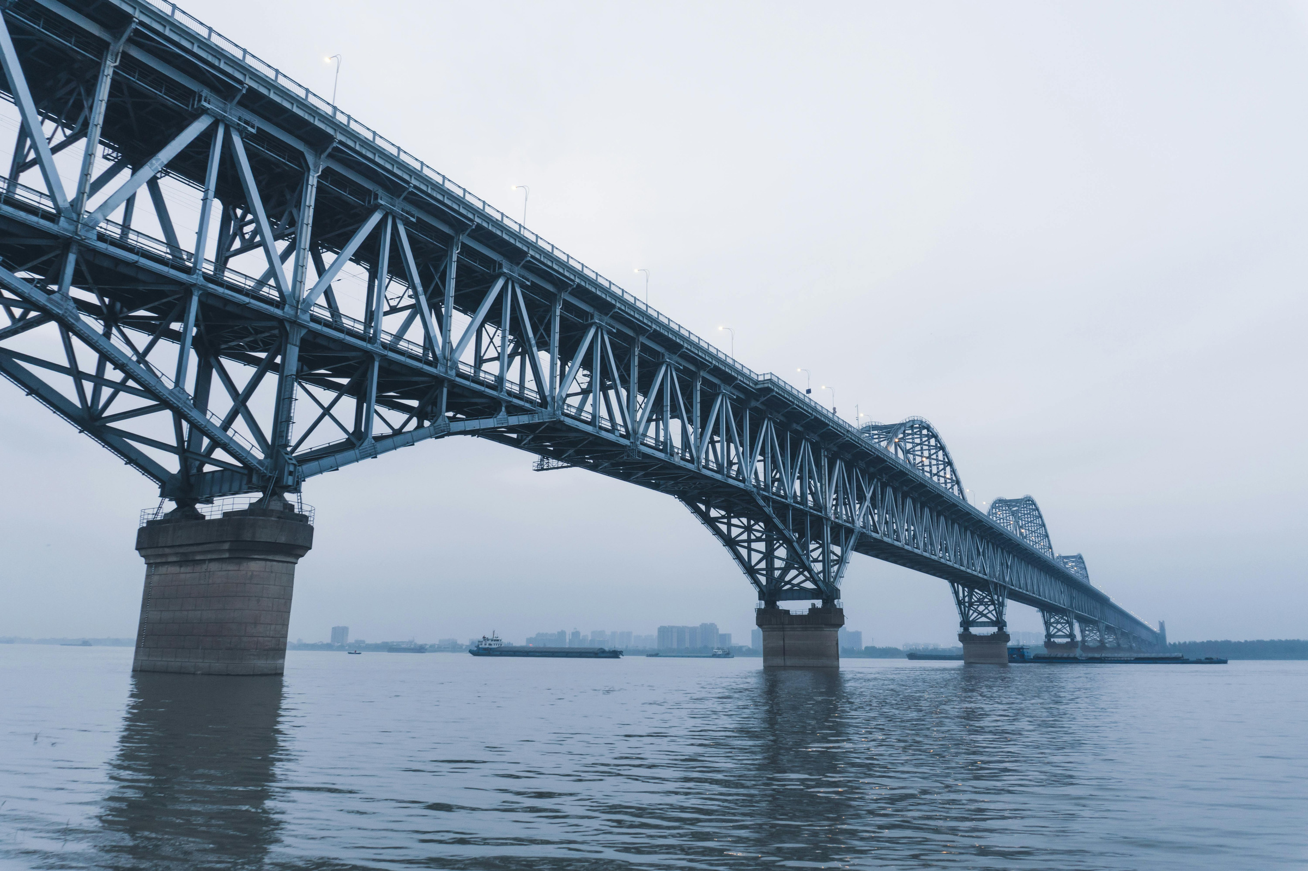
Interactive 3D Physics Simulation Platform
INTELLIGENT 3D BRIDGE SIMULATION & OPTIMIZATION
THE STRUCTURES WE CROSS WITHOUT A THOUGHT

Slide 2
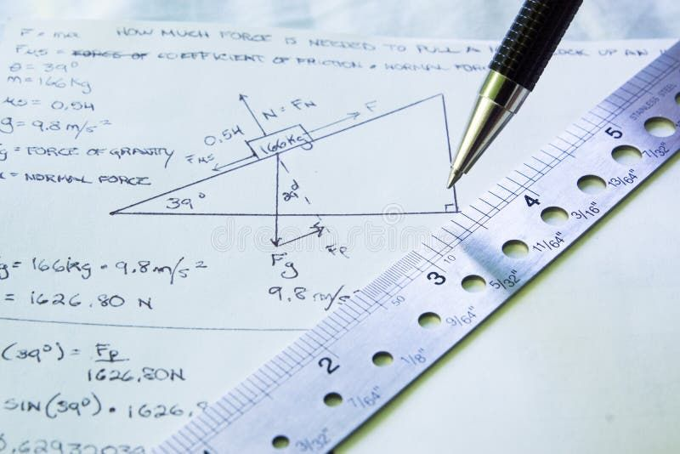
THE PROBLEM
The Problem
CALCULATIONS
EXTENSIVE ENGINEERING MATH IS NEEDED BEFORE A SINGLE BEAM IS EVER PLACED.
COMPLEX CALCULATIONS, EXPENSIVE PROTOTYPES, AND SPECIALIZED EXPERTISE MAKE PHYSICS-BASED DESIGN SLOW, COSTLY, AND DIFFICULT TO ITERATE.
SIMULATIONS
MULTIPLE PHYSICAL AND DIGITAL TESTS ARE NEEDED TO VALIDATE EVERY DESIGN.
PROTOTYPING
PHYSICAL MODELS AND TESTING ADD SIGNIFICANT COST AND DELAY.
EXPERTISE
FINDING A STRUCTURE'S WEAK POINTS STILL DEPENDS ON SCARCE SPECIALIST KNOWLEDGE.

Slide 3




THE SOLUTION
THE AI POWERED PHYSICS LAB
A 3D UNIVERSAL LABORATORY WHERE USERS BUILD ANY PHYSICAL SYSTEM, APPLY REAL-WORLD MULTIPHYSICS FORCES, AND LET AI OPTIMIZE THE DESIGN.
01
02
BUILD
SIMULATE
DESCRIBE YOUR IDEA AND CONSTRAINTS TO THE AI AGENT
APPLY GRAVITY, AERO LOADS, THERMAL STRESS, AND ELECTROMAGNETIC FORCES IN REAL-TIME.
03
04
VISUALIZE
OPTIMIZE
AI IDENTIFIES CRITICAL FAILURE POINTS AND SUGGESTS AUTONOMOUS MATERIAL AND STRUCTURAL IMPROVEMENTS.
SEE VECTOR STRESS, TURBULENCE, FORCES, etc. UPDATE IN REAL TIME AS PARAMETERS CHANGE.

Slide 4

THE BIG PICTURE
BUILD. SIMULATE. PREDICT. OPTIMIZE.
AN AI-POWERED 3D PHYSICS SIMULATION PLATFORM THAT LETS USERS DESIGN STRUCTURES, TEST THEM UNDER REALISTIC LOADS, VISUALIZE STRESS AND DEFORMATION, PREDICT POTENTIAL FAILURES, AND INTELLIGENTLY OPTIMIZE THEIR DESIGNS — ALL BEFORE THEY ARE BUILT.
How this Helps?
WHY IT'S EXTRAORDINARY
THE EVERYDAY MIRACLE
DESIGNING THESE STRUCTURES SAFELY REQUIRES COMPLEX ENGINEERING, EXTENSIVE SIMULATION, AND COUNTLESS ITERATIONS. WHAT IF AI COULD HELP US BUILD, TEST, PREDICT, AND OPTIMIZE THEM BEFORE THEY EVER EXIST?
ALMOST EVERY STRUCTURE WE RELY ON IS DESIGNED TO WITHSTAND FORCES WE CAN’T SEE — FROM MOVING LOADS AND WIND TO VIBRATIONS, PRESSURE, AND TIME.

Slide 5
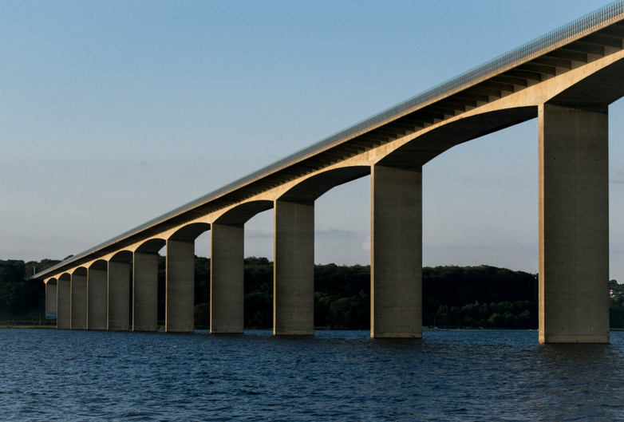
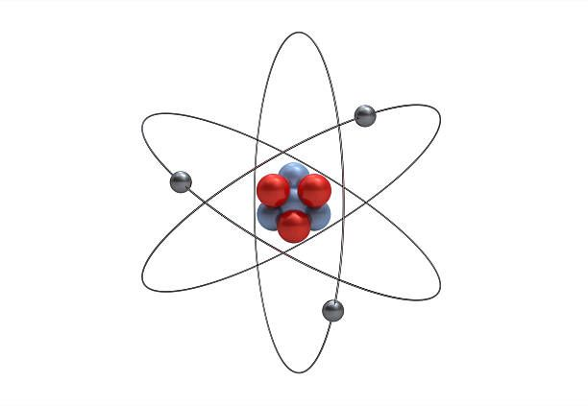
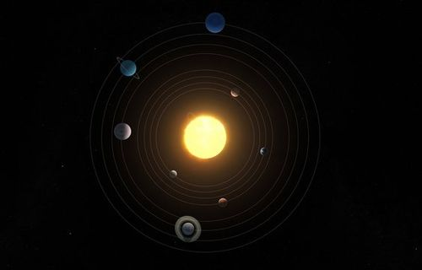

THE MAIN TYPES
FOUR WAYS TO SPAN
MOST STRUCTURES ARE BUILT AROUND A HANDFUL OF FUNDAMENTAL DESIGN PRINCIPLES, EACH SUITED TO DIFFERENT LOADS, MATERIALS, ENVIRONMENTS, AND ENGINEERING CHALLENGES.
BRIDGE
ATOM
SOLAR SYSTEM
PENDULUM
A SIMPLE STRUCTURE THAT DISTRIBUTES LOADS THROUGH ITS DECK AND SUPPORTS, DEMONSTRATING FORCE, STRESS, AND DEFORMATION.
A SIMPLIFIED ATOMIC MODEL SHOWING PARTICLES INTERACTING THROUGH FUNDAMENTAL FORCES AND DYNAMIC MOTION.
A PLANETARY SYSTEM DEMONSTRATING GRAVITATIONAL ATTRACTION, ORBITAL MECHANICS, AND THE MOTION OF CELESTIAL BODIES.
A SWINGING SYSTEM THAT DEMONSTRATES GRAVITY, ACCELERATION, MOMENTUM, AND THE CONVERSION BETWEEN POTENTIAL AND KINETIC ENERGY.

Slide 6
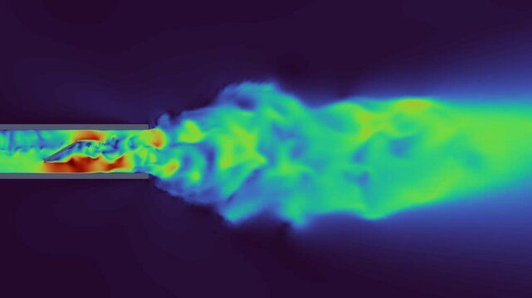
FORCES AT WORK
PHYSICS SIMULATION PARAMETERS
COMPRESSION
THE SQUEEZING FORCE THAT ARCHES AND PIERS ARE BUILT TO RESIST.
01
EVERY PHYSICAL SYSTEM IS A CONSTANT INTERPLAY OF FORCES, MOTION, ENERGY, AND MATTER.
TENSION
THE PULLING FORCE CARRIED BY THE CABLES OF SUSPENSION BRIDGES.
02
LOAD
THE COMBINED WEIGHT OF THE STRUCTURE, TRAFFIC, AND CONDITIONS LIKE WIND AND SNOW.
03
BALANCE
A BRIDGE STANDS BECAUSE THESE FORCES ARE CAREFULLY HELD IN EQUILIBRIUM.
04

Slide 7
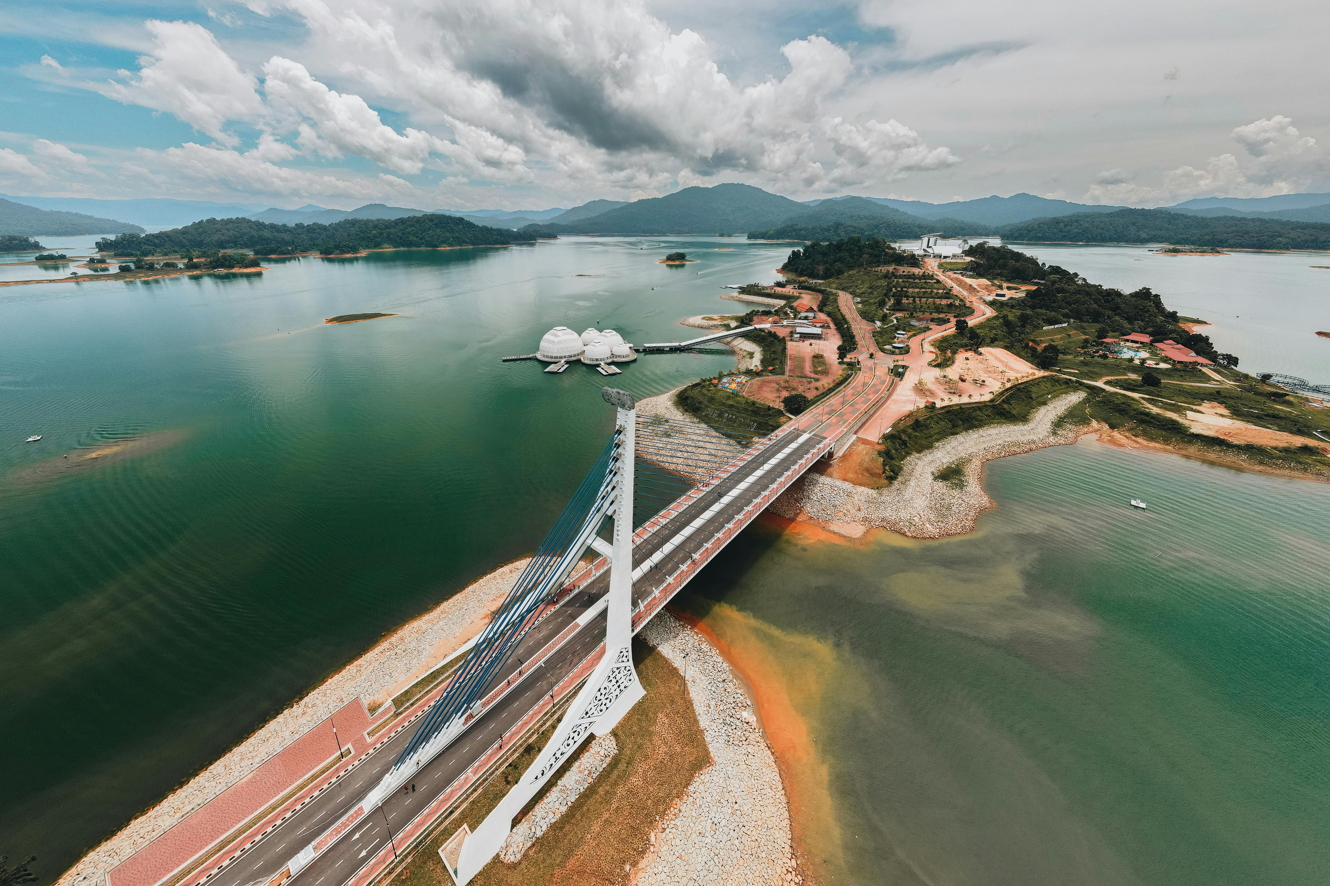
BY THE NUMBERS
FUTURE SCOPE
EXLPAIN
OPTIMIZE
Explain "Why did the object accelerate?".
Find the configuration requiring the least energy.
PREDICT
GENERATE
Will this structure collapse under this load?
Create a system that demonstrates projectile motion.

Slide 8
THANK YOU
TEAM MEMBERS :
Keshav Sikka
Udit Jain
Sarthak gupta
Abhishek gupta

