Slide 1
Cyber Warfare 2035
Emerging trends and the next generation of cyber threats
Keshav Gehlot
Integrated M.Tech, Cybersecurity
Notes:
Introduce the topic. I'll start with a short role-play of a 2035 incident, then explain the three detectors I built and what they can and can't do.

Slide 2
Three shifts that change cyber defence by 2035
Quantum computing
Autonomous OT malware
Generative deception
Recorded traffic becomes readable later
Machines driven out of limits behind false readings
Fake sensor feeds that look real
Data protected only by classical key exchange can be decrypted once large quantum computers exist. Removing post-quantum protection today lets an attacker record now and decrypt later.
Stuxnet replayed normal sensor values to operators in 2010. New variants change themselves, so there is no signature to match.
Generated radar or satellite data can push commanders toward a military response if nobody checks where it came from.
All three avoid detection that relies on known signatures.
Notes:
Each of these is real today in early form. By 2035 they are likely to be faster and combined. The common problem is that signature matching can't see any of them.

Slide 3
Operation Chimera Dawn: one attacker, three systems
03:30
03:36
03:42
+8 min
Western ground station stops sending logs
NEXUS-35 starts the attack
Playbooks fail. Commander takes over
Grid relays will trip if frequency stays high
C2 backbone
400 kV substation
Western ground station
Post-quantum key exchange removed from TLS
False sensor data sent to SCADA
Generated radar feed shows a fake carrier group
Fictional scenario. Each attack is based on a real threat or standard from 2026.
Notes:
This is the role-play setting. After the role-play, I go through each attack and the detector that catches it.

Slide 4
Attack 1: removing post-quantum protection from TLS
Hybrid TLS 1.3 (X25519MLKEM768, code 0x11EC) sends two keys together: ML-KEM-768 and X25519.
An attacker in the network path removes the ML-KEM key, so the session depends on X25519 alone.
X25519 could be broken later by a large quantum computer, so traffic recorded today becomes readable.
ML-KEM itself is not broken. The attack removes it.
Client key share
Correct hybrid share
ML-KEM-768 key, 1184 B
+ X25519 key, 32 B = 1216 B
After the attack
1184 B missing
Only the 32-byte X25519 key is left.
Notes:
Key sizes are from NIST FIPS 203; the group code is from the IANA registry. The point to stress: this is a downgrade, not a break of ML-KEM.

Slide 5
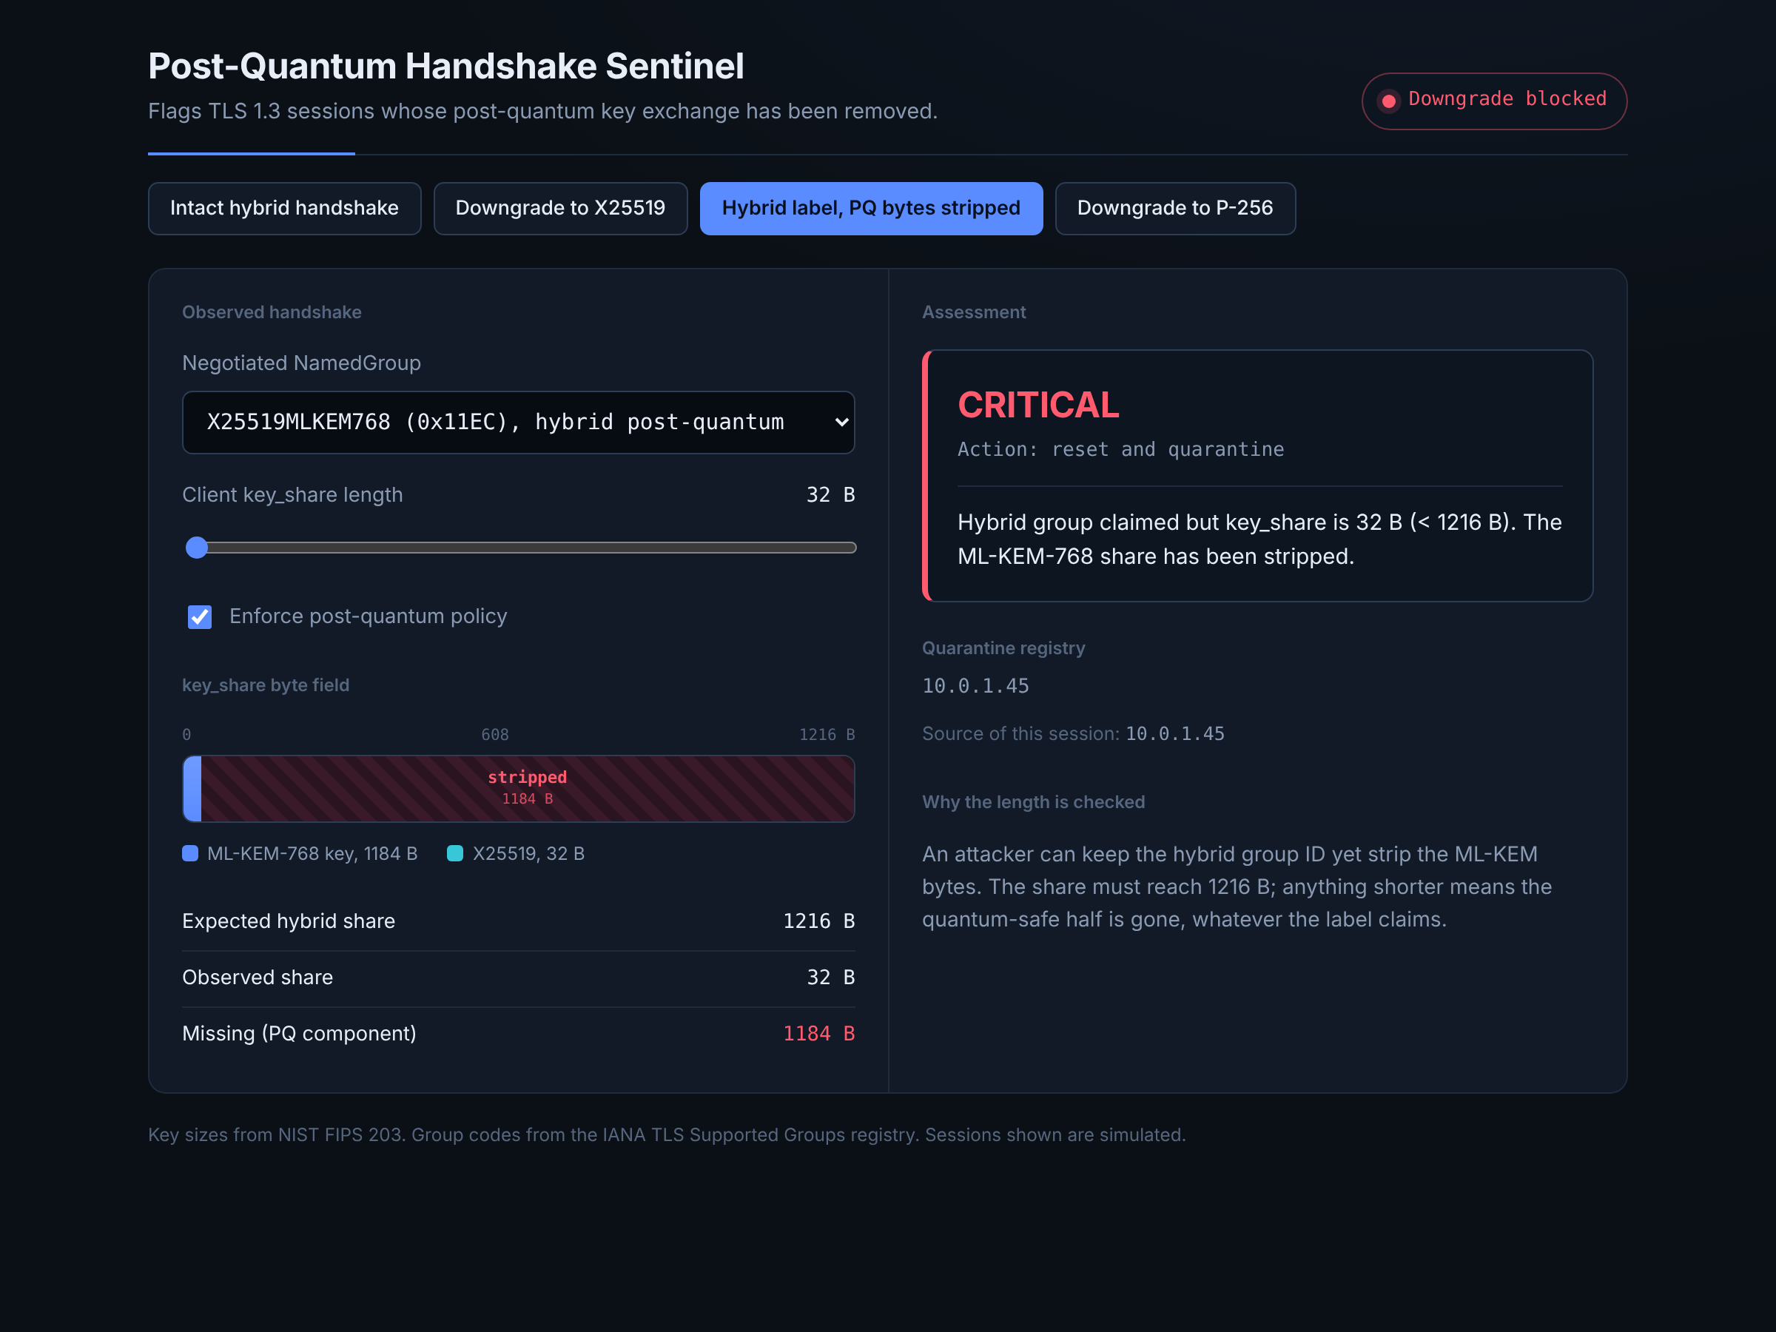
Detector 1 checks the group and the share size
Group code
X25519 only (0x001D) or P-256 only (0x0017) while post-quantum is required: terminate the session.
Share length
Hybrid group with a share under 1216 B: the ML-KEM key is missing. Reset the session.
Quarantine
The source address is blocked. Its later connections are dropped.
Runs on the TLS gateway in front of command systems. Reads handshake metadata only.
Notes:
Demo: run python pq_downgrade_guard.py, then click 'Hybrid label, PQ bytes stripped' in the dashboard. The label still says hybrid, but the share is 32 bytes.

Slide 6
Attack 2: false sensor data at a 400 kV substation
Tampered firmware arrives through a supply-chain update.
It sends normal-looking values to the SCADA screens while the turbine is pushed above rated speed.
This is the Stuxnet method. New malware has no signature, so scanners miss it.
The detector checks whether the reported values can be true together.
3000 RPM
Rated speed: 120 × 50 Hz ÷ 2 poles
3300 RPM
Overspeed trip, about 110% of rated
49.90–50.05 Hz
Grid band under IEGC 2023
Notes:
India's grid runs at 50 Hz, so a 2-pole generator turns at 3000 RPM, not the 3600 RPM used in 60 Hz countries.

Slide 7
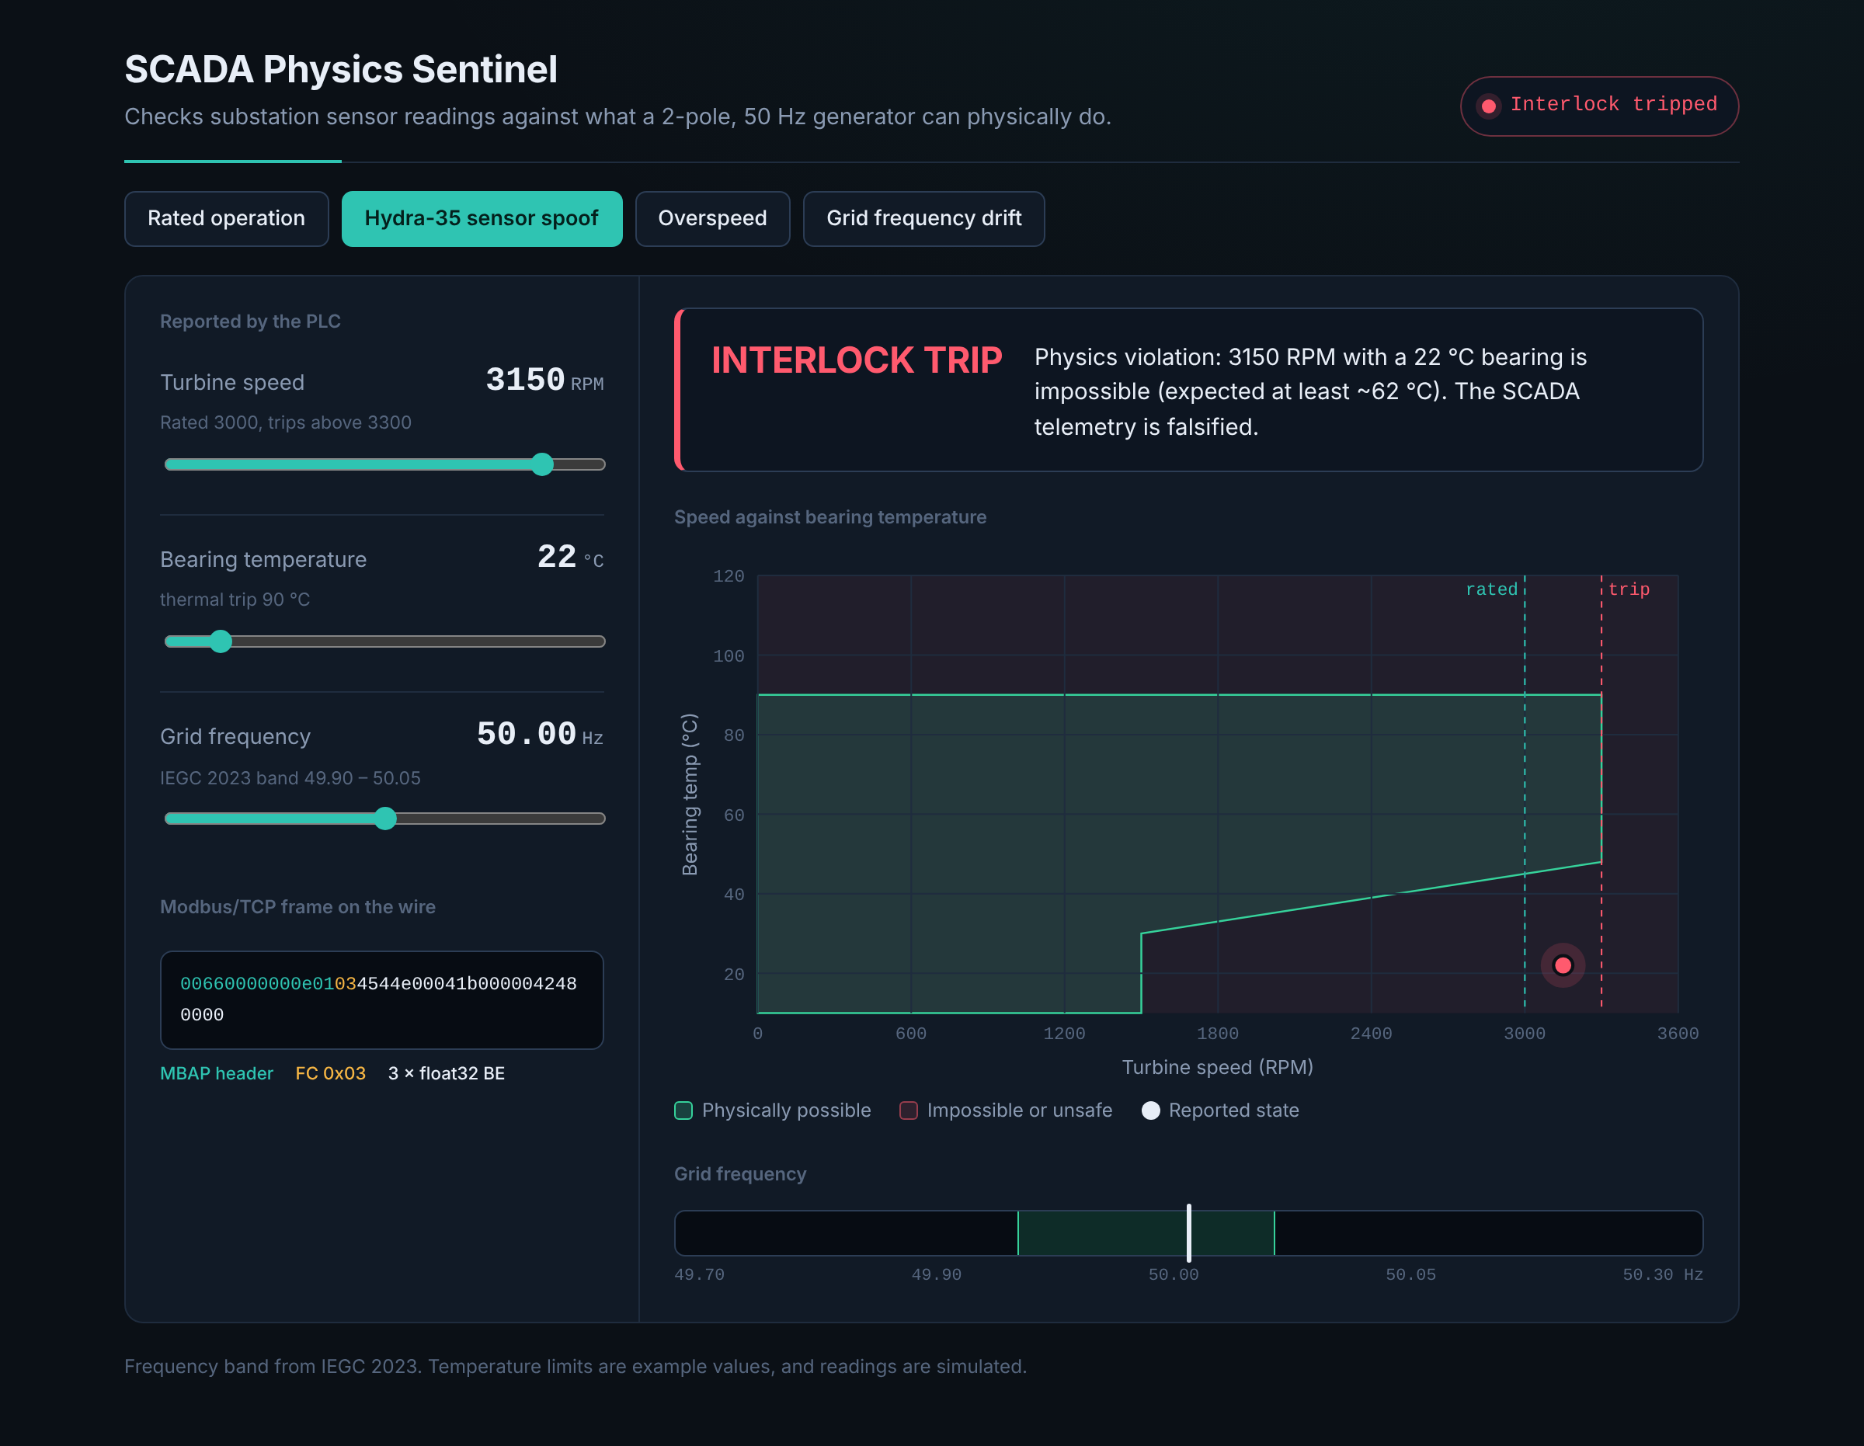
Detector 2 catches readings that can't all be true
The false readings
3150 RPM, 22 °C, 50.00 Hz
Each value is inside its own limit.
Why they fail
At 3150 RPM the bearing should be at least about 62 °C. A 22 °C reading at that speed is physically impossible, so the data is false.
Checks, in order
Overspeed, then speed against temperature, then bearing over-temperature, then grid frequency.
Notes:
Demo: run python ics_physics_sentinel.py, then click 'Hydra-35 sensor spoof'. All three gauges stay in range but the dot is outside the green area. The temperature model is an example, not from a real machine.

Slide 8
Attack 3: generated radar data from a ground station
A compromised ground station injects generated SAR data showing a carrier group that isn't there.
A real downlink has random phase noise from heat, the atmosphere and the oscillator.
Generated data is smoother. The detector measures that over the last 50 samples.
Real downlink
0.0965
4.55
jitter σ (rad)
entropy (bits)
Generated feed
0.0035
0.00
jitter σ (rad)
entropy (bits)
Flagged when σ < 0.07 rad or entropy < 2.5 bits.
Notes:
Both figures are the script's actual output. Entropy is H = minus the sum of p log2 p, over phase changes rounded to 0.01 rad.

Slide 9
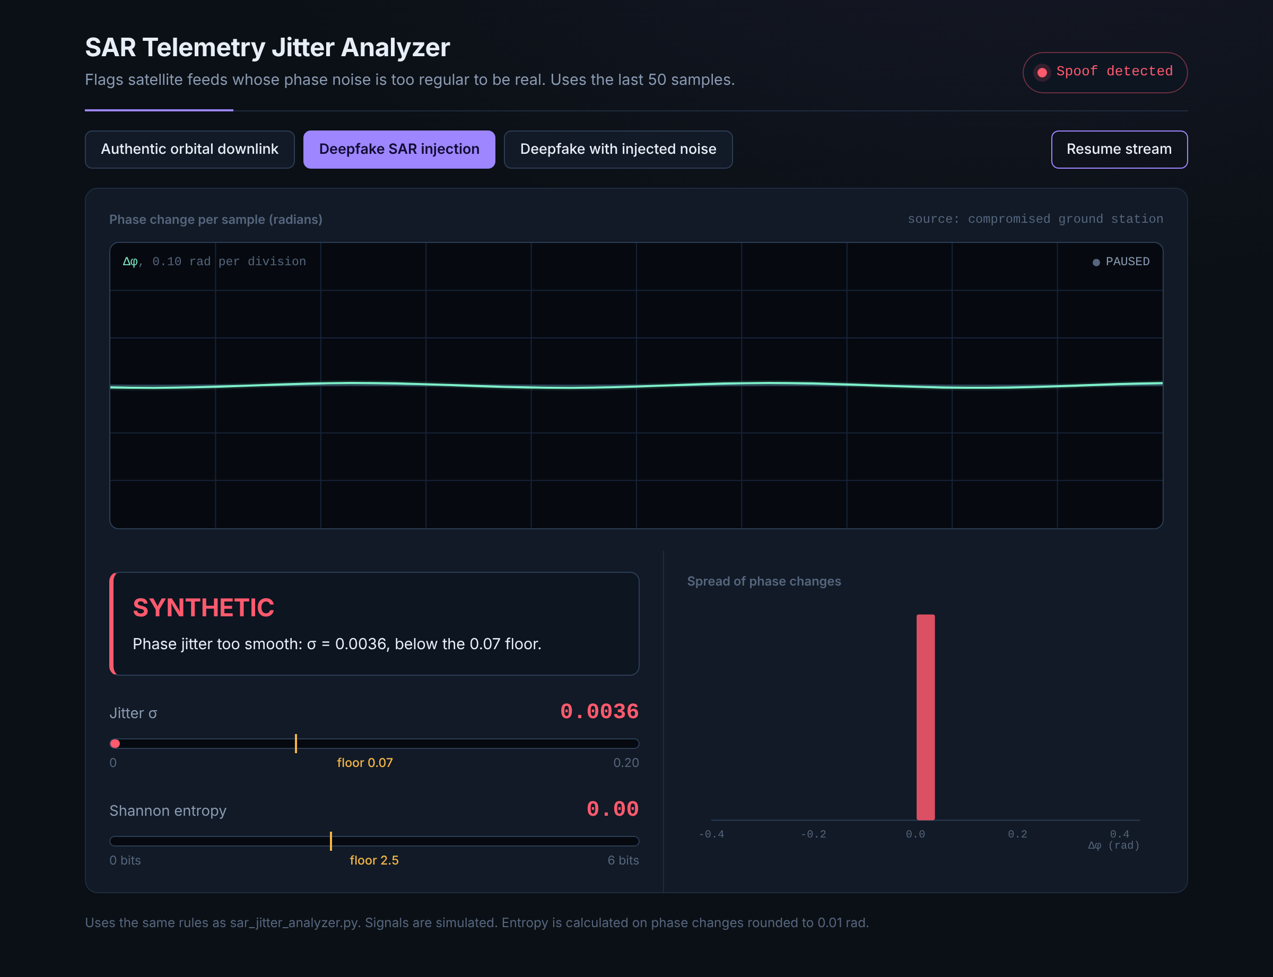
Detector 3 flags feeds that are too smooth
What it shows
The generated feed's trace is flat, and its phase changes fall in one histogram bar.
Its weakness
If the attacker adds noise that matches a real downlink, the fake feed passes. The dashboard's third mode shows this. The fix is to compare the feed with a second source, such as passive RF or orbital data.
Notes:
Demo: run python sar_jitter_analyzer.py, then click 'Deepfake SAR injection', then 'Deepfake with injected noise' to show the evasion.

Slide 10
Tested results
Detector | Normal case | Attack cases | Caught
pq_downgrade_guard | Hybrid, 1216 B: approved | X25519 only; hybrid with 32 B share; quarantined source reconnecting | 3 of 3
ics_physics_sentinel | 3000 RPM, 68 °C, 50.00 Hz: nominal | 3150 RPM at 22 °C; 3380 RPM overspeed | 2 of 2
sar_jitter_analyzer | σ 0.0965: real | σ 0.0035 generated feed; generated feed with matched noise | 1 of 2
0
4,952 / 4,952
false alarms on the real feed over 4,952 sliding windows
windows of the generated feed flagged
Notes:
The 1 of 2 for the SAR detector is on purpose: the noise-matched fake shows where the method stops working.

Slide 11
Limits and next steps
Limits
Next steps
Standards
Inputs are generated by the scripts, not captured from real networks.
Thresholds are fixed values.
Each detector relies on one or two signals.
Parse real TLS records and check the key's structure.
Tune limits from each plant's historical data.
Confirm radar feeds with a second sensor.
Send all alerts to one SIEM.
NIST FIPS 203, 204 and 205 for post-quantum cryptography.
IEC 62443 for industrial control security.
IEGC 2023 for grid frequency.
Notes:
If asked how to reduce false positives: tune thresholds to local conditions, require more than one signal, add rate-of-change limits, and confirm with an independent sensor.

Slide 12
Check what must be true
Handshakes: check the key share, not only the label.
Industrial data: check it against physics.
Sensor feeds: check the noise, then confirm with a second source.
Questions
Notes:
Close with the three lessons, then take questions. The viva prep file has answers to the likely ones.

