Slide 1
Hack-For-Environment
Keshav Deo Jain Nilankar Sen.

Slide 2
Smart solution to curb emission of greenhouse gases in IT industries

Slide 3
Problem Statement
As per some independent research, if the Server is on for eight hours a day then it uses almost 600 kWh and emits 175 kg of CO2 per year.
A Laptop\Desktop uses between 50 and 100 W/hour when it is being used, depending on the model.
A laptop that is on for eight hours a day uses between 150 and 300 kWh and emits between 44 and 88 kg of CO2 per year

Slide 4
Solution
Quite often we see the non essential servers, desktops and other devices are up and running during non-business hours. If we identify these non-essential devices and turn-off these servers\desktops\other device during non-business hours then we can limit the carbon emission.

Slide 5
Solution
Our solution is a "Full Stack Solution" that will identify the devices which are not required during "non-business hours" and turn them off during non productive hours. With our solution we can control any servers\desktops\laptops running in :
Private Cloud or Datacenter.
Any Public Cloud (Azure\AWS\Etc.)
Hybrid Cloud.
On-Premises

Slide 6
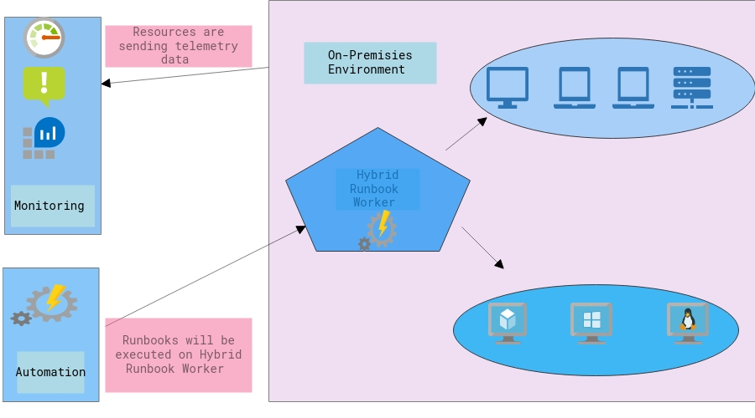
Solution Architecture

Slide 7
Demo
Location | Link
Onedrive Use this link for watching video | https://1drv.ms/v/s!AtaahoqRQxFCh81NCeg1ls5HwX-7OQ?e=94KnHz
Github | https://github.com/Keshav1308/Hack-For-Environment/blob/master/Hack-For-Environment-01.mp4?raw=true

