Slide 1
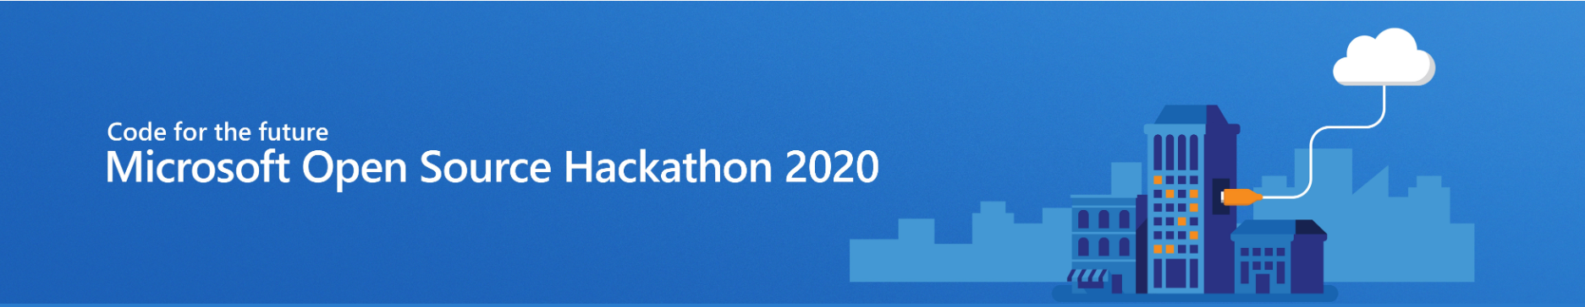
Team Name – Hack-For-Environment
Team Organization – DXC.Technology
PROBLEM STATEMENT :
Smart solution to curb emission of greenhouse gases in IT industries

Slide 2
Idea and Approach - Problem Statement
Quite often we see the servers, desktops and other devices are up and running during non-business hours.
Devices. | Consumptions | Carbon Impact
Server Type :Rack HDD/SSD Quantity :x4 300GB 2.5” HDD DRAM Capacity 32GB CPU Quantity 2 | It consumes 1760.3 kWh / year | 320 kg CO2e/year assuming a four-year life span.
Computer | Almost 600 kWh | Emits 175 kg of CO2 per year.
Laptop | Uses between 50 and 100 W/hour *when it is being used, depending on the model | A laptop that is on for eight hours a day uses between 150 and 300 kWh and emits between 44 and 88 kg of CO2 per year.
Reference article :- https://i.dell.com/sites/csdocuments/CorpComm_Docs/en/carbon-footprint-poweredge-r640.pdf

Slide 3
Idea and Approach - Solution
Our solution is a "Full Stack Solution" that will identify the devices which are not required during "non-business hours" and turn them off during those hours. Hence we can limit the carbon emission.
With our solution we can control the Shutdown of any Servers/VM running in :
Private Cloud or Datacenter.
Any Public Cloud (Azure\AWS\Google\Etc.)
Hybrid Cloud.
On-Premises.

Slide 4
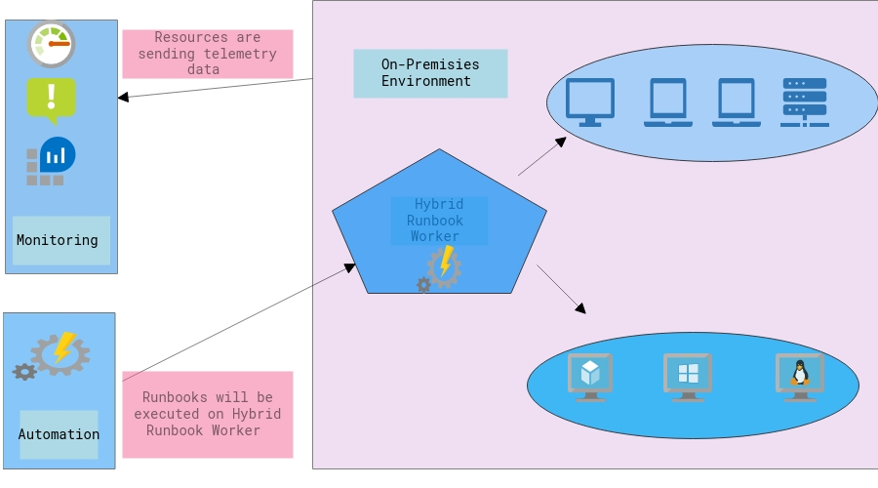
Implementation
Working –
This solution is a working solution. At the moment we are controlling around 5-6 Machines.
Tech Stack –
Azure Monitor is used to monitor the usage of the machines. Azure Automation is used to run the code for Turning-Off the machines during non-business hours.
Hybrid Runbook Worker is used to run the code directly of the On-premises\Datacenter\Other cloud.

Slide 5
Demonstration

Slide 6
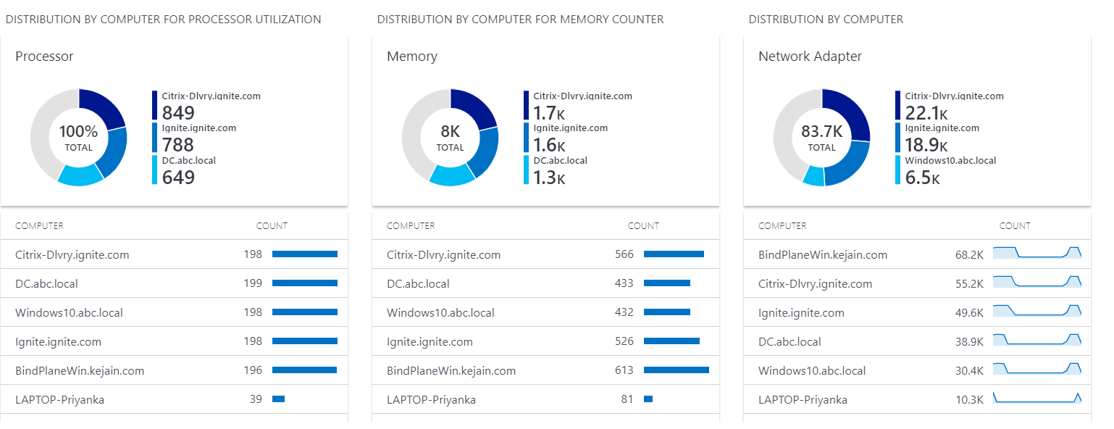
Demonstration 1 Azure Monitor Dashboards

Slide 7
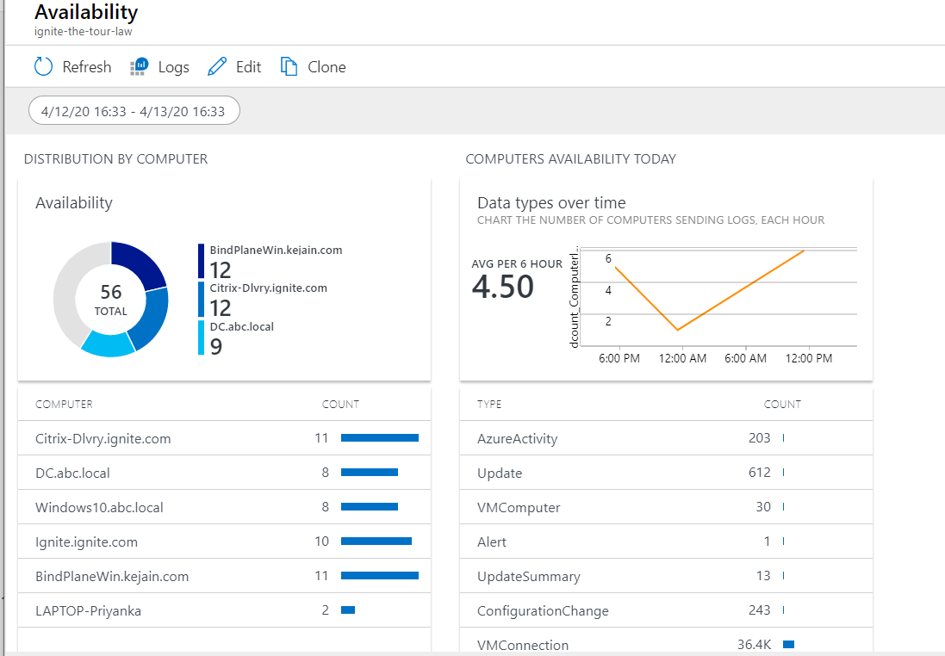
Demonstration 1.1 Azure Monitor Dashboards

Slide 8
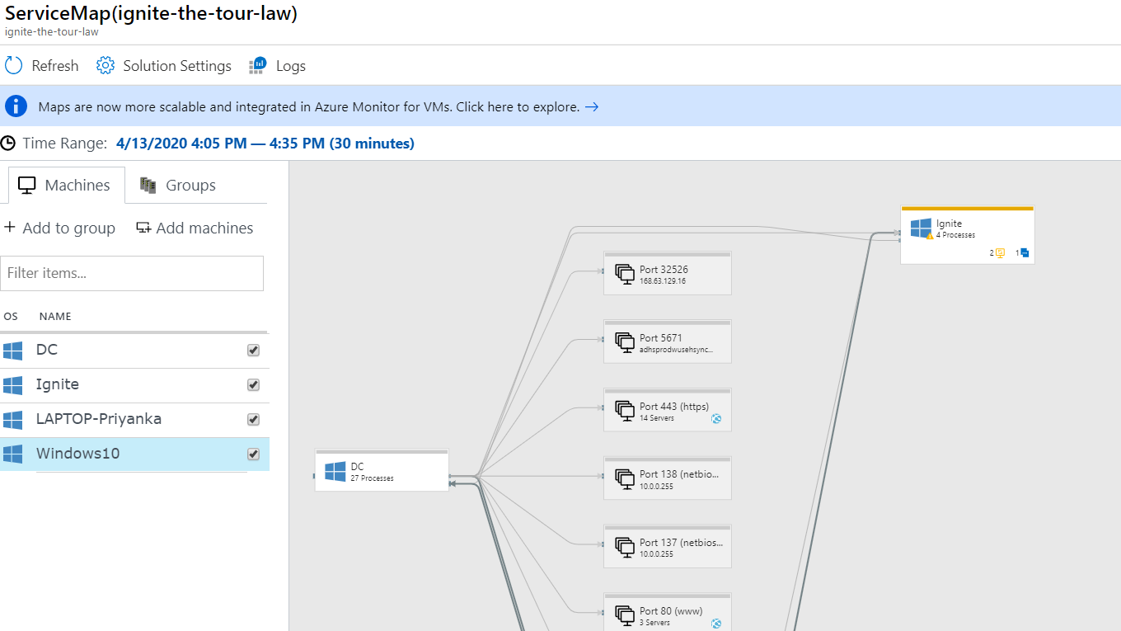
Demonstration 1.2 Azure Monitor Dashboards

Slide 9
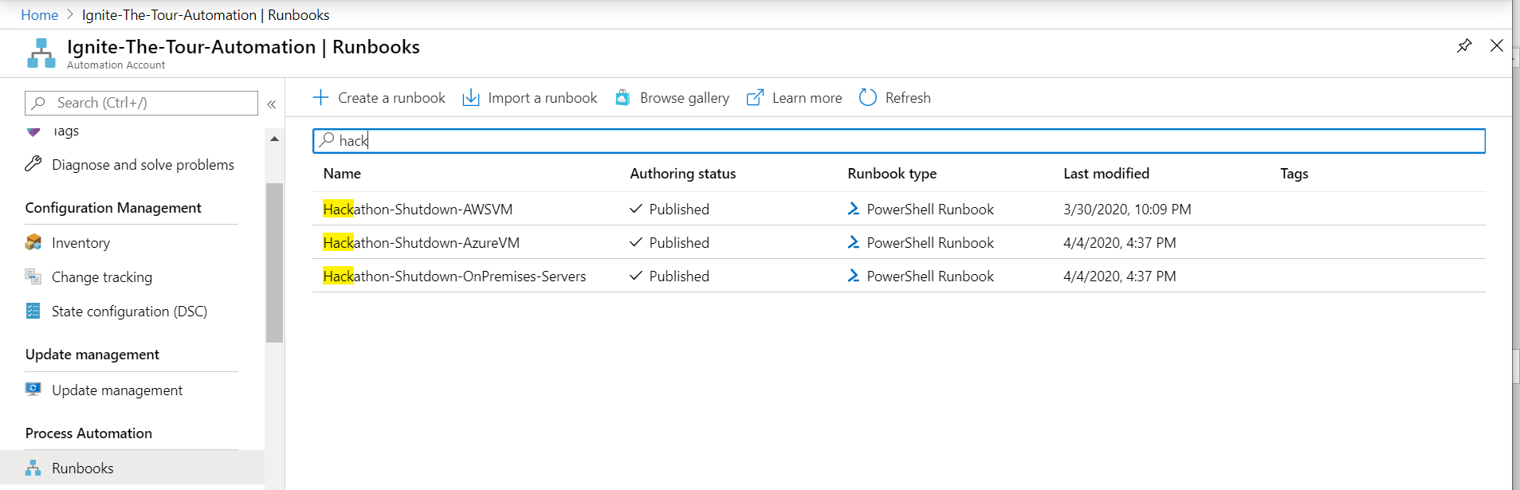
Demonstration 2 Azure Automation Runbooks

Slide 10
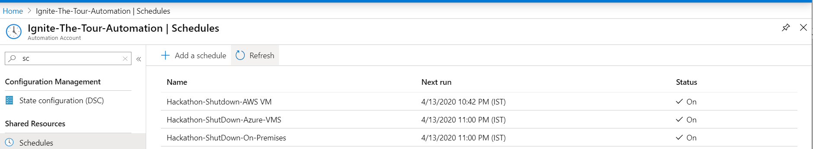
Demonstration 3 Azure Automation Schedules

Slide 11
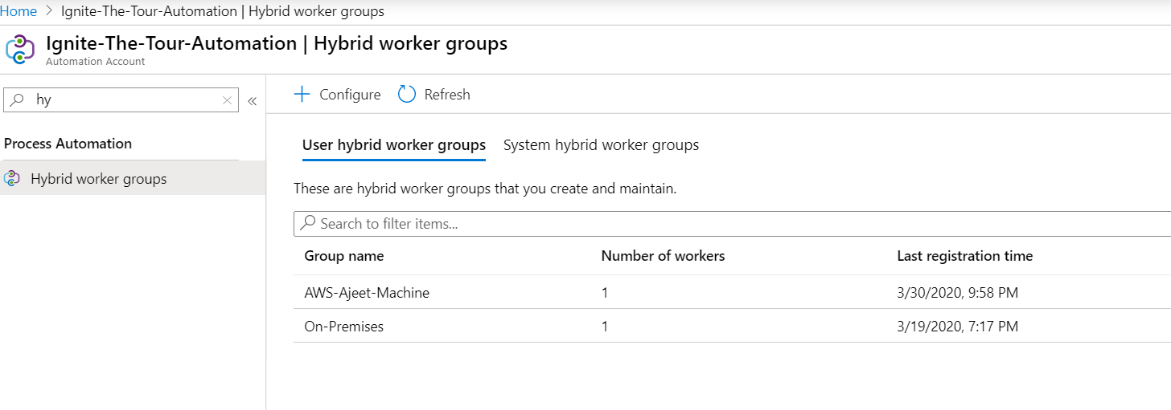
Demonstration 4 Azure Automation Hybrid Runbook Workers

Slide 12
Challenges Faced
Nothing much. These Azure Components like Azure Monitor, Azure Automation are quite stable and can be easily configured.
Little bit challenges were faced in configuring the Hybrid Runbook worker on AWS servers.

Slide 13
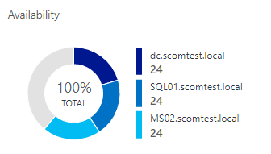
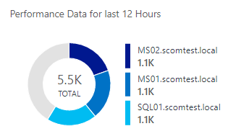
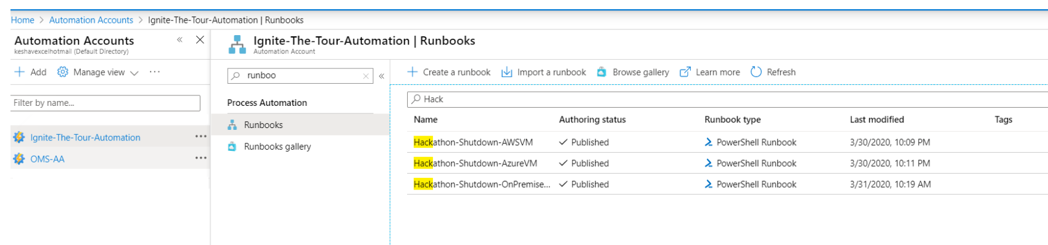
Completion Status
This solution is a working solution. At the moment we are controlling around 5-6 Machines. Servers are hosted in Azure and AWS Cloud. Few personal laptop.

Slide 14
Future Prospectus
How will this project make the earth more greener?
- If the server is not running then we need less cooling in datacentre. So here we will not only save the electricity by Turning of the server but also by minimizing the cooling.
Quantify terms how much of carbon emission you intend to reduce or any other green measure you can come up with ?
Good amount of carbon emissions can be controlled. Below is the breakdown :-
 | Energy Consumed and Carbon Emit per day
Server | By turning OFF the Server for 1 day can easily save around 4kWH and carbon emissions by 1 kg CO2e.
Desktop | Can easily save around 2kWH and it emits .5 kg CO2e

Slide 15
Thank You

