Slide 1
Hack-For-Environment
Keshav Deo Jain Nilankar Sen.

Slide 2
Smart solution to curb emission of greenhouse gases in IT industries

Slide 3
Problem Statement
As per some independent research, if the Server is on for eight hours a day then it uses almost 600 kWh and emits 175 kg of CO2 per year.
A Laptop\Desktop\Servers uses between 50 and 100 W/hour when it is being used, depending on the model.
A laptop that is on for eight hours a day uses between 150 and 300 kWh and emits between 44 and 88 kg of CO2 per year

Slide 4
Solution
Quite often we see the non essential servers, desktops and other devices are up and running during non-business hours. If we identify these non-essential devices and turn-off these servers\desktops\other device during non-business hours then we can limit the carbon emission.

Slide 5
Solution
Our solution is a "Full Stack Solution" that will identify the devices which are not required during "non-business hours" and turn them off during non productive hours. With our solution we can control any servers\desktops\laptops running in :
Private Cloud or Datacenter.
Any Public Cloud (Azure\AWS\Etc.)
Hybrid Cloud.
On-Premises

Slide 6
Non essential Servers
These are the servers which are under utilized.
They are needed for testing and development and may not needed during night and weekends.
Our solution will first help us in identifying these servers by analyzing the telemetry data sent by then to Azure Monitor Workspace.

Slide 7
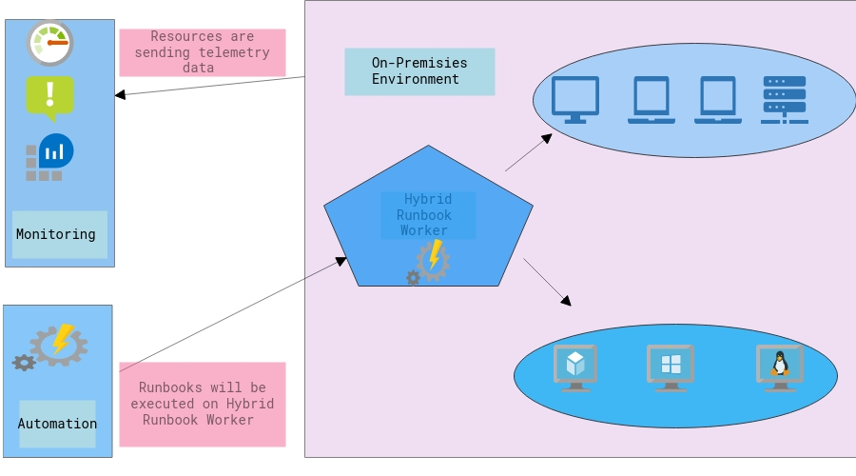
Solution Architecture

Slide 8
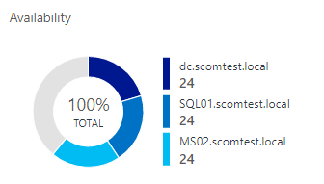
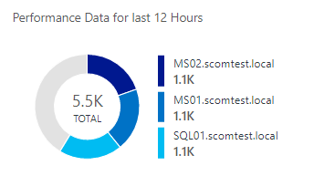
Azure Monitor.
Azure Monitor is used for collecting, analyzing, and acting on telemetry from your cloud and on-premises environments.
In this solution Azure Monitor is used to monitor the usage of the machines

Slide 9
Azure Automation Runbook and Hybrid Runbook Worker.
Azure Automation provides us the ability to automate frequent, time-consuming, and error-prone cloud management tasks. Azure Automation is used here to run the code for Turning-Off the machines during non-business hours.
Hybrid Runbook Worker feature of Azure Automation can directly run runbooks on the computer that's hosting the role and against resources in the environment to manage those local resources. Hybrid Runbook Worker is used here to run the code directly of the on-premises machines. This will also allow us to execute the code on the machines which resided on the on-premises infrastructure.

Slide 10
Demo
Location | Link
Onedrive Use this link for watching video | https://1drv.ms/v/s!AtaahoqRQxFCh81NCeg1ls5HwX-7OQ?e=94KnHz
Github | https://github.com/Keshav1308/Hack-For-Environment/blob/master/Hack-For-Environment-01.mp4?raw=true

