Slide 1
Big Data Analytics for Predictive Maintenance
Submitted in the partial fulfillment for the award of the degree of
BACHELOR OF ENGINEERING
IN
Computer Sciences and Engineering with Specialization in AI & ML
Submitted by:
Keshav
21BCS5372
Under the Supervision of:
Mr. Nirmalya Basu
Department of AIT-CSE
DISCOVER . LEARN . EMPOWER

Slide 2
Outline
Introduction to Project
Problem Formulation
Objectives of the work
Methodology used
Results and Outputs
Conclusion
Future Scope
References

Slide 3
Introduction to Project
In modern industries, ensuring the reliability of equipment is essential to avoid costly downtime and unnecessary maintenance. Traditional approaches, such as reactive or preventive maintenance, often result in inefficiencies, either due to unexpected failures or performing maintenance too frequently.
This project, "Big Data Analytics for Predictive Maintenance," aims to leverage big data to predict equipment failures and schedule maintenance proactively. By analyzing the past data and other sources, the project seeks to develop a predictive model that optimizes maintenance schedules, reduces downtime, and enhances operational efficiency. This innovative approach not only saves costs but also improves the reliability and lifespan of critical machinery.

Slide 4
Problem Formulation
Traditional maintenance strategies often lead to unexpected equipment failures, costly downtime, and inefficient resource use. There is a need for a solution that can leverage big data to predict equipment failures accurately and schedule maintenance proactively, improving operational efficiency and reducing costs.

Slide 5
Problem Formulation
Data Quality:
- Ensuring clean, accurate, and complete data for reliable predictions.
Model Accuracy:
- Developing precise models to avoid false predictions.
Scalability:
- Managing large data volumes and real-time processing efficiently.
Integration:
- Seamlessly integrating predictive systems with existing workflows.
Cost and Expertise:
- High initial investment and the need for specialized skills in data science and machine
learning.

Slide 6
Objectives of the Work
To utilize big data analytics to create a predictive maintenance system that forecasts equipment failures accurately Using LSTM. The goal is to optimize maintenance schedules, minimize unplanned downtime, reduce maintenance costs, and improve operational efficiency by leveraging data-driven insights from equipment sensors, historical logs, and operational data.

Slide 7
Methodology used
Data Collection:
Sources: Gather time-series data from sensors, maintenance logs, and operational records. This data should include variables such as temperature, vibration, pressure, and historical maintenance events.
Data Types: Focus on continuous data that changes over time, relevant to predicting equipment failures.
Data Preprocessing:
Data Cleaning: Handle missing values, remove noise, and ensure the data is in a consistent format.
Normalization: Scale the data to a uniform range (e.g., between 0 and 1) to improve model performance.
Sequence Generation: Convert raw time-series data into sequences that can be fed into the LSTM model. For example, create sliding windows of data sequences representing the past n timesteps.

Slide 8
Methodology used
Exploratory Data Analysis (EDA):
Trend Analysis: Use plots to identify trends and patterns in the data.
Correlation Analysis: Identify which variables are most correlated with equipment failures.
Model Development:
LSTM Model Design:
Build an LSTM network with layers designed to capture long-term dependencies in the data.
Include layers such as input, LSTM, dropout, and dense layers.
Training: Train the LSTM model using historical data sequences, with the target being the prediction of future failures or maintenance needs.
Hyperparameter Tuning: Optimize hyperparameters like the number of LSTM units, learning rate, batch size, and sequence length.

Slide 9
Methodology used
Model Evaluation:
Validation: Use a portion of the dataset as a validation set to evaluate the model’s performance during training.
Metrics: Evaluate the model using metrics such as RMSE (Root Mean Square Error), precision, recall, and F1-score to ensure it accurately predicts maintenance needs.
Implementation:
Integration: Deploy the LSTM model within the existing maintenance management system, ensuring it can take real-time input from sensors.
Real-Time Prediction: Set up the system to process incoming data, generate sequences, and predict potential failures in real time.

Slide 10
Methodology used
Testing and Optimization:
Pilot Testing: Run the LSTM model in a controlled environment to assess its predictive accuracy and make adjustments as needed.
Continuous Improvement: Regularly update the model with new data, retrain it to adapt to changing conditions, and fine-tune as more data becomes available.
Deployment and Monitoring:
Full-Scale Deployment: Implement the LSTM-based predictive maintenance system across all relevant equipment.
Monitoring: Continuously monitor the model's performance, ensuring it remains accurate and reliable over time.
Documentation and Reporting:
Process Documentation: Record the entire methodology for future reference.
Results Reporting: Create reports on the model’s performance and the impact on maintenance schedules, downtime reduction, and cost savings.

Slide 11
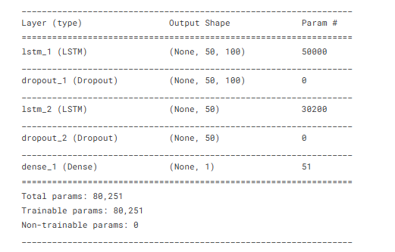
Preliminary Results

Slide 12
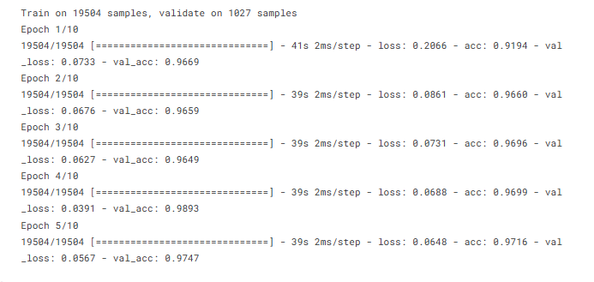

Preliminary Results

Slide 13
Results and Outputs
The model outputs a binary classification that determines whether a machine is likely to fail within a specified time frame, such as 30 days. This classification is based on the probability of failure, which is derived from analyzing historical operational data. The model predicts the probability of failure as either a “failure” (1) or “non-failure” (0), enabling the identification of critical machines that require maintenance or inspection.
The final output from the model also includes performance metrics such as accuracy, precision, recall, F1-score, and confusion matrix, which help assess the model's reliability and effectiveness in predicting failures. These metrics are essential for understanding how well the model distinguishes between failure and non-failure events, which is critical for implementing effective predictive maintenance strategies.

Slide 14

Results and Outputs

Slide 15
Conclusion
In conclusion, the predictive maintenance model based on LSTM networks effectively analyzes time-series data to predict potential equipment failures. By classifying machines into failure or non-failure categories, the model aids in scheduling maintenance proactively, minimizing downtime, and optimizing operational efficiency. With robust evaluation metrics and successful implementation, this approach presents a reliable and efficient method for enhancing industrial maintenance strategies. Future improvements could further refine accuracy and generalize the model to a wider range of applications, contributing to a more intelligent and cost-effective maintenance framework in industrial settings.

Slide 16
Future Scope
The future scope of this predictive maintenance model includes enhancing its generalizability across different industries by integrating additional sensor types and real-time data sources Improved model architectures, such as hybrid models combining LSTM with other deep learning techniques, could further refine accuracy. Additionally, expanding the model to predict multi-failure scenarios, optimizing resource allocation, and automating maintenance decision-making processes could drive more advanced solutions. Further research can also explore the use of edge computing for real-time predictions and integrating AI-based recommendations for maintenance actions, contributing to more intelligent, autonomous industrial systems.

Slide 17
References
Big data analytics for predictive maintenance strategies
CKM Lee, Y Cao, KH Ng - … Chain Management in the Big Data Era, 2017 - igi-global.com2
Predictive maintenance: How big data analysis can improve maintenance
J Daily, J Peterson - Supply chain integration challenges in commercial …, 2017 – Springer
3) Big data analytics for predictive maintenance in maintenance management
MN Razali, AF Jamaluddin, R Abdul Jalil… - Property …, 2020 - emerald.com
4) Big data analytics for predictive maintenance modeling: Challenges and opportunities
IHF Santos, MM Machado, EE Russo… - Offshore Technology …, 2015 - onepetro.org.

Slide 18
References
5) A global manufacturing big data ecosystem for fault detection in predictive maintenance
W Yu, T Dillon, F Mostafa, W Rahayu… - IEEE Transactions on …, 2019 - ieeexplore.ieee.org

