Slide 1


SMART INDIA HACKATHON 2025
Hack2Ya
Problem Statement ID – SIH25139
Problem Statement Title - Student Innovation
Theme - Disaster Management
PS Category - Software
Team ID -
Team Name (Registered on portal)

Slide 2
Hack2Ya
Hack2Ya
Proposed Solution
Emergency SOS:
A simple one-tap panic button instantly calls for help.
At the same time, it shares your live location with your emergency contacts and nearby volunteers, creating a rapid response network when every second matters.
Notifications & News:
Real-time alerts, government advisories, and safety news keep people updated.
Communities can stay informed and make quick, safe decisions during disasters.
Virtual Mock Drills:
Digital practice sessions let people rehearse safety steps anytime.
Makes disaster preparedness accessible even without physical drills.
Volunteers:
A dashboard with live maps, heat zones, and resource tracking.
Helps NGOs and authorities act faster with real-time data.
Donation:
A secure donation platform that directly connects people to verified NGOs.
Builds trust and ensures that relief reaches the right people at the right time.

Slide 3














TECHNICAL APPROACH
Hack2Ya
Technology Stack
Frontend : React Js , Redux , Tailwind Css , Zustand , Lenis , GSAP,
Shad CN
Backend : Node Js , Express Js , REST API, MongoDB , Socket IO , Flask
API Services : Government Disaster API , Gis APIs , Azure API , Weather APIs , Node Mailer ,Cloudinary , Razor Pay , Twilio
AI and ML : TensorFlow , OpenCV , Hugging Face
Cloud and Deployment : AWS , GitHub
Add-Ons: Redis , ElasticSearch , GraphQL , Postman , Jest

Slide 4
FEASIBILITY AND VIABILITY
Hack2Ya
During Floods: A villager taps the SOS button, and their location instantly reaches local authorities and family, so help can be sent quickly.
Preparedness: Students and citizens take part in virtual mock drills, learning safety steps without leaving their homes.
Real-Time Awareness: A farmer in Punjab gets a notification in Punjabi about rising water levels, giving him time to move to a safe zone.
Relief & Recovery: Families find nearby shelters and rehabilitation support on the platform after a disaster.
Transparency: A donor contributes through the app and tracks how funds are being used, building trust in the system.
Feasibility :
Use Cases :
Built on existing web, API & cloud tech → cost-effective & scalable.
Works on mobile & web → accessible even in low network.
Govt. API integration → ensures reliable & real-time data.
Accessible for rural & urban users with multilingual support.
Real-time alerts & SOS keep users constantly engaged.
Partnerships with NGOs & authorities increase adoption..
Visibility :
Challenges :
Building trust as people rely on traditional sources.
Maintaining real-time accuracy across multiple APIs.
Limited internet and digital literacy in rural areas.
Continuous funding required for scaling and maintenance.
Our platform has strong business potential as it can be adopted by governments, NGOs, and CSR partners. With donation support and scalable modules, it ensures both sustainability and long-term impact
Business Potential :
Solutions :
Partner with govt. bodies & NGOs to build credibility.
Use multiple data sources with AI validation for accuracy.
Add multilingual support, offline PWA, and community volunteers.
Ensure sustainability via donations, CSR tie-ups, and govt. grants.
Disaster We Can Handle
In the 2025 floods in Punjab, about 1,400 villages were affected across multiple districts .
Over 3.5 lakh people have been affected (around 350,000+) in those floods.

Slide 5
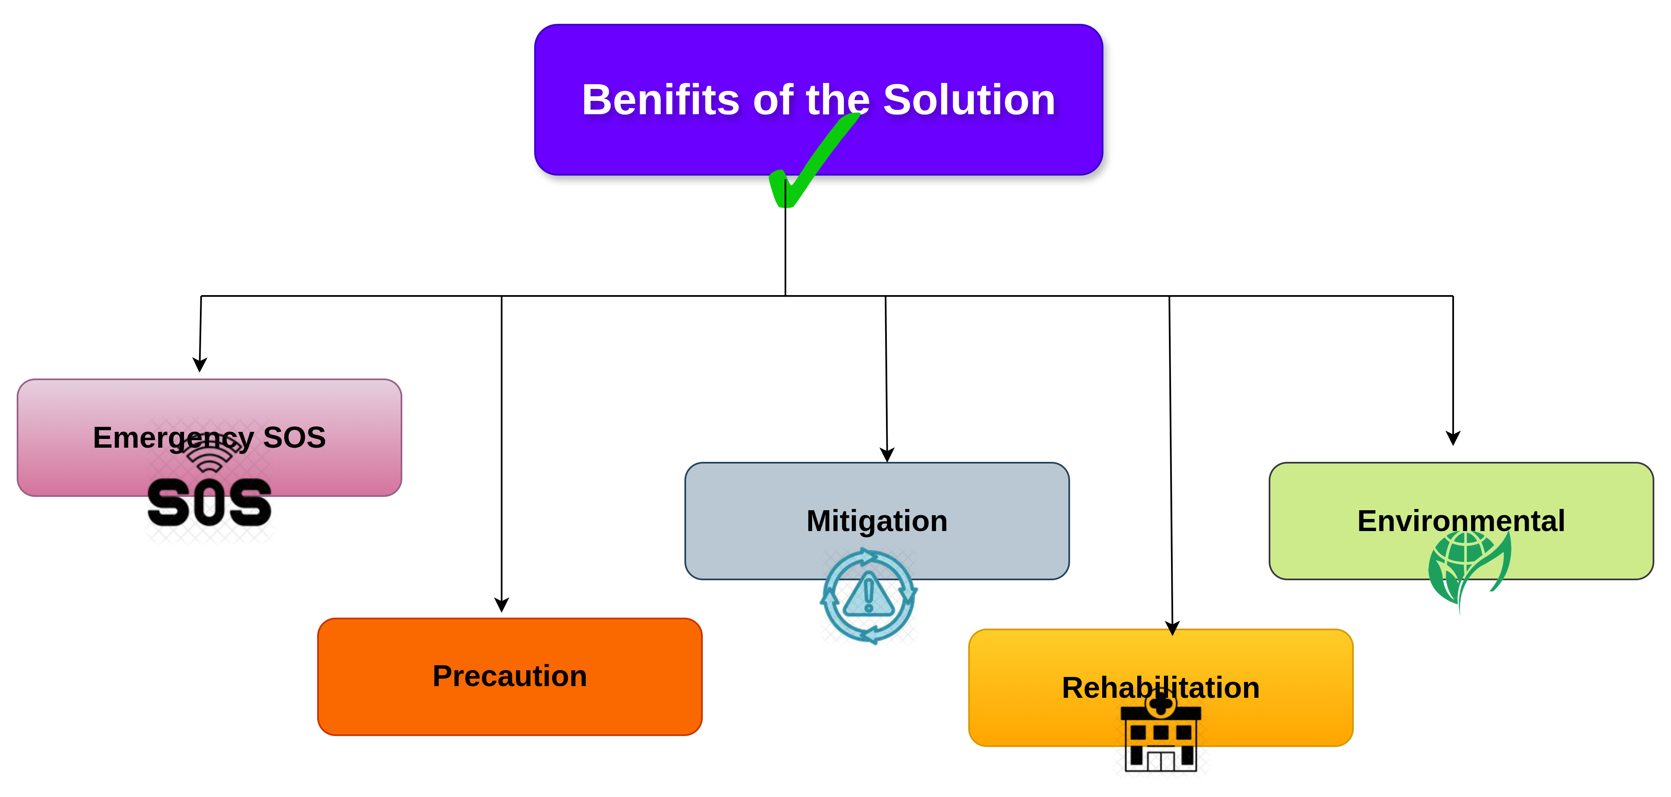
IMPACT AND BENEFITS
Hack2Ya
Emergency SOS : Our system gives people a one-tap SOS
option that directly alerts nearby rescue teams with their location.
This cuts down the time between distress and response, which
can literally save lives in flood zones.
Precaution : By combining weather forecasts and satellite flood
maps, our solution warns communities before water levels rise.
Families get enough time to move valuables, livestock, and
themselves to safer.
places.
Mitigation : Authorities can see real-time flood extent and
resource status on a single dashboard. This helps them send
boats, food, and medical kits where they are needed most,
reducing chaos and losses.
Rehabilitation : After the flood, our platform keeps track of
affected families and relief distribution. This ensures fair
rehabilitation and faster recovery without duplication or missed
support.
User Environment : We designed a clean, easy-to-use interface
and responsive website so that even in stressful situations, users
can quickly access alerts, maps, and emergency services without
confusion.
Impacts :
Benefits :
🌍 Potential Impact:
Lives Saved – faster SOS response and accurate rescue coordination reduce casualties.
Reduced Losses – early warnings help protect valuables, crops, and livestock.
Efficient Relief – resources reach the right place at the right time.
Scalable Model – solution can be adapted for floods, cyclones, earthquakes, or other disasters.

Slide 6
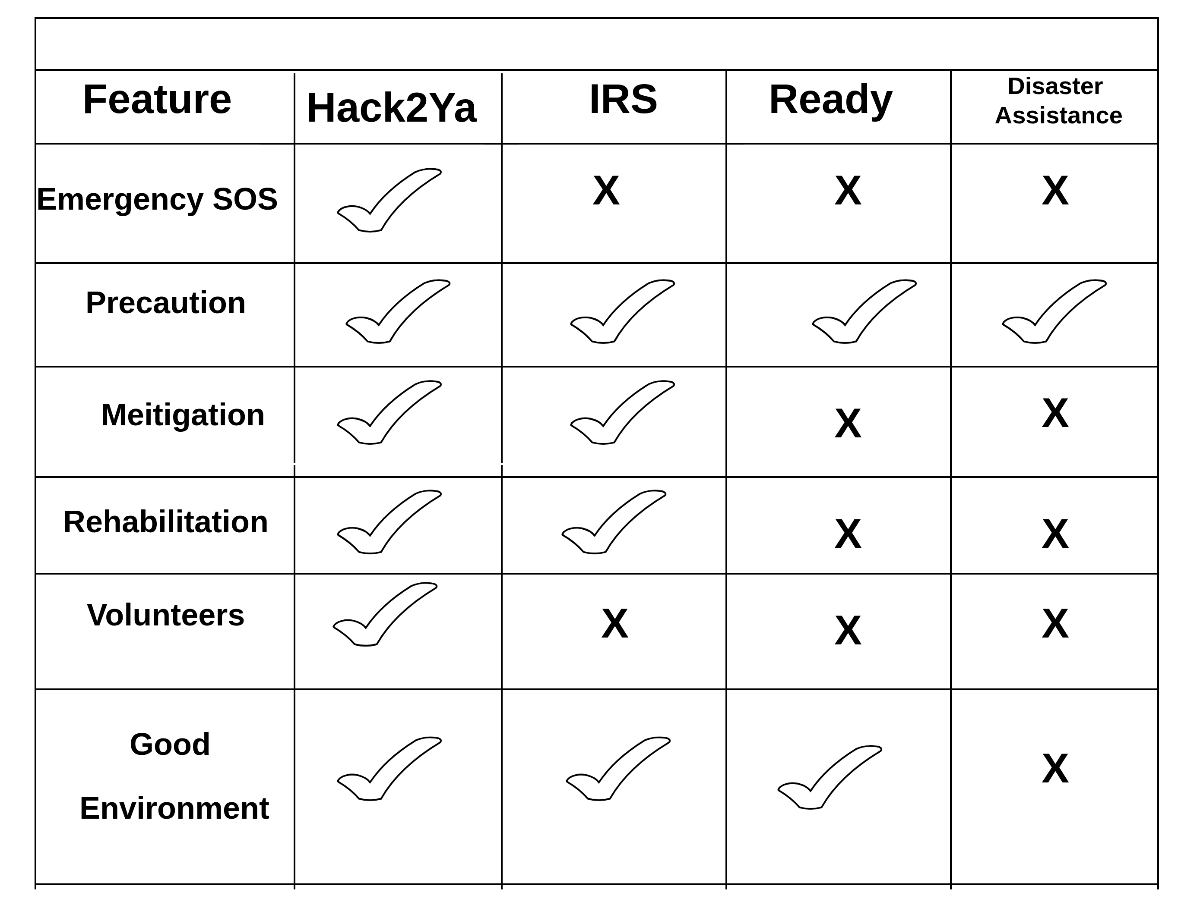
RESEARCH AND REFERENCES
Hack2Ya
Comparision with other Solutions :
Research :
Disaster Assistance : www.disasterassistance.gov/
IRS : https://www.irs.gov/
Ready : https://www.ready.gov/
References :
We studied recent floods in Punjab (2025) and their
devastating impact on villages, crops, and human lives.
Collected and analysis open-source satellite flood maps to see how real-time flood extent is detected.
Studied weather & rainfall APIs to check how flood alerts can be automated.
Research Work :

