Slide 1

INTERNSHIP REPORT
Community Service and Social Development
at Neev Shakti Sanstha
Student Name Keshav Agarwal
DURATION
Enrollment Number 25SCS1003001000
22 Jul – 13 Aug 2026
Program & Semester B.Tech CSE – AI & ML with IBM, 2nd Year, 3rd Semester
TOTAL HOURS
Organization Neev Shakti Sanstha
60 Hours
Internship Role: Community Service Intern
1

Slide 2
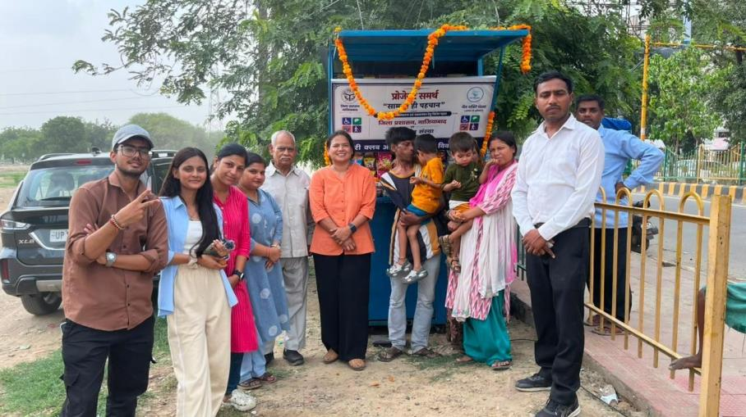
About Neev Shakti Sanstha
Organisation Introduction
A non-governmental organisation (NGO) dedicated to empowering persons with disabilities by promoting inclusion, equal opportunities, and independent living — improving quality of life through education, skill development, awareness, and access to welfare schemes.
Key Areas of Work
✓
Education & skill development for persons with disabilities
✓
Disability-rights awareness & social inclusion
Community outreach stall organised with the district administration
✓
Assistance with UDID / Aadhaar cards, certificates & pensions
✓
Educational, recreational & community engagement activities
✓
Awareness campaigns, cleanliness drives & environmental initiatives
✓
Household surveys & data analysis for welfare planning
Beneficiaries: persons with disabilities and the wider community they belong to.
2

Slide 3
Internship Objectives & Role
Bridging classroom learning with real-world social work
◎
Objectives
✦
Role: Community Service Intern
Understand the mission & working model of the NGO
Assisted staff during orientation, awareness sessions & outreach programs
Gain practical knowledge of disability inclusion & community welfare
Interacted with beneficiaries; supported educational & recreational sessions
Interact with beneficiaries and understand their needs
Participated in awareness campaigns, poster-making & Best Out of Waste
Participate in awareness campaigns & outreach activities
Took part in the community cleanliness drive
Support survey data organisation, analysis & reporting
Accompanied the NGO team on a beneficiary field visit
Develop communication, teamwork & leadership skills
Assisted in organising & reviewing household survey data
3

Slide 4
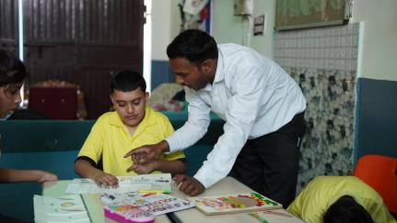
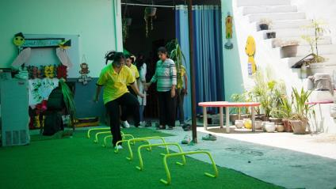
WK
Orientation and NGO Immersion
1
22 – 26 July 2026
Key Activities
Attended orientation covering the NGO's history & services
Observed staff coordinating education, counselling & welfare
Interacted directly with beneficiaries during learning sessions
Encouraged participation in simple exercises and games
Skills Developed
Communication
Observation
Teamwork
Empathy
Observation & Learning
Every beneficiary was treated with patience, respect & dignity — staff focused on building confidence and independence, not just assistance. This built a far deeper understanding of disability inclusion than theory alone.
4

Slide 5
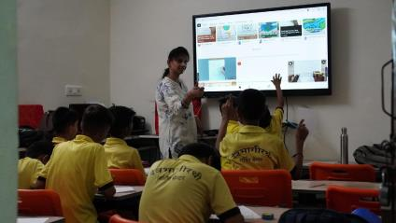
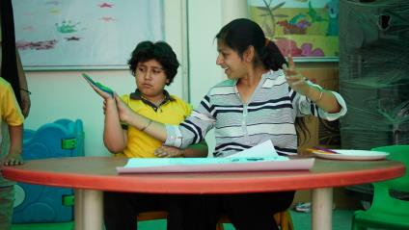
WK
Awareness, Creative Activities & Environmental Sustainability
2
28 July – 1 August 2026
Key Activities
Took part in disability-inclusion & environmental awareness sessions
Contributed to the 'Best Out of Waste' recycling activity
Helped design awareness posters (inclusion, cleanliness, environment)
Supported a creative Earth Day awareness session with beneficiaries
Skills Developed
Creativity
Coordination
Env. Awareness
Teamwork
Observation & Learning
Creative activities proved highly effective at conveying social messages, with beneficiaries showing great enthusiasm. Strengthened understanding of how environmental sustainability and disability inclusion reinforce each other.
5

Slide 6
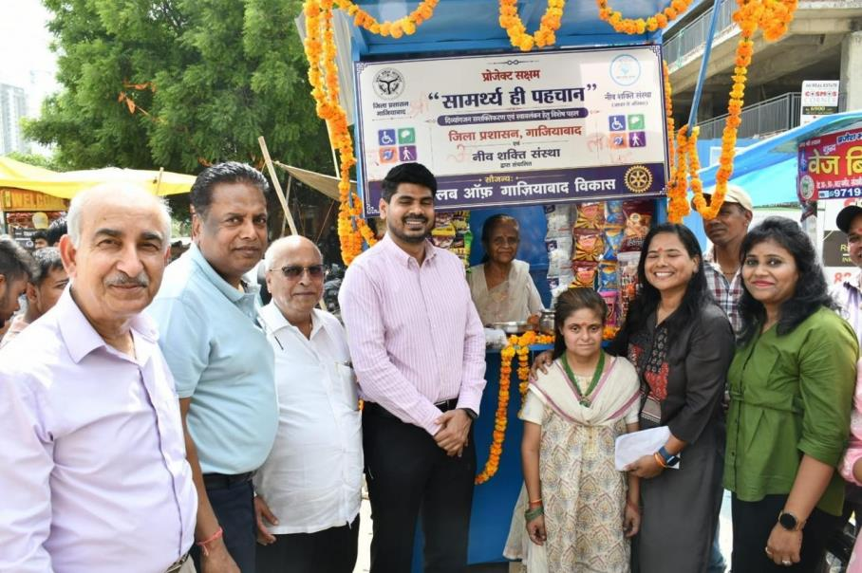
WK
Cleanliness Drive and Community Engagement
3
3 – 7 August 2026
Key Activities
Took part in a cleanliness drive promoting hygiene & participation
Collected litter alongside fellow volunteers
Joined a community outreach event with the local administration
Interacted with beneficiaries & community members at the event
Skills Developed
Communication
Teamwork
Env. Awareness
Observation & Learning
A clean environment is a shared responsibility — small collective efforts by volunteers make a real difference. Continued beneficiary interaction deepened understanding of accessibility, inclusion, and equal opportunity.
Social Responsibility
6

Slide 7

WK
Beneficiary Visit, Survey Data Analysis & Report Preparation
4
8 – 13 August 2026
Key Activities
Accompanied the NGO team on a beneficiary field visit
Observed support for livelihood & self-employment opportunities
Organised & reviewed household survey data (Aadhaar, UDID, pension, employment)
Sorted responses, checked records & helped prepare a summary
Skills Developed
Data Organisation
Documentation
Critical Thinking
Observation & Learning
Deepened understanding of the link between fieldwork and data analysis — accurate collection and systematic analysis are essential for NGOs to identify needs and plan effective welfare interventions.
Comm. Engagement
7

Slide 8
Skills & Learning Outcomes
Skills Acquired
★
Communication
★
Data Organisation
Key Learning Outcomes
Teamwork & Collaboration
Report Writing
Practical exposure to community service & disability inclusion beyond theory
★
★
★
Leadership
★
Community Engagement
Beneficiary interaction taught patience, empathy & communication
★
Problem-Solving
★
Creativity
Awareness & environmental activities showed the power of collective effort
★
Time Management
★
Environmental Awareness
Survey work reinforced evidence-based approaches, accuracy & documentation
★
Observation
★
Empathy & Social Responsibility
Strengthened social responsibility & appreciation of the NGO's role
★
Analytical Thinking
★
Adaptability
8

Slide 9
Challenges & Personal Development
Challenge → Learning → Improvement
CHALLENGE
LEARNING
IMPROVEMENT
Communicating with beneficiaries of differing needs
→
Patience & careful, sensitive interaction
→
Stronger confidence & communication
CHALLENGE
LEARNING
IMPROVEMENT
Keeping survey data accurate amid large information volumes
→
Close attention to detail
→
Sharper analytical & documentation skills
CHALLENGE
LEARNING
IMPROVEMENT
Coordinating community activities (drives, awareness sessions)
→
Time management & teamwork
→
Improved problem-solving ability
With guidance from NGO staff and consistent practice, these challenges were overcome — strengthening confidence, communication, and problem-solving abilities over the course of the internship.
9

Slide 10
Internship Journey & Conclusion
1
2
3
4
5
6
7
Orientation
Beneficiary Interaction & Awareness
Creative & Environmental Activities
Cleanliness Drive & Outreach
Beneficiary Field Visit
Survey Data & Documentation
Growth & Learning
Conclusion
This internship at Neev Shakti Sanstha was a valuable, enriching experience that revealed the real-world importance of community service, disability inclusion, and social responsibility — insights that went well beyond classroom learning.
It strengthened communication, teamwork, leadership, and analytical thinking, while deepening confidence and empathy towards persons with disabilities — a meaningful step in both personal and professional growth, and an inspiration to keep contributing to community welfare.
THANK YOU
10

