Slide 1
Life Expectancy Analysis using MLR
Keshav Elango
Het Patel

Slide 2
Data
Although there have been lot of studies undertaken in the past on factors affecting life expectancy considering demographic variables, income composition and mortality rates. It was found that affect of immunization and human development index was not taken into account in the past.
The data is taken from the kaggle website which in turn was collected from WHO and United Nations website with the help of Deeksha Russell and Duan Wang. (https://www.kaggle.com/datasets/kumarajarshi/life-expectancy-who)
The data contains information on socioeconomic factors, immunization factors, and other factors (Life expectancy, Polio , Measles, BMI, GDP, Population etc) from years 2000 - 2015.
The data contains 2938 records from 193 countries.

Slide 3
Goal
The goal of the project is to predict Life Expectancy using various factors and to determine the relationship that exists between them.
Life expectancy: the number of years that an average person can be expected to live.
To build a MLR model, interpret the results , perform residual analysis and evaluate model performance.
Identify key factors affecting life expectancy.

Slide 4
Regressors
Country:
Year:
Status : Developed or Developing status
Life Expectancy: Life Expectancy in Age
Adult mortality: Adult Mortality Rates of both sexes (probability of dying between 15 and 60 years per 1000 population)
Infant deaths : Number of Infant Deaths per 1000 population
Alcohol: Alcohol, recorded per capita (15+) consumption (in litres of pure alcohol)
Percentage expenditure: Expenditure on health as a percentage of Gross Domestic Product per capita(%)
Hepatitis : Hepatitis B (HepB) immunization coverage among 1-year-olds (%)
Measles : Measles - number of reported cases per 1000 population
BMI: Average Body Mass Index of entire population

Slide 5
Under five deaths: Number of under-five deaths per 1000 population
Polio : Polio (Pol3) immunization coverage among 1-year-olds (%)
Total Expenditure: General government expenditure on health as a percentage of total government expenditure (%)
Diphtheria : Diphtheria tetanus toxoid and pertussis (DTP3) immunization coverage among 1-year-olds (%)
HIV/AIDS: Deaths per 1 000 live births HIV/AIDS (0-4 years)
GDP: Gross Domestic Product per capita (in USD)
Population: Population of the country
thinness 1-19 years: Prevalence of thinness among children and adolescents for Age 10 to 19 (% )
thinness 5-9 years: Prevalence of thinness among children for Age 5 to 9(%)
Income Composition of Resources: Human Development Index in terms of income composition of resources (index ranging from 0 to 1)
Schooling: Number of years of Schooling(years)

Slide 6
Descriptive Statistics
The Country with highest Life expectancy was Belgium (89)
The Country with Least Life expectancy was Haiti (36.3)
The Country with Highest Adult Mortality was Zimbabwe
The Country with Least Adult Mortality was Albania

Slide 7
Multiple Linear Regression
In practical problems, involving historical data, there is a large pool of possible independent variables which is often referred to as the variable selection problem.
Our aim is to build a model with high R-square and less √MSE
We use selection-type procedures to tackle the variable selection problem.
The goal here is to determine the independent variables/regressors which have a significant impact on our target variable (Life Expectancy).
We have applied the forward selection, backward elimination and stepwise regression procedures with the different values of 𝛼 (0.05, 0.10).

Slide 8
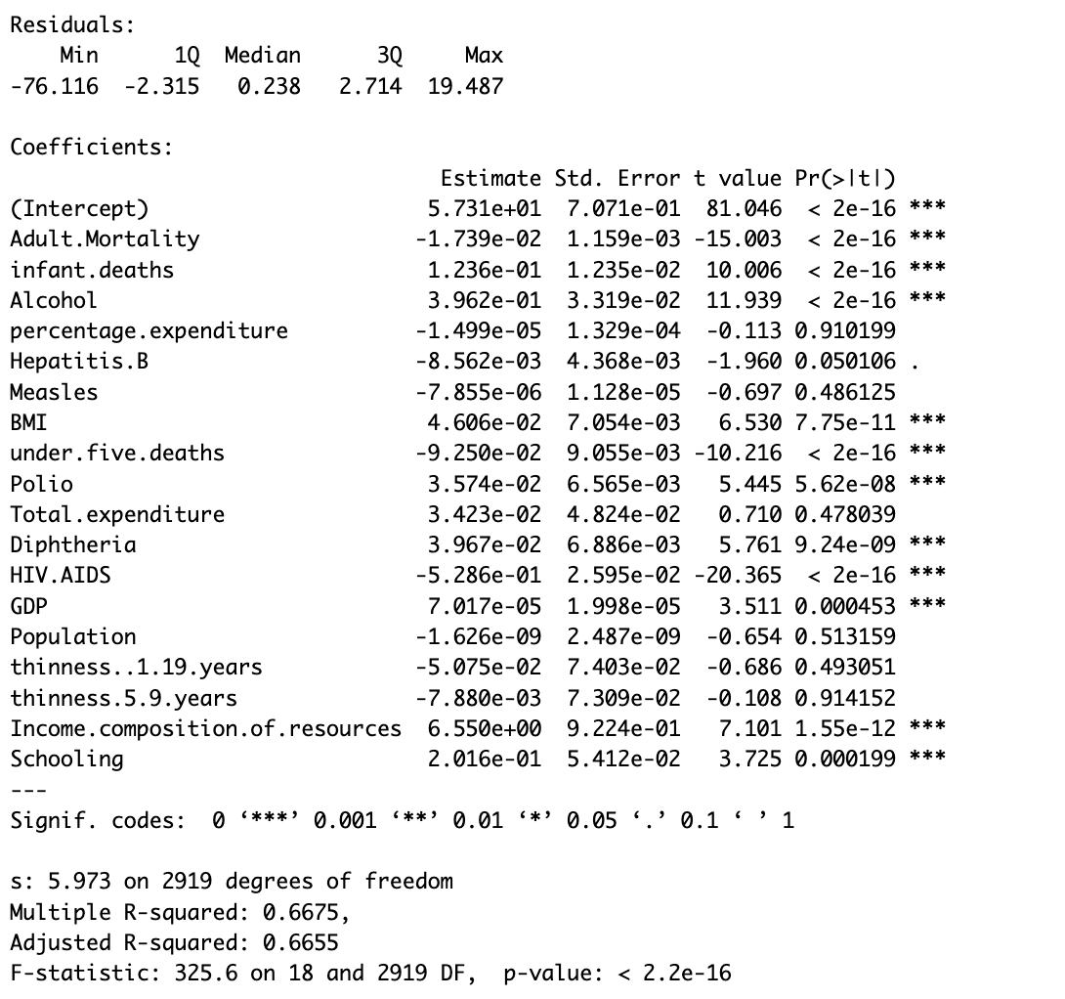
Full Model
The Full model with the parameters has a Multiple R-squared value of 0.6675 and adjusted R-Squared value of 0.6655
It has an F-stat value of 325.6 with 18 and 2919 degrees of Freedom.
The p-value is < 2.2 e-16

Slide 9
Backward Selection
There were 6 variables that were not contributing much to the model which were eliminated.
In backward selection, for 0.05,
First Step: thinness.5.9.years 1 0.4 104150 10519 0.0116 0.9141519
Deleted “thinness.5.9.years” first as it has highest p-value, making it less significant.
Second step, percentage.expenditure 1 0.5 104150 10517 0.0129 0.9095353
Deleted “percentage.expenditure“ next with next highest p-value, making it less significant
Third Step:Population 1 15.2 104166 10516 0.4256
Deleted “Population” next as it has next highest p-value, making it less significant

Slide 10
Fourth Step: Measles 1 16.2 104182 10514 0.4539 0.5005273
Deleted “Measles” next as it has next highest p-value, making it less significant
Fifth Step: Total.expenditure 1 19.9 104202 10512 0.5579 0.4551616
Deleted “Total.expenditure” next as it has next highest p-value, making it less significant
Sixth Step: thinness..1.19.years 1 111.4 104313 10514 3.1266 0.077128
Deleted “thinness..1.19.years” next as it has next highest p-value, making it less significant
In case of backward selection, for 0.10, the sixth step doesnt happen leading to “thinness..1.19.years” being included in Model

Slide 11
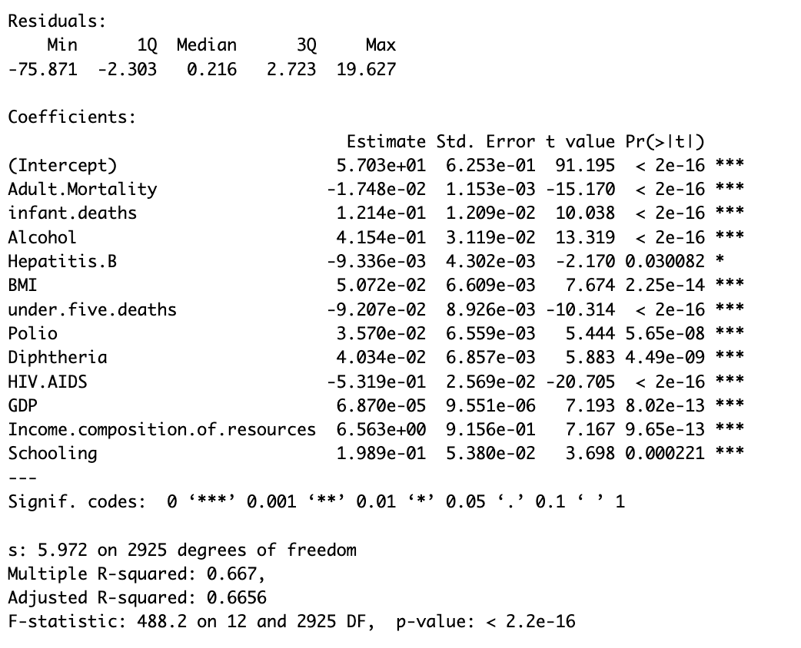
Here, the F-statistic is 451.2 with a very low p-value (< 2.2e-16), indicating that the overall model is statistically significant.
Overall, the final model using backward selection shows a good fit to the data, with all predictor variables being statistically significant in predicting Life Expectancy

Slide 12
Full model vs Final Model
Your final model includes 12 predictor variables: Adult Mortality, Infant Deaths, Alcohol, Hepatitis B, BMI, Under-Five Deaths, Polio, Diphtheria, HIV/AIDS, GDP, Income Composition of Resources, and Schooling.
The full model includes additional predictor variables such as Percentage Expenditure, Measles, Total Expenditure, Population, Thinness (1-19 years), and Thinness (5-9 years).
The coefficients in both models represent the estimated effects of each predictor variable on Life Expectancy.
In both models, all predictor variables are significant at the 0.05 level except for some variables in the full model like

Slide 13
Percentage Expenditure,
Hepatitis B,
Measles,
Total Expenditure,
Population, Thinness (1-19 years), and
Thinness (5-9 years),
which have higher p-values (> 0.05), indicating they may not be statistically significant predictors.
Both models have similar multiple R-squared values, indicating that they explain approximately the same amount of variance in Life Expectancy (around 66.7%).
The full model has a slightly higher number of predictor variables but does not significantly improve the model fit compared to final model.
This is evident from the similar multiple R-squared and adjusted R-squared values between the two models.
F-stat: Full Model(325.6 on 18 and 2919 DF), Final Model (488.2 on 12 and 2925 DF)

Slide 14
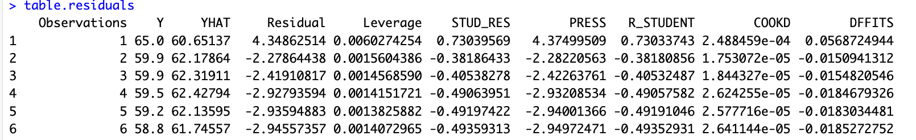
Residual Analysis
While building up the MLR model to predict, we have made some assumptions where the model is expected to perform well if all the assumptions are correct. Else its performance can be extremely bad. We check the following assumptions with help of Residual Analysis.
relationship between the response y and the regressors is linear.
The errors are normally distributed with mean 0 and constant variance.
The errors are uncorrelated.

Slide 15
By creating this table, we can inspect various metrics and statistics related to model performance, residuals, leverage, and influence of observations, which can help you assess the quality and reliability of your linear regression model.
Observation 1:
Comparing the residuals, the majority of the values are near zero, indicating it is a good fit.
Also the Leverage points are relatively small indicating the model is not being overly influenced by the observation.
Observation 2:
Most of the Studentized residual values are less than 3 except for Observations 2089, 2093, 2094.
Hence we can conclude that the data points are reliable except those 3 values.
> table.residuals %>% filter(STUD_RES >3)
Observations Y YHAT Residual Leverage STUD_RES PRESS R_STUDENT COOKD DFFITS
2089 2089 82 63.94575 18.05425 0.005240896 3.031195 18.14937 3.035448 0.003723678 0.2203265
2093 2093 87 67.37318 19.62682 0.006045545 3.296553 19.74620 3.302130 0.005084472 0.2575305
2094 2094 86 67.22740 18.77260 0.005943983 3.152916 18.88485 3.157747 0.004572441 0.2441804

Slide 16
Observation 3:
R-student follow t-distribution with (n-p-1) degrees of freedom. (2924 df)
Hence at 5% level the t-value is 1.645375.
In our dataset, we have only 55 points above the t-value and can be considered as outliers.
> r_thresh <- qt(0.95,summary(mdl_final)$df[2])
> r_thresh
[1] 1.645375
> r_std_outlier <- table.residuals %>% filter(R_STUDENT > r_thresh)
55 Observations are outliers.

Slide 17
Observation 4:
From the observations, Cook's distance seems to be relatively small.
None of the values are above the acceptable Cook’s distance (all values are less than 1)
Observation 5:
DFFITS is measure the influence as well and it is only a suspect if it is higher than 2*sqrt(p / n)
dffit_thresh = 2*sqrt(p / n) # 0.133038
> dffit_outlier <- table.residuals %>% filter(abs(DFFITS) > dffit_thresh)
> View(dffit_outlier)
dffit_outlier -> 130 observations.

Slide 18
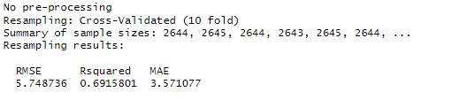
Cross Validation
We perform k fold cross validation on our model to assess the performance of our model
These metrics provide insights into the performance of the linear regression model. Lower values of RMSE and MAE indicate better predictive performance, while higher values of Rsquared indicate a better fit of the model to the data.
Overall, the cross-validated linear regression model appears to perform reasonably well. These metrics provide insights into the performance of the linear regression model. An RMSE of 5.75 suggests that, on average, the model's predictions are off by approximately 5.75 units. An R-squared of 0.692 indicates that around 69.2% of the variance in the dependent variable is explained by the independent variables in the model. And an MAE of 3.57 suggests that, on average, the model's predictions are off by approximately 3.57 units.
Notes:
The magnitude of this difference can give you insights into the spread and distribution of errors in your model's predictions. If the RMSE is significantly larger than the MAE, it might suggest that the model is making larger errors for some samples, possibly due to outliers or specific patterns in the data.

Slide 19
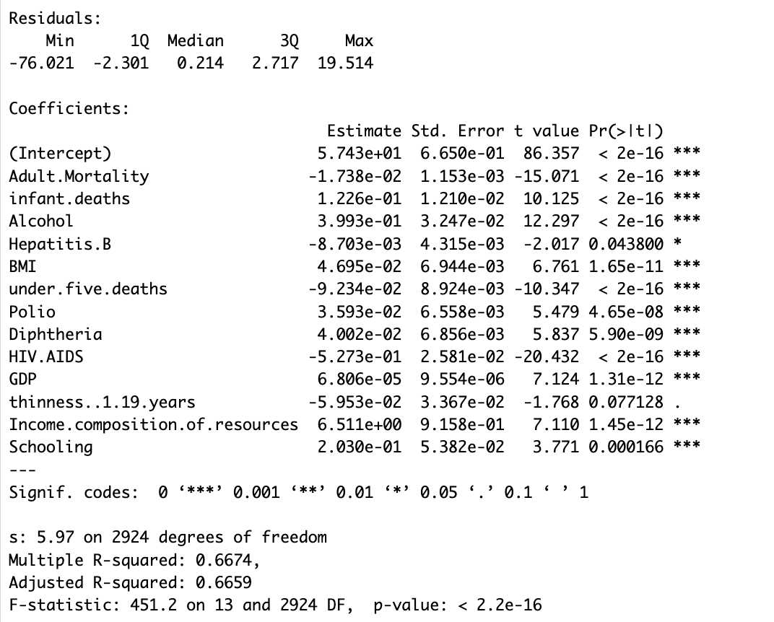
Final Model with thinness..1.19 years
When the backward elimination is performed with the alpha value as 0.10, the thinness..1.19 years variable would be retained as a significant variable as it has a p-value of 0.077.
The R-square and adjusted R-square remains the same however we are able to observe a difference in the F-stat value.
F-stat:
With thinness (451.2 on 13 and 2924 DF)
Without thinness (488.2 on 12 and 2925 DF)

Slide 20
Coefficient Interpretation- without thinness
Intercept: The intercept is 57.03. This represents the estimated life expectancy when all predictor variables are zero. However, in real-world terms, this value may not have a meaningful interpretation since many of the predictors can't realistically be zero.
Adult Mortality: For every one unit increase in adult mortality, life expectancy is estimated to decrease by 0.01748 years.
Infant Deaths: For every one unit increase in infant deaths, life expectancy is estimated to increase by 0.1214 years.
Alcohol: For every one unit increase in alcohol consumption, life expectancy is estimated to increase by 0.4154 years.
Hepatitis B: For every one unit increase in Hepatitis B prevalence, life expectancy is estimated to decrease by 0.009336 years. This coefficient is statistically significant (indicated by '*').
BMI (Body Mass Index): For every one unit increase in BMI, life expectancy is estimated to increase by 0.05072 years.
Notes:
Country
Year
Status : Developed or Developing status
Life Expectancy: Life Expectancy in Age
Adult mortality: Adult Mortality Rates of both sexes (probability of dying between 15 and 60 years per 1000 population)
Infant deaths : Number of Infant Deaths per 1000 population
Alcohol: Alcohol, recorded per capita (15+) consumption (in litres of pure alcohol)
Percentage expenditure: Expenditure on health as a percentage of Gross Domestic Product per capita(%)
Hepatitis : Hepatitis B (HepB) immunization coverage among 1-year-olds (%)
Measles : Measles - number of reported cases per 1000 population
BMI: Average Body Mass Index of entire population

Slide 21
Under-Five Deaths: For every one unit increase in deaths under the age of five, life expectancy is estimated to decrease by 0.09207 years.
Polio: For every one unit increase in polio immunization coverage, life expectancy is estimated to increase by 0.0357 years.
Diphtheria: For every one unit increase in diphtheria immunization coverage, life expectancy is estimated to increase by 0.04034 years.
HIV/AIDS: For every one unit increase in HIV/AIDS prevalence, life expectancy is estimated to decrease by 0.5319 years.
GDP (Gross Domestic Product): For every one unit increase in GDP, life expectancy is estimated to increase by 0.0000687 years.
Income Composition of Resources: For every one unit increase in income composition of resources, life expectancy is estimated to increase by 6.563 years.
Schooling: For every one unit increase in average schooling years, life expectancy is estimated to increase by 0.1989 years.
Notes:
Under five deaths: Number of under-five deaths per 1000 population
Polio : Polio (Pol3) immunization coverage among 1-year-olds (%)
Total Expenditure: General government expenditure on health as a percentage of total government expenditure (%)
Diphtheria : Diphtheria tetanus toxoid and pertussis (DTP3) immunization coverage among 1-year-olds (%)
HIV/AIDS: Deaths per 1 000 live births HIV/AIDS (0-4 years)
GDP: Gross Domestic Product per capita (in USD)
Population: Population of the country
thinness 1-19 years: Prevalence of thinness among children and adolescents for Age 10 to 19 (% )
thinness 5-9 years: Prevalence of thinness among children for Age 5 to 9(%)
Income Composition of Resources: Human Development Index in terms of income composition of resources (index ranging from 0 to 1)
Schooling: Number of years of Schooling(years)

Slide 22
Conclusion
The model without the thinness is the better one..
Final Model without thinness variable:
Life.expectancy = 57.03 - 1.748e-02 * Adult.Mortality + 1.214e-01 * infant.deaths
+ 4.154e-01 *Alcohol - 9.336e-03 * Hepatitis.B + 5.072e-02 *BMI
- 9.207e-02 * under.five.deaths
+ 3.570e-02 *Polio + 4.034e-02 *Diphtheria - 5.319e-01 * HIV.AIDS
+ 6.870e-05 * GDP + 6.563e+00 * Income.composition.of.resources
+ 1.989e-01 *Schooling + Error
The Income Composition of Resources (Human Development Index in terms of income
composition of resources (index ranging from 0 to 1) ) has more impact whereas GDP has less impact on the life expectancy.

