Slide 1
Gridlock AI
Automated Real-Time Traffic Violation Enforcement
Gridlock Hackathon 2.0

Slide 2
The Problem
Manual traffic enforcement is impossible to scale.
Existing AI solutions are fragmented (single-use models for a single violation type).
Running multiple massive AI models on a single camera feed destroys computational efficiency and edge-device feasibility.

Slide 3
Our Solution: The Unified Pipeline
An Orchestrator pipeline that ingests an image once and detects 7 violations simultaneously.
Identifies the offense (Helmet, Seatbelt, Red Light, Wrong Side, etc.).
Automatically crops and extracts the License Plate using OCR.
Logs annotated photographic evidence into a searchable SQLite database in milliseconds.

Slide 4
Architecture & Engineering
Hybrid AI Approach:
Trained lightweight YOLOv8 Nano models locally for high-speed edge inference (Helmets/Seatbelts).
Utilize Cloud APIs (Roboflow) for complex environmental detection (Parking/Wrong-side).
Smart Logic Layers (Our Secret Sauce):
Instead of training redundant heavy AI models for Triple Riding or Stop-Lines, we built mathematically efficient clustering and geometry layers directly on top of the base detections.

Slide 5
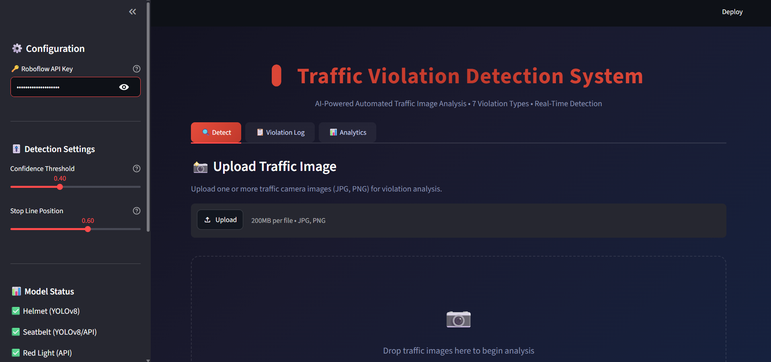
The Gridlock Dashboard
A production-ready, dark-mode Streamlit interface.
Detect Tab: Live annotated bounding boxes and violation summaries.
Analytics Tab: Live performance metrics, charts, and YOLO mAP scores.
Violation Log: Searchable SQLite database of all captured offenders.

Slide 6
Scalability & Future Work
Edge Scalability: The Nano pipeline can be deployed directly on NVIDIA Jetson devices at intersections.
RTSP Video Stream support for real-time live-camera processing.
Direct API integration with government e-Challan enforcement databases.
Multi-camera vehicle tracking across city intersections.

