Slide 1

IPL Mania
-By Team 6

Slide 2
TEAM
1. Priyanshu Jaiswal - 21CS8106 2. Sugnik Mukherjee - 21CS8116 3. Abbadasari Satish - 21CS8126 4. Ashutosh Kumar - 21CS8136 5. Daki Jithin Siva - 21CS8146 6. Challa Venkata Yashaswi - 21CS8156 7. Keshav Jha - 21CS8166 8. CVNL Sravanti - 21CS8176 9. Abhijit Kumar Sinha - 21CS8186 10. Poorab Kumar - 21CS8196

Slide 3
Description
Our project leverages extensive cricket data, including ball-to-ball and match statistics, to create an interactive web platform. Using a robust DBMS, we organize and manage this data efficiently. Our frontend is developed using ReactJS, offering a dynamic user interface, while Postgres serves as the backend database, providing scalable storage for the diverse cricket statistics.
The platform features interactive data visualizations, detailed match analysis, and advanced search capabilities, enabling users to explore player performances, match dynamics, and historical trends seamlessly.

Slide 4
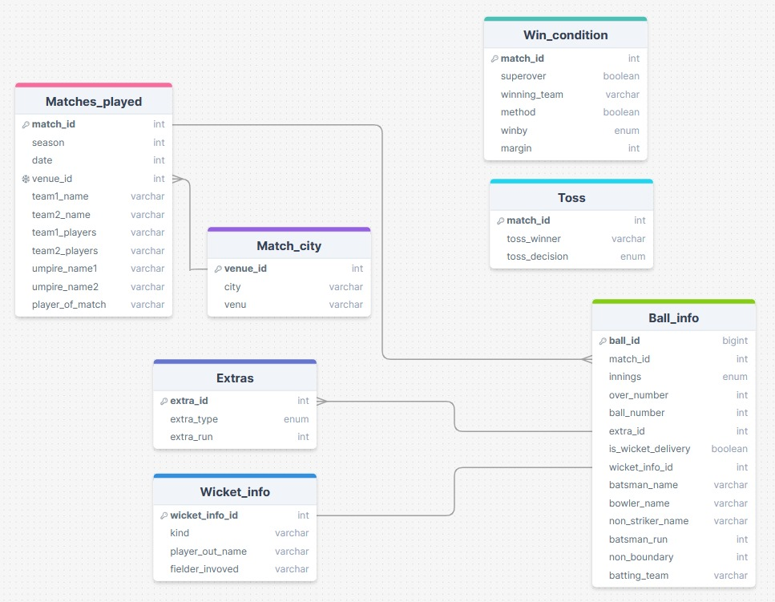
RELATIONAL SCHEMA

Slide 5
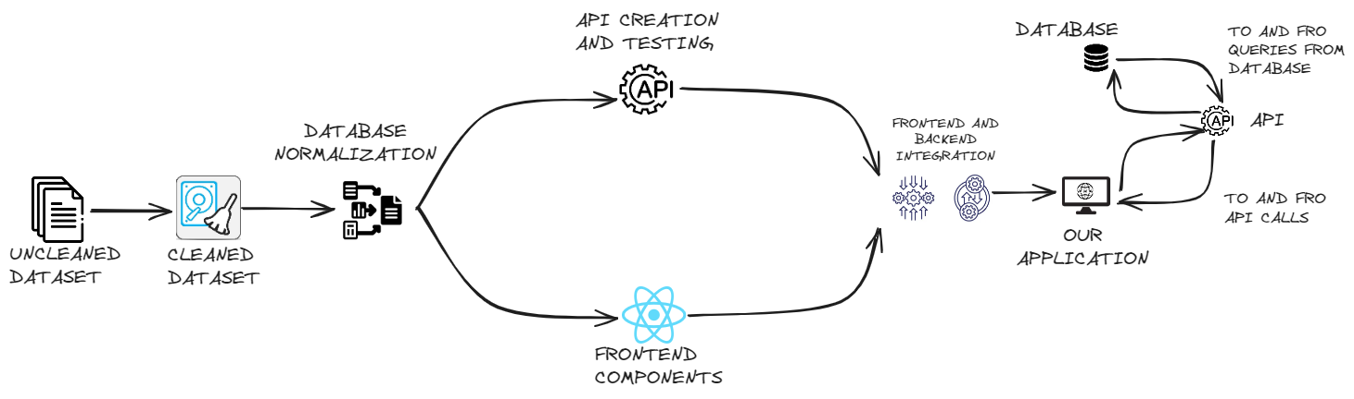
SYSTEM DESIGN

Slide 6









TECHNOLOGIES USED

Slide 7
API INFO
Top Bowlers Details
Endpoint: /get_top_bowlers
Description: Retrieves details of the top bowlers based on the number of wickets taken.
Top Batters Details
Endpoint: /get_top_batter
Description: Retrieves details of the top batters based on the total runs scored.
Boundary Details
Endpoint: /get_boundary_details
Description: Retrieves details of the number of fours and sixes scored by batters.
Top Bowlers Details for a Specific Season
Endpoint: /get_top_bowlers/:season
Description: Retrieves details of the top bowlers for a specific season based on the number of wickets taken.

Slide 8
API INFO
Top Batters Details for a Specific Season
Endpoint: /get_top_batter/:season
Description: Retrieves details of the top batters for a specific season based on the total runs scored.
Boundary Details for a Specific Season
Endpoint: /get_boundary_details/:season
Description: Retrieves details of the number of fours and sixes scored by batters for a specific season.
Win Details for a Specific Season
Endpoint: /get_win_details/:season
Description: Retrieves details of wins and losses for each team in a specific season.
Top Bowlers Details for a Specific Team
Endpoint: /get_top_bowlers/:teamname
Description: Retrieves details of the top bowlers for a specific team based on the number of wickets taken against opponents.

Slide 9
API INFO
Top Batters Details for a Specific Team
Endpoint: /get_top_batter/:teamname
Description: Retrieves details of the top batters for a specific team based on the total runs scored against opponents
Boundary Details for a Specific Team
Endpoint: /get_boundary_details/:teamname
Description: Retrieves details of the number of fours and sixes scored by batters for a specific team.
Win-Loss Details for a Specific Team
Endpoint: /get_win_details/:teamname
Description: Retrieves details of matches won and lost by a specific team in each season.
Error Handling
In case of any errors, the API will respond with a 500 Internal Server Error along with an error message in the response body.

Slide 10




TEAM ROLES
SCHEMA DESIGN
Sugnik
Keshav
FRONTEND
Priyanshu
Satish
Jithin
Yashaswi
Sravanti
Poorab
Abhijit
Ashutosh
BACKEND
Keshav
Sugnik
PPT Presentation
Sravanti
Yashaswi

Slide 11
THANK YOU.

