Slide 1

E-Commerce Customer Segmentation Dashboard
Data Analytics Project for Strategic Business Insights

Slide 2
Key Business Metrics
High-level performance indicators showing strong engagement and substantial revenue generation
$863K
5,000
500
$172.60
Total Revenue
Total Orders
Active Customers
Average Order Value
Generated from 5,000 orders across 500 unique customers
Completed transactions processed through the platform
Unique individuals making purchases in the current period
Per-transaction revenue indicating strong basket size

Slide 3
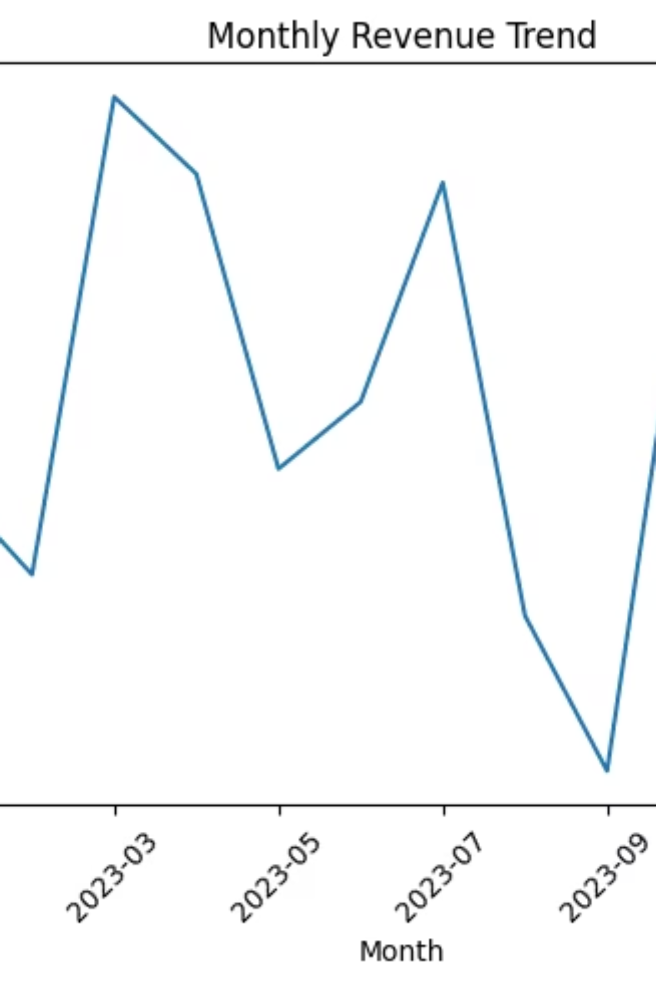
Monthly Revenue Trend
Revenue pattern showing seasonal peaks and troughs throughout the year
Revenue Pattern
Key Observations
The trend shows seasonal peaks and troughs throughout the year, with notable increases during promotional periods
Q4 shows strongest performance, likely driven by holiday shopping season and year-end promotions
Opportunities
Consider targeted campaigns during lower-revenue months to smooth out seasonal fluctuations

Slide 4
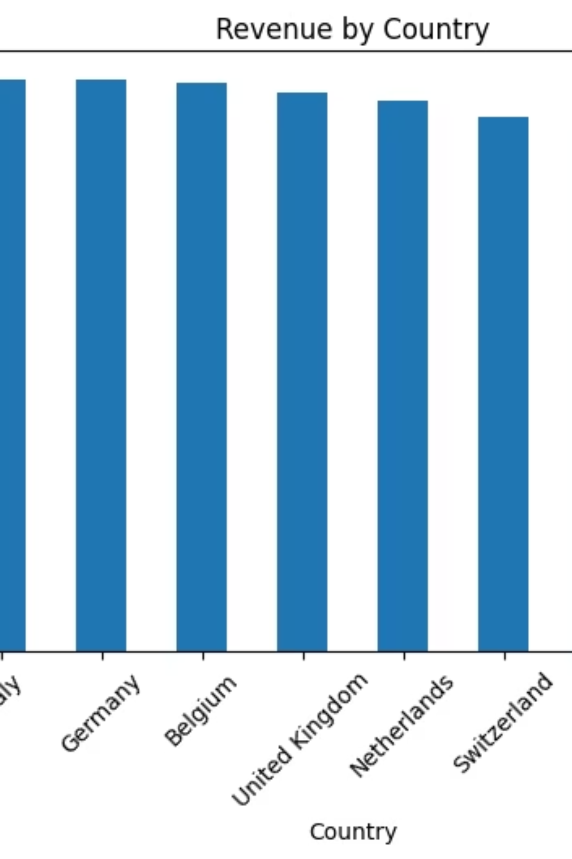
Revenue by Country
Geographic distribution showing concentration in certain markets
Market Insights
Strategic Implications
Revenue distribution shows concentration in certain markets, with clear tier structure by geographic region
Top-performing countries likely benefit from established logistics and marketing presence. Emerging markets show untapped potential for expansion.

Slide 5
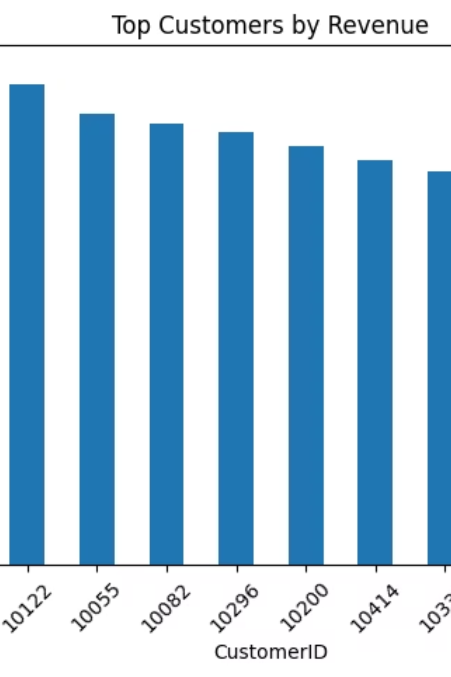
Top Customers
High-value customers driving disproportionate revenue, with significant gaps between tiers
Loyal Customer Base
Segmentation Strategy
Top customers show consistent purchasing patterns and high lifetime value
Consider creating platinum tier for top 10 customers with exclusive benefits
Retention Focus
Personalized communication and early access to new products could increase retention

