Slide 1
Population Census and Demographics Insights Analytics System – Capstone
Keshav U Kartha

Slide 2
Problem Statement & Project Objectives
An end-to-end analytics solution using Python, Pandas, Databricks, Airflow and Power BI to convert raw census evidence into policy-ready insights.
Project Objectives
  Design and implement an end-to-end robust data analytics pipeline following a medallion architecture using databricks as the compute and storage backbone, airflow for orchestration, spark and pandas for analytics and Power BI for a visual representation of key insights derived.
  Derive highly insightful metrics from the data useful for a variety of stakeholders interested in this domain.

Slide 3
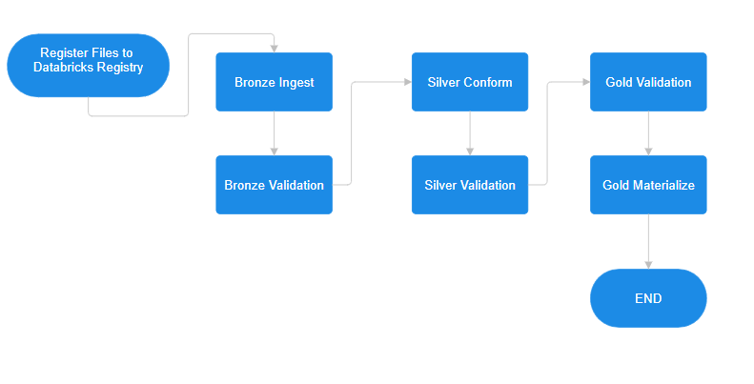
Solution Architecture (High Level)

Slide 4
Salient Features of the Solution
A production-style census analytics system designed with reliability, scalability, and analytical depth as core principles.
Medallion Architecture (Bronze → Silver → Gold)
Robust File Registry & Batch-Driven Ingestion
Strong Data Validation Layer
Validation-Driven Orchestration Logic
Intelligent Retry & Failure Handling
Slowly Changing Dimension (SCD-2) Person Modeling
Advanced Gold-Layer Analytics

Slide 5
Implementation Overview – End-to-End Pipeline
Raw census files are registered, fingerprinted, and versioned before ingestion
Bronze layer captures immutable raw records with ingestion metadata
Validation notebooks formally assess data quality before downstream processing
Silver layer performs canonicalization, deduplication, and entity modeling
Gold layer produces analytics-ready facts, indicators, and insight tables
Power BI consumes only curated Gold tables for reporting

Slide 6
Implementation – Bronze Layer (Ingestion & Quality Control)
File registry maintains ingestion state, row counts, checksums, and attempt history
Bronze ingestion writes raw census data exactly as received, without business logic
All records are tagged with ingestion batch IDs and source file references
Bronze validation enforces hard data quality rules before allowing progression
Validation reports and audit tables capture every execution outcome

Slide 7
Implementation – Silver Layer (Conformance & Data Modeling)
Deterministic entity resolution merges duplicate census records
Slowly Changing Dimension (SCD-2) logic preserves historical changes
Household-level aggregates are derived from person-level facts
A lineage table maps every canonical person back to raw records

Slide 8
Implementation – Gold Layer (Analytics & Insight Engineering)
Population and demographic fact tables
Literacy and employment indicator tables
Income distribution and inequality metrics
Education-level distributions and cross-analysis
Statistical small-area smoothing estimates
Flattened reporting tables for BI consumption

Slide 9
Implementation – Workflow Orchestration with Airflow
Manual trigger ensures controlled execution
Preflight checks prevent missing dependency failures
Validation-driven branching governs pipeline behavior
Intelligent retry policies handle transient failures
Failures are immediately surfaced with detailed logs
The pipeline never silently stalls or partially succeeds

Slide 10
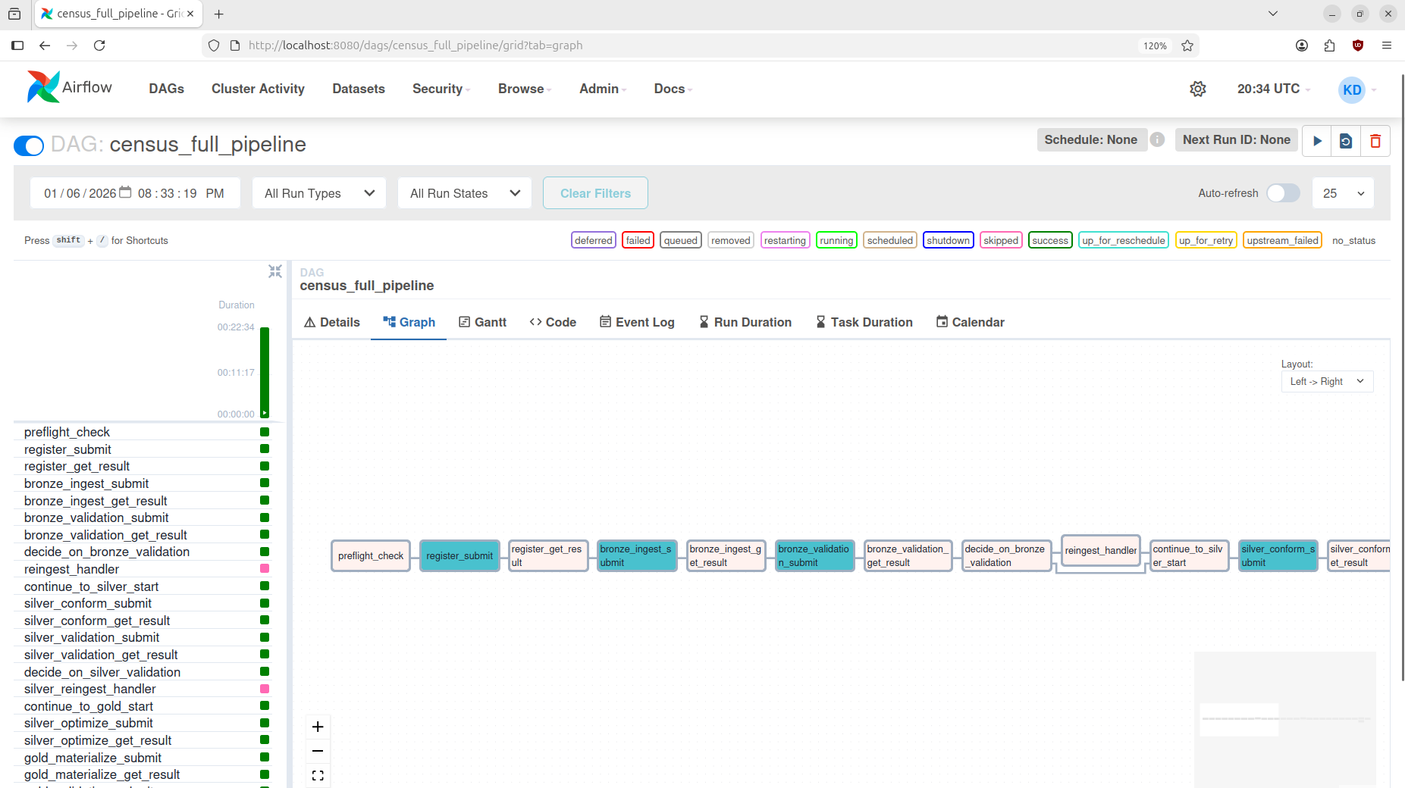

Demo Screenshot

Slide 11
Results & Business Value Delivered
Automated quality enforcement and auditability
Demographic and socio-economic indicators
Regional and temporal trend visibility
Decision-ready datasets powering interactive dashboards

Slide 12
Future Scope & Enhancements
Integration with agentic AI frameworks to enable natural-language querying of Gold data, allowing stakeholders to generate instant business insights using simple English prompts.
Can be used for human development planning
Advanced anomaly detection and outlier models
Machine learning for population forecasting
Automated data quality scoring frameworks

