Slide 1


SMART INDIA HACKATHON 2025
AUTOMATIC FABRIC INSPECTION SYSTEM FOR TEXTILE INDUSTRY
Problem Statement ID – SIH25118
Problem Statement Title – Student Innovation
Automatic Fabric Inspection System for Textile
Industry
Theme – Smart Automation
PS Category – Hardware
Team ID - 75056
Team Name - FabSpector

Slide 2
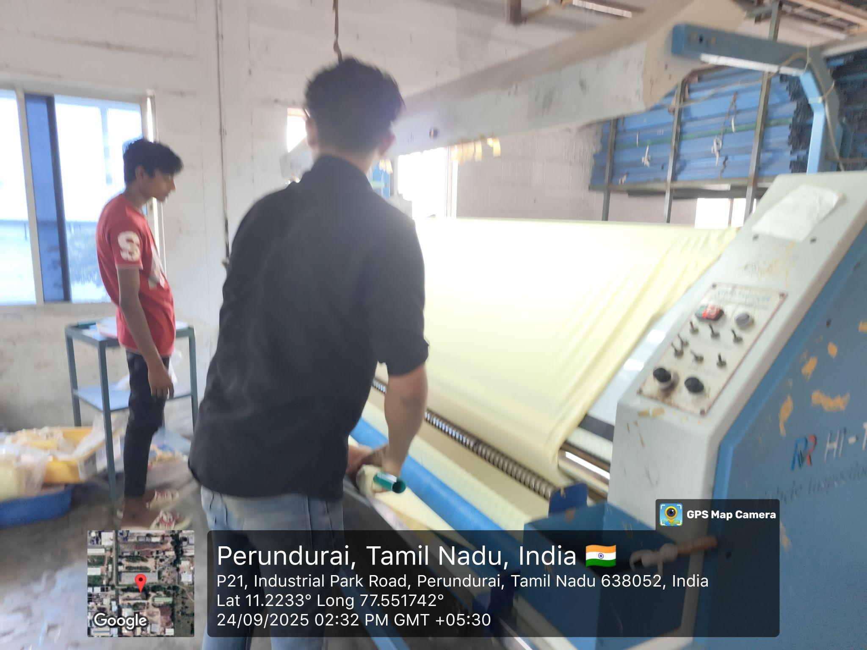
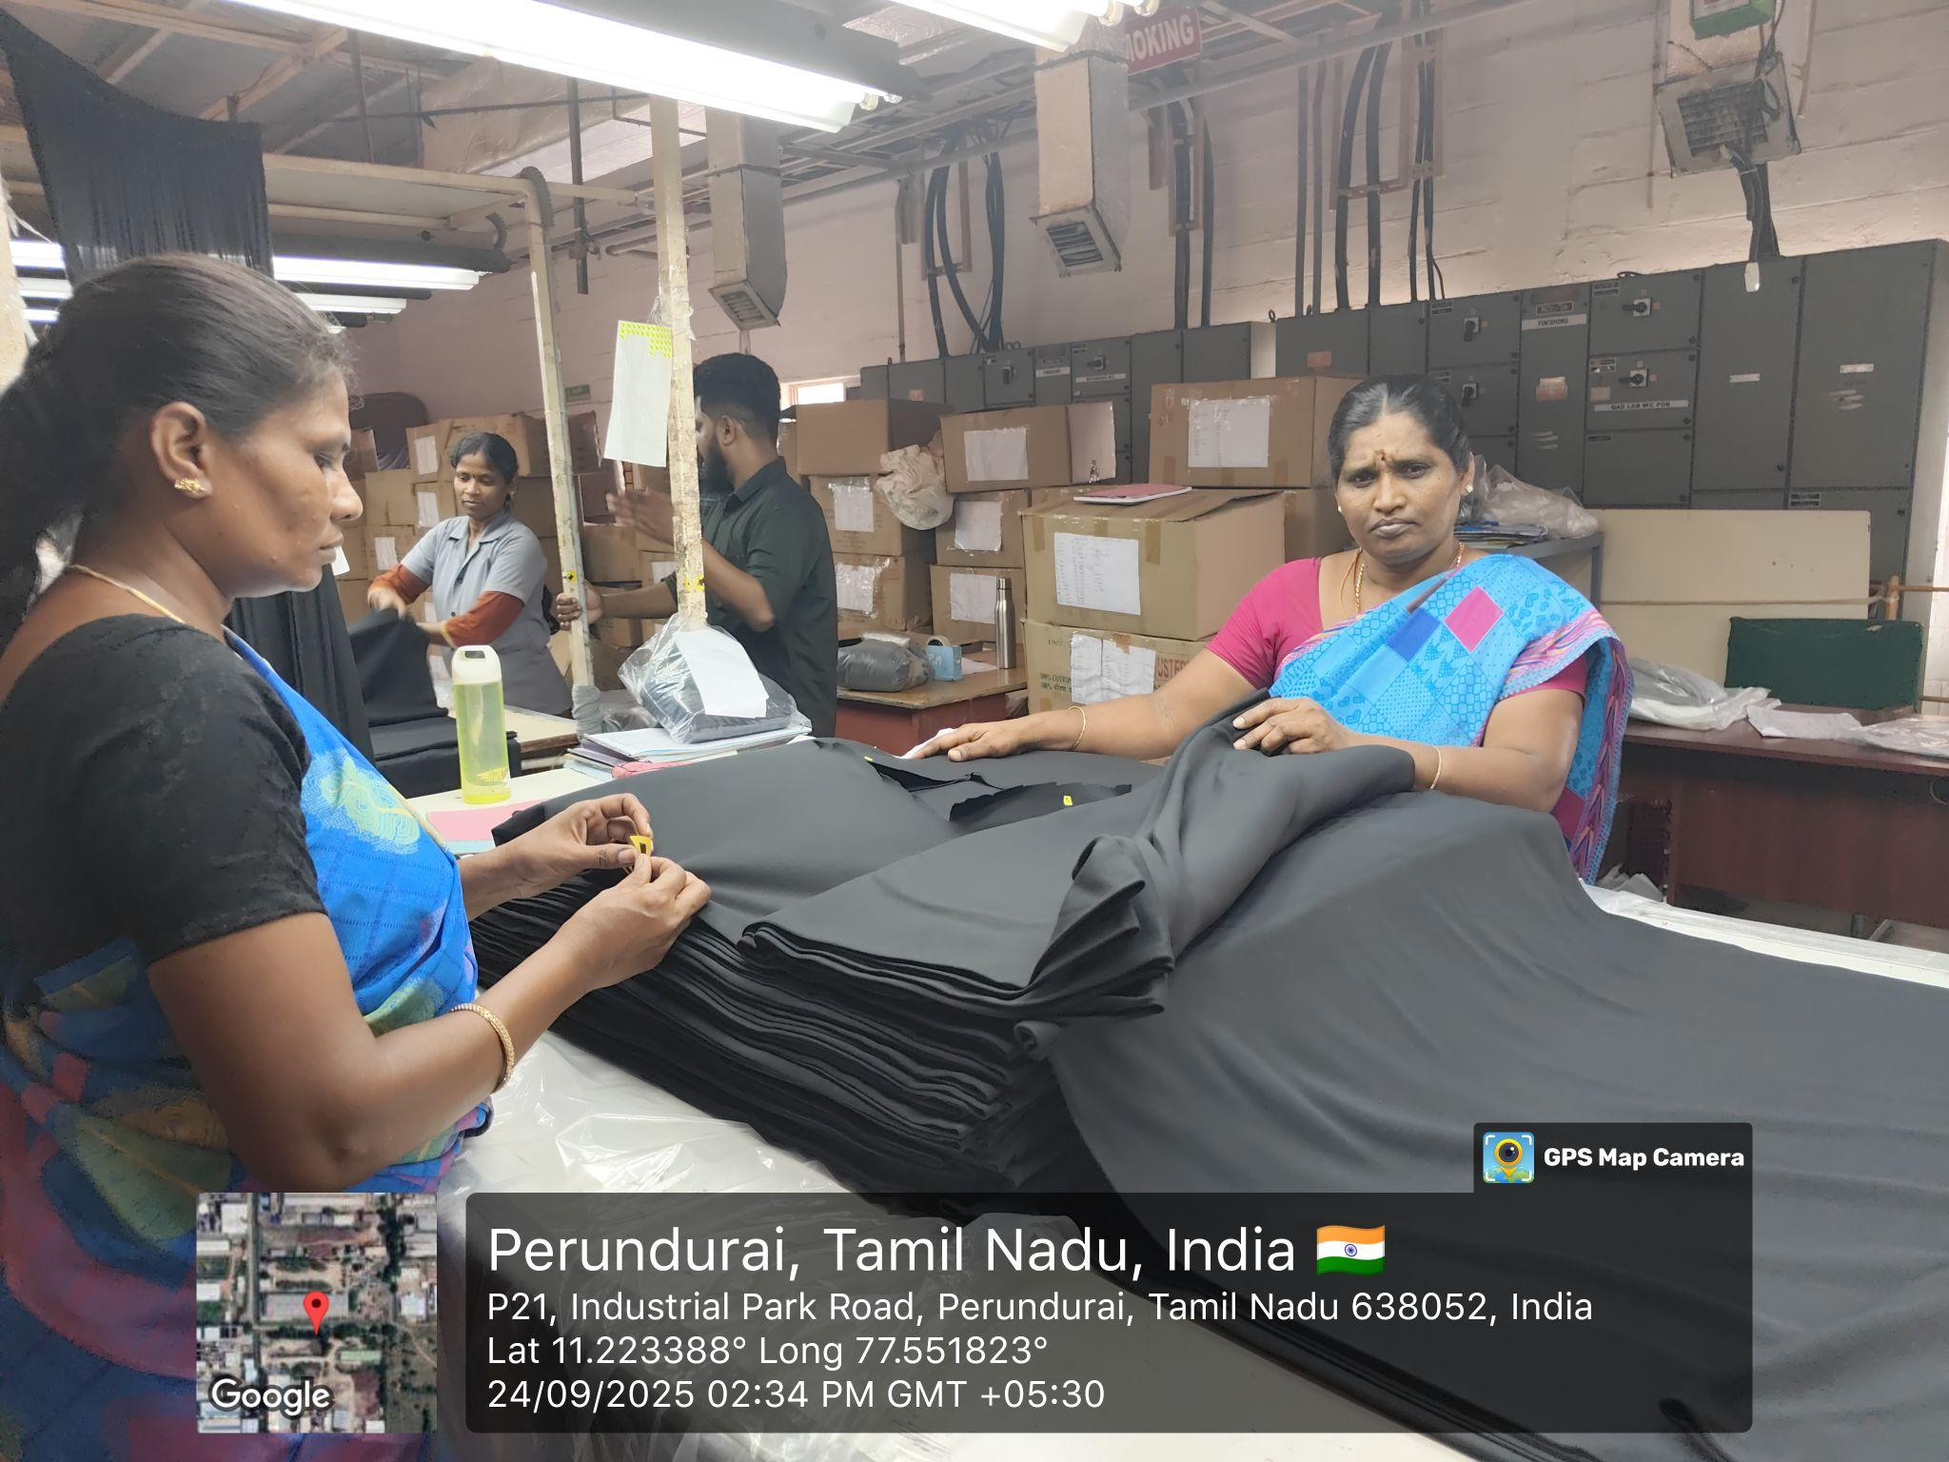
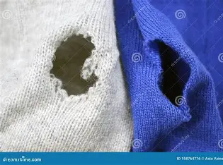
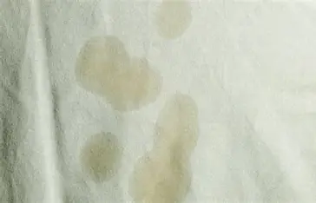
AUTOMATIC FABRIC INSPECTION SYSTEM FOR TEXTILE INDUSTRY
FabSpector
📌 Problem Statement
📝 Proposed Solution
Nowadays Industries are facing many challenges during manual fabric inspection system. Manual errors will occur during inspecting defects like uneven dying, oil stain, yarn defect, large and tiny holes etc.
✅ How it Addresses the Problem
Trained deep learning model identify defects captured fabric images.
Spot hidden defects reducing manual errors.
Works in real time without delays in production.
Every defect is saved with images and details, helping industries analyze patterns and improve quality over time.
Prevents defective fabric from reaching customers, reducing losses, complaints, and rework costs.
Can be added to many production lines without hiring extra manpower.
Allows workers to focus on skilled tasks like quality control, maintenance, and process improvement.
System sends defected data to a Cloud for monitoring, logging, and quality analysis.
System trigger motor control unit to stop the machine, marking the defective section for corrective action.
💡 Innovation and Uniqueness
MANUAL INSPECTION METHODS IN TEXTILE INDUSTRIES
Combines real-time edge detection with powerful cloud-based analysis, balancing speed and intelligence and directly control fabric rollers to stop at the defective portion.
Generates defect reports and analysis and the system can adapt to different defect categories by retraining the AI model.
AI does the repetitive inspection validate critical defects, ensuring balance between automation and expertise.
Integrates the system with existing available machines and Reducing fabric waste and rework
Provides real-time alerts, defect images, and production statistics for supervisors
HOLES
OIL STAINS

Slide 3
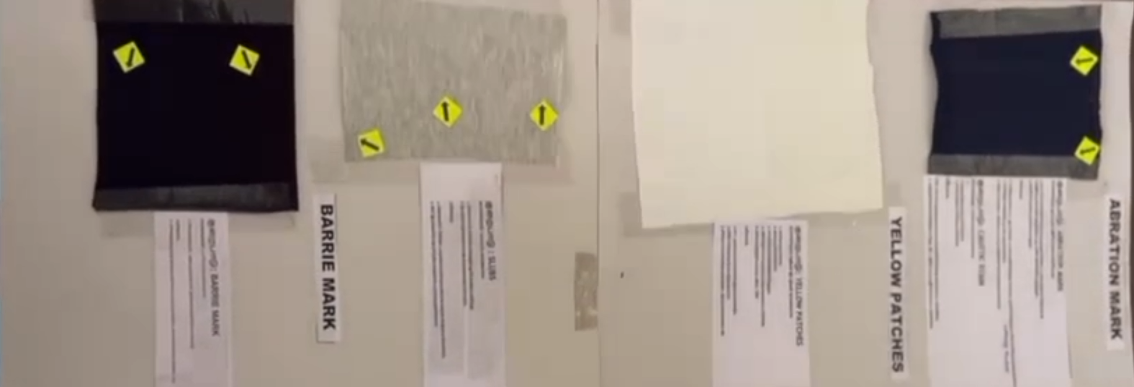
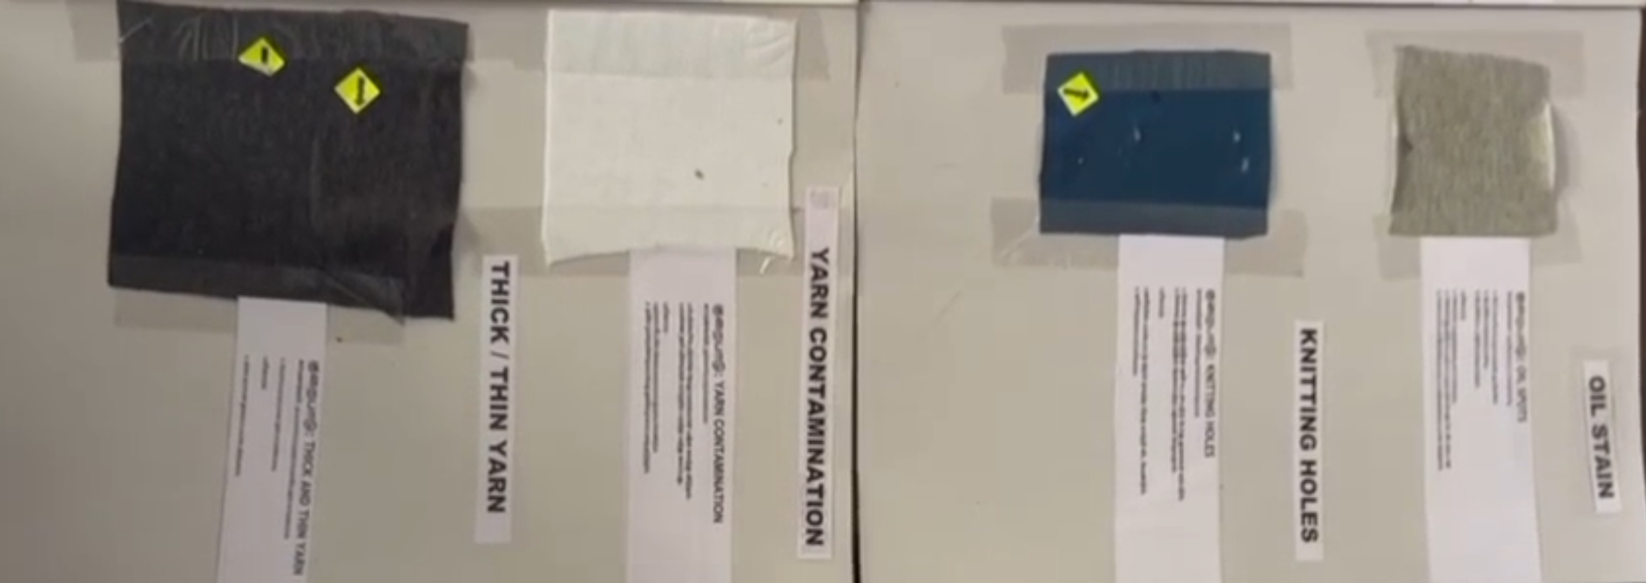
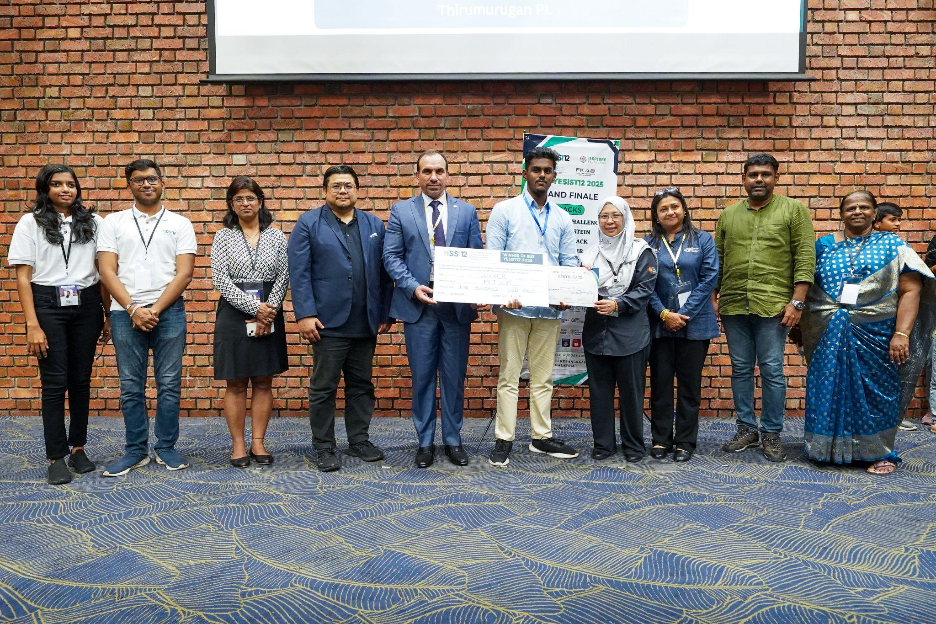
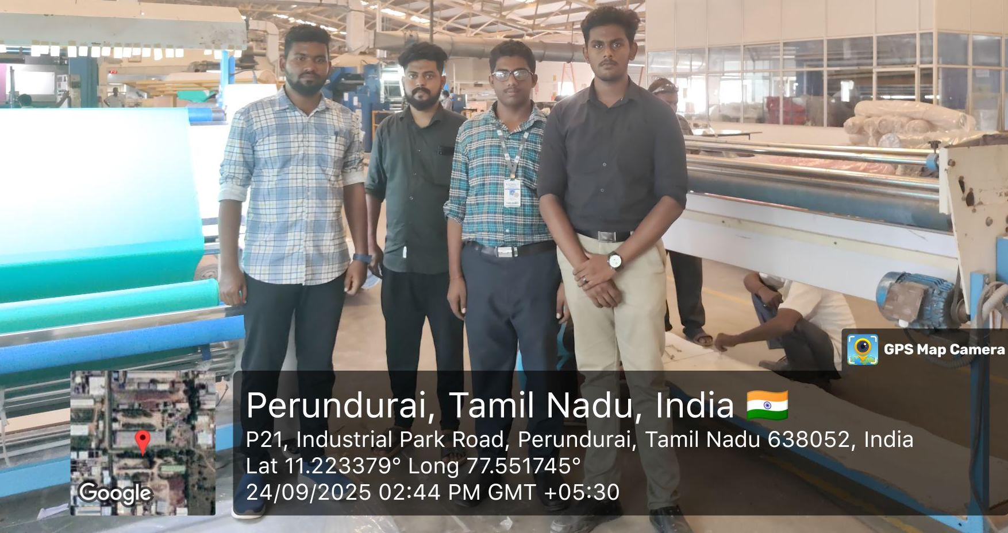
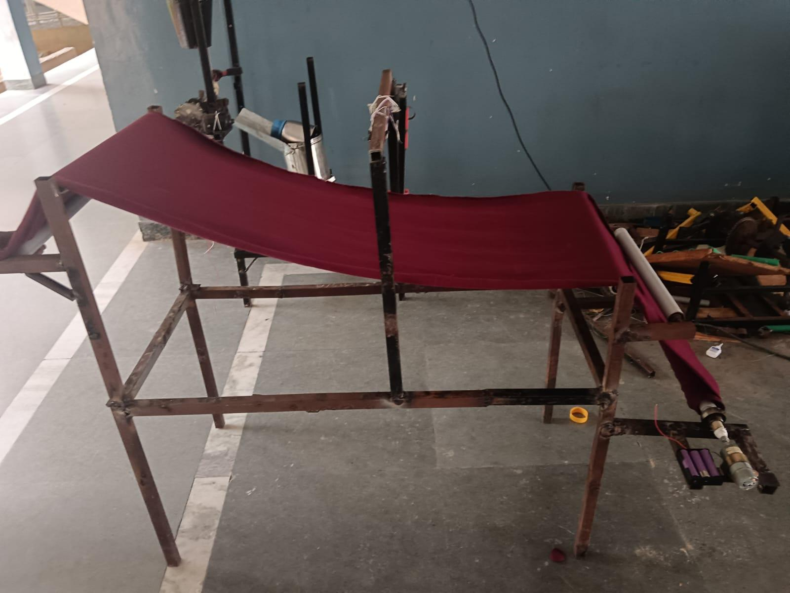

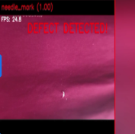
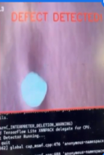
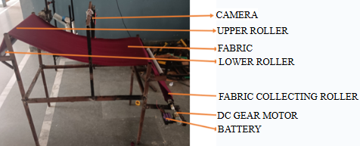
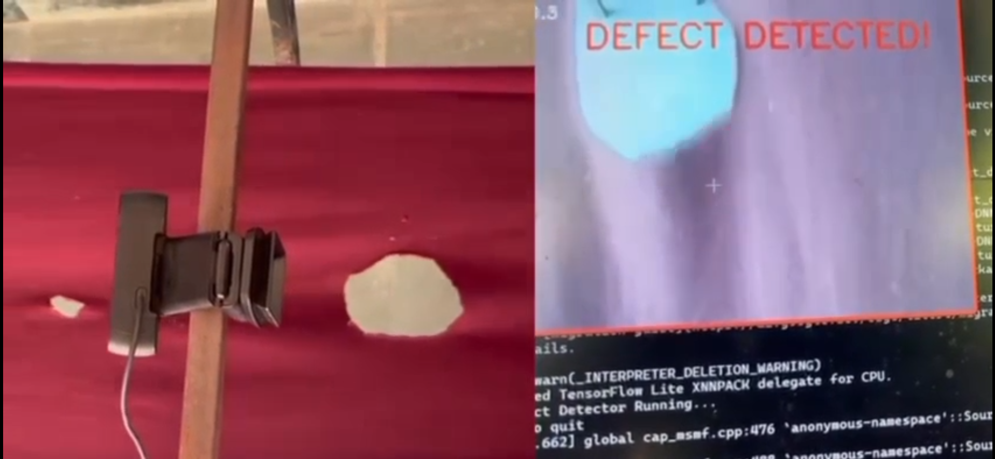
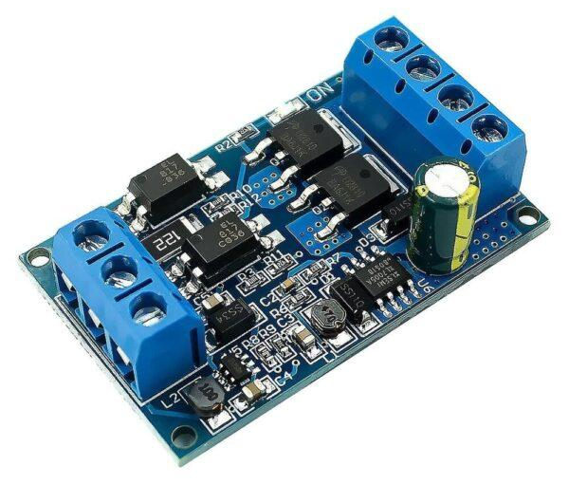


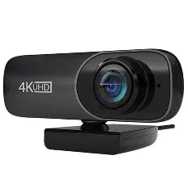
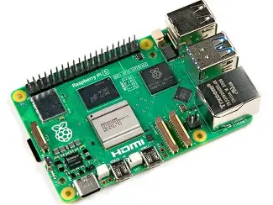



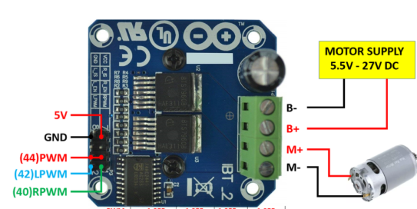






TECHNICAL APPROACH
FabSpector
IEEE YESIST12 2025 WINNER UNDER FET100 TRACK
“AUTOMATIC FABRIC INSPECTION SYSTEM FOR TEXTILE INDUSTRY”
WORKFLOW OF PROPOSED PROTOTYPE
FIELD VISIT IN SHAKTHI KNITTING COMPANY
Dataset collection & Model Training
Fabric feeding & Motion control
Model deployment to CAM module for real time interface
TECHNOLOGY STACK
Real time implementation for image capturing
Motion control using motor drive for controlled algorithm
HARDWARE
SOFTWARE
Defect Detection using CNN
Prototype survey, analysis, working and explanation video:
https://drive.google.com/drive/folders/1uBCRgxcFI5DfS6Bi2pdIJtUXnFhkYPX-?usp=sharing
CAMERA
RASPBERRY PI 5
PYTHON
SEABORN
TENSORFLOW
Storage of detected image in cloud using IOT integration
Multi-model concept for fabric inspection on both edge and cloud:
⚡ Real-time defect detection on edge → MobileNetV3 Small light, fast model that quickly flag fabric defects
🎯 High-accuracy validation on cloud → EfficientNetB0 heavier model runs in the cloud/PC
🔄 Fallback for reliability → ShuffleNetV2 ultra-light model works smoothly when edge devices have limited power or resources
KEARAS
MATPLOTLIB
NUMPY
bts7960 motor driver and 12v dc motor
SCIKIT LEARN
OPEN CV
PILLOW

Slide 4
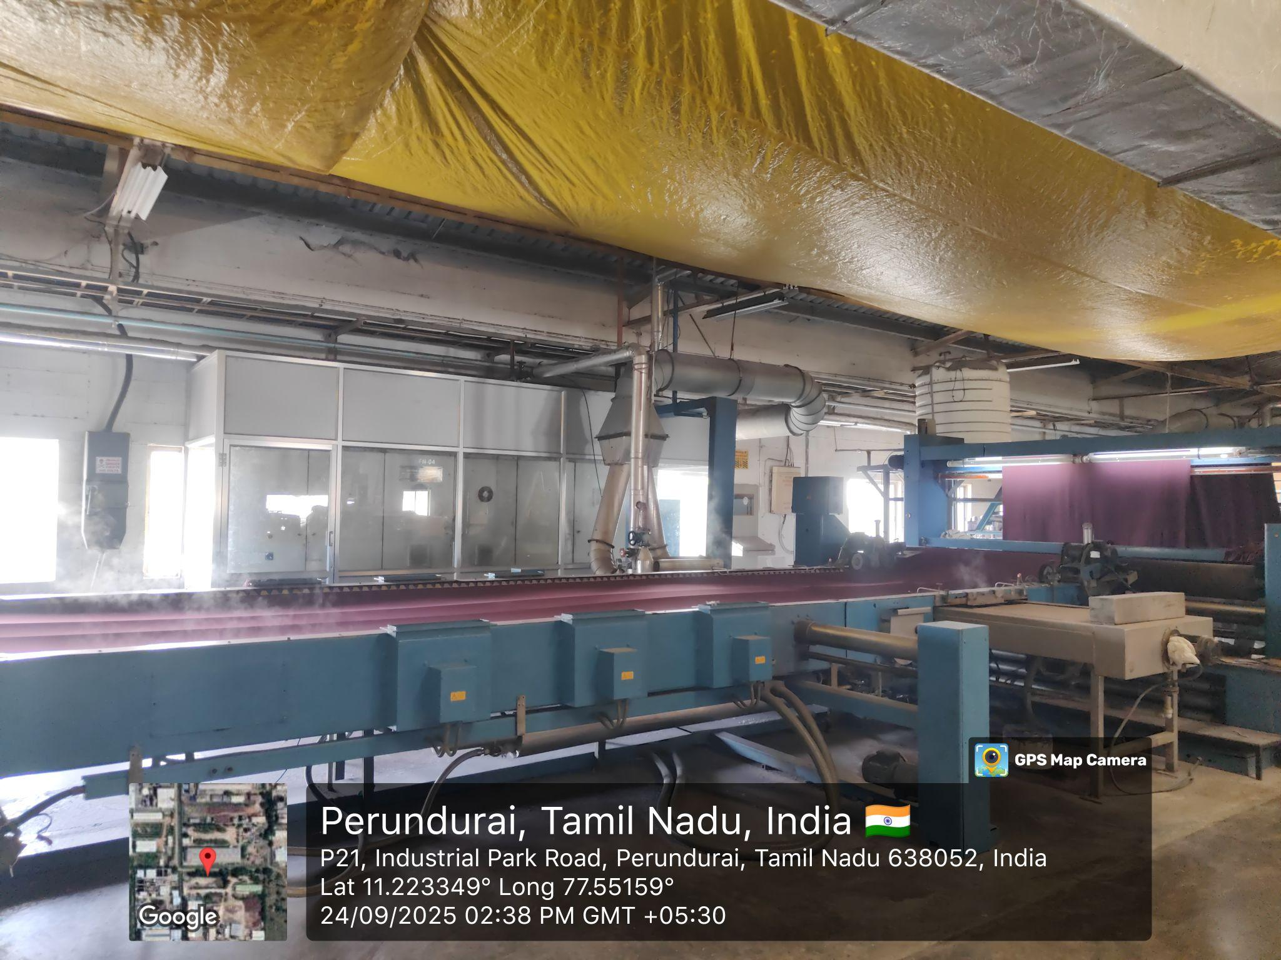
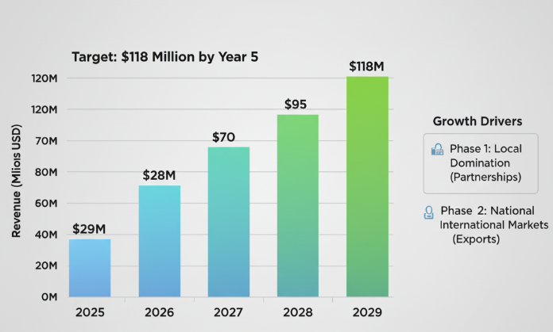
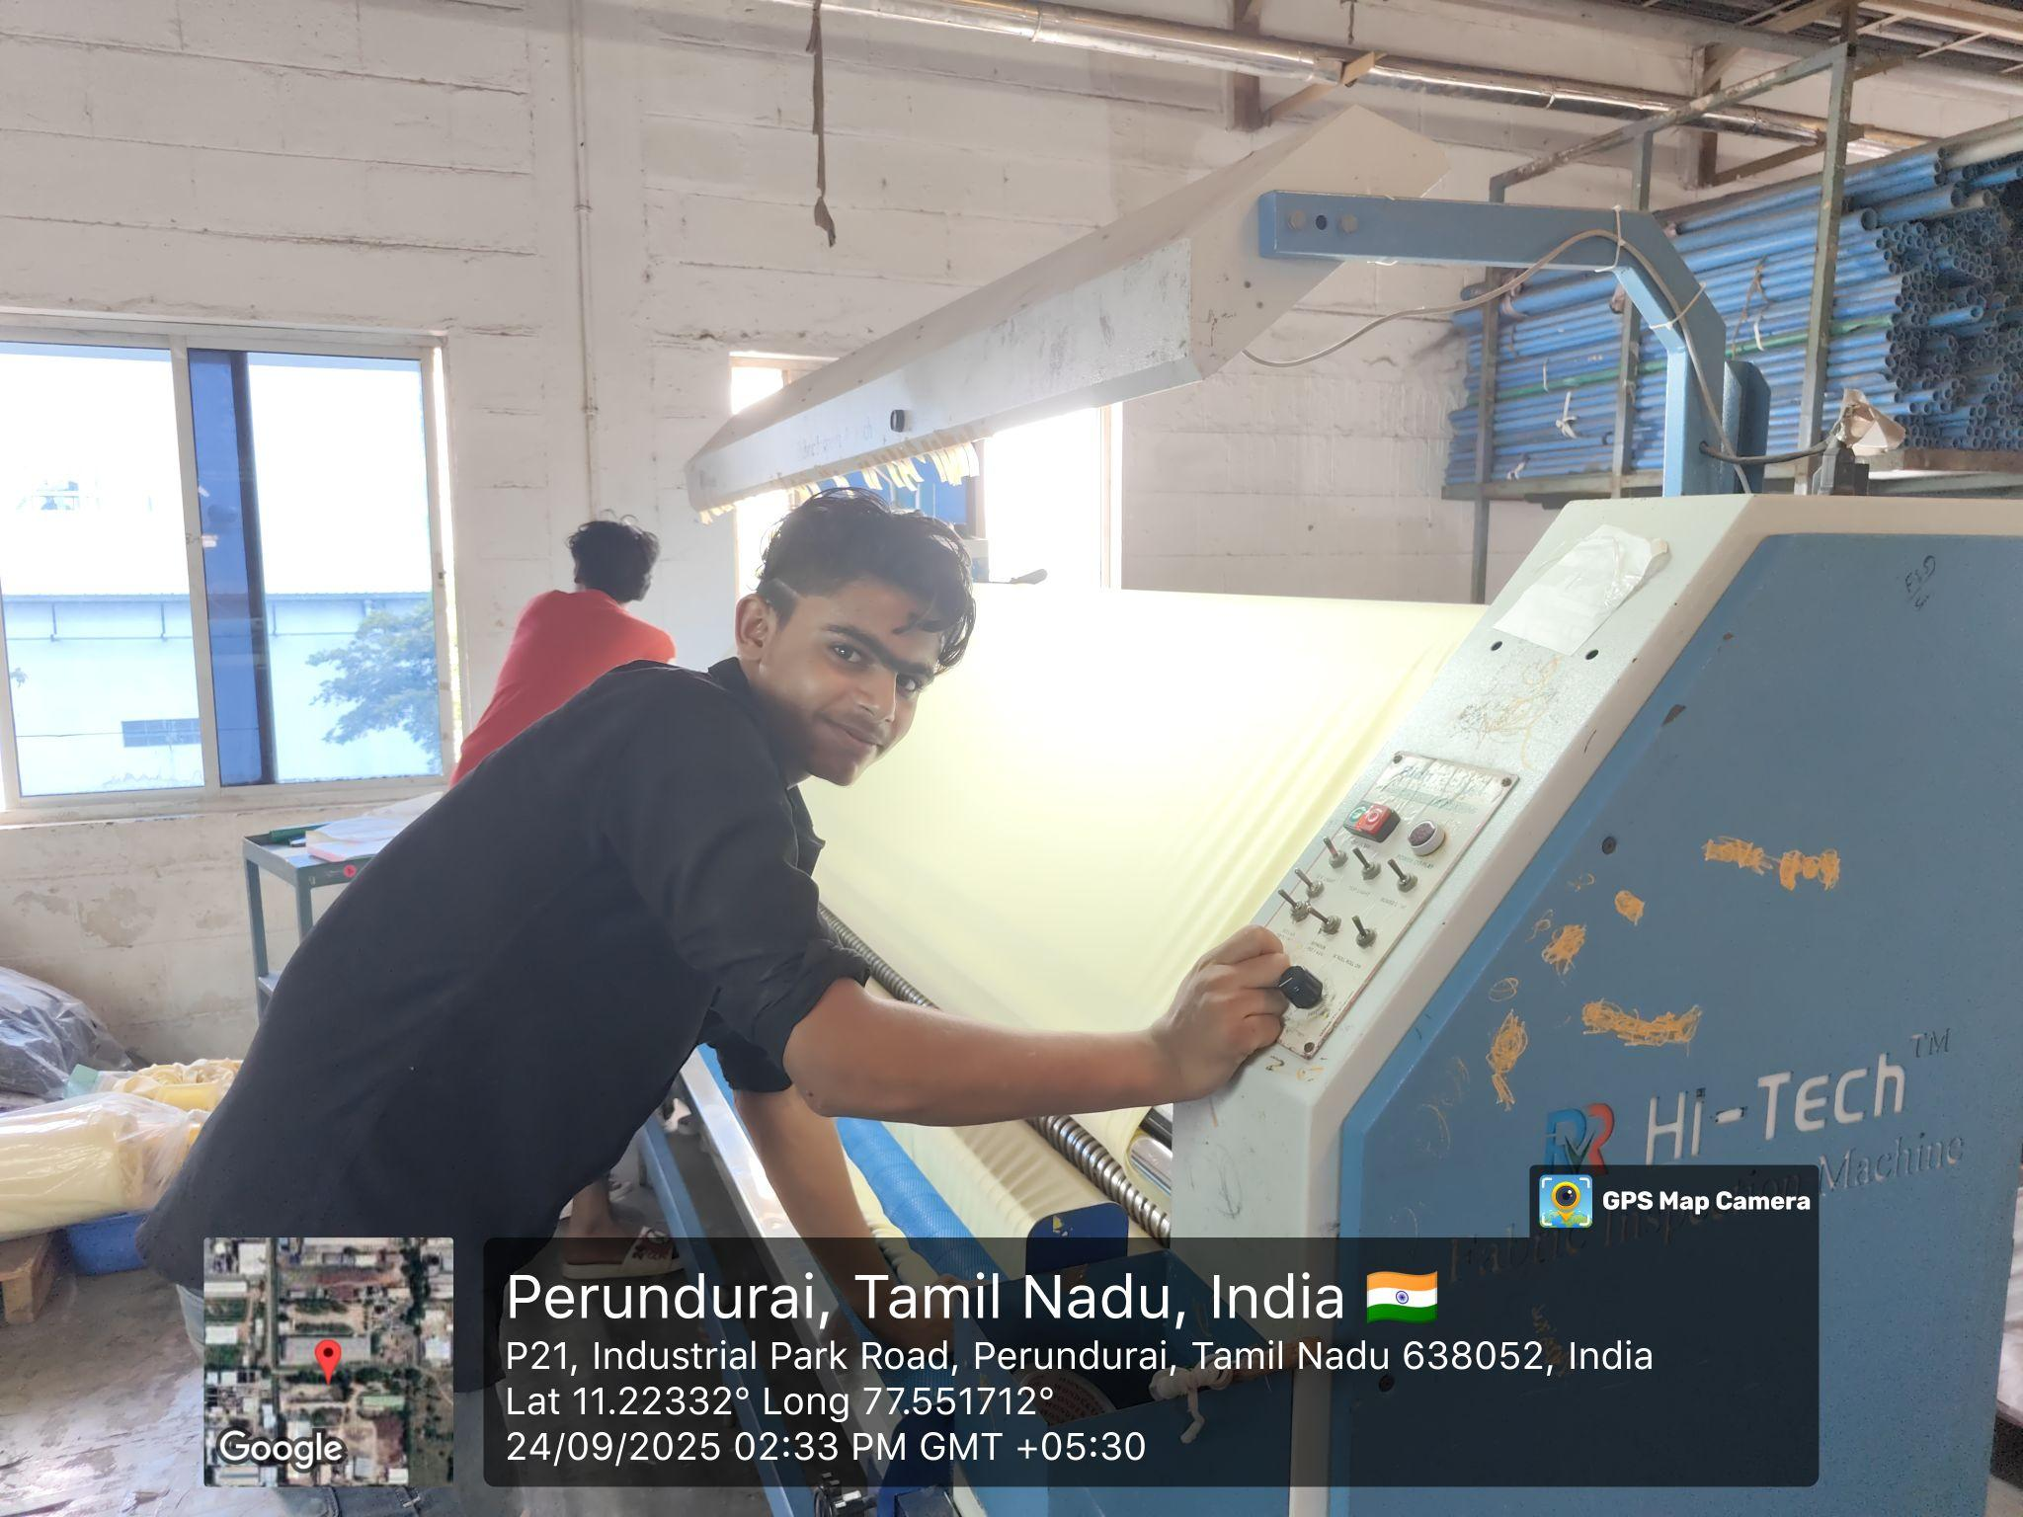
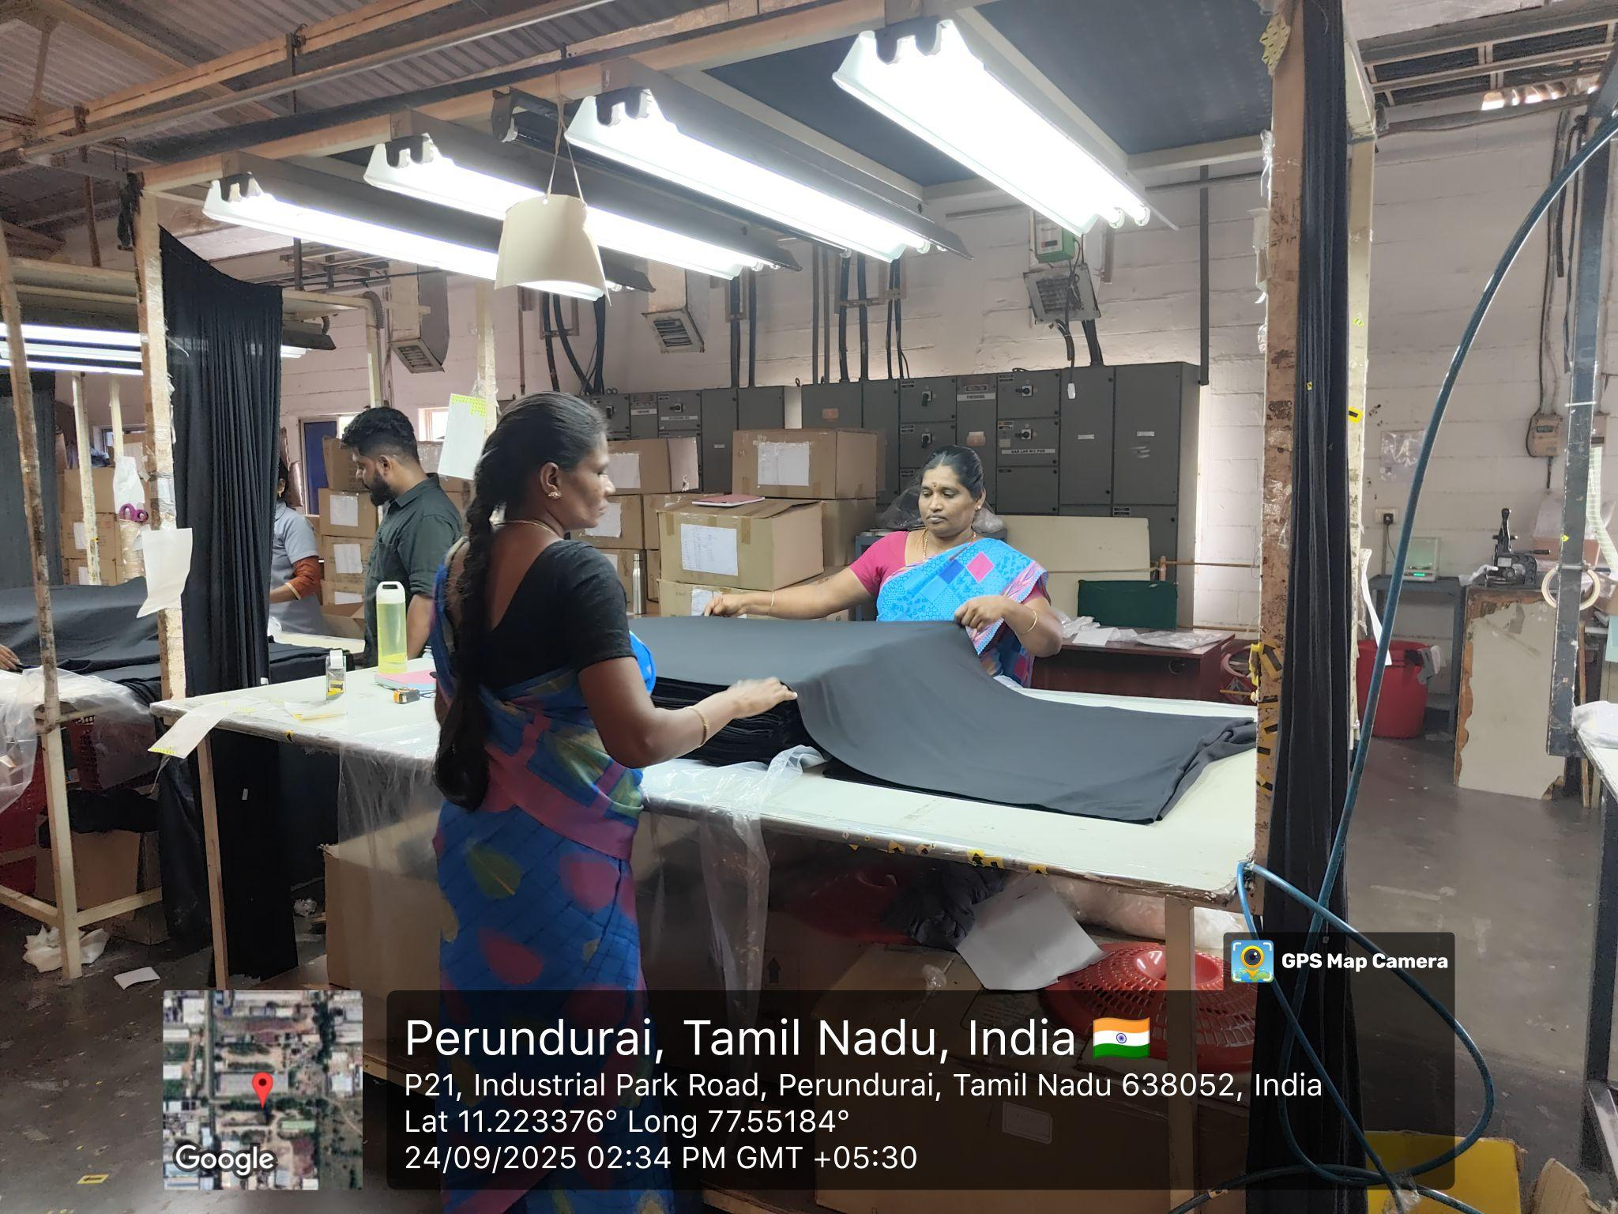
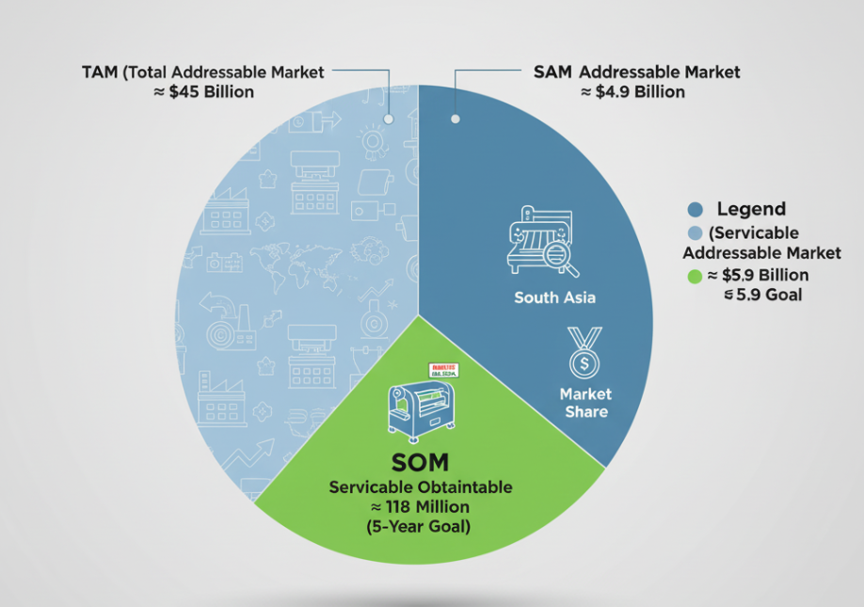
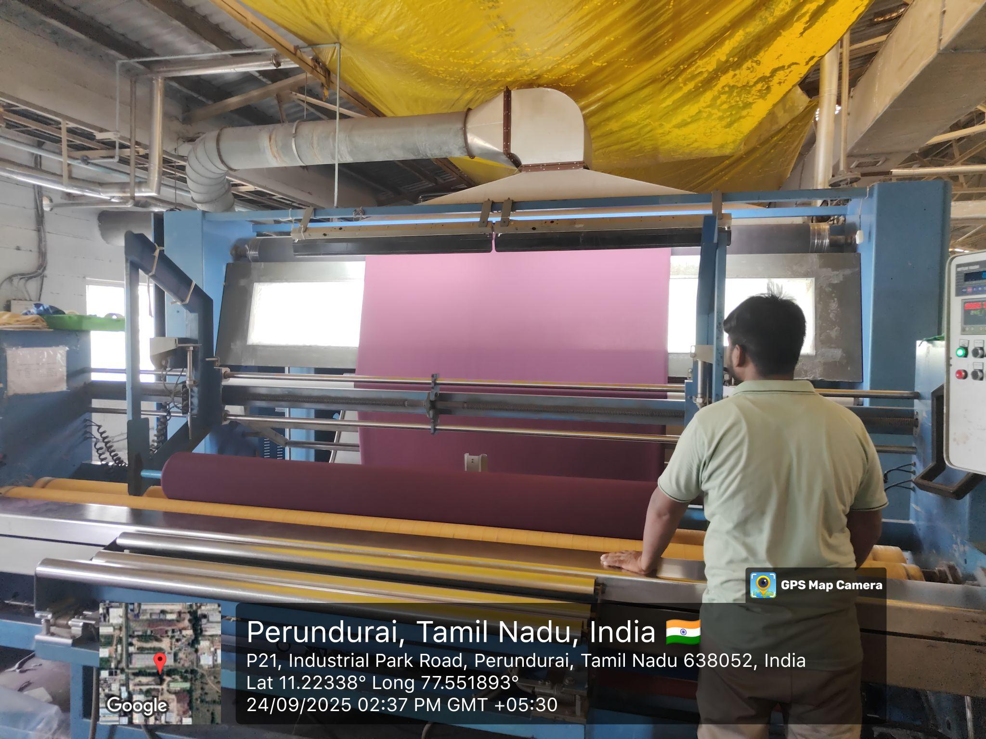
FEASIBILITY AND VIABILITY
FabSpector
STRATEGIES
FEASIBILITY
POTENTIAL CHALLENGES
Technical: Highly feasible using affordable, off-the-shelf hardware (Raspberry Pi, cameras) and mature, open-source software (OpenCV, TensorFlow).
Operational: Easily integrates into existing factory workflows with a simple user dashboard, requiring minimal staff training and maintenance.
Economic: Offers a strong and rapid Return on Investment (ROI) due to low initial costs and significant savings from reduced labor, increased speed, and less material waste.
Create a Proprietary Dataset: data-sharing partnerships with local mills creating an unmatched, proprietary training asset.
Engineer a Controlled Inspection Module: physical enclosure for the camera with integrated lighting eliminates external light
Hybrid AI Approach: deep-learning model to classify known defects, while a secondary anomaly detector (trained on flawless fabric) flags new or unseen imperfections, even in complex patterns.
Lack of a Diverse, Labeled Dataset: making robust AI model training extremely difficult.
Environmental Interference & Variability: Fluctuating ambient light, dust, and high-speed fabric vibrations can severely degrade camera image quality, leading to inaccurate defect detection.
Complexity of Fabrics and Defects: Model may fail to identify subtle defects on complex patterns, dark fabrics, or textured surfaces.
MARKETING STRATEGIES
Total Addressable Market (TAM) | Global fabric production, labor costs, cost of quality failures. | $45 - $50 Billion
Serviceable Addressable Market (SAM) | Go-to-market strategy, product specifications, target customer. | ~$5.88 Billion
Serviceable Obtainable Market (SOM) | Competition, sales execution, product USP, pricing. | ~$117.6 Million (5-Year Goal)

Slide 5

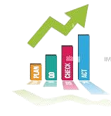
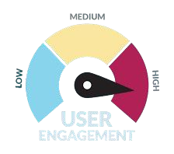








IMPACT AND BENEFITS
Productivity Boost: Keeps the production line moving smoothly without delays.
FabSpector
BENEFITS:
IMPACTS:
Spots even the smallest fabric flaws—defects that might easily be missed by the human eye.
Real-Time Quality Checks Problems are addressed before they worsen because flaws are identified immediately during production.
❖
Reliable Consistency doesn't tire or lose focus, ensuring each inspection remains just as thorough as the one before.
Efficient Operations provides entire process is more cost-effective when expenses are reduced and resources are used more wisely.
Faster Output Inspection increases production rather than slows it down.
Saves Time which take hours to do manually now gets done in minutes, keeping things running smoothly.
Boosts Productivity by more efficient inspections, your production line stays on track.
Increased Customer Confidence by reputation and loyalty are fostered by consistent quality.
Cuts Costs by reduced waste, fewer mistakes, and lower labor requirements lead to significant savings.
Encourages Smart Manufacturing by assists sectors in moving toward automation and workflows that are prepared for the future.
Better Quality Control providing more defect-free fabric reaches customers, enhancing the overall product quality.
Competitive Edge by adhering to global standards and consistently delivering high quality, textile companies can build trust and stay ahead in the market.
Decreased Human Errors lessens the possibility of errors and weariness that accompany manual inspection.

Slide 6
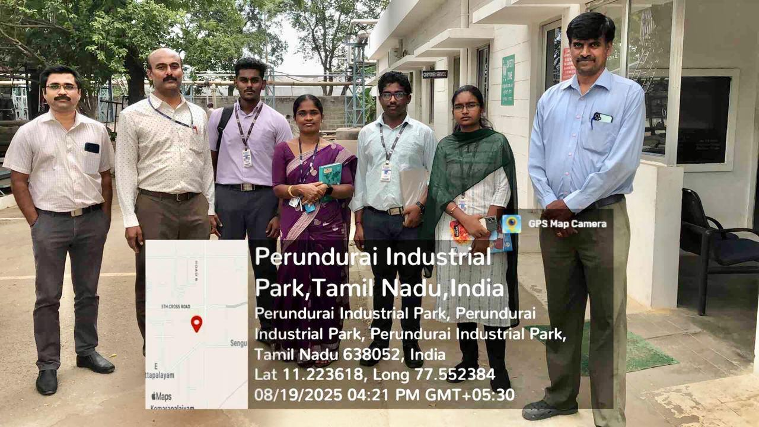
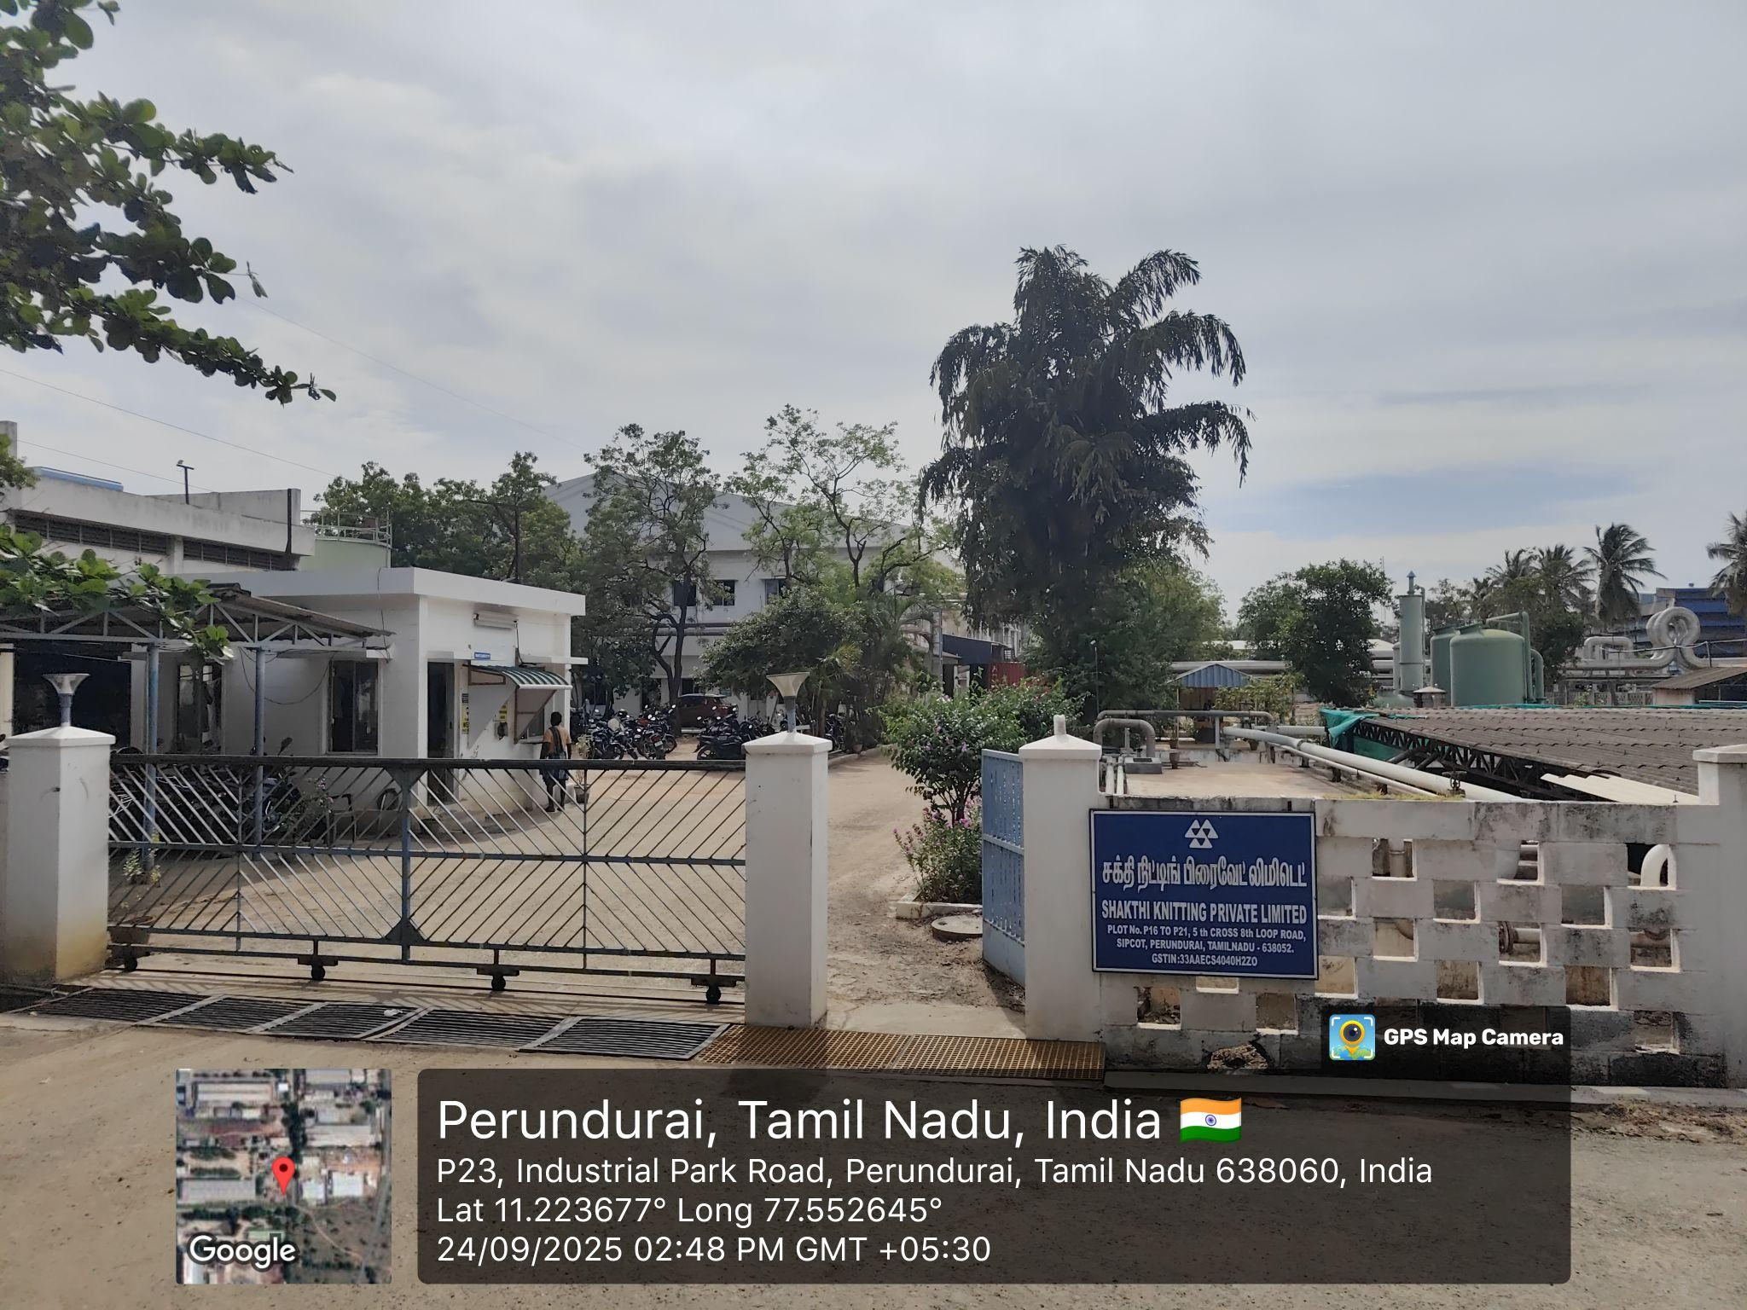
RESEARCH AND REFERENCES
FabSpector
Guosheng, Xie, et al. "An intelligent defect detection system for warp-knitted fabric." Textile Research Journal 92.9-10 (2022): 1394-1404.
Jin, R., Niu, Q. (2021). "Improved YOLOv5-based model for automatic fabric defect detection." IEEE Transactions on Image Processing, 32(5), 433-445.
Deshmukh, S.M., Patil, G. (2022). "Fabric defect detection using statistical methods for feature extraction." Journal of Industrial Textile Engineering, 32(1), 15-28.
Yang Li, Laihu Peng, Xudong Hu, "Fabric Defect Detection Based on FCN Uncertainty Feature", 2023 IEEE 16th International Conference on Electronic Measurement & Instruments (ICEMI), pp.346-350, 2023
Chen, J., Fu, X., He, L., Li, C., Li, J., Li, Y. (2021). "Survey on fabric defect detection in textile manufacturing." International Journal of Advanced Textile Engineering, 11(2), 107-121.
M/s. SHAKTHI KNITTING PRIVATE LIMITED
Industrial Mentor : Mr. Arumugam P
B.Tech(Textile Technology)
email ID : arumugam@shakthiknitting.com
Address : PLOT No, P16 to P21, 5th Cross 8th
loop road, Sipcot, Perundurai,
Tamil Nadu- 638052.
prototype survey, analysis, working and explanation video:
https://drive.google.com/drive/folders/1uBCRgxcFI5DfS6Bi2pdIJtUXnFhkYPX-?usp=sharing

