Slide 1

ENGINEERING EXPLORATION PROJECT ON "CRAZY PLANE"
A.Vivek (160121733166)
B.Sharath (160121733167)
M.Tharun (160121733184)
K.Keshav (160121733195)
Under the mentorship of E.SWATHI (Asst Professor)

Slide 2

CONTENTS: 1) Introduction
2) Background
3) Motivation
4) Problem Statement
5) Formulation
6) Results and Discussion
7) Future Scope
8) Reference
9) Conclusion

Slide 3

INTRODUCTION
Python is an interpreted high-level general-purpose programming language. Python is dynamically-typed and garbage-collected. It supports multiple programming paradigms, including structured, object-oriented and functional programming.
Flappy Bird is an arcade-style game in which the player controls the bird Flappy, which moves persistently to the right. The player is tasked with navigating flappy through pairs of pipes that have equally sized gaps placed at random heights. Flappy automatically descends and only ascends when the player taps the touchscreen. Each successful pass through a pair of pipes awards the player one point. Colliding with a pipe or the ground ends the gameplay.

Slide 4
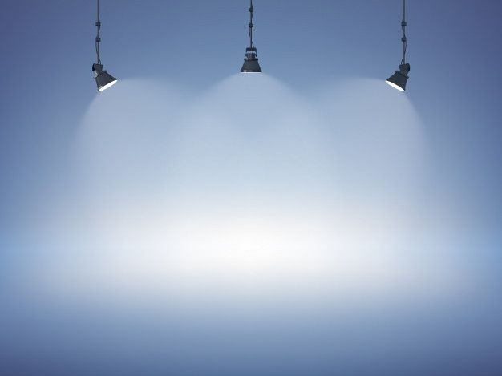
BACKGROUND
We designed a computer game "Crazy Plane" inspired from the mobile game "flappy bird"
Flappy Bird is a mobile game developed by Vietnamese video game artist and programmer Dong Nguyen (Vietnamese: Nguyễn Hà Đông), under his game development company dotGears.
The game is a side-scroller where the player controls a bird, attempting to fly between columns of green pipes without hitting them.
The game was released in May 2013 but received a sudden rise in popularity in early 2014 and became a sleeper hit.
At the end of January 2014, it was the most-downloaded free game in the App Store for iOS. During this period, its developer said that Flappy Bird was earning $50,000 a day from in-app advertisements as well as sales.

Slide 5
MOTIVATION
Our group has chosen to work on prototype of a common and famous game Flappy Bird named "Crazy Plane" . It is a game that involves using the mouse to navigate a plane between hilly surfaces that keep moving. In today’s age, games are the most addictive when it comes to the youth. It has become even more so because of our current pandemic situation that forces us to adopt virtual means to keep ourselves engaged. We thought that working on a game would thus be not only interesting but also relevant and relatable. We’ve chosen this particular game because of its accessible and easily comprehensible programming language, that makes it simpler for us to build on the existing software and modify it according to our preferences. This is how we all discussed and narrowed down to this particular game.

Slide 6

PROBLEM STATEMENT
The first problem faced was to come up with an idea for the project on which every person in group would agree.
Gathering the pictures and audio for sprites that are to be used in the game.
Gathering knowledge about how we use pygame module to develop game in python.
Most of the commands and built-in methods to be used in python are case sensitive.
There is a issue of synchronization between loop in the software and frame buffer update in hardware. We need to update the object position when the frame is not showed on the screen.
Plane motion need time variable which is not straightforward to get. Because the data type we get from system clock is not available for calculation.
Surface height had to set in such a way that the plane could pass in between them.
The is a risk of getting semantic error in the functions defined since we cannot know about this error till we complete code.

Slide 7

FORMULATION
We referred to official documents of pygame provided on the internet so that we could gain more knowledge about how we can implement those pre-defined methods to be used in the game and this helped us to reduce the syntactical error.
The synchronization issue is resolved when we update the screen only when it scans to the bottom of the screen.
It was very hectic to make sure that the buttons we create around the titles "play", "quit" goes in hand with each other.
An offset distance is set for the minimum height of the pipe such that there is enough free space between the pipes to pass through it.

Slide 8
FUTURE SCOPE
Improve our coding style. In our hardware coding, we unroll the program without making it hierarchical as a module which may lead to difficulty for debugging.
Choose high resolution sprite pictures and eliminating sprite background more clearly can make our game picture looks better.
Design more complex game logic can increase our game integrity. For example, background changes with time, distance between pillar become random.
Make sure that music stops when the plane hits the hilly surfaces or touches the upper or the lower extreme.
To improve the window size and make it fit precisely on the screen
We can try to improve the difficulty of the game as the time progresses and create levels to this game
We can come up with moving surfaces to make the game more tricky

Slide 9

References
The Original game Flappy Bird has been scrutinized by playing the game on the website https://flappybird.io
The Flappy Bird Game Documentation is available on the website which we used for our reference
https://pygamezero-bird.readthedocs.io
http://pygame-learning-environment.readthedocs.io
Pygame Documentary where the information regarding pygame modules and methods which are very much needed for making games like flappy bird are being documented with detailed information. Visit the above website of pygame documentary for more information. https://www.pygame.org
We also referred this youtube video for a better interpretation of what is pygame
https://youtu.be/AY9MnQ4x3zk

Slide 10
The important modules like sys module, random module and the data types in python and their attributes that are used in this game their complete information is extracted from the original website of python. Click the above link for more information.
https://docs.python.org
The above game code is written in Python Language. The Integrated Development Environment Software (IDE) used is Pycharm. Click on the above link for more information about pycharm.
https://www.jetbrains.com/pycharm/download/#section=mac ( for macs)
https://www.jetbrains.com/pycharm/download/#section=windows ( for windows )

Slide 11
Conclusion
Implementing this game in hardware was an enjoyable project for all of us. It paired a fun final product with a challenging implementation, an ideal combination for a project in this class. The work was modular and divided well between four people. Our goals were achievable, and we tried our level best to accomplish them . Overall, this project helped all of us gain experience working with hardware implementation and interfacing with the outside world. We gained a first hand experience about how real

