Slide 1
PROJECT REPORT
SENTIMENT DETECTION USING FACE

Slide 2

STUDENT DETAILS
NAME : Keshav Kumar
ROLL NO- 19001011031

Slide 3
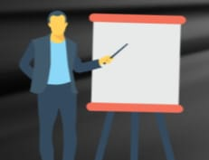
FACULTY DETAILS
MENTOR NAME
(Dr. Komal Kumar Bhatia)

Slide 4
INTRODUCTION
Human emotion detection is implemented in many areas requiring additional security or information about the person. It can be seen as a second step to face detection where we may be required to set up a second layer of security, where along with the face, the emotion is also detected.
In this we will add both face expression and audio for the detection of emotions for better results.
Human emotions can be classified as: fear, contempt, disgust, anger, surprise, sad, happy, and neutral.

Slide 5
OBJECTIVE
The primary objective of our project is to detect emotions of any person during video call or simple interaction
Using the face fact that our facial features undergo significant changes with emotions.
Using speech features include tone, energy, pitch, formant frequency, etc. and identifying emotions through changes in these.
Emotion detection has a remarkable contribution in various industries to include healthcare, marketing, entertainment, surveillance, retail, e-commerce, HR, and more.

Slide 6
Topic we have studied:
Data cleaning, preprocessing.
Machine learning algorithms.
Neural network model training.
Opencv for camera use and emotion recognition.

Slide 7
Modules studied:
Numpy
Pandas
Matplotlib
Seaborn
Sci- kit learn
Tensorflow keras
Opencv
Librosa

Slide 8
Work done in project till now:
We have designed deep neural network model for face emotion recognition.
In this we he collected data from GitHub and trained model using tensorflow keras module.
Opencv code done to detect emotions live through camera.
Audio emotion detection model created.

Slide 9
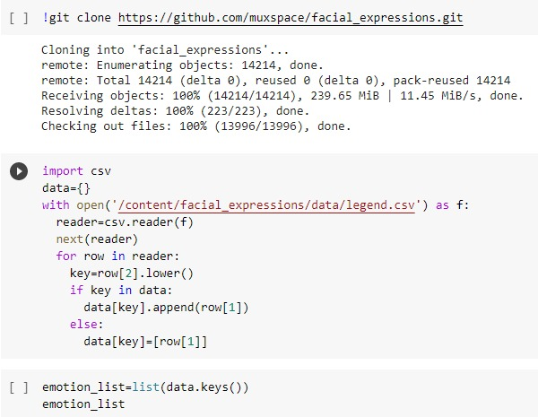
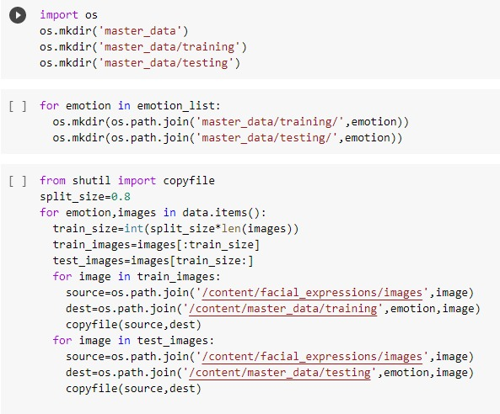
Model Code Screenshot:

Slide 10
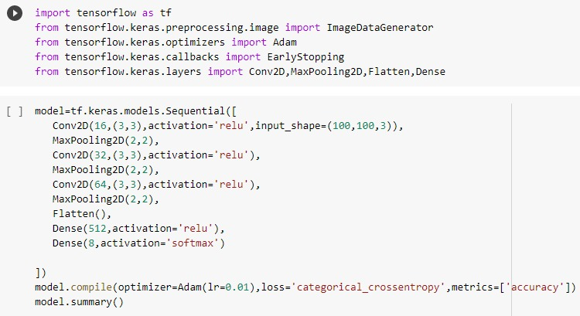
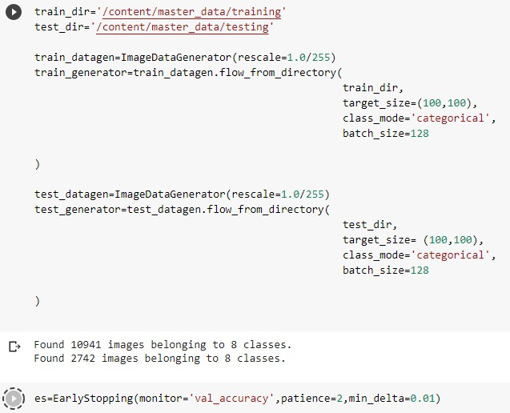
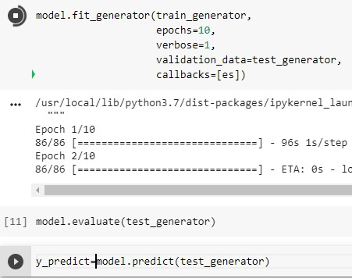
Code segment:

Slide 11
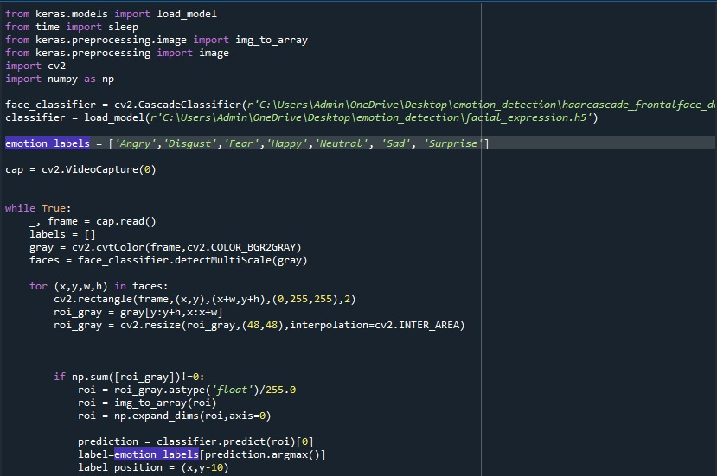
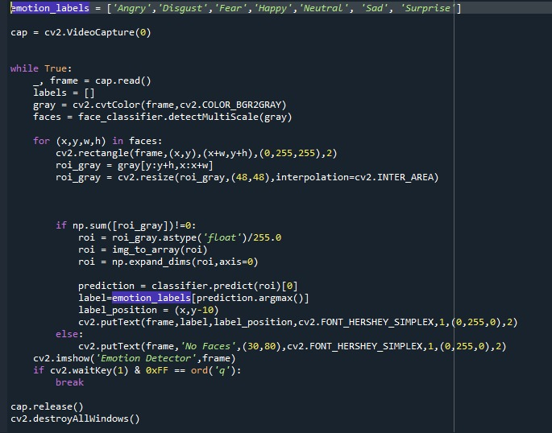
Opencv code:

Slide 12
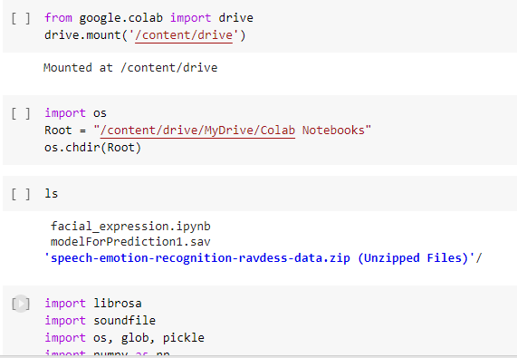
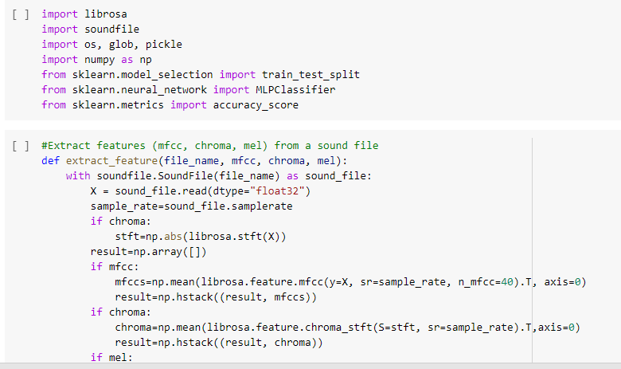
Audio Emotion Detection Model code:

Slide 13
Future work we will add:
Record voice live and predict emotion.
Implementation together with the faical expression model.

Slide 14
Thank you

