Slide 1
Queer Corner Initiative
Impact and Perception Report
Aligned and scaled visual summary

Slide 2
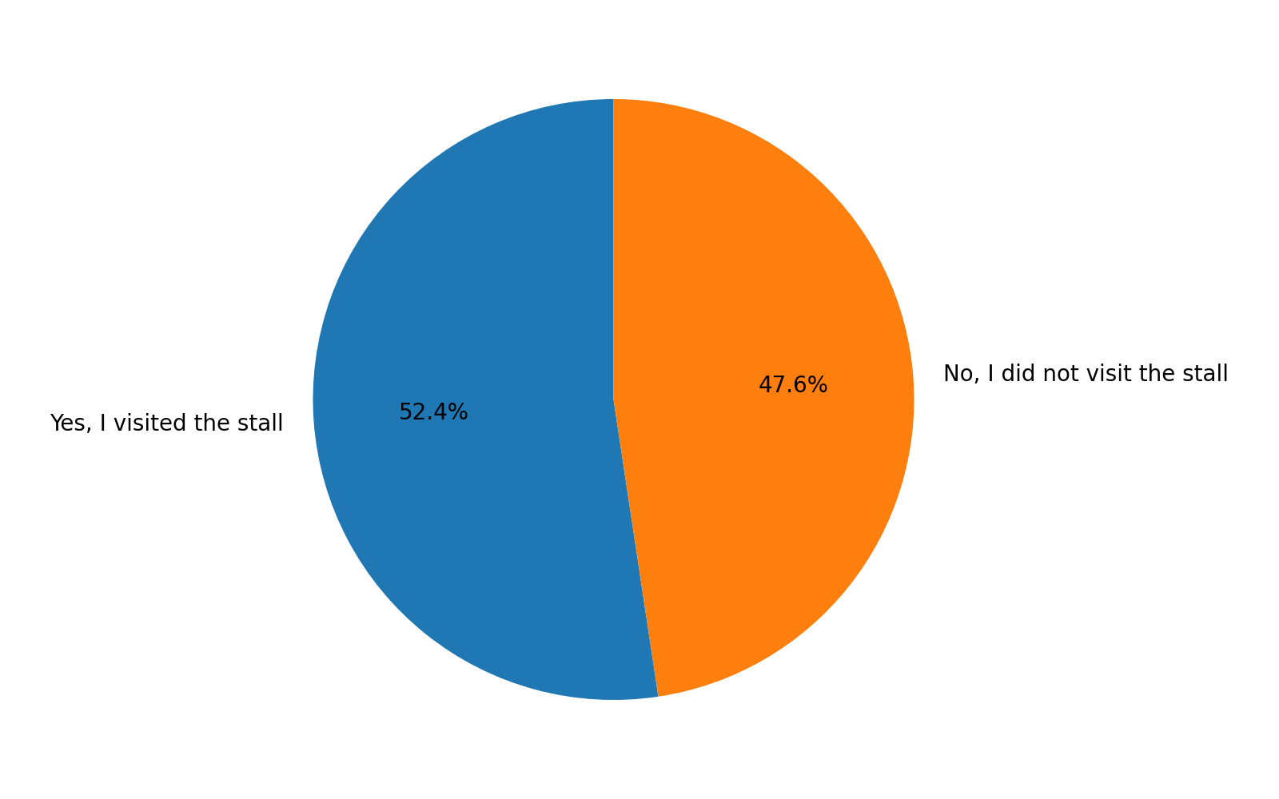
Survey Respondent Composition
Proportion of respondents who visited versus did not visit the stall. Data reflects survey respondents only.

Slide 3
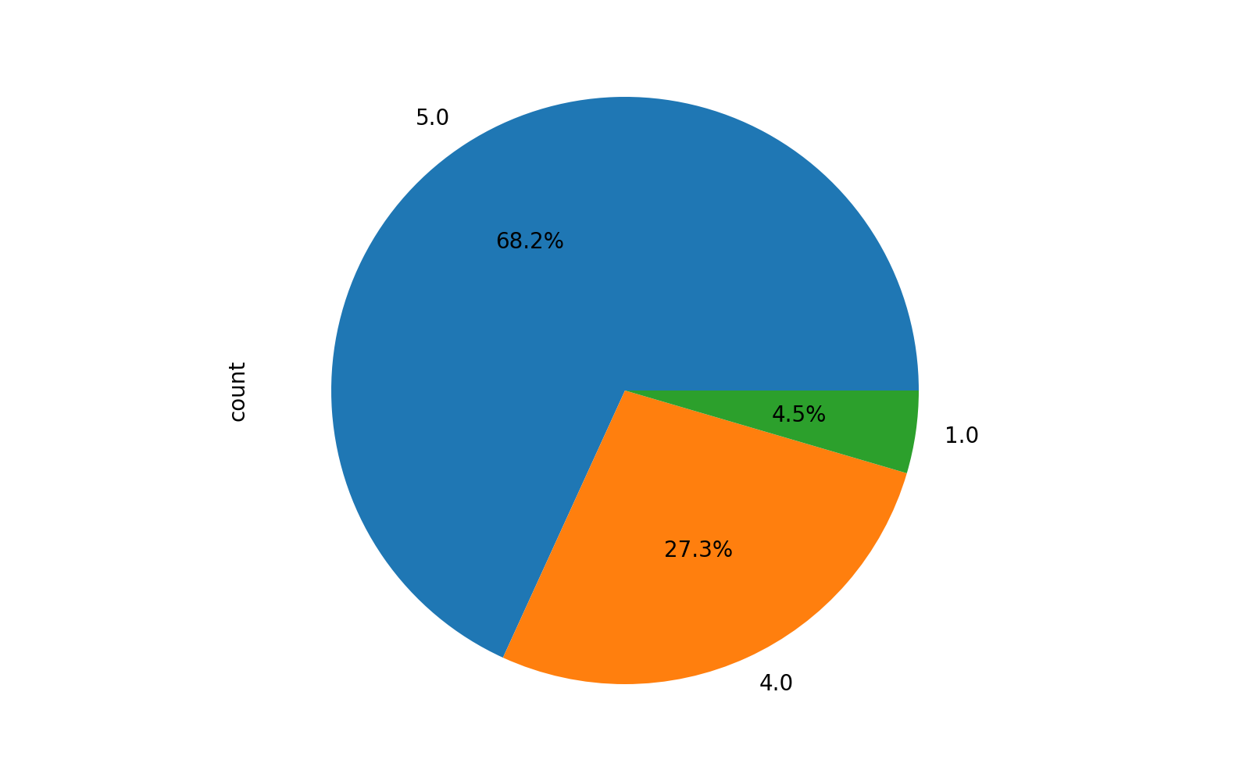
Visitor Comfort and Safety
High comfort ratings indicate a safe and respectful interaction space.

Slide 4
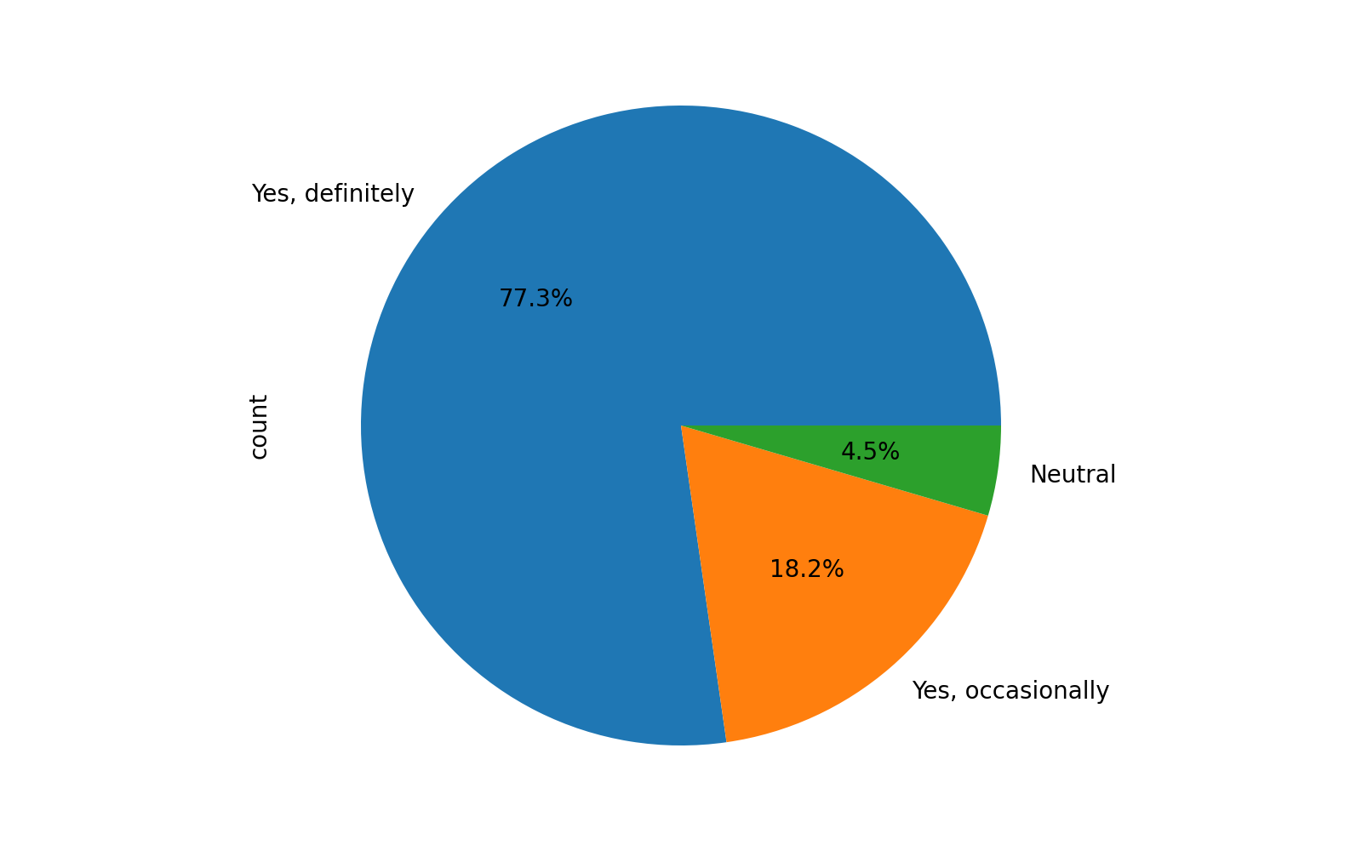
Visitor Demand for Continuation
Visitors who engaged express strong support for repeating the stall at future events.

Slide 5
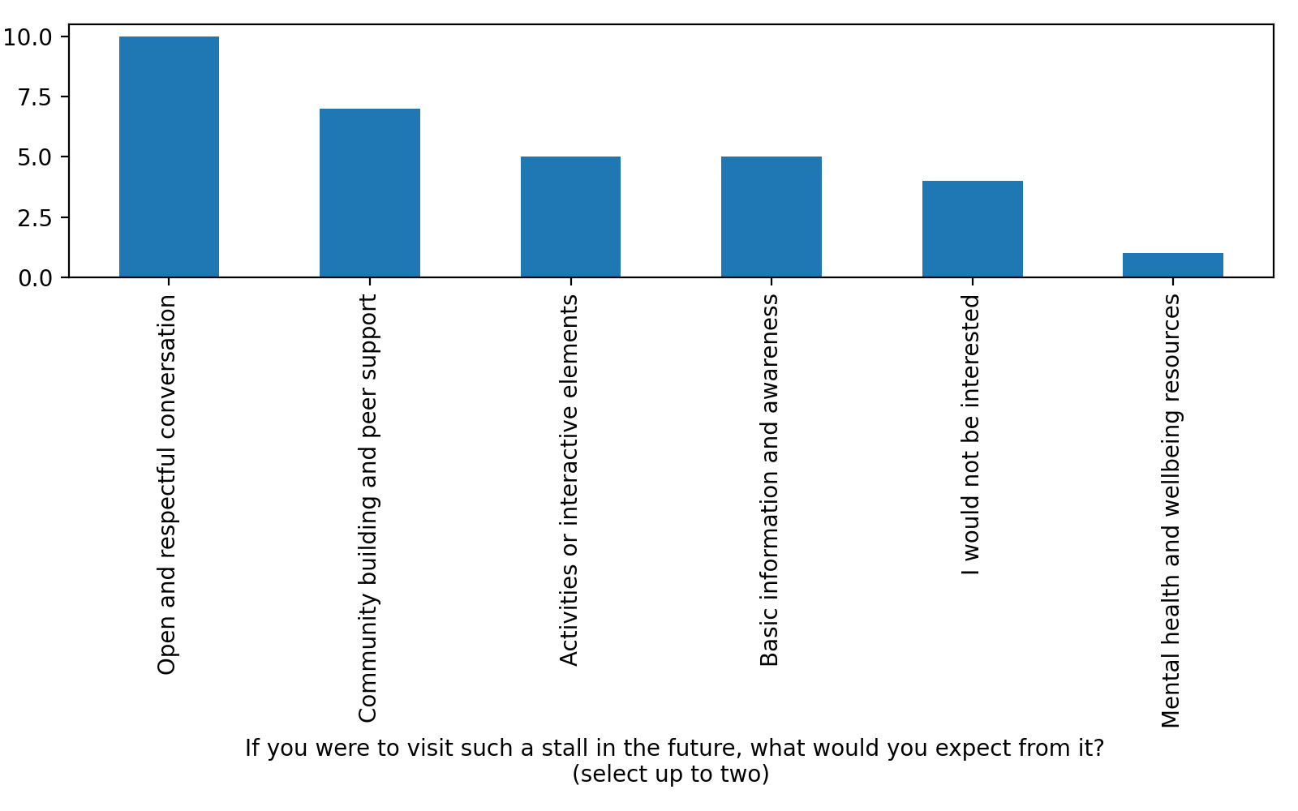
Expectations Among Non Visitors
Non visitors primarily expect conversation, community support, and awareness.

Slide 6
Scope of This Request
This request is limited to approval of a stall at the next event

Slide 7
Student Experience Observations
Students engaged openly and respectfully during interactions
Visibility of a stall reduced hesitation and encouraged dialogue
The format functioned as a calm and inclusive presence

Slide 8
Institutional Value
Supports student wellbeing through peer led engagement
Encourages respectful campus dialogue
Delivers impact without operational or reputational risk

