Slide 1
Queer Corner Initiative
Impact and Perception Report
Aligned and scaled visual summary

Slide 2
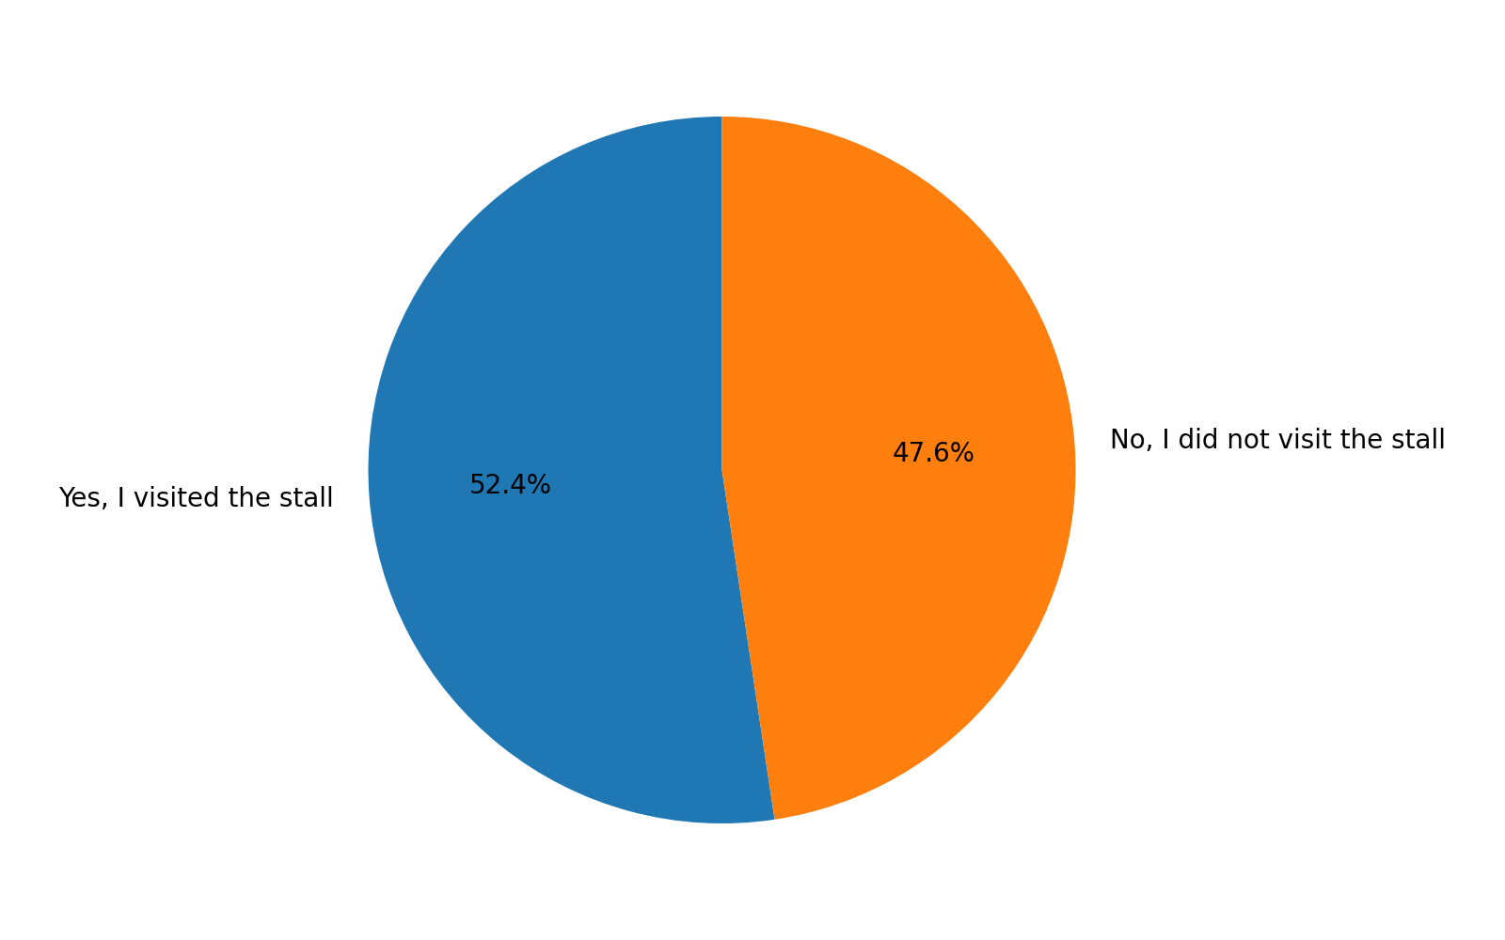
Survey Respondent Composition
Proportion of respondents who visited versus did not visit the stall. Data reflects survey respondents only.

Slide 3
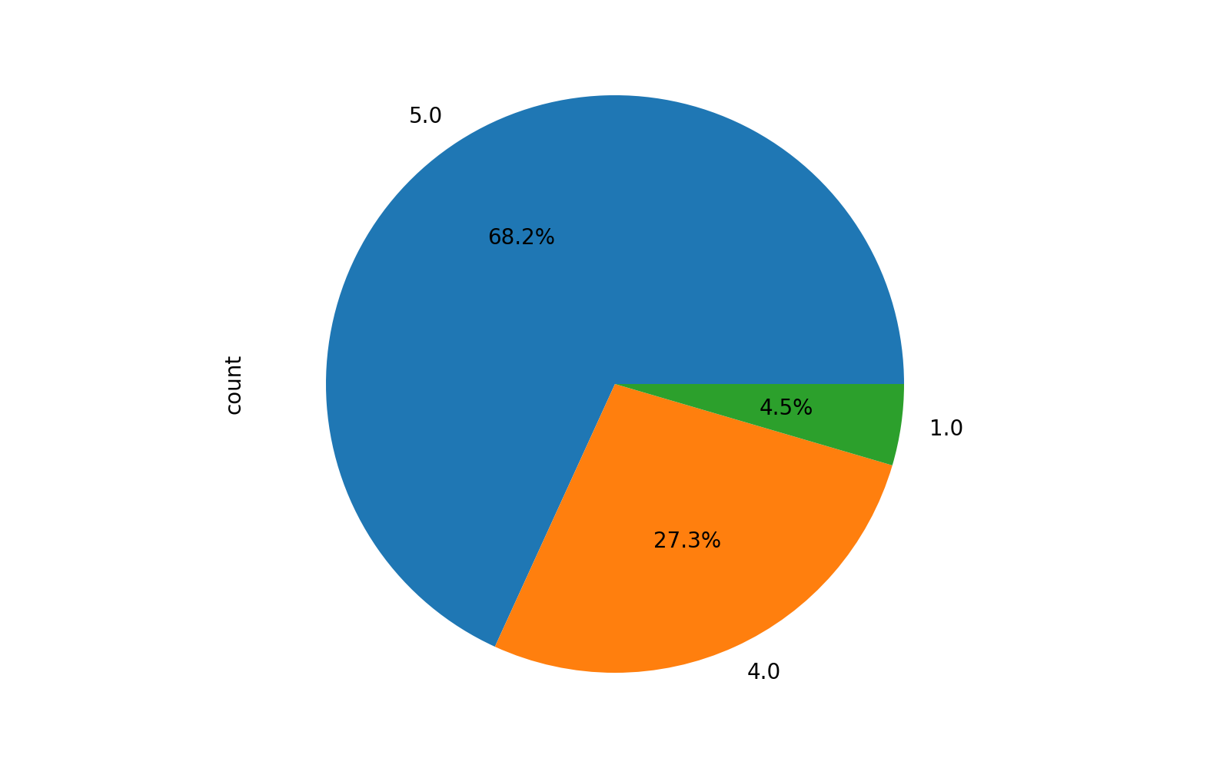
Visitor Comfort and Safety
High comfort ratings indicate a safe and respectful interaction space.

Slide 4
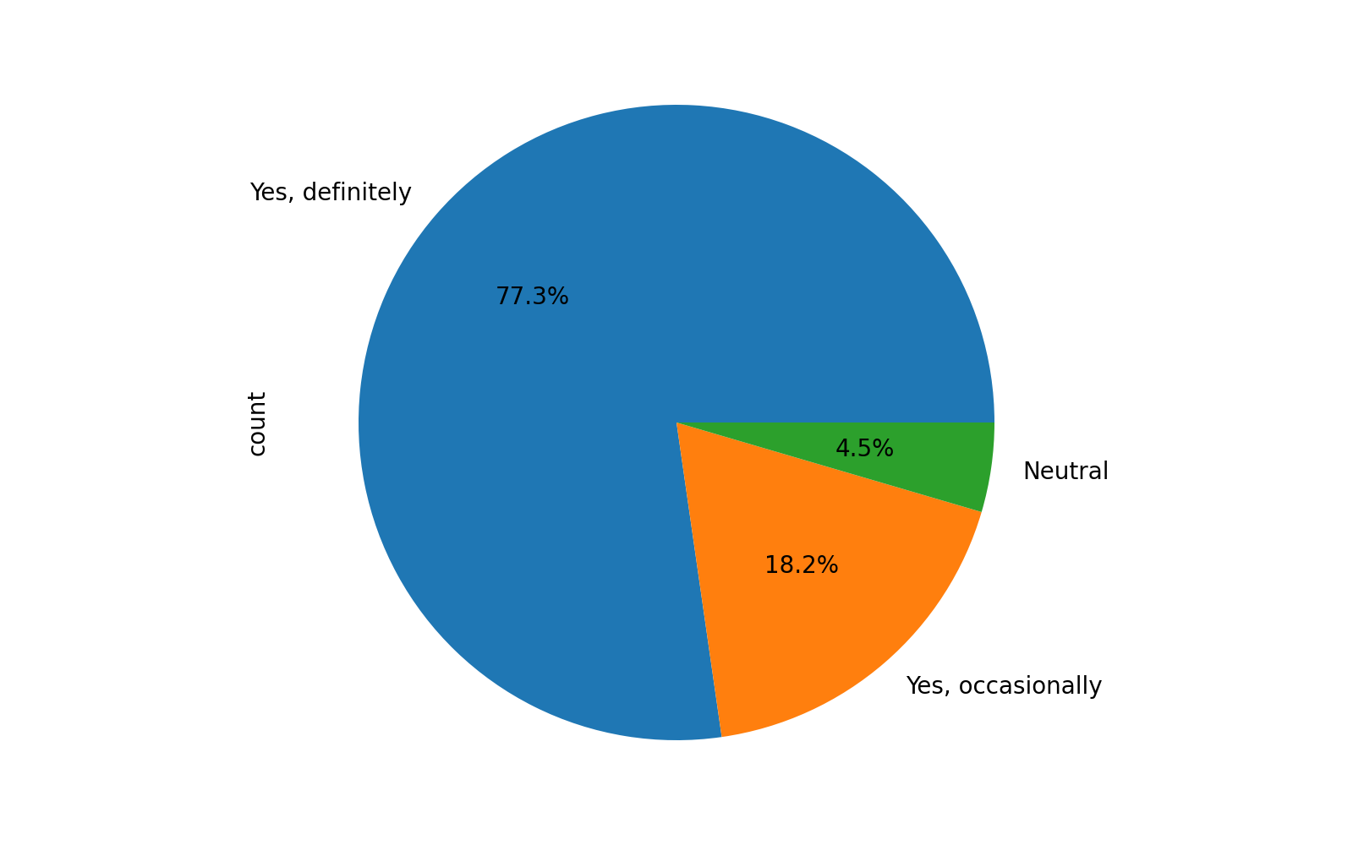
Visitor Demand for Continuation
Visitors who engaged express strong support for repeating the stall at future events.

Slide 5
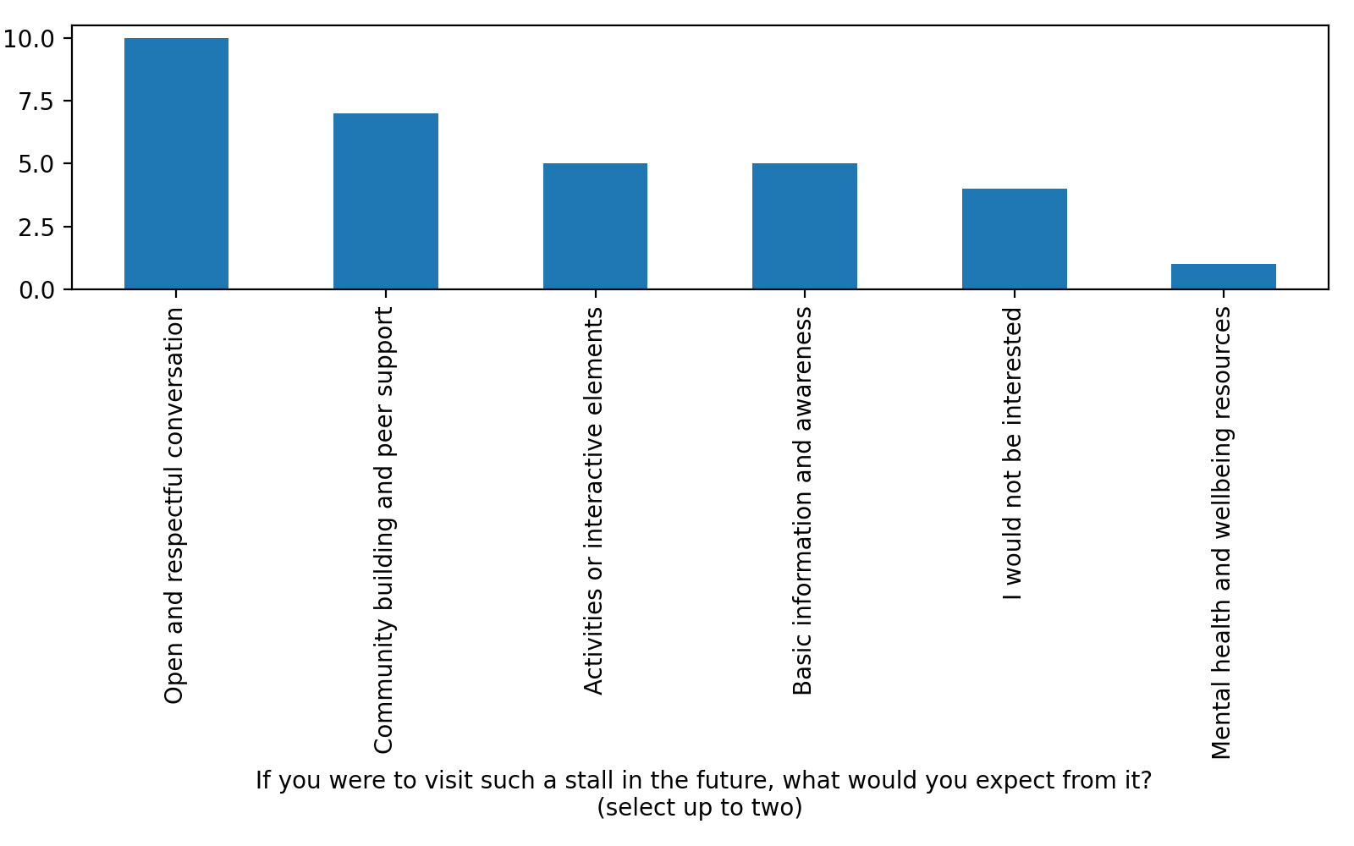
Expectations Among Non Visitors
Non visitors primarily expect conversation, community support, and awareness.

Slide 6
Clarifying the Current Goal
The immediate objective is approval to set up a Pride stall at the next campus event.
This proposal does not seek formal society recognition at this stage.
The focus is on demonstrating safety, relevance, and positive student engagement.

Slide 7
Community and Volunteer Feedback
Internal reflections from community members indicate:
• Students felt seen and respected during interactions
• There is a clear need for visible, low pressure safe spaces
• Even informal stalls spark meaningful dialogue and curiosity

Slide 8
Why Approving a Stall Matters
Feedback consistently highlights that a stall:
• Normalises respectful conversation
• Supports student wellbeing without disruption
• Serves as a minimal risk, high impact initiative for the campus

