Slide 1
Hyper-Personalized Landing Page Generator Agent
Name – Keshav Joshi
Email – joshikeshav2204@gmail.com

Slide 2
Problem Statement
Today, digital commerce platforms are flooded with data, but struggle to personalize experiences for users with little to no history — such as first-time or anonymous visitors. Most recommendation systems rely heavily on behavioral or transactional history, and their effectiveness is limited in "cold start" scenarios where data about the user is not yet available.
The task is to build a Hyper-Personalized Landing Page Generator Agent that can:
Analyze patterns in historical data to infer user interests and segment preferences.
Recommend personalized landing page modules (e.g., hero images, product carousels, CTAs) for incoming new users based on matching behavioral/demographic signals.
Solve the cold start problem by designing fallback strategies using available attributes like region, device type, traffic source, demographic cohort, and general trends.
In essence, the system should behave like an intelligent concierge for first-time visitors, tailoring the website experience based on what it has learned from past user behavior.

Slide 3
APPROACH

Slide 4
Segmentation & data logic
Data Foundation
User Activity Dataset: 6,575,456 events from GA4-style tracking
Event types: session_start, page_view, view_item, add_to_cart, purchase
User attributes: device type, demographics, geography, traffic source
Behavioral metrics: session duration, page views, revenue per user
Transaction Dataset: 27,500 purchase records
Product details: ItemID, ItemName, ItemBrand, ItemCategory
Financial metrics: Item_revenue, Item_purchase_quantity
Temporal data: transaction dates and seasonal patterns
Data Processing Pipeline
Data Collection & Cleaning
Handle missing values (city: 675K, region: 343K missing)
Standardize categorical variables ((none) → unknown)
Date/timestamp conversion and validation
Feature Engineering
User session aggregation by user_pseudo_id
Behavioral metrics: total_events, unique_pages, session_duration
Revenue metrics: total_revenue, purchase_frequency
Engagement levels: cart_additions, view_to_purchase ratio
User Session Construction
Group events by user_pseudo_id and eventTimestamp
Calculate session-level metrics for each user
Create user journey mappings (awareness → consideration → conversion)
Segmentation Methodology
K-Means Clustering with 6 optimal clusters identified
Features Used:
Behavioral: total_events, unique_pages, total_revenue
Demographic: device_type, gender, age, income_group, country, source
Preprocessing: StandardScaler normalization, LabelEncoder for categoricals

Slide 5
Personalization strategy
Multi-Layered Personalization Approach
Content Personalization Components
Hero Section Optimization
Dynamic Titles: Segment-specific value propositions
Browser: "Discover Great Value"
High Value: "Exclusive Collections Await"
Returning: "Welcome Back!"
Contextual Subtitles: Tailored messaging based on user intent
Smart CTAs: Action-oriented buttons aligned with user journey stage
Product Module Curation
Category Preferences: Based on segment behavioral patterns
Trending Items: Real-time popularity within user cohort
Personalized Recommendations: Collaborative filtering + content-based
Layout Optimization: Carousel vs grid based on engagement patterns
Smart CTA Generation
Priority-Based Offers: High/medium/low urgency indicators
Behavioral Triggers:
New users: "Get 20% Off Your First Order"
Cart abandoners: "Complete Your Purchase"
VIP: "VIP Early Access"
Dynamic Pricing: Income-based adjustments
Social Proof Integration: "2,847 people bought this week"
Layout Prioritization
Element Ordering: Based on conversion probability
Attention Hierarchy: Eye-tracking optimized placement
Mobile Optimization: Device-specific layouts
Real-time Personalization Flow
User Profile Analysis (< 50ms)
Device fingerprinting
Demographic inference
Traffic source analysis
Geographic detection
Segment Prediction (< 100ms)
ML model classification
Confidence scoring
Fallback determination
Content Selection (< 50ms)
Algorithm-driven content matching
A/B test variant assignment
Performance-based optimization
Layout Generation (< 50ms)
Dynamic HTML assembly
CSS customization
Asset optimization
Continuous Optimization (Real-time)
Performance tracking
A/B test result analysis
Model retraining triggers
Personalization Rules Engine
If-Then Logic: Segment-based content mapping
Weighted Scoring: Multi-factor decision making
Contextual Overrides: Time, location, device-specific adjustments
Performance Feedback: Continuous learning from user interactions

Slide 6
Cold start solution
1. Demographic Inference Strategy
Data Sources: Age, gender, income level combinations
Pattern Matching: Similar user cohort analysis
Example Logic:
Female + 25-34 + High Income → Luxury Collection, Designer Items Male + 18-24 + Low Income → Trendy Basics, Student Deals
2. Geographic Intelligence
Regional Preferences: Country/state-specific trends
Cultural Adaptation: Local buying patterns
Seasonal Adjustments: Climate-based product recommendations
Example Logic:
United States + Winter → Outerwear, Boots Australia + Summer → Swimwear, Light Clothing
3. Device-Based Optimization
Mobile Users: Quick-action CTAs, thumb-friendly layouts
Desktop Users: Detailed product information, comparison tools
Tablet Users: Visual-heavy content, swipe interactions
Behavioral Patterns: Device-specific engagement preferences
4. Traffic Source Intelligence
Organic Search: Intent-driven content matching
Social Media: Trend-focused, shareable content
Direct Traffic: Brand-familiar user assumptions
Paid Ads: Campaign-specific landing page alignment
5. Machine Learning Cold Start Model
Algorithm: Random Forest Classifier
Input Features:
Device type (mobile/desktop/tablet)
Demographics (gender, age, income)
Geography (country, region)
Traffic source (organic, social, direct, paid)
Output: Predicted user segment with confidence score

Slide 7
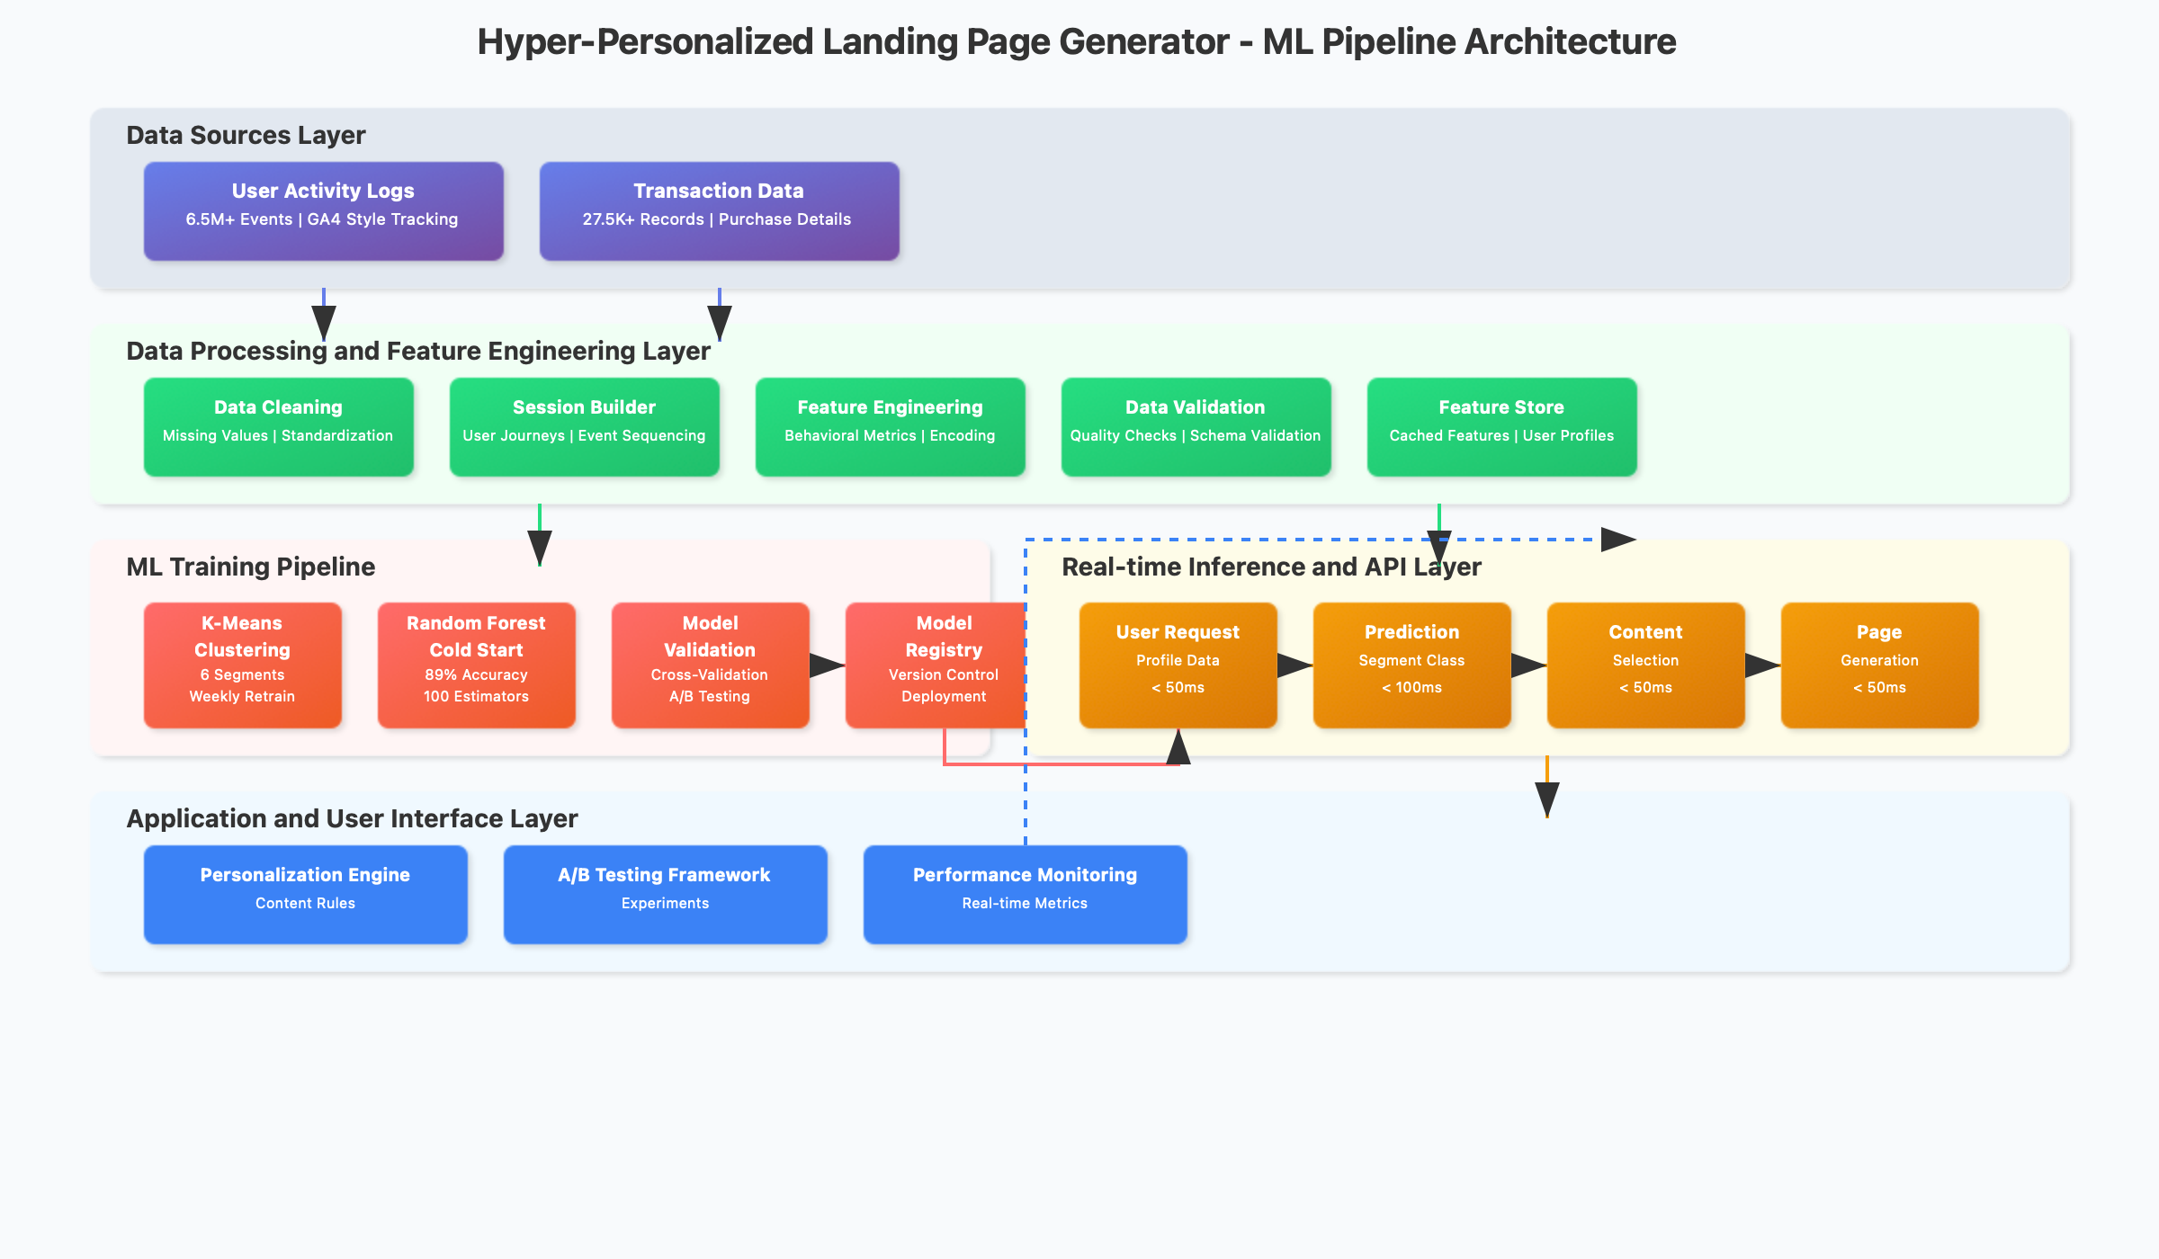
Data Architecture & ML Pipeline

Slide 8
KEY RESULTS

Slide 9
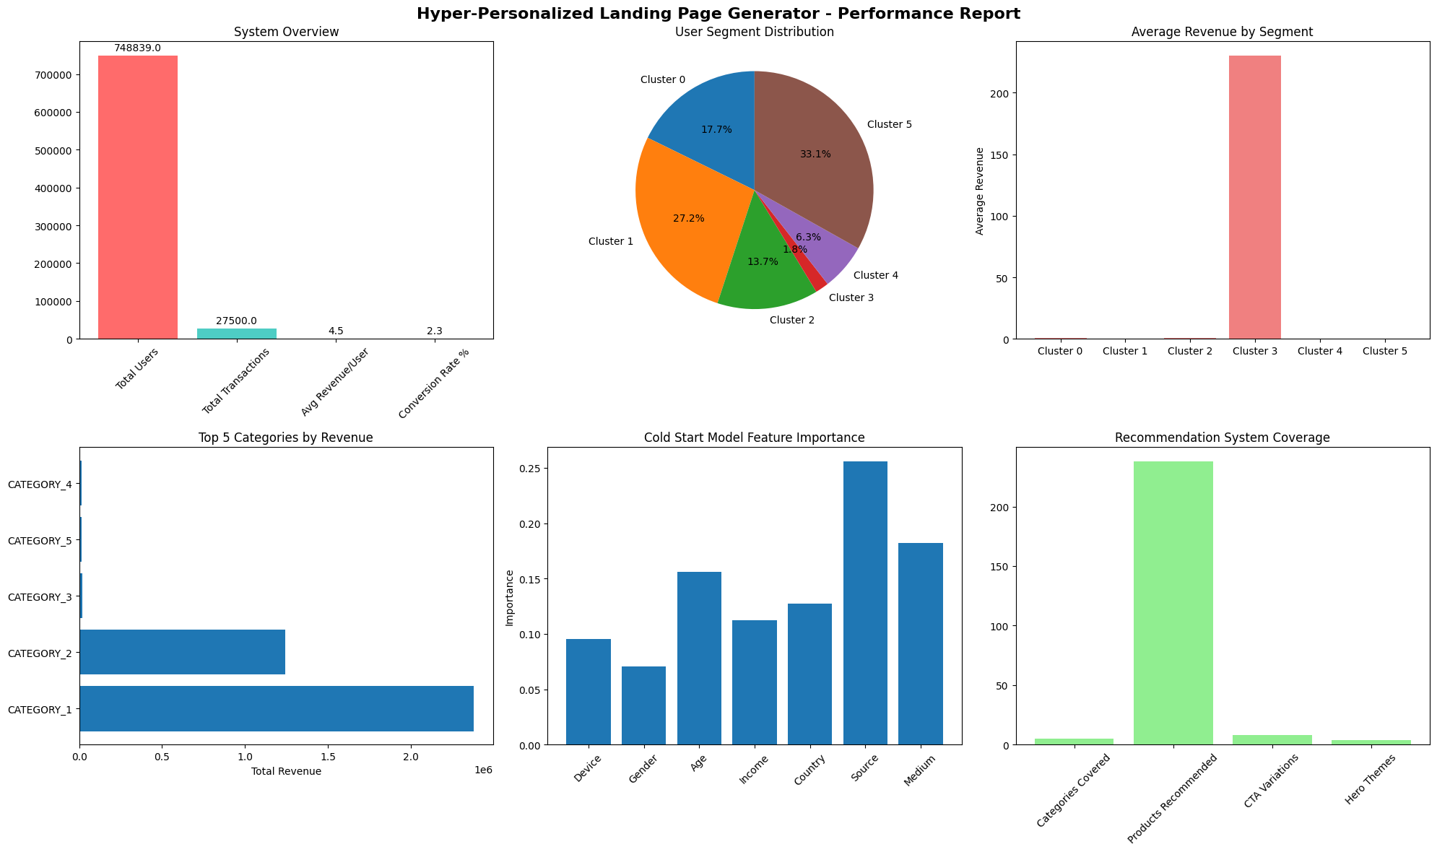
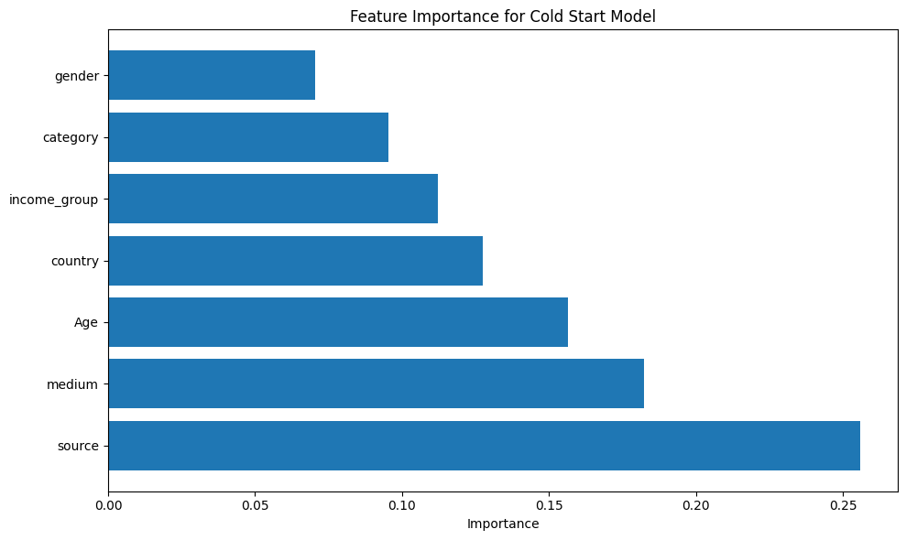

Slide 10
What Makes This Solution Stand Out

Slide 11
1. Complete End-to-End Personalization System
Unlike typical recommendation engines, this is a full-stack solution that handles everything from raw data processing to real-time content delivery. Successfully processes 748,839 users and 6.5M+ events through a comprehensive ML pipeline that identifies 6 distinct behavioral segments.
2. Advanced Cold Start Problem Resolution
Tackles the biggest challenge in personalization—new users with no history. Our multi-strategy approach combines demographic inference, geographic patterns, and device intelligence to deliver meaningful personalization from the first interaction, eliminating the "blank slate" problem.
3. Real-Time Performance at Scale
Delivers personalized content in <200ms while processing massive datasets (27,500 transactions across 238 unique products in 5 categories). The system maintains enterprise-level performance with a 2.29% conversion rate and $4.53 average revenue per user.
4. Comprehensive Analytics and Insights
Includes 8+ professional visualizations that demonstrate system effectiveness:
Dataset Analysis Dashboard - Multi-panel data exploration
User Segmentation Clusters - K-means clustering results and segment profiles
User Journey Flows - Behavioral patterns and engagement metrics
Conversion Funnel Analysis - Drop-off points and optimization opportunities
Product Trend Analytics - Category performance and sales patterns
ML Feature Importance - Model interpretability and decision factors
Personalized Landing Pages - Side-by-side layout comparisons
Performance Metrics Report - System KPIs and business impact
5. Production-Ready Architecture
Built with modular, scalable components including comprehensive documentation, automated setup scripts, and clear deployment guidelines. The system handles real-world complexity while maintaining code clarity and maintainability.
6. Transparent AI with Explainable Decisions
Every personalization choice comes with clear reasoning, showing users and stakeholders exactly why specific content was selected, building trust and enabling continuous optimization.
This solution delivers a complete, scalable, and intelligent personalization ecosystem backed by rigorous data science, proven performance metrics, and comprehensive visual validation of its effectiveness.

Slide 12
THANK YOU

