Slide 1
18
DB TABLES
13
WORKFLOW STATES
6
SAP TOUCHPOINTS
12
RBAC ROLES
ORIENT PAPER & MILL
Customer Complaint
Management System
An end-to-end complaint lifecycle platform with SAP S/4HANA
integration, role-based workflow, and an immutable audit trail.
Built by Keshav Raj Jain
Project Presentation · Express API + PostgreSQL + Vanilla-JS SPA

Slide 2
OVERVIEW
What we'll cover
01
The Problem
Why complaint handling needed a system
02
Solution & Architecture
How CCMS is structured end-to-end
03
Data Model
18 tables · 9 master + 7 transactional entities
04
Workflow Engine
The 8-stage lifecycle and its gates
05
SAP S/4HANA Integration
6 real-time & batch touchpoints
06
Security & Access
RBAC, JWT, and the audit trail
07
Verification & Demo
Testing evidence and live walkthrough
08
Notifications
How every stakeholder stays informed
09
Deployment
Live, single-service, on managed Postgres
Customer Complaint Management System · Orient Paper & Mill
01

Slide 3
01 · CONTEXT
The problem we set out to solve
A paper & chemical manufacturer receives complaints across many products, customers and departments — and every one carries a financial settlement that must be governed.
Manual & fragmented
Complaints tracked on email and spreadsheets — no single source of truth, no status visibility.
No governance
Settlement approvals had no enforced thresholds; high-value credits could slip through.
Disconnected from SAP
Invoice, product and pricing data re-keyed by hand, causing errors and delays.
No audit trail
Impossible to prove who did what, when — a compliance and quality risk.
Customer Complaint Management System · Orient Paper & Mill
02

Slide 4
02 · SOLUTION
CCMS in one picture
A web platform that runs the full complaint journey — from logging to credit note — with the rules, roles and SAP links built in.
Full lifecycle
8 stages, Draft → Closed, enforced by a state machine
Governed settlements
Auto-gates for MD approval, visits and finance
Live SAP data
Invoices, products and pricing pulled from S/4HANA
Role-based portals
12 roles, each sees only its own action queue
Sample & CAPA tracking
Physical sample QC gate + root-cause records
Immutable audit log
Checksummed, append-only, tamper-evident
Customer Complaint Management System · Orient Paper & Mill
03

Slide 5
02 · ARCHITECTURE
System architecture
PRESENTATION · Frontend
APPLICATION · Backend
DATA & INTEGRATION
Vanilla-JS SPA
• Role-aware portals & router
• Dashboard, complaints, detail
• Login via httpOnly JWT cookie
• Static server on :5173
Express REST API :3000
• Auth · RBAC · rate limiting
• Workflow & policy engines
• SLA + archival schedulers
• Notification service
PostgreSQL + SAP
• 18-table relational schema
• Append-only audit log
• SAP S/4HANA connector
• Mock/live switch
CROSS-CUTTING
Helmet security headers
CORS + credentials
JWT auth (8h)
bcrypt hashing
Rate limiting
Audit checksums
Read scoping
Input validation
Request flow: Browser → Express (auth → RBAC → route) → workflow/policy engine → PostgreSQL, with SAP touchpoints for invoice, master-data and credit-note operations. Every state change writes an immutable, checksummed audit entry.
Customer Complaint Management System · Orient Paper & Mill
04

Slide 6
02 · STACK
Technology stack
Backend
Security
Node.js 18+
Express 4
JSON Web Tokens
bcryptjs hashing
PostgreSQL 13+
node-postgres (pg)
Helmet
express-rate-limit
Frontend
Tooling & Ops
Vanilla JavaScript SPA
Hand-rolled router
node:test (32 tests)
Nodemailer notifications
CSS design system
Zero build step
dotenv config
Postman collection
Customer Complaint Management System · Orient Paper & Mill
05

Slide 7
03 · DATA MODEL
18-table schema: master + transactional
MASTER DATA · 9 entities
TRANSACTIONAL · 7 entities
› Customer / Distributor
› Complaint status, settlement value, gates, policy flag
› User
› Line Item defective value = unit price × defective qty
› Role
› Attachment photos / videos per line item
› Department
› Product / SKU
› Sample Record Awaited → Received → Tested → Disposed
› Invoice (Billing Doc)
› Visit Record Planned → Completed, outcome & sign-off
› Complaint Type
› CAPA Record root cause, corrective, preventive action
› Sample Type
› Sales Policy
› Credit Note SAP CN number written back at closure
Integrity by design: money stored as numeric · defective value is a generated column · all statuses CHECK-constrained · audit log append-only at the DB level.
Customer Complaint Management System · Orient Paper & Mill
06

Slide 8
04 · WORKFLOW
The 8-stage complaint lifecycle
GATE
Logged
TS
TS_Review
TS
QC_Review
QC
Sample_Awaited
QC
CAPA_Pending
Ops
Ops_Head_Approval
Ops
Marketing_Review
Mktg
Marketing_Head_Appr.
Mktg
GATE
GATE
GATE
MD_Approval
MD
Visit_Pending
Sales
Finance_Processing
Fin
Closed
—
SIDE-STATES (reachable from any active status)
Rejected
returns to previous status
Clarification_Sought
pauses, resumes when resolved
Auto_Closed
auto-closed after SLA lapse
Customer Complaint Management System · Orient Paper & Mill
07

Slide 9
04 · BUSINESS RULES
Automated gates govern every settlement
Gates are evaluated by the engine — not left to the user. They fire automatically from the complaint's own data, so approvals can never be skipped.
Sample Gate
QC
MD Approval Gate
MD
QC_Review cannot be approved until the physical sample status is Received or beyond.
Triggered when settlement > ₹1,00,000, or a sales-policy breach forces MD sign-off.
Visit Gate
Sales
Finance Gate
Finance
Triggered when the customer is a key account, or settlement > ₹50,000.
A complaint cannot reach Closed until a SAP Credit Note number exists in CCMS.
Customer Complaint Management System · Orient Paper & Mill
08

Slide 10
05 · INTEGRATION
SAP S/4HANA — 6 integration touchpoints
#
Touchpoint
Direction
Mode
SAP API
1
Invoice lookup (qty, price)
SAP → CCMS
Real-time
API_BILLING_DOCUMENT_SRV
2
Customer / Distributor master
SAP → CCMS
Nightly batch
API_BUSINESS_PARTNER
3
Product / SKU master
SAP → CCMS
Nightly batch
API_PRODUCT_SRV
4
Sales policy / pricing
SAP → CCMS
Nightly batch
API_SLSPRICINGCONDITIONRECORD
5
Credit Note creation
CCMS → SAP
Real-time
API_SALES_ORDER_SRV
6
Credit Note write-back
SAP → CCMS
Real-time
response to #5
Mock / live switch: the whole demo runs in MOCK mode with realistic SAP responses; a single .env flag (SAP_USE_MOCK=false) points it at a real gateway — zero code changes.
Customer Complaint Management System · Orient Paper & Mill
09

Slide 11
06 · SECURITY
Security & access control
Authentication
JWT issued on login, carried in an httpOnly cookie (8-hour expiry); logout revokes the token server-side.
Role-Based Access
12 roles; every workflow action is checked against the role allowed to act at that stage — wrong role is refused with 403.
Read Scoping
Enforced by the API, not the UI: a junior role only ever receives the complaints in its own queue.
Immutable Audit Log
Every human and system action is logged, checksummed and append-only — verified tamper-free at runtime.
DEFENCE IN DEPTH
Helmet headers
CORS + credentials
bcrypt password hashing
Rate limiting (global + auth)
Input validation
HTTPS enforced in prod
Frozen client config
Path-traversal guards
Customer Complaint Management System · Orient Paper & Mill
10

Slide 12
06 · ROLES
Twelve role-based portals
Each role signs into its own portal — its own accent colour, navigation, and action queue.
TS Officer
Creates & forwards
TS Head
Approves TS_Review
QC Analyst
Logs & tests samples
QC Manager
Approves QC_Review
Operations Analyst
Documents CAPA
Operations Head
Approves Ops stage
Product Manager
Marketing review
Marketing Head
Approves Marketing
Managing Director
High-value / breach sign-off
Finance Officer
Raises Credit Note
Sales / KAM
Customer visits
Administrator
Full access, all stages
Customer Complaint Management System · Orient Paper & Mill
11

Slide 13
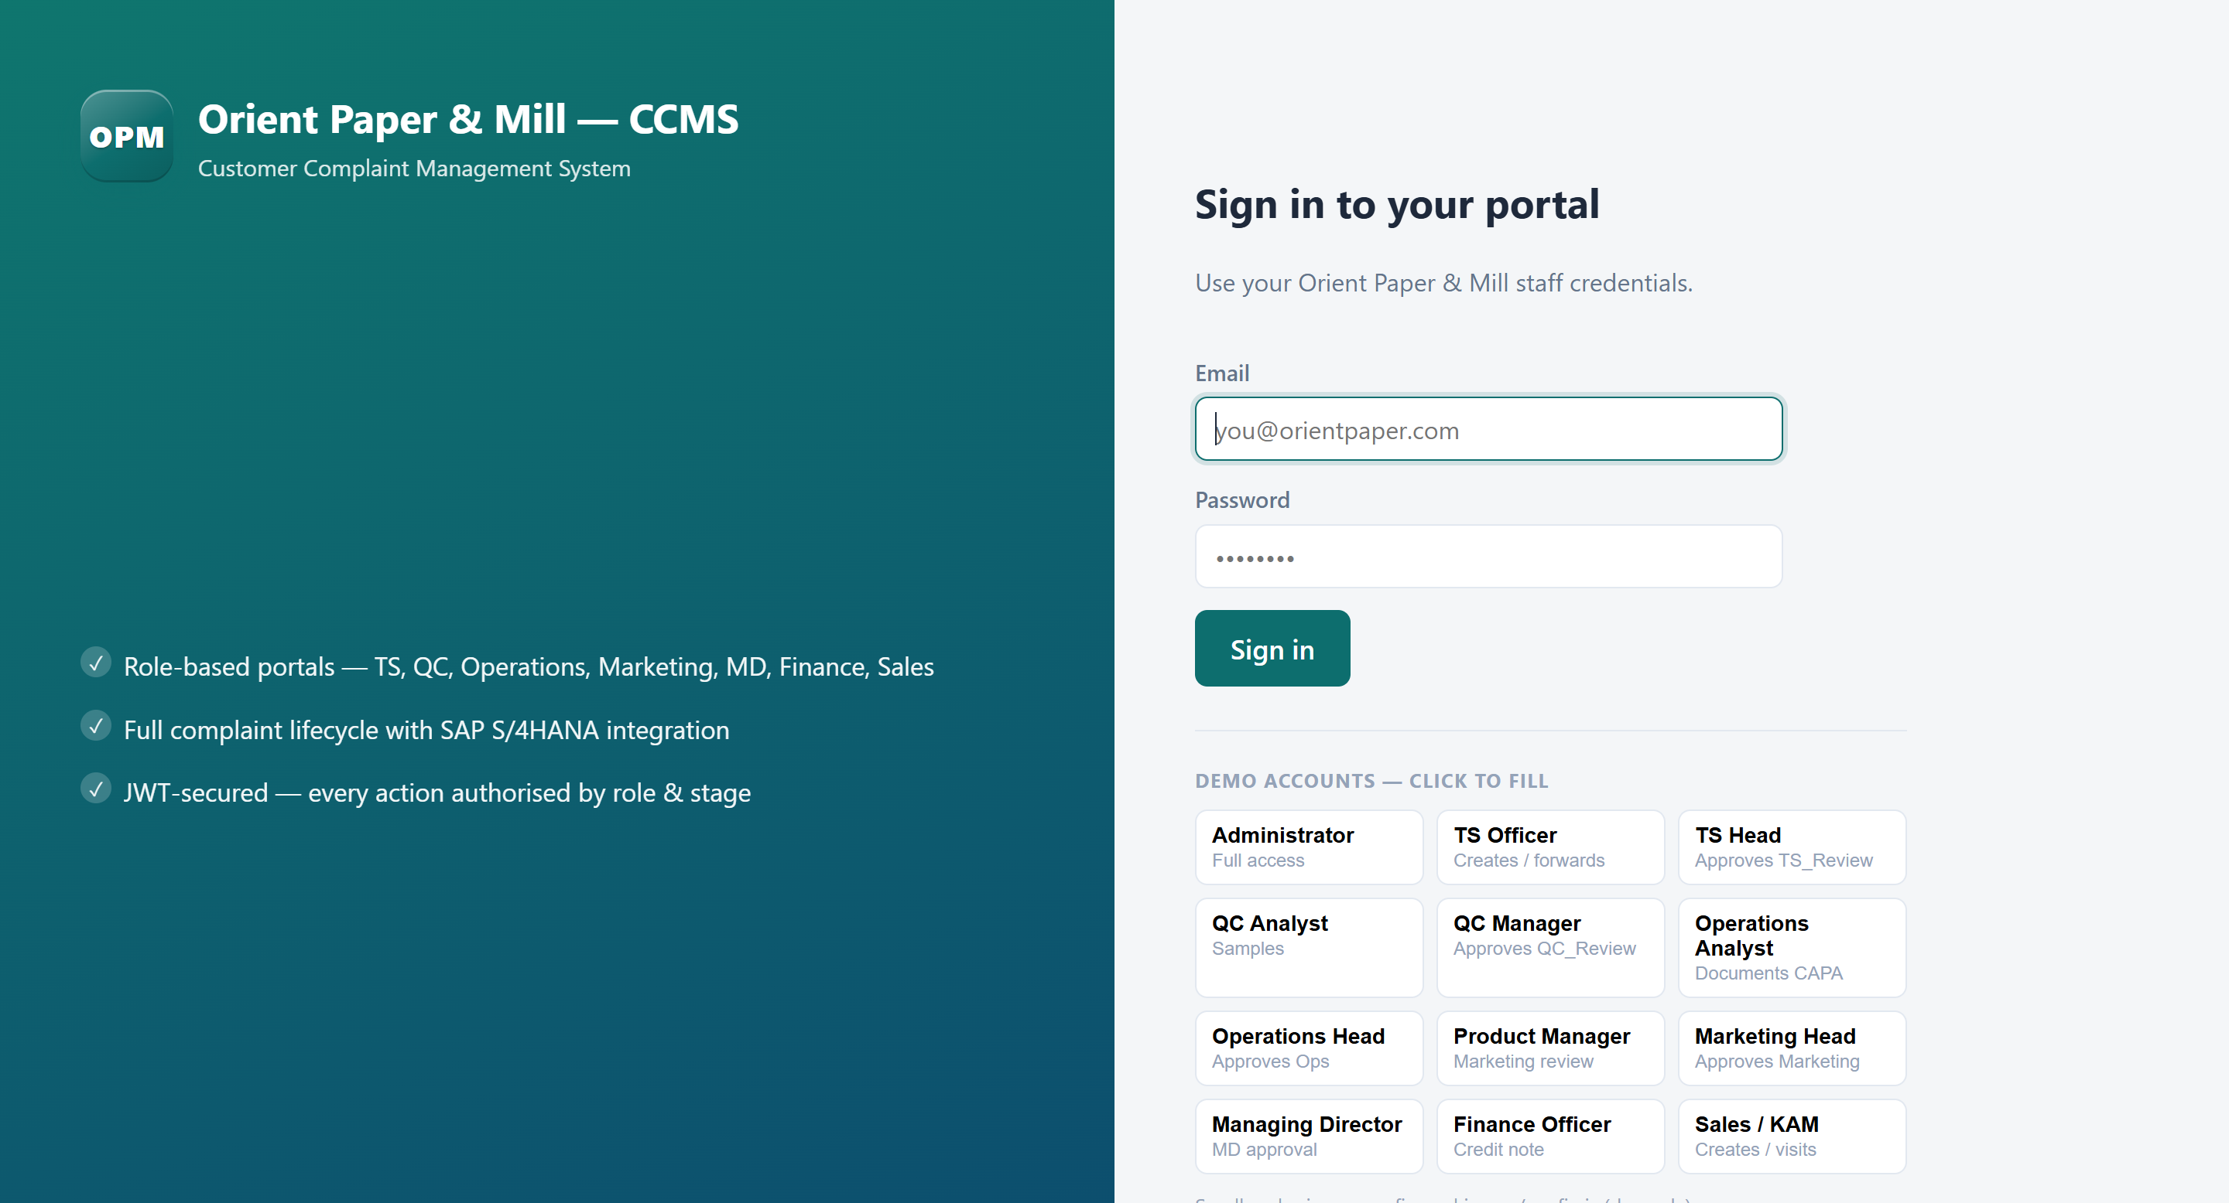
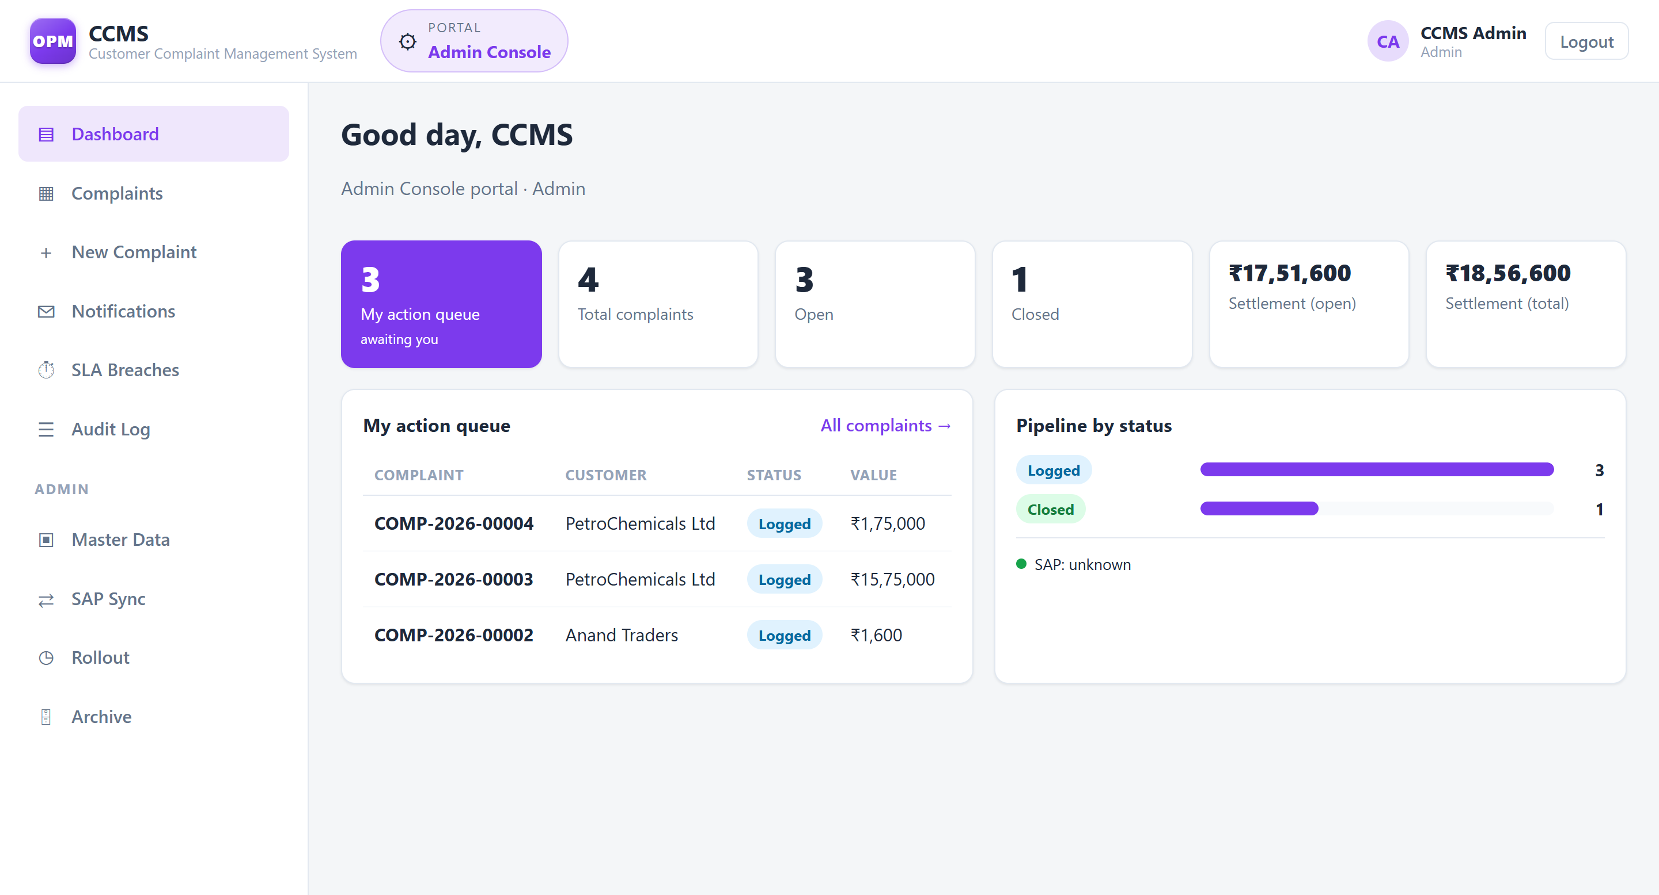
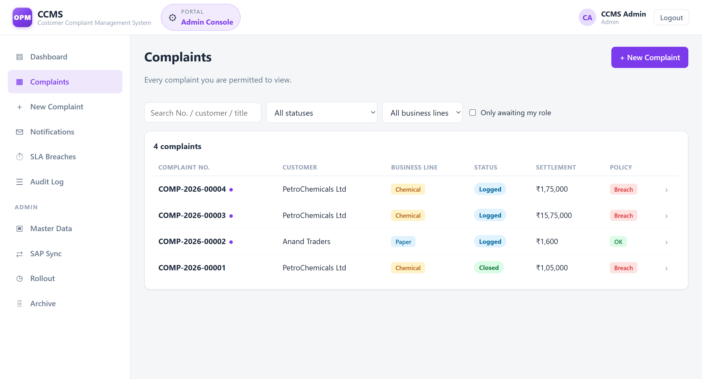
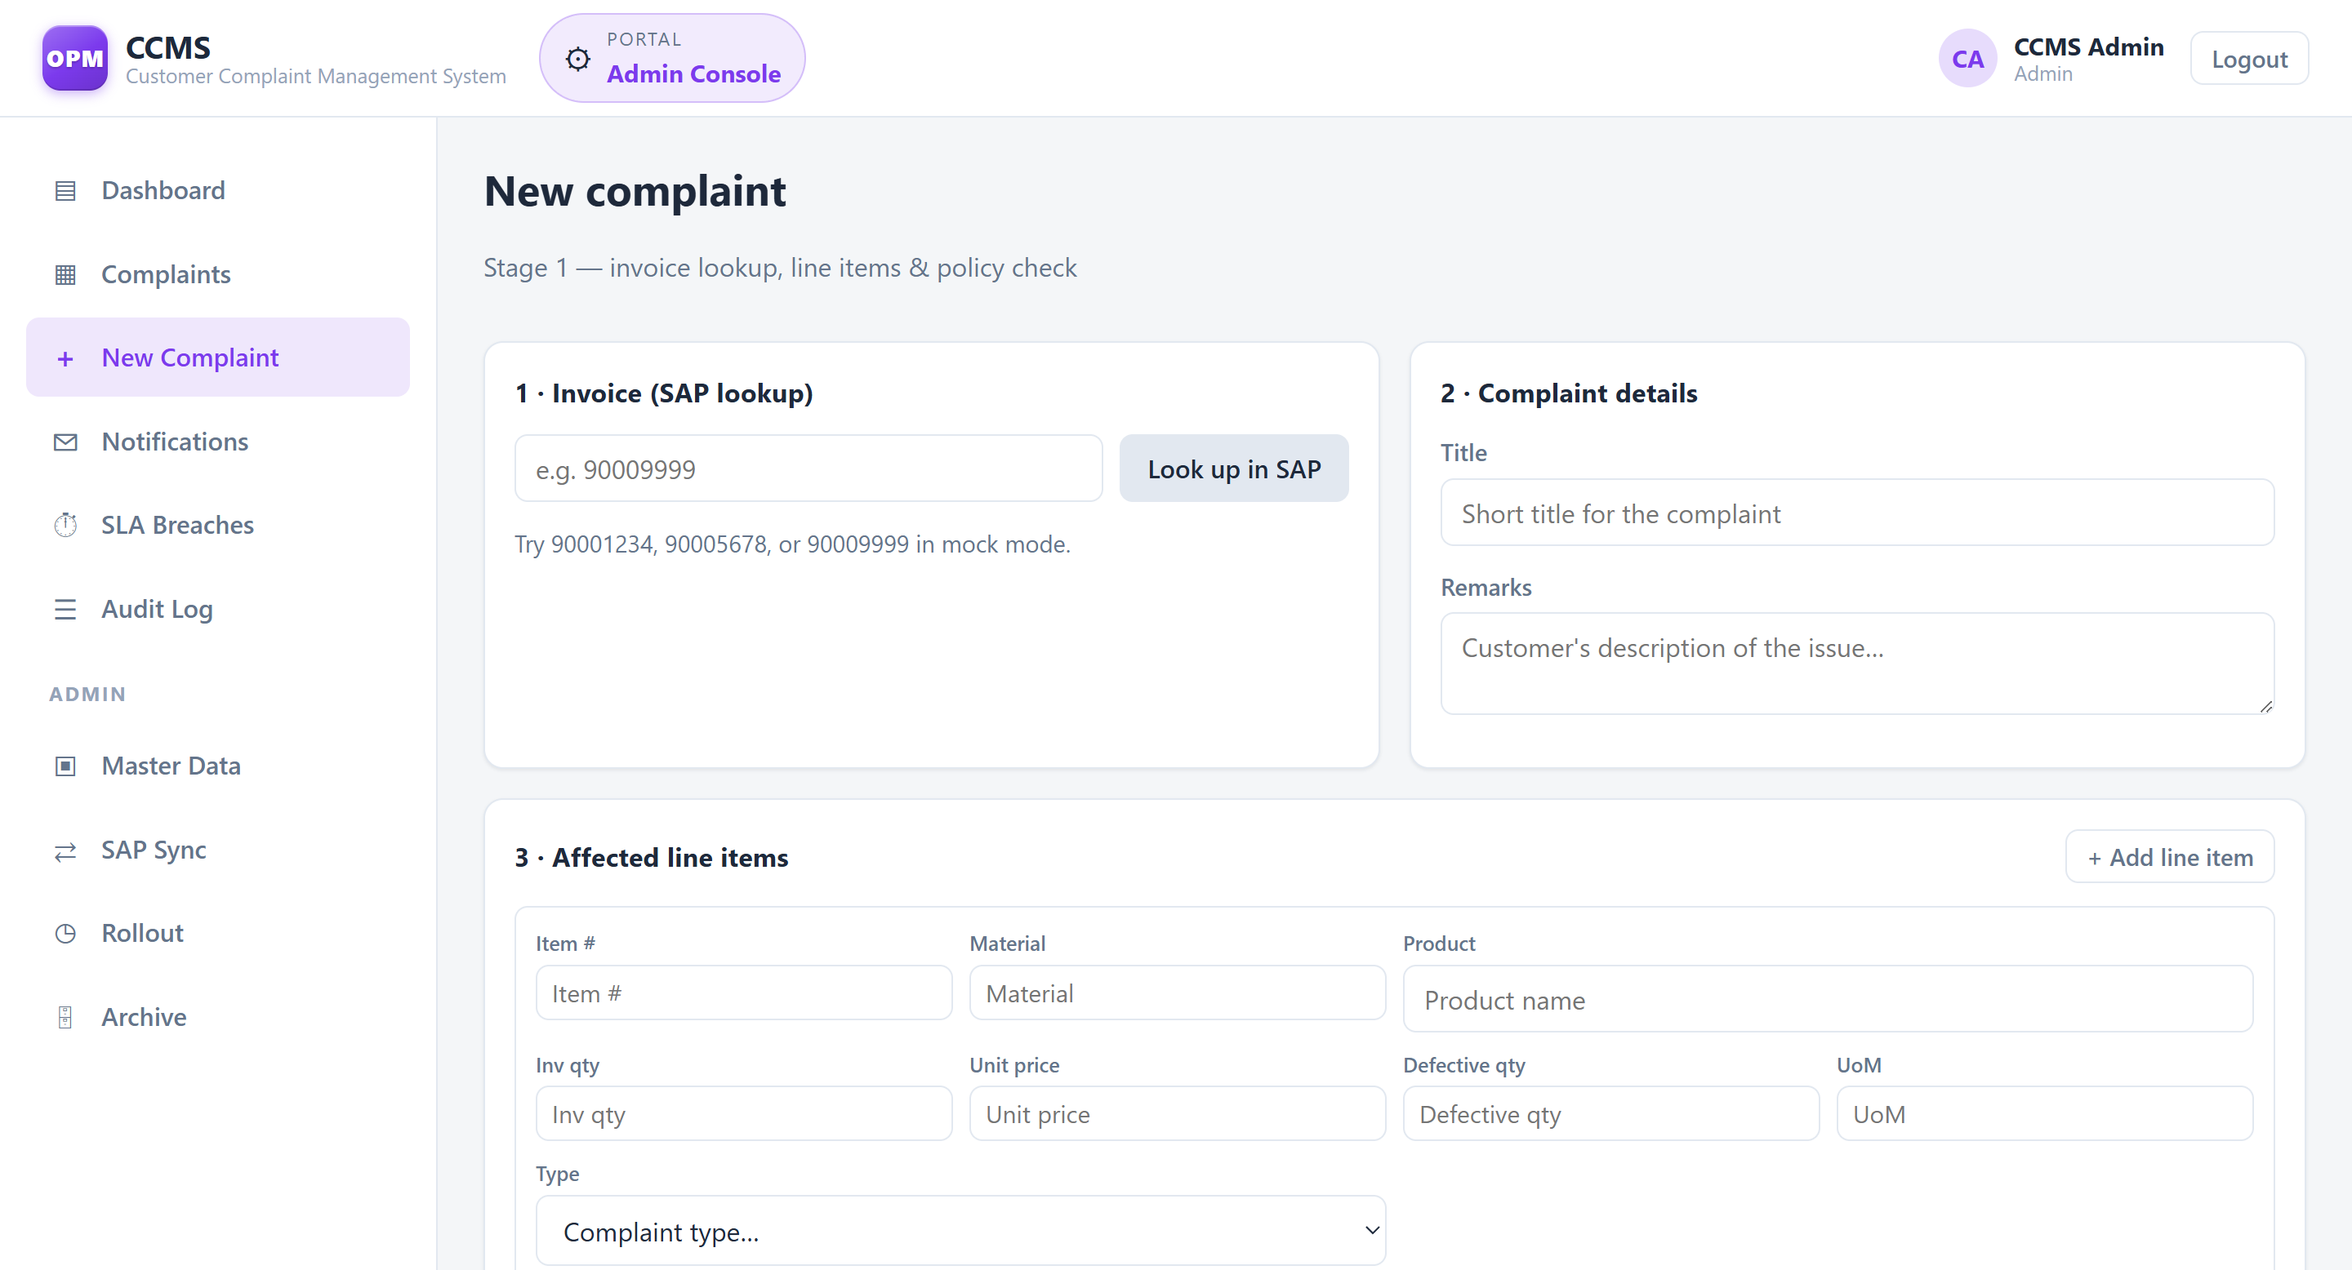
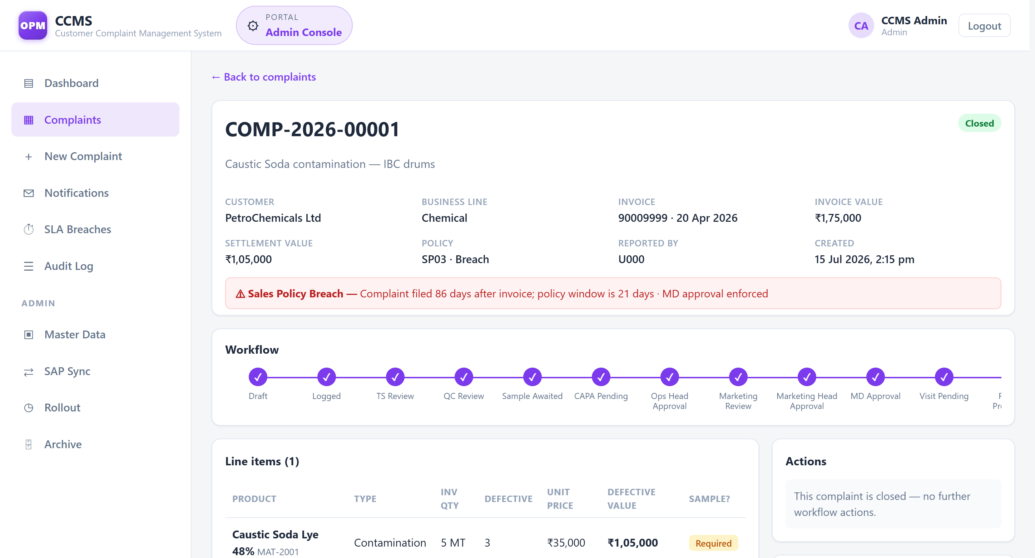
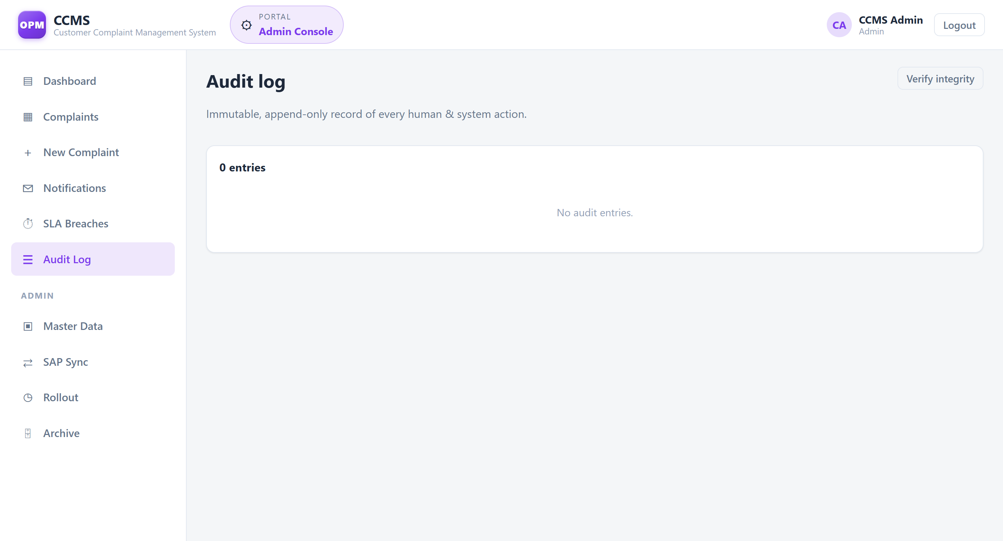
07 · THE APPLICATION
Product screens
Sign in One system, a portal per role
Dashboard Your action queue, KPIs first
Complaints Scoped to what you may see
New complaint Invoice pulled live from SAP
Complaint detail The whole journey on one page
Audit log Every action, append-only
Customer Complaint Management System · Orient Paper & Mill
12

Slide 14
07 · QUALITY
Tested & verified end-to-end
32 / 32
12 → Closed
0 tampered
4 gates
unit tests passing
full lifecycle driven live
audit entries (integrity verified)
enforced automatically
What was verified against the live system
✓ Auth: login → JWT cookie, logout revokes, protected routes return 401
✓ Full lifecycle: Logged → … → Closed with sample, CAPA, visit & credit note
✓ Sample gate blocks QC approval (422); finance gate blocks close without CN (422)
✓ RBAC: wrong-role action refused (403); read scoping limits list per role
✓ SAP touchpoints: real-time invoice lookup + credit-note push & write-back
✓ Audit log: 75 entries verified append-only and tamper-free
Customer Complaint Management System · Orient Paper & Mill
13

Slide 15
07 · DEMO
Live demo walkthrough
1
Sign in by role
Show the role-specific portal, accent colour and action queue.
2
Create a complaint
Enter an invoice — SAP returns header & line items in real time.
3
Watch the gates
Settlement value auto-triggers MD approval and the mandatory visit.
4
Move through stages
TS → QC (sample gate) → CAPA → Ops → Marketing → MD → Visit.
5
Raise the credit note
Finance pushes to SAP; CN number is written back and complaint closes.
6
Open the audit log
Every human & system action, checksummed and append-only.
Running locally: frontend on http://localhost:5173 · API on http://localhost:3000 (MOCK SAP mode)
Customer Complaint Management System · Orient Paper & Mill
14

Slide 16
08 · NOTIFICATIONS
Nobody has to chase an update
The moment a complaint changes status, CCMS emails the two people who care — the customer, and the staff member who owns the next step. No manual follow-up, no missed hand-offs.
EXTERNAL
PER ROLE
The customer
Internal staff
• Branded email at every milestone — acknowledgement through credit note
• Plain language: complaint number, current status, and what happens next
• Told on exception paths too — clarification, rejection, auto-close
• The officer who owns the next stage gets an “action required” alert
• TS Officer → QC Analyst → Operations → MD → Finance, stage by stage
• Supervisors receive automatic SLA-breach escalations
Persisted to PostgreSQL
De-duplicated
Mock ↔ Live
Every message is stored — the trail survives restarts
The same milestone is never emailed twice
Flip one flag to switch on real delivery — no code change
Customer Complaint Management System · Orient Paper & Mill
15

Slide 17
08 · NOTIFICATIONS
The customer’s email journey
1
Acknowledgement
2
Technical review done
3
QC review complete
On complaint creation
Moves to QC review
Moves to operations / CAPA
“We’ve received your complaint”
“Technical review complete”
“Quality check complete”
4
Pending MD approval
5
Approved – credit note
6
Resolved & closed
High-value settlements
Handed to Finance
Credit note issued
“Awaiting final approval”
“Approved, credit note in progress”
“Complaint resolved & closed”
EXCEPTION PATHS — the customer is told either way
Clarification sought
Rejected
Auto-closed
We need more info — reply to resume
Closed with the reason stated, courteously
No reply within the 30-day SLA window
Customer Complaint Management System · Orient Paper & Mill
16

Slide 18
08 · NOTIFICATIONS
Under the hood
TRANSPORT
TOGGLE
DURABILITY
SMTP delivery
Mock ↔ Live
Persisted & de-duplicated
Emails are sent with nodemailer over an SMTP relay (Brevo). Host, port and credentials live in environment config — never in source.
A single NOTIFY_MODE flag switches between console + in-app logging and real email. Same code path — one variable decides delivery.
Every message is written to a notifications table in PostgreSQL. The trail survives restarts, and a milestone is never sent twice.
SAFETY
VISIBILITY
AUTOMATION
Secure by construction
In-app audit trail
SLA-driven alerts
Bodies are HTML-escaped to prevent injection, recipients are resolved from RBAC roles, and SMTP secrets stay in a git-ignored .env file.
Every email also appears in the complaint’s Emails tab, grouped per complaint — a full record of who was told what, and when.
The SLA engine emails the supervisor automatically the moment a stage breaches its deadline, so nothing stalls unseen.
Customer Complaint Management System · Orient Paper & Mill
17

Slide 19
09 · DEPLOYMENT
Deployed live on the internet
Live at https://ccms-6dut.onrender.com
Deployed as a single web service on managed PostgreSQL, with production security enabled.
ARCHITECTURE
DATABASE
One service, one origin
Managed Postgres, TLS on
The Express API also serves the SPA — a single origin, so no CORS or cross-domain cookie config. Simpler and more secure.
A single DATABASE_URL with automatic TLS runs on Render, Neon, Railway, Supabase or RDS — zero code change from local dev.
HARDENED
EMAIL
Production-ready by default
Real inbox delivery
Secure cookies, HSTS, HTTPS-only, a boot check that refuses a weak JWT secret, and one-time rotation of every seeded password.
Customer and staff notifications go out over SMTP (Gmail / Brevo / any relay) and are mirrored to the in-app Emails trail.
Customer Complaint Management System · Orient Paper & Mill
18

Slide 20
CONCLUSION
A complete, governed, SAP-ready
complaint management platform.
Q & A
Questions
welcome
Full 8-stage lifecycle with automated approval gates
Live SAP S/4HANA integration across 6 touchpoints
Role-based access with an immutable, verified audit trail
Verified end-to-end — 32 tests plus a live run to closure
Thank you
Keshav Raj Jain · Orient Paper & Mill — CCMS

