Slide 1
Coffee Sales Performance Dashboard
Data Analysis using Excel, SQL, and Tableau

Slide 2
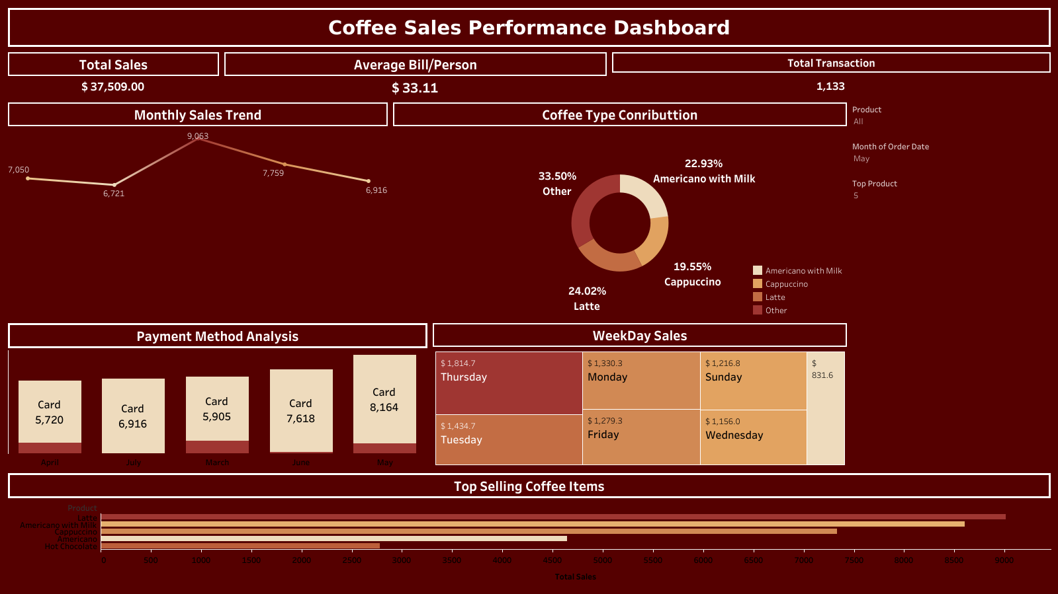
Coffee Sales Dashboard Overview

Slide 3
Key Insights from Dashboard
- Total Sales: $37,509.00
- Total Transactions: 1,133
- Average Bill per Person: $33.11
- Best Selling Product: Americano with Milk (22.93%)
- Top Sales Day: Thursday ($1,814.7)
- Top Month: May ($9,063)
- Preferred Payment Method: Card (Highest in May with $8,164)

Slide 4
SQL Analysis Overview
Key SQL Queries Used:
1. Total Sales Calculation
2. Top 5 Coffee Products by Sales
3. Sales Trend by Month
4. Sales by Payment Type
5. Top Spending Customer (Card-wise)
6. Sales Distribution by Day

Slide 5
Tools Used & Conclusion
Tools Used:
- Excel: Data Cleaning & Preprocessing
- SQL: Data Extraction & Aggregation
- Tableau: Dashboard Visualization
Conclusion:
The coffee shop achieved total sales of $37,509 with consistent weekly trends.
Thursday recorded the highest sales, and Americano with Milk was the top-selling coffee.
Card payments dominated across all months, especially in May.

