Slide 1
Flyway
Database Migration Tool

Slide 2
About
Flyway is an open-source library that lets you to automate version-based database migrations. Flyway records of all applied migrations into your RDBMs so that it can detect and execute the required migration steps to update your database to the latest version. You can trigger Flyway in several ways: either use its command line client or integrate it into your Java application.

Slide 3
Flyway Schema History Table
When the migration process starts, Flyway tries to locate its schema history table. As the database is empty, Flyway won't find it and will create it instead.
Important: This table will be used to track the state of the database.
Migrations can either be versioned or repeatable. The former has a unique version and is applied exactly once. The latter does not have a version. Instead, they are (re-)applied every time their checksum changes.
By default both versioned and repeatable migrations can be written either in SQL or in Java and can consist of multiple statements.

Slide 4
Versioned Migrations
Each versioned migration has a version, a description and a checksum. The version must be unique. The description is purely informative for you to be able to remember what each migration does. The checksum is there to detect accidental changes. Versioned migrations are applied in order exactly once.
Versioned migrations are typically used for:
Creating/altering/dropping tables/indexes/foreign keys/enums/UDTs/…
Reference data updates
User data corrections
Naming Syntax : V__init.sql , here V stands for versioned

Slide 5
Repeatable migrations
Repeatable migrations are very useful for managing database objects whose definition can then simply be maintained in a single file in version control. Instead of being run just once, they are (re-)applied every time their checksum changes.
They are typically used for
(Re-)creating views/procedures/functions etc
Bulk reference data reinserts
Naming Syntax : R__People_view.sql , here R stands for repeatable

Slide 6
How Flyway Works
The framework performs the following steps to accommodate evolving database schemas:
It checks a database schema to locate its metadata table (SCHEMA_VERSION by default). If the metadata table does not exist, it will create one
It scans an application classpath for available migrations (src/main/resources/db/migration).
It compares migrations against the metadata table. If a version number is lower or equal to a version marked as current, it is ignored
It marks any remaining migrations as pending migrations. These are sorted based on version number and are executed in order
As each migration is applied, the metadata table is updated accordingly

Slide 7
Flyway Migration Type
Sql Based Migration
Flyway has a naming convention for database migration scripts which can be adjusted to our needs using the following configuration properties in application.properties.
spring.flyway.sql-migration-prefix=V
spring.flyway.repeatable-sql-migration-prefix=R
spring.flyway.sql-migration-separator=__
spring.flyway.sql-migration-suffixes=.sql
Let’s create our first migration script : V1__init.sql:

Slide 8
Flyway Migration Type
Java-Based Migration
If we have a case that requires more dynamic database manipulation, we can create a Java-based migration. This is handy for modifying BLOB & CLOB columns, for instance, or for bulk data changes like generating random data or recalculating column values.
File naming rules are similar to SQL-based migrations, but overriding them requires us to implement the JavaMigration interface.

Slide 9
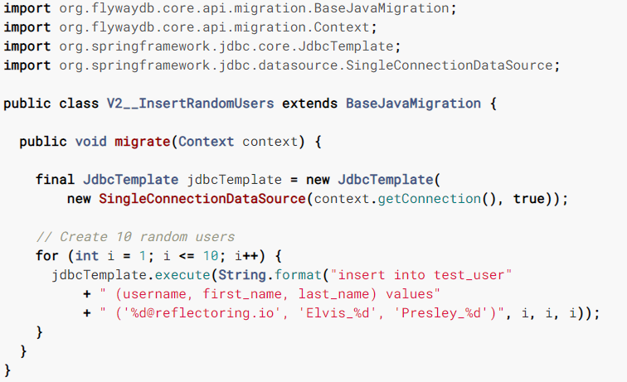
Java Based Migration Example

Slide 10
Steps To Integrate With Flyway For New Projects by Sql
Add dependency in pom.xml
Add properties in apploication.properties file.
Create folder db/migration in src/resources folder.
Add Sql files according to naming convention as V1__Initial.sql
We can change default migration Sql file location and naming convention by adding properties into application.properties file.

Slide 11
Steps To Integrate With Flyway For Existing Projects by Sql
Add dependency in pom.xml
Add properties in apploication.properties file with baseline options.
spring.flyway.baseline-version=2
spring.flyway.baseline-on-migrate=true
baselining- if your database schema was already created without the usage of any of these tools and you want to start deployments with them at a later time, you can use the baselining commands to create the schema baseline on top of which incremental scripts can be added. The baseline will include the DDLs but not the data. Sometimes there is a confusion for developers starting the tool for the first time, thinking that baselining will also migrate data.

Slide 12
Steps To Integrate With Flyway For Existing Projects
3. If your case, baseline your database with flyway.baselineVersion=2 will tell flyway that your database is already at the version 2. Any subsequent flyway migrate will only process migrations greater than 2.
Note: If previous migrations failed, it may be necessary to drop table flyway_schema_history first.
4. Create folder db/migration in src/resources folder.
5.Add Sql files according to naming convention as V1__Initial.sql

Slide 13
Supported Versions For PostgreSQL
12
11
10
9.6
9.5
9.4
9.3 Flyway Enterprise
9.2 Flyway Enterprise
9.1 Flyway Enterprise
9.0 Flyway Enterprise

Slide 14
Flyway Vs Liquibase
Flyway uses SQL. But, Liquibase work with XML or JSON or Sql, we can use it in environments in which the database is of one flavor on one machine, and of another flavor on another machine( exp: H2 on dev, Oracle on test).
In Liquibase you get the rollback scripts automatically generated if you use xml tags that allow for automatic rollback generation. This includes simple tags such as create table, add column etc., for which the engine can easily deduce the rollback. For more complicated scripts with more business logic used inside <Sql> Liquibase tags you need to write the rollback yourself.
Also there is DIFF in Liquibase, which is not available in Flyway. It allows you to compare two database schemas and identify differences .

