Slide 1
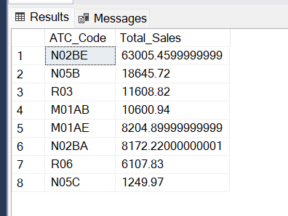
SQL Analysis & Data Processing
Top Performing Category
SELECT ATC_Code, SUM(Sales) AS Total_Sales
FROM pharma_sales_final
GROUP BY ATC_Code
ORDER BY Total_Sales DESC;

Slide 2
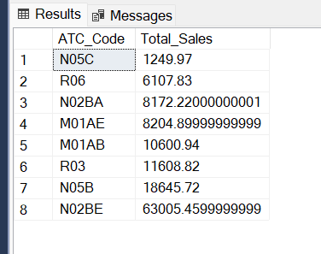
SQL Analysis & Data Processing
Lowest Performing Category
SELECT ATC_Code, SUM(Sales) AS Total_Sales
FROM pharma_sales_final
GROUP BY ATC_Code
ORDER BY Total_Sales ASC;

Slide 3
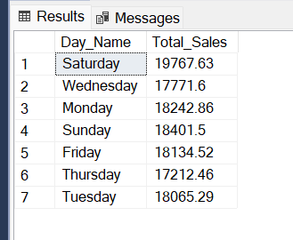
SQL Analysis & Data Processing
Day-wise Pattern
SELECT DATENAME(WEEKDAY, Date) AS Day_Name,
SUM(Sales) AS Total_Sales
FROM pharma_sales_final
GROUP BY DATENAME(WEEKDAY, Date);

Slide 4
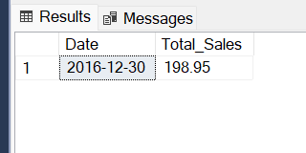
SQL Analysis & Data Processing
Peak Sales Day
SELECT TOP 1 Date, SUM(Sales) AS Total_Sales
FROM pharma_sales_final
GROUP BY Date
ORDER BY Total_Sales DESC;

Slide 5
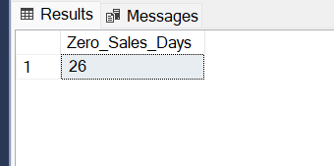
SQL Analysis & Data Processing
Zero Sales Days
SELECT COUNT(*) AS Zero_Sales_Days
FROM (
SELECT Date
FROM pharma_sales_final
GROUP BY Date
HAVING SUM(Sales) = 0
) AS t;

Slide 6
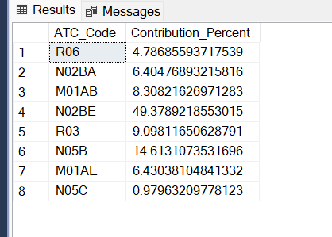
SQL Analysis & Data Processing
Category Contribution %
SELECT
ATC_Code,
SUM(Sales) * 100.0 / (SELECT SUM(Sales) FROM pharma_sales_final) AS Contribution_Percent
FROM pharma_sales_final
GROUP BY ATC_Code;

Slide 7
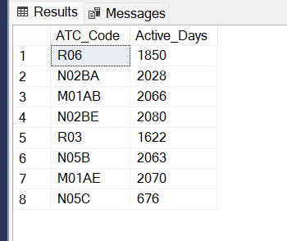
SQL Analysis & Data Processing
Sales Consistency
SELECT ATC_Code, COUNT(*) AS Active_Days
FROM pharma_sales_final
WHERE Sales > 0
GROUP BY ATC_Code;

Slide 8
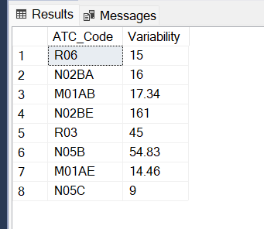
SQL Analysis & Data Processing
Demand Variability
SELECT ATC_Code,
MAX(Sales) - MIN(Sales) AS Variability
FROM pharma_sales_final
GROUP BY ATC_Code;

Slide 9
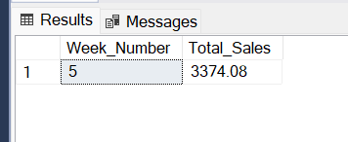
SQL Analysis & Data Processing
Best Week sale performance
SELECT TOP 1
Week_Number,
SUM(Sales) AS Total_Sales
FROM pharma_sales_weekly_final
GROUP BY Week_Number
ORDER BY Total_Sales DESC;

Slide 10
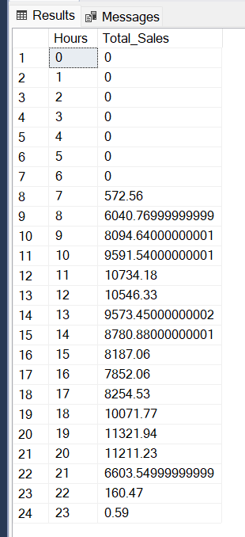
SQL Analysis & Data Processing
Hourly Trend sale
SELECT
Hours,
SUM(Sales) AS Total_Sales
FROM pharma_sales_hourly_final
GROUP BY Hours
ORDER BY Hours;

Slide 11
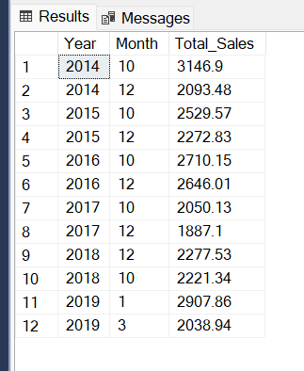
SQL Analysis & Data Processing
Top 2 Months sale per Year
WITH MonthlySales AS (
SELECT
Year,
Month,
SUM(Sales) AS Total_Sales,
ROW_NUMBER() OVER (
PARTITION BY Year
ORDER BY SUM(Sales) DESC
) AS rn
FROM pharma_sales_monthly_final
GROUP BY Year, Month
)
SELECT
Year,
Month, Total_Sales
FROM MonthlySales
WHERE rn <= 2;

Slide 12
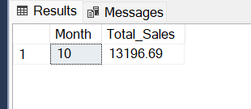
SQL Analysis & Data Processing
Best Month Overall
SELECT TOP 1
Month,
SUM(Sales) AS Total_Sales
FROM pharma_sales_monthly_final
GROUP BY Month
ORDER BY Total_Sales DESC;

Slide 13
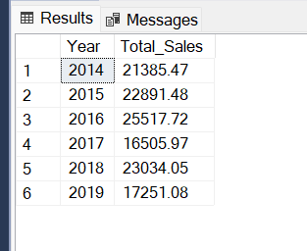
SQL Analysis & Data Processing
Yearly Growth of sale
SELECT
Year,
SUM(Sales) AS Total_Sales
FROM pharma_sales_monthly_final
GROUP BY Year
ORDER BY Year;

Slide 14
Thank you…

