Slide 1


Slide 2
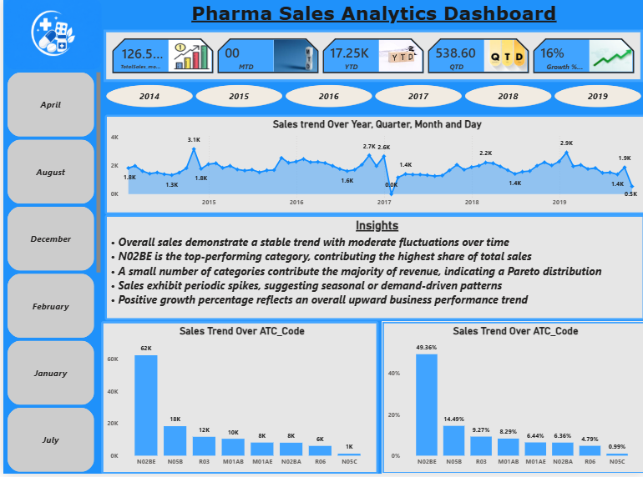

Slide 3
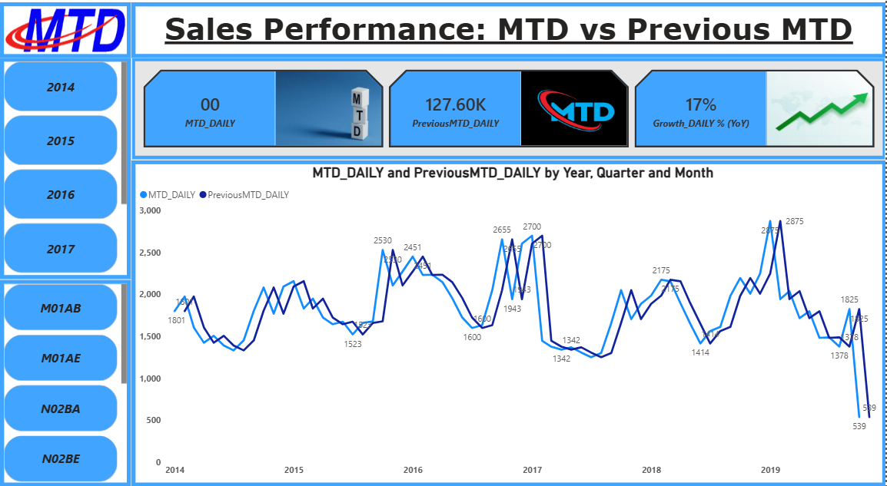
• Sales show strong 17% YoY growth, indicating increasing demand
• Consistent upward trend with peak performance in late 2019
• Seasonal patterns observed with predictable demand cycles
• Performance tracking enabled using Previous MTD benchmarks
• Sudden drop at the end likely due to data anomaly, not actual decline
• Opportunity to optimize planning based on trends and growth drivers

Slide 4
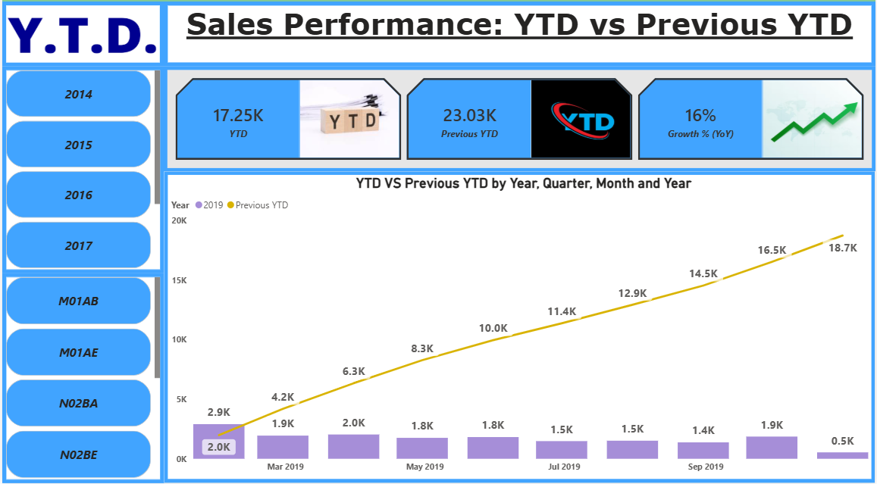
• YTD performance shows clear growth compared to Previous YTD
• Consistent outperformance indicates improved sales efficiency
• Seasonal patterns remain stable across both periods
• Key months drive significant contribution to overall growth
• Performance gaps highlight scope for improvement in low periods
• Spikes or drops should be monitored for data accuracy

Slide 5
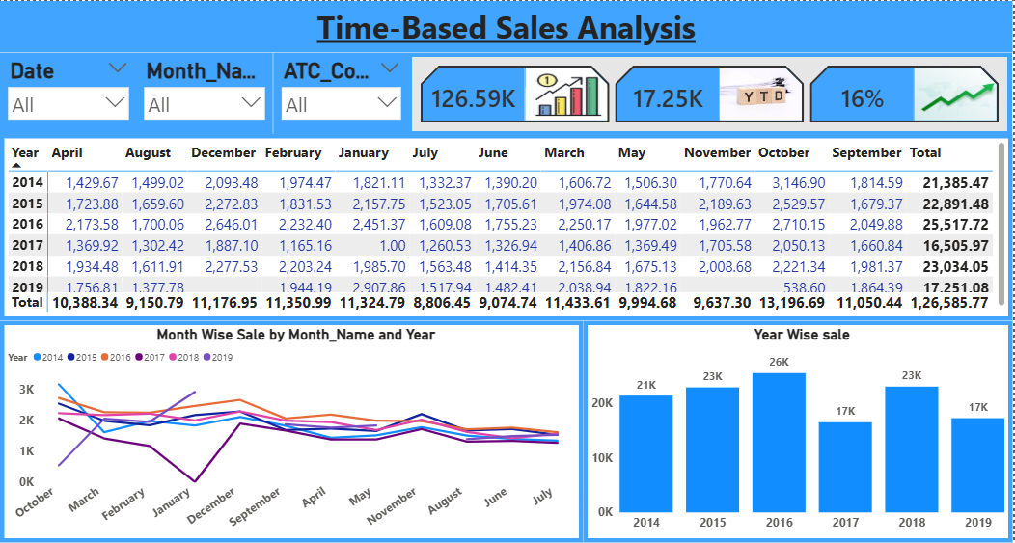
• Sales show high yearly volatility with a major dip in 2017 and recovery in 2018
• October is the top-performing month, while July records the lowest sales
• 2016 stands as the peak year in overall performance
• Strong performance observed in Q1 (Jan–Mar)
• Clear seasonal trends with early growth and mid-year slowdown
• Opportunity to optimize low months and leverage peak periods

Slide 6
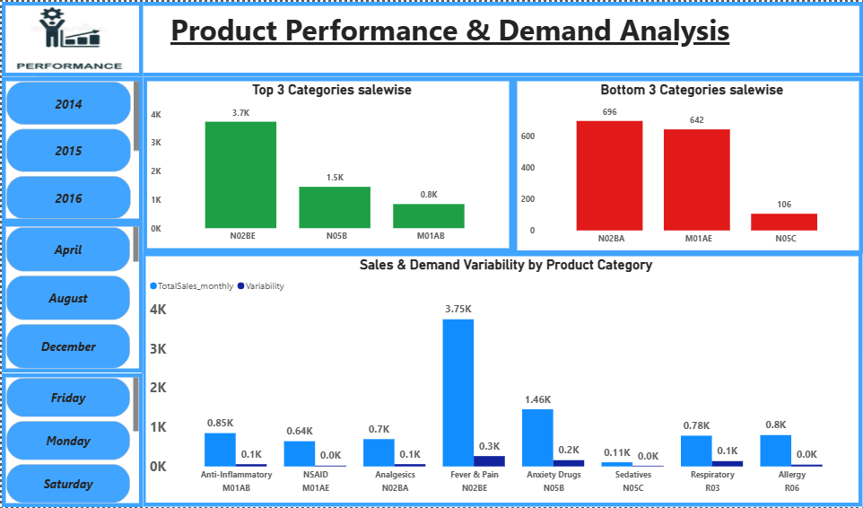
• N02BE is the dominant category driving the highest sales
• Top 3 categories contribute majority of total revenue
• N05C is the lowest-performing category with minimal sales
• High variability in N02BE indicates fluctuating demand
• Stable demand observed in NSAID and Allergy categories
• Sales concentration highlights need for product diversification

Slide 7
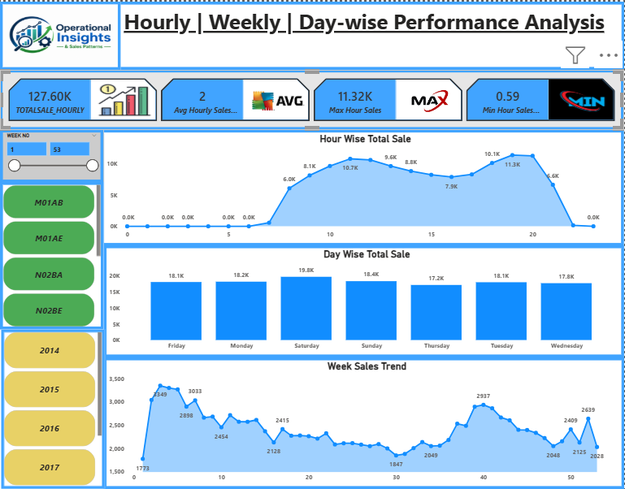
• Total sales reach 127.6K, showing strong overall performance
• Peak sales occur between 10 AM – 8 PM, with highest activity in evening hours
• Minimal sales observed during early morning and late night hours
• Saturday is the top-performing day, while weekdays show stable demand
• Weekly trend shows fluctuations with mid-year dip and later recovery
• Overall sales pattern is consistent with clear peak periods and variability

Slide 8
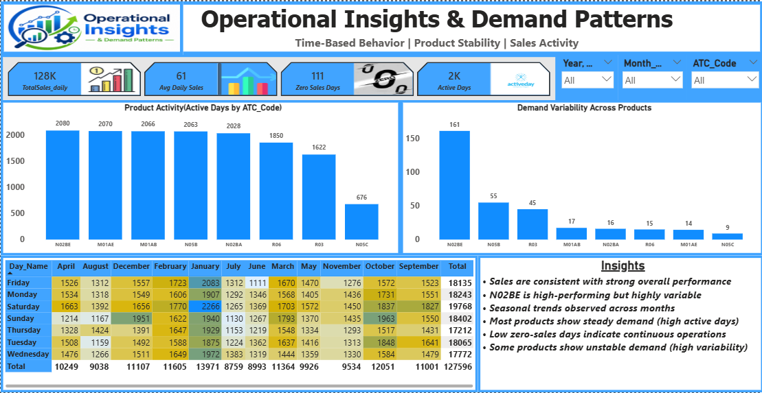

Slide 9
Thank you…

