Slide 1
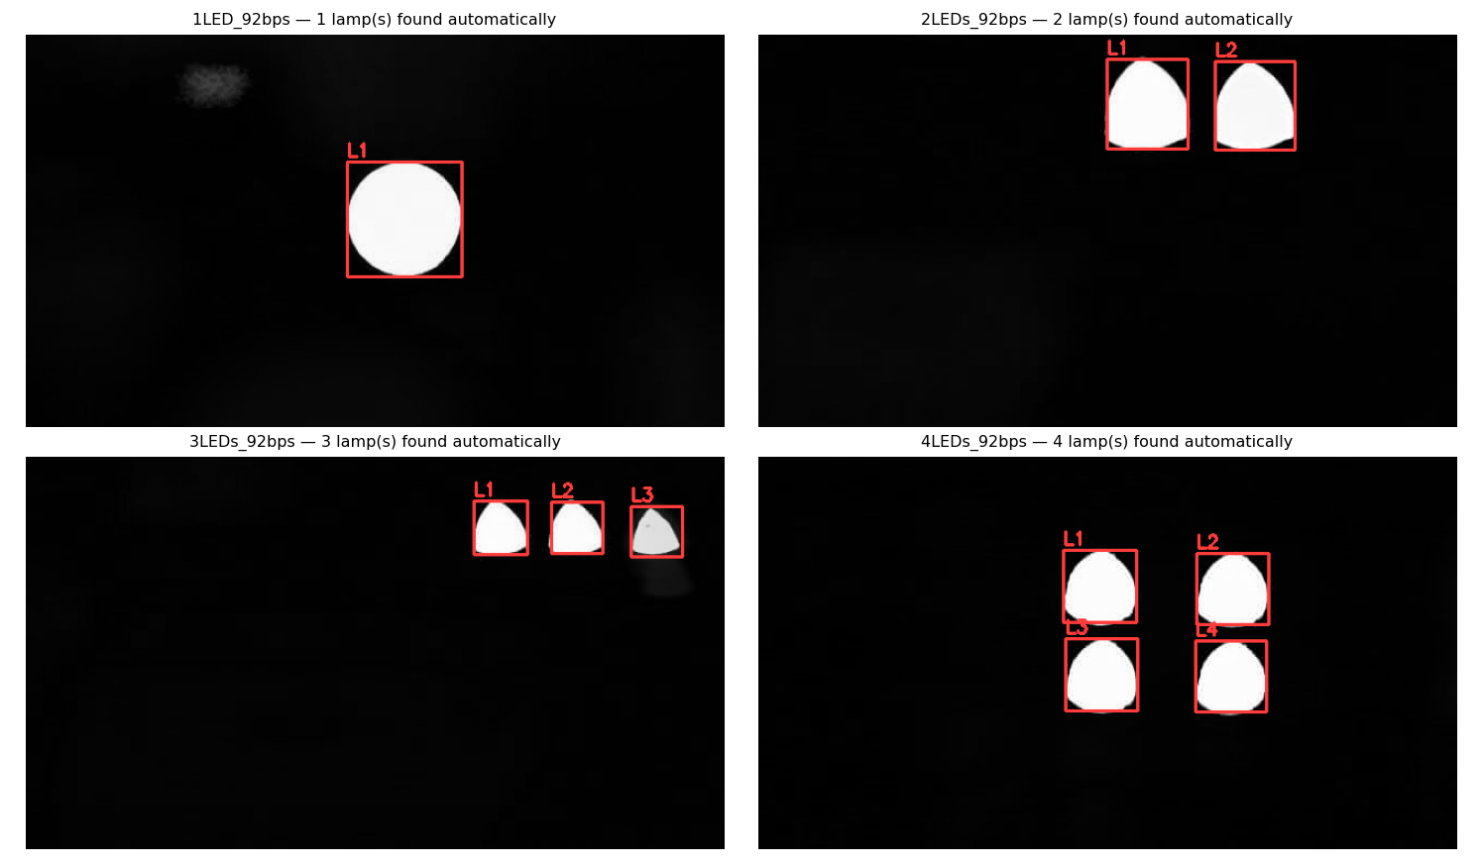
1
Transmitter ROI — found automatically
Every lamp located from the data alone. No hand-drawn boxes, no lamp count supplied.
How it works
Group the changing pixels by how their brightness behaves over time.
Pixels of one lamp blink together. Pixels of different lamps do not.
This splits touching lamps, which a shape-based method cannot do.
Halo and glare rejected by fill ratio and relative size.
4 / 4
videos: correct lamp count
0
hand-drawn boxes needed
Lamp count was never given to the detector — it is inferred, and it matches the filename in all four videos.
Notes:
ROI strategy: temporal-behaviour clustering, not shape. Fixes the three ROI faults found on Day 07-08.

Slide 2
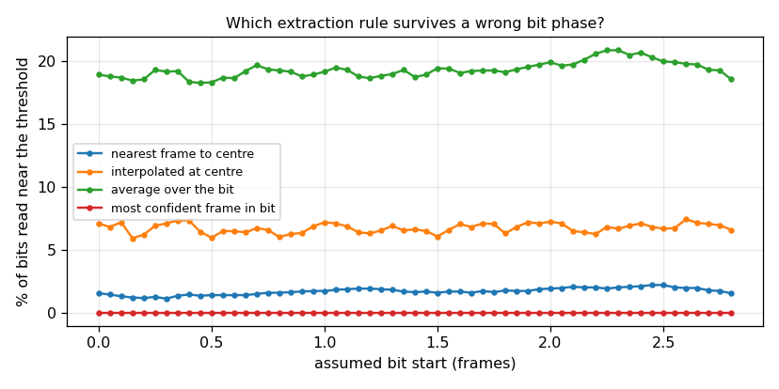
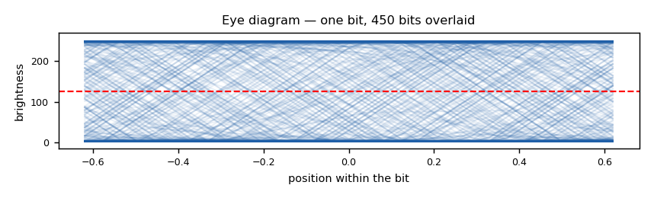
2
Signal extraction — the rule matters more than the timing
2.83 frames per bit means about one frame in three straddles a bit boundary. How we sample decides everything.
Four rules, tested across every bit phase
most confident frame in the bit
0.00 %
nearest frame to the bit centre
1.13 %
interpolated at the bit centre
5.94 %
averaged across the whole bit
18.28 %
Percentage of bits read too close to the threshold to trust. Lower is better.
The eye is NOT cleanly open. Because 2.83 is not a whole number, transitions land at every position inside the bit — so no fixed sampling point is always safe.
But at least one frame per bit always is safe. Picking it scored 0.00% at every phase tested.
Notes:
Averaging over the bit is the worst rule because it mixes in the straddling frames. Picking the most extreme frame inside each bit is immune to phase error at 2.83 frames per bit.

Slide 3
3
Preprocessing frozen — and what we ask you to approve
Locked today. Any later change needs a log entry and a re-run of everything above it.
Frozen preprocessing
Synchronisation and evaluation
1
Trim
Bit rate is known: 260 fps ÷ 92 bps = 2.826 frames per bit.
Phase found by eye-opening search, re-estimated per block over long clips.
Report the tolerance range, not one accuracy number.
Tune on the first 30% of each video, report on the last 70%.
Per-lamp bitstreams saved before any combining.
On sustained activity, not the first bright frame
2
Locate lamps
Behaviour clustering; one ROI per lamp
3
Brightness
Mean of the brightest half of each ROI
4
Detrend / normalise
OFF by default — ambient varies 0.1% of contrast
Blocking — we need a decision
5
Smoothing
No ground truth was supplied. BER and message correctness cannot be computed on any video, and the ML branch cannot run at all.
The recovered bits are not plain text and not Manchester coded — the framing format is unknown.
OFF — it would erase the edges we read
6
Sample
Most confident frame inside each bit
Everything above is frozen pending your approval of these two answers.
Notes:
Ask: (1) can we have the transmitted bits, (2) what framing sits above the raw bits, (3) is 92bps per lamp or shared.

