Slide 1
AGILE METHODOLOGY
PRESENTED BY;
KESHIKA T
PYTHON BATCH 1

Slide 2
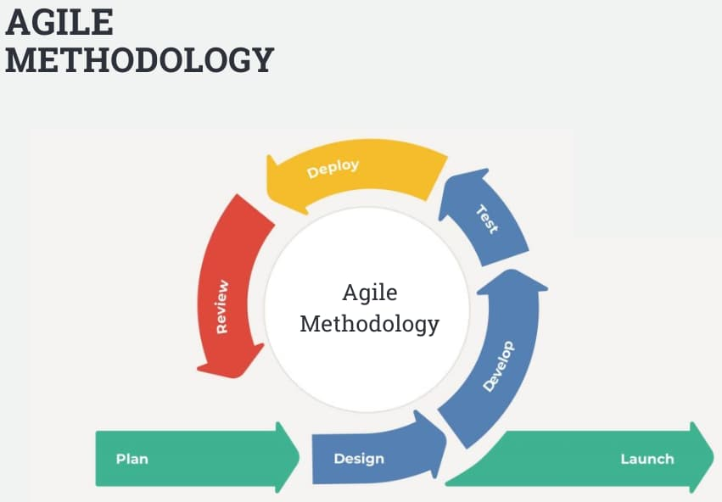
AGILE
A project management approach that involves breaking the project into phases.
Emphasizes continuous collaboration and improvement.
Agile teams embody "we" rather than “I“.

Slide 3
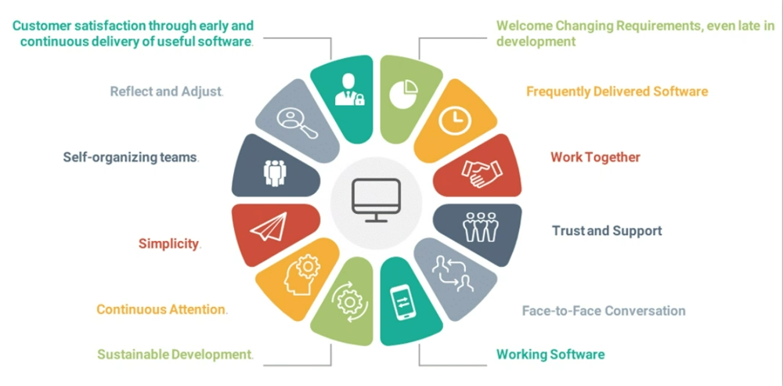
12 Principles of agile methodology

Slide 4
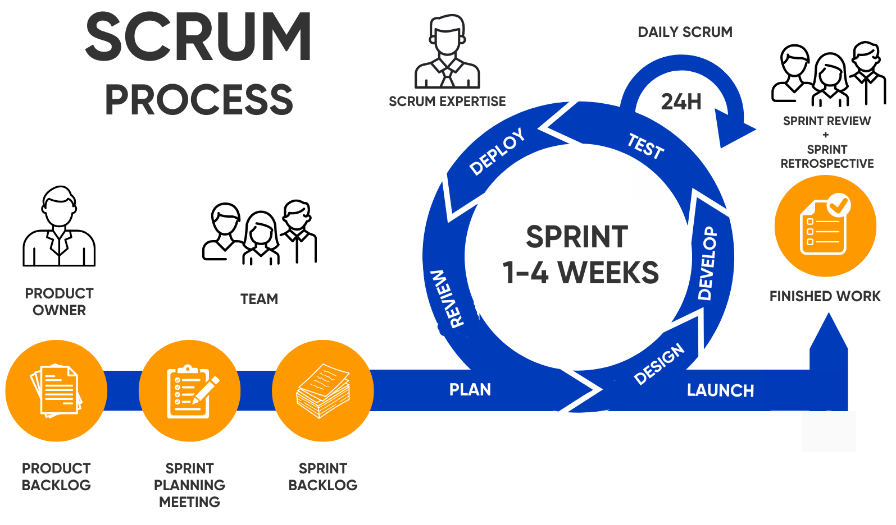
SCRUM
A framework for agile software development that involves
iterative cycles called sprints,
daily stand-up meetings,
and a product backlog that is prioritized
by the customer.

Slide 5
CASE STUDY – SMS(Student Management System)
Product Backlog
The Product Owner (Institution) defines the key features:
Student Management – Profile Management, Course Enrolment
Timetable & Scheduling – Class Timings, Exam Timetables
Attendance Tracking – Daily, Weekly, and Monthly Reports
Exam Management – Exam Scheduling, Marks Entry, Report Cards
2. Plan the Sprint and Set the Goal
Sprint Duration: 2-4 weeks
Sprint Goal: Develop specific features in each sprint
Example Sprint Planning:
Sprint 1: Develop & Test Student Registration Module
Sprint 2: Implement Attendance & Communication System
Sprint 3: Integrate Grade Management & Exam Module

Slide 6
CASE STUDY – SMS(Student Management System)
3. Work in Sprints/Iterations
Each sprint follows the Agile cycle:
Design & Development – Create UI/UX, implement backend functionality
Testing & Debugging – Ensure smooth functionality & fix errors
Review & Feedback – Improve based on user feedback
4. Daily Standups
Daily Scrum Meetings (15 mins) include:
What was done yesterday?
What is the plan for today?
Are there any blockers?
5. Deliver Working Software at the End of Sprint
Each sprint delivers a functional module that users can test.
Example Deliverables:
Sprint 1 → Working Student Registration System
Sprint 2 → Attendance Module integrated with UI
Sprint 3 → Exam & Grading System

Slide 7
CASE STUDY – SMS(Student Management System)
7. Reflect and Improve in Retrospectives
After each sprint, the team discusses:
What went well? – Identify successes in development
What could be improved? – Address challenges faced
Action Plan for Next Sprint – Optimize performance & usability
6. Review Progress and Get Feedback
Sprint Review: Demonstrate the completed features to users (Admins, Teachers, Students).
Feedback Collection: Identify bugs, usability issues, and feature requests.

Slide 8


Slide 9
THANK YOU!

