Slide 1

Lab 01: Introduction to Visure
Sina Keshvadi
September 07, 2022
Thompson Rivers University
Notes:
Lab’s main goal: Give students a big picture of Visure.
Road Map
The whole idea is to give the student a big picture of Visure. It gives them a map of different components that they can relate different things into a united system, and everything stays relevant in the system.
why to learn a requirement management tool
why this particular tool
The visure’s license model
The client/server architecture of the visure
A closer look at the visure
The general architecture of the visure
Tracking requirement
Configuration management

Slide 2
Labs’ Timeline
Lab Sections
Start | End | To-do
3:30 pm | 4:00 pm | Part 1 – Sina teaches
4:00 pm | 4:10 pm | Break
4:10 pm | 5:00 pm | Part 2 – Students work on worksheets
5:00 pm | 5:10 pm | Wrap up and save your work
5:00 pm | 5:20 pm | Sina is open for questions/discussion/talk

Slide 3
What do we learn from today lab?
License model
Client/Server Model
The general architecture of Visure
Tracking requirements
Configuration management (CM) tools
Notes:
Why learn it?
It is a complex task.
It is important to learn tools so that you become one with a bag of tricks.
Learning how to work with a requirement engineering tool is an asset. It is valuable.
It helps you to be familiar with this type of tools
Does not have online community or enough resources
It is similar to other product management tools
Benefits of using a requirement management tool
You can have a shared document between different stakeholders

Slide 4
License model
Visure floating license server
Visure requirements Client 1
Visure requirements Client 2
Visure Requirement Administration Center
Notes:
Floating licensing
https://en.wikipedia.org/wiki/Floating_licensing
https://www.youtube.com/watch?v=eHoUlMmX2LI

Slide 5
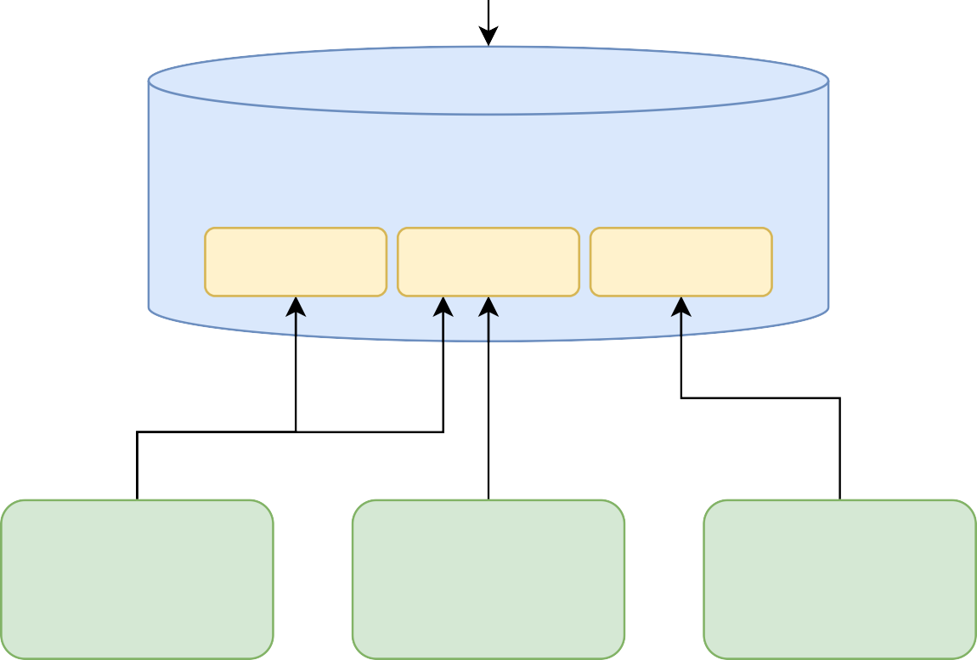
Client/Server Model
Administration center
Create
Visure DB
Project 1
Project 2
Project 3
Visure requirements client 1
Visure requirements client 2
Visure
requirements client 3
4

Slide 6
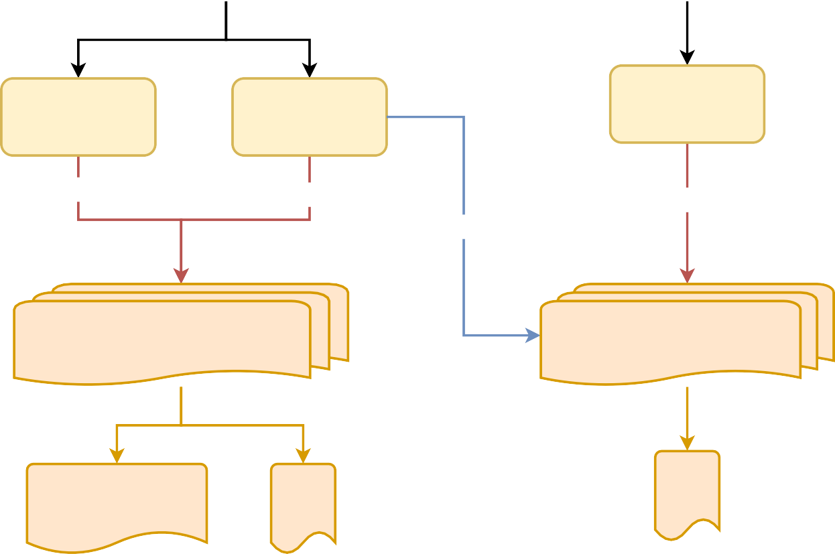
The general architecture of Visure
Users
Alice
Bob
Groups
Requirements Engineer
Project Managers
Testers
Read/Write
Read
Read/Write
Read
Partitions
Requirements and Risk Management
Test Management
Specifcation
Scope and Vision document
Test suites
SRS

Slide 7
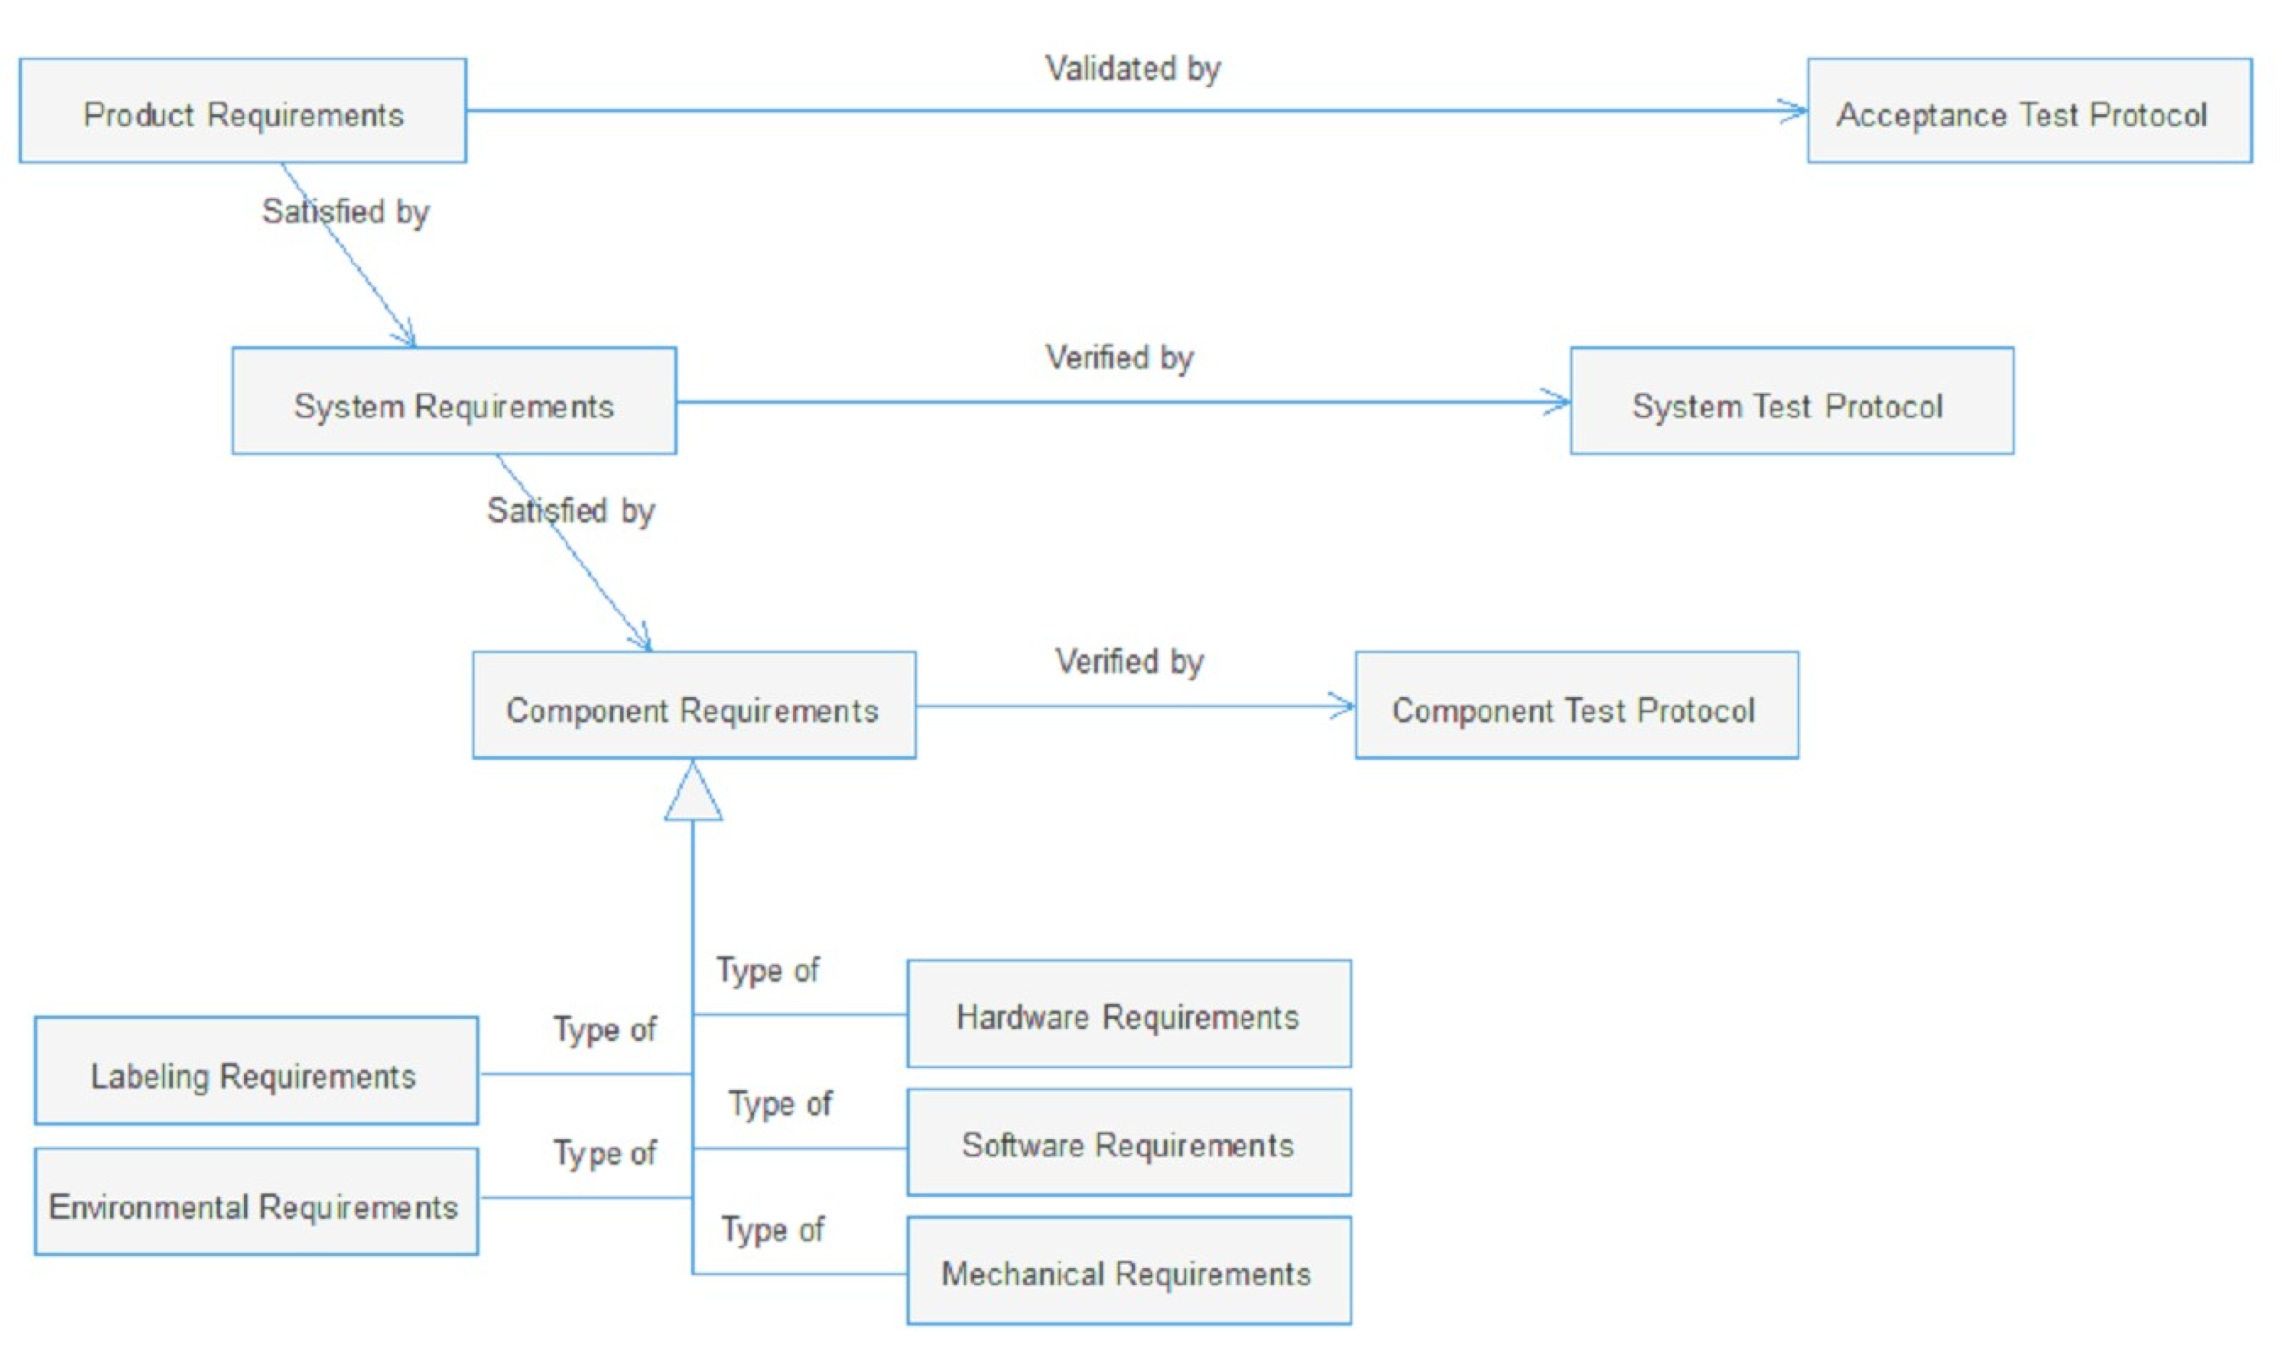
Tracking requirements

Slide 8



Configuration Management (CM) tools
Change request (CR)
User 1
User 1
Baseline
Check out
Check in
Baseline
SRS Vl
SRS V2
SRS V2
Check out
User 2

Slide 9

Part 2
The Context Diagram

Slide 10
Context Diagram
A context diagram shows the entire system as a single process.
Context diagrams show the interactions between a system and other actors (external factors) with which the system is designed to interface.
They are used early in a project to get agreement on the scope and can be included in a requirements document.

Slide 11
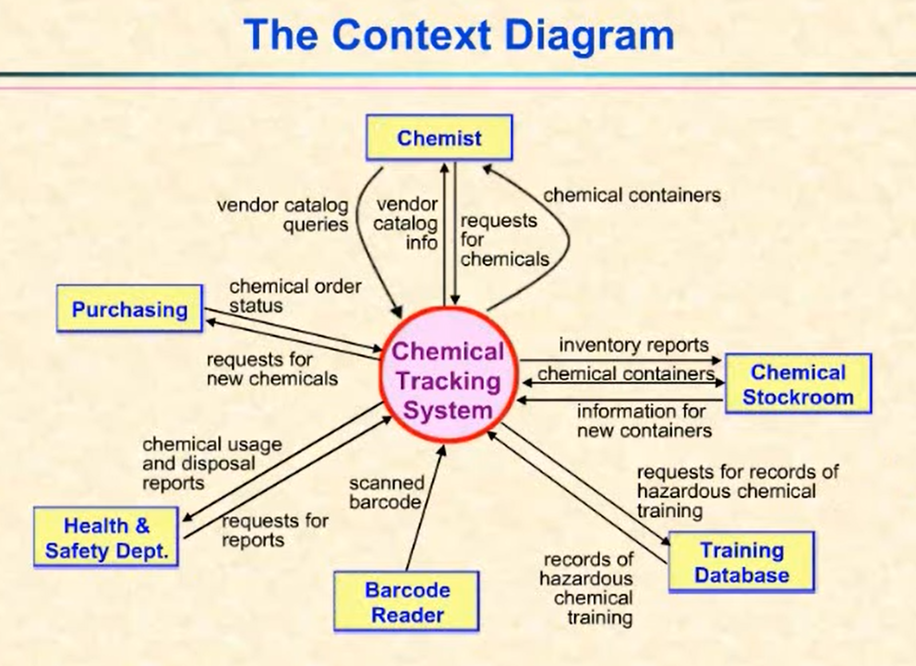
Example from the Book

Slide 12
Steps:
Label the system/process in the center
Identify entities that interact directly with the system/process
Group like entities
Identify major flows of data between the entity and system/process

Slide 13
Activity
Open Visio to draw a context diagram for following systems

Slide 14
Food Ordering System

Slide 15
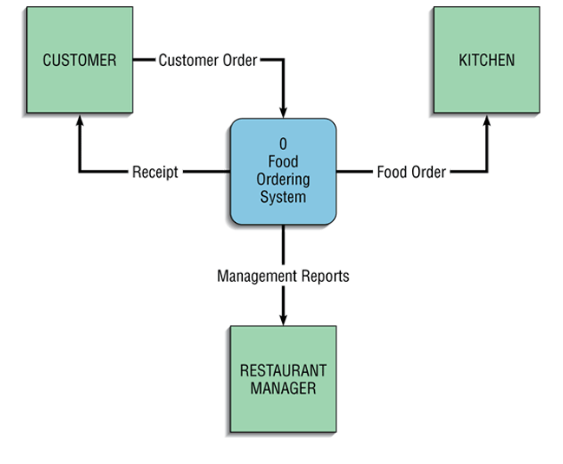
Food Ordering System

Slide 16

Next steps
Next step is to expand the context diagram to show the breakdown of processes

Slide 17
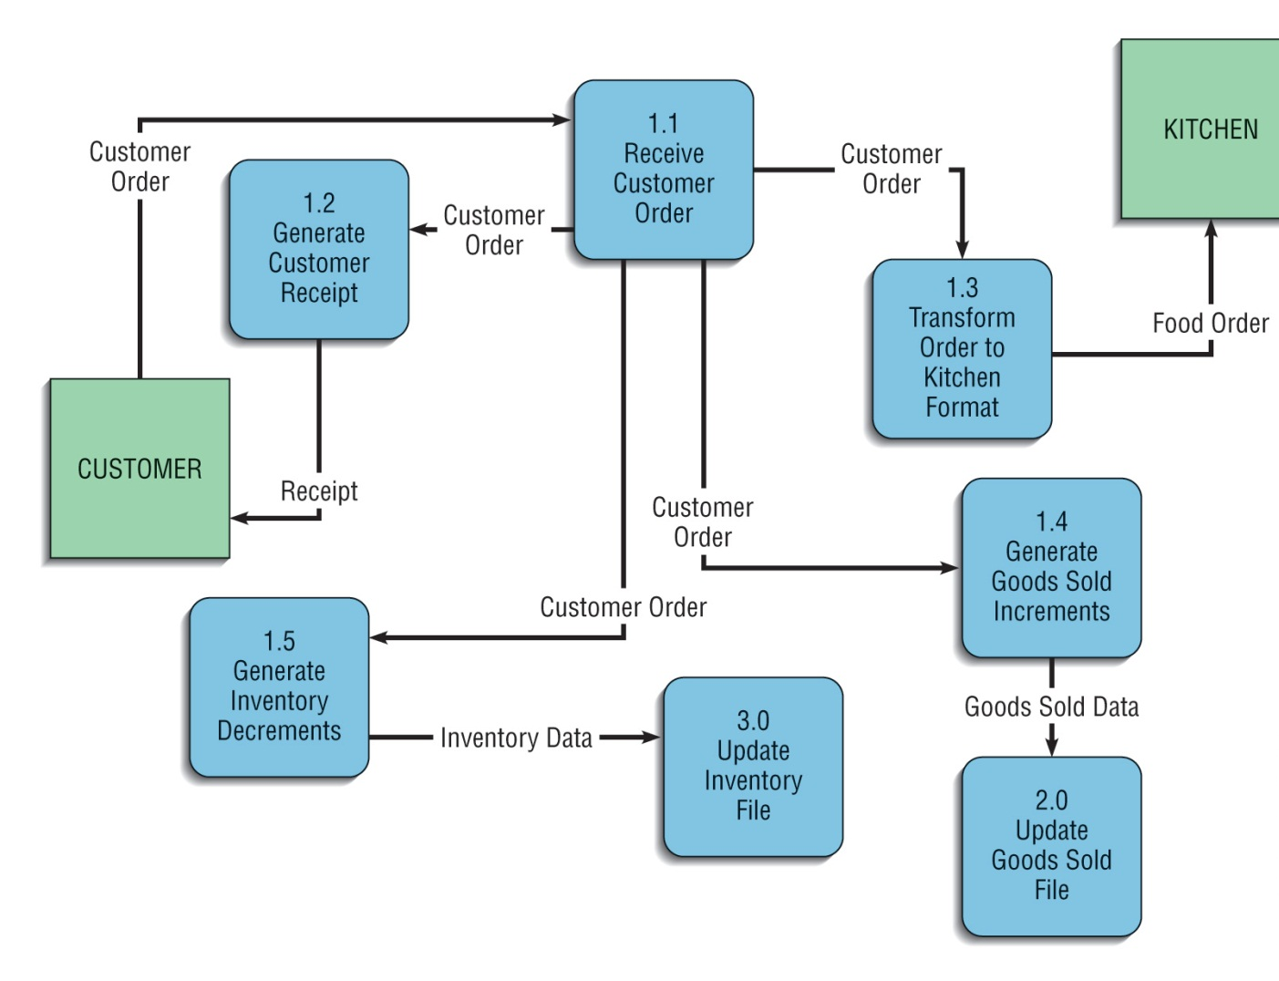
Food Ordering System

Slide 18
Booking Room System

Slide 19
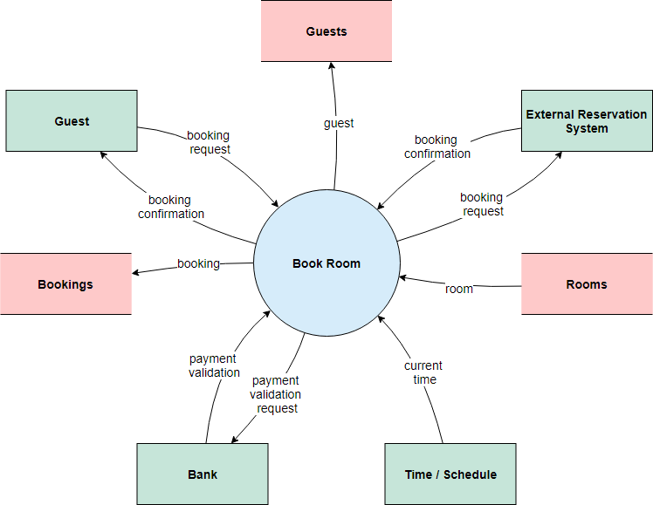
Booking Room System
https://www.edrawmax.com/context-diagram/

Slide 20
Online shopping system

Slide 21
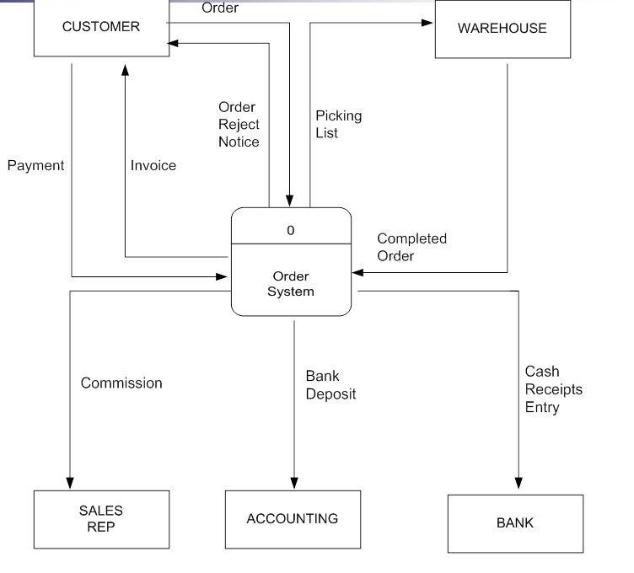
Online shopping system

Slide 22
Notes
Be consistent. Circle for system, rectangle for external systems, and arrows for connections.
It’s good to ask each group of stakeholders to draw their own context diagram. In this way we can see the similarities and differences.
Don’t add connections between external entities if it is not important for your system.
Boxes are called external entities or terminators. It could represent a group of users like faculties, other organizations like Health and Safety Dept., other systems, etc.

Slide 23
Notes (cont.)
Interaction between the system and external entities are shown using arrows. These directional arrows indicate the input/output in/from the system.
The context diagram provides a very high-level view of what the system does. It shows the environment that the system exists.
The context diagram is used to have discussion about the scope of a project.

Slide 24
Lab health and safety rules
Lab health and safety rules
Report all emergencies immediately.
Call TRU campus security (250-828-5033). Use TRU Safe App for quick access (Get Help!)
All injuries must be reported. Even if you experience a minor injury in the lab that does not require first aid, please let your instructor know.
Food and drinks are not allowed in the labs.
You should report and label broken or damaged tools. These should be labeled with DAMAGED DO NOT USE/ OUT OF SERVICE
Be vigilant: all laboratory users have a responsibility to take reasonable precautions against theft or misuse of materials.
Follow current COVID-19 precautions
You must protect yourself: tie back long hair, secure loose sleeves or other loose articles of clothing, you should glance away from the screen periodically to avoid eye strain.
Please use the lab for running experiments only.
You must follow written procedures when using electrical components

Slide 25
Lab health and safety rules
Encourage students to get the TRU Safe App on their phones
Remind students where the fire alarms are and where the nearest exists are. (What to do in the event of a fire- which I remind everyone that your priority is to get yourself and your students out of the building safely, and call security.)
After you discuss these things, ask the student to complete the short quiz associated with their year located on ENGR Hub. The quiz should only take about 5 minutes.
https://moodle.tru.ca/course/view.php?id=30075

