Slide 1
Machine Learning for Computer Systems
Nick Feamster University of Chicago

Slide 2
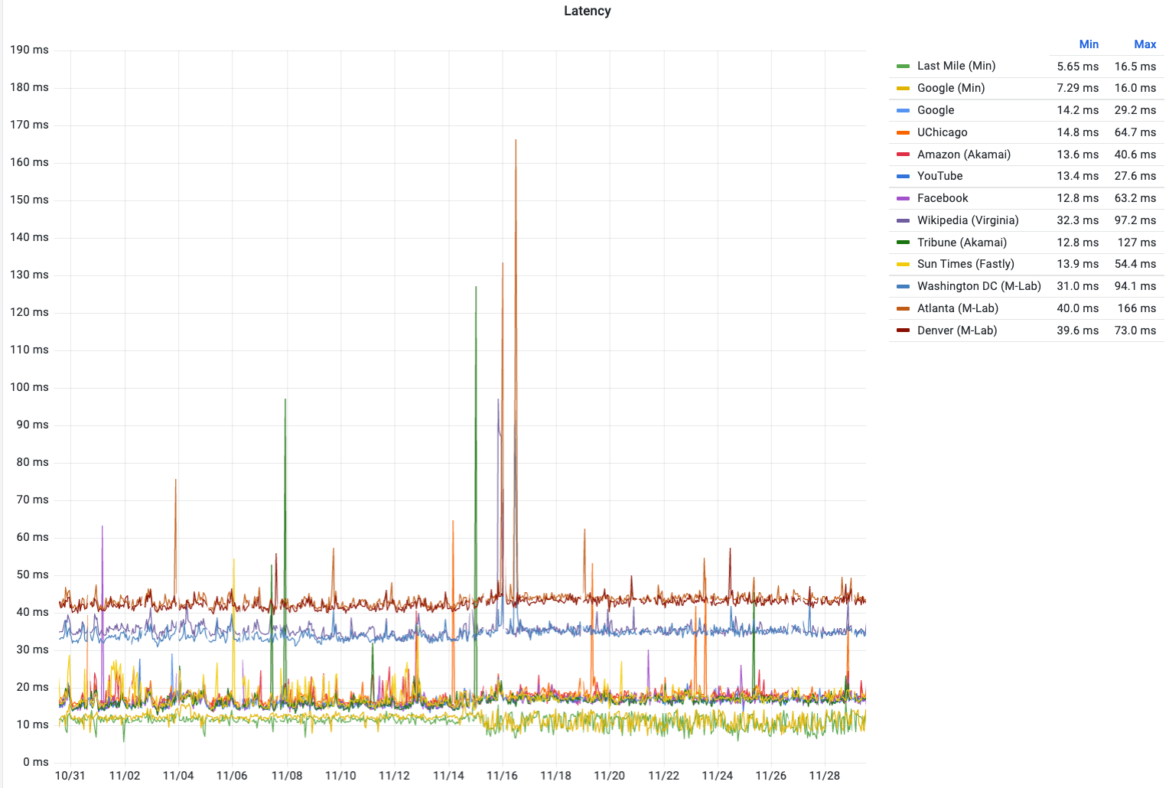

Slide 3
Anomaly Detection

Slide 4
Timeseries Analysis

Slide 5



Autoregressive–moving-average (ARMA)
Describes timeseries in terms ot two polynomials:
Autoregression (AR)
Moving average (MA)
Tool for understanding (and predicting) future timeseries values.
Notes:
The autoregressive model specifies that the output variable depends linearly on its own previous values and on a stochastic term (an imperfectly predictable term); thus the model is in the form of a stochastic difference equation (or recurrence relation which should not be confused with differential equation).
Autoregressive models implicitly assume that the future will resemble the past.
Thus, a moving-average model is conceptually a linear regression of the current value of the series against current and previous (observed) white noise error terms or random shocks. The random shocks at each point are assumed to be mutually independent and to come from the same distribution, typically a normal distribution, with location at zero and constant scale.

Slide 6
ARIMA Parameters
Each component in ARIMA functions as a parameter with a standard notation. For ARIMA models, a standard notation would be ARIMA with p, d, and q, where integer values substitute for the parameters to indicate the type of ARIMA model used. The parameters can be defined as:
p: the number of lag observations in the model; also known as the lag order.
d: the number of times that the raw observations are differenced; also known as the degree of differencing.
q: the size of the moving average window; also known as the order of the moving average.

Slide 7
Seasonal ARIMA
Autoregressive (AR) : Accounts for any long-term trends in the data by regressing future values on past values.
Moving Average (MA): Accounts for any sudden shocks in the data by regressing future values on past errors.
Integrated (I): Ensures stationarity in the data (replace values by differences in the values)
Seasonal (S): Accounts for seasonality that occurs over a fixed time period.
Seasonal decomposition allows you to break (or “decompose”) time series data into its seasonal, trend, and residual components. By analyzing these components, we are able to identify some pieces of our SARIMA model to include.
Notes:
In order to discern which pieces to include, it is useful to look at the seasonal decomposition of the data.

