Slide 1
Machine Learning for Computer Systems
Nick Feamster University of Chicago

Slide 2



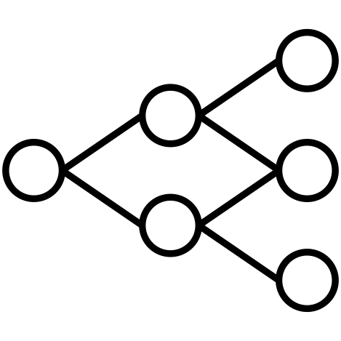
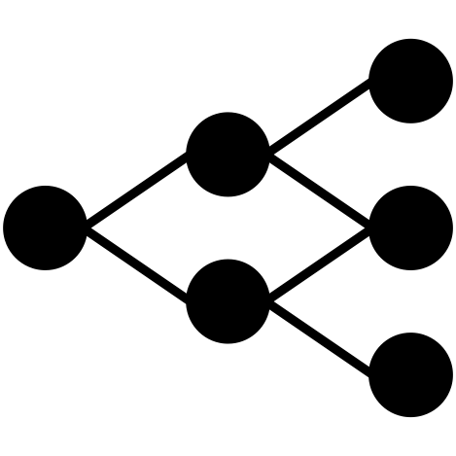
Machine Learning Framework
Labels
Representation
Compression
(Optional)
Input
(Packets)
Packet
Transformation
Data
Representation
Model
Training
Output
(Trained Model)
Each step has an associated cost.
Goals:
Explore general capabilities, capturing the limits of what is possible in traffic analysis
Consider cost-accuracy tradeoffs
Notes:
Our pipeline works, but what if we want to make the representation even smaller?
Faster training
Faster transformation

Slide 3




















Training and Testing (Review)

Slide 4
Model Selection
Biggest question: Does the machine learning algorithm work?
Need to evaluate the quality of models created through algorithms and training.
Key to all evaluation approaches: Never touch the test data!
In practice, this can be a lot harder than it sounds

Slide 5
Problem
Getting the right balance between underfitting and overfitting.
Huge design space for the possibilities of all machine learning models.
Lots of tunable “knobs” (called hyperparameters)
The lambda parameter in regularization of linear regression models
Choice of penalty functions, basis functions, …
The hyperparameters can be tweaked, but it can be hard to figure out what the right setting is because training error isn’t informative.

Slide 6
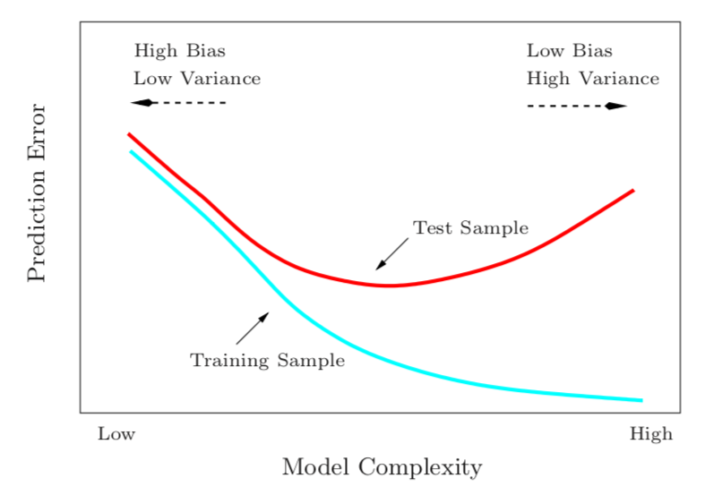
Training Aims to Minimize Error
If our training includes hyper-parameters, then optimization will include over-fitting.
Example: High-degree polynomial expansion.

Slide 7
General Approach: Validation “Hold Out” Set
1. Prepare data: Split data into three sets
Training data: learning/model training
Validation data: For training hyper-parameters
Testing data: only for testing
2. Optimize model on training data
Using training data, optimize model to minimize bias on training set
3. Find optimal hyper-parameters (meta-learning, hyper-parameter optimization)
Use validation data to tune parameters (polynomial degree, loss weight) to minimize error (e.g., MSE) on each validation sample.

Slide 8
How Large Should the Test Set Be?
No fixed rule, but there are some tradeoffs
Test data needs to be large enough to estimate out-of-sample error
Training data needs to be large enough to train the model
Rough Guideline: Error estimation is inversely proportional to the square root of the size of the test set.
Common Approach: 80% Training, 20% Testing

Slide 9






How to Split the Data?
Randomly Split
Split Samples Based on Time

Slide 10








Splitting the Data for Meta-Learning

Slide 11
Overfitting can occur in meta-learning, too!

Slide 12









Solution: Cross-Validation
Goal: Avoid over-fitting to the validation set during meta-learning
Approach: Perform meta-learning using different subsets of the training data for the validation set.
Two general approaches
K-Fold Cross Validation
Leave-One Out Cross-Validation: mostly useful for small datasets

Slide 13
Summary
Machine learning models typically have hyper-parameters that can improve the performance of the models.
Training to optimize both model parameters and hyper-parameters on the training data can result in a model that is overfit.
We can make sure that a model is not overfit by holding out a validation set from the training set

Slide 14
Machine Learning Pipeline: Training and Evaluation

Slide 15
Evaluation of Classification Methods
Rates
True Positive (Recall, Sensitivity)
True Negative Rates (Specificity)
Confusion Matrix
Receiver Operator Characteristic
Predictive Values
Precision (Positive Predictive Value)
Precision-Recall
Single Metrics
Accuracy
F1 Score

Slide 16
Confusion Matrix
Predictions are sometimes scores between 0 and 1
We can map them into 0 or 1 by selecting a threshold
Predicted Class
 | Yes | No
Yes | True Positives (TP) | False Negatives (FN)
No | False Positives (FP) | True Negatives (TN)
Actual Class

Slide 17




Evaluation Metrics
Accuracy: (TP + TN) / (TP + TN + FP + FN)
Precision (Positive Predictive Value): TP / (TP + FP)
Recall (True Positive, Sensitivity): TP / (TP + FN)
Specificity: TN / (TN + FP)
Predicted
 | Yes | No
Yes | True Positives (TP) | False Negatives (FN)
No | False Positives (FP) | True Negatives (TN)
Actual

Slide 18






Why Precision-Recall Matters
Suppose low prevalence of class to detect (lots of negative examples)
Even a very low false positive rate can result in poor positive predictive value.
A significant fraction of positive tests can thus be bogus (low precision).

Slide 19
The Threshold Itself Can Vary
For example: For certain problems, more concerned with high detection, often at the cost of false positives (or vice versa).
Thresholds can be varied/tuned to achieve the right tradeoff between detection rate and false positive (also, precision and recall).
One can evaluate a classifier across the range of thresholds.

Slide 20
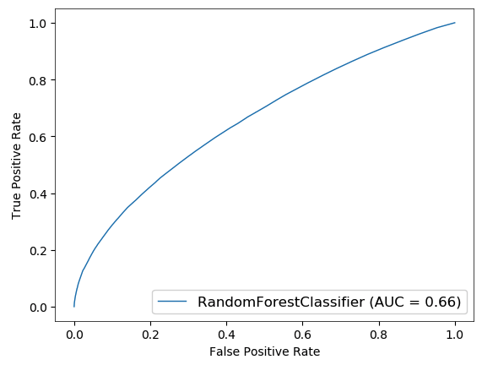


Receiver Operating Characteristic / AUC
Want to see:
high true positive rate
low false positive rate
Overall performance measured by Area Under the Curve (AUC)

Slide 21
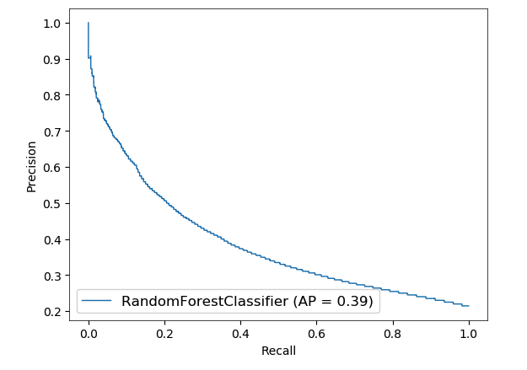

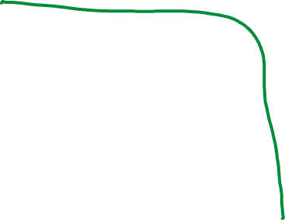
Precision-Recall
Want to see:
High precision
High recall
Overall performance measured by AP (area under the precision-recall curve)

Slide 22
Accuracy
Gives the fraction of all instances that are correctly characterized
Advantages: Simple (single number)
Disadvantages: Often not that useful
Mixes true positives and true negatives
Depends a lot on prevalence (consider a dataset where one class is 99%...)

Slide 23

F1 Score
Single score reflecting the combination of precision and recall.
Disadvantages: Does not incorporate the true negative rate (hence, more suited to information retrieval, and other areas where true negatives are hard to count)

Slide 24
Common Errors in Evaluation: Leakage
Data used to train the model contains information about what we’re trying to predict
Model appears to be better than it actually is
Examples
Including the ground truth (or proxy) as an input feature
Imputing/normalizing the entire dataset
Using any information not available at time of prediction
Using future data to make predictions on the past

Slide 25
Summary
Many metrics can be used to evaluate a classifier.
Important to look at various different metrics to understand classifier performance.
If accuracy over a range of thresholds, or at a particular operating point, is important, then ROC/PR curves can be very useful.

