Slide 1
Machine Learning for Computer Systems
Nick Feamster University of Chicago

Slide 2
Resource Allocation

Slide 3
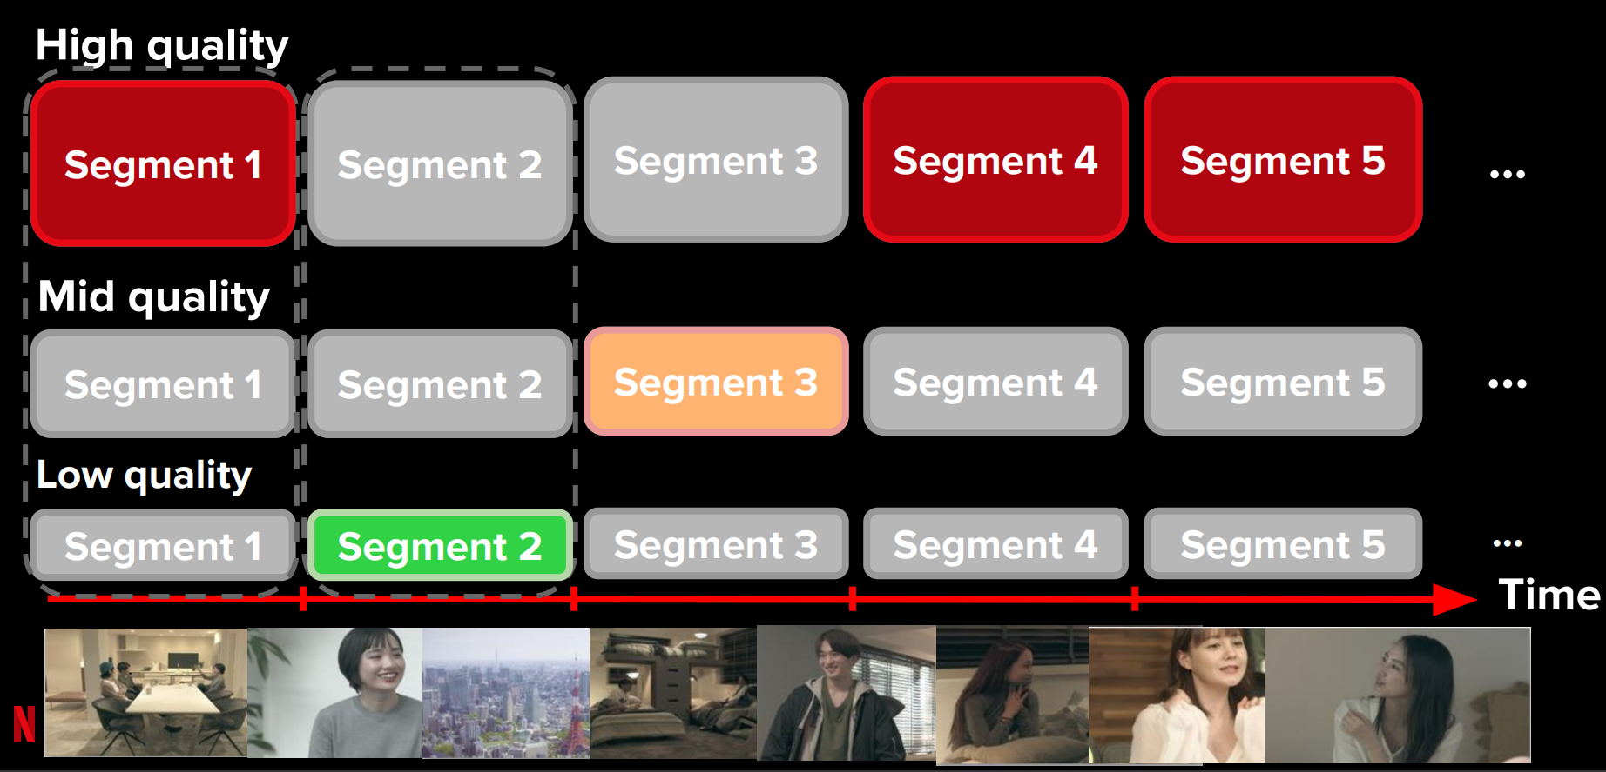
Adapt Video Quality Based on Changing Conditions

Slide 4
WISE: “What If” Scenario Evaluator
What-if Scenario Evaluator for CDNs
Predicts distribution of response time for hypothetical network deployment and configuration questions
Uses causal structure among system variables and machine learning to answer the what-if questions
Tariq, Mukarram and Zeitoun, Amgad and Valancius, Vytautas and Feamster, Nick and Ammar, Mostafa. Answering what-if deployment and configuration questions with WISE. ACM SIGCOMM. August 2008.

Slide 5
Predicting Behavior: Observations
Typical what-if scenario is a modification to an existing, baseline setup
Implication: we have a good sense of “starting-point” from dataset of existing deployment
Response-time function is a black-box but there is a lot of data to learn about the system
Implication: use machine learning instead of analytical modeling

Slide 6
WISE: “What If” Scenario Evaluator
Distribution of input variables X under the “what-if” conditions
Service Response-time Estimation Function rt = f (X)
Distribution of response-time under the “what-if” conditions
What are the variables (X)?
What is this function?
Sufficient to determine the response-time (domain knowledge)
Statistically learned using the data from the existing deployment
What is the distribution under “what-if” conditions?
Existing deployment = Distribution of existing conditions
How to transform current scenario to “what-if”?
6

Slide 7
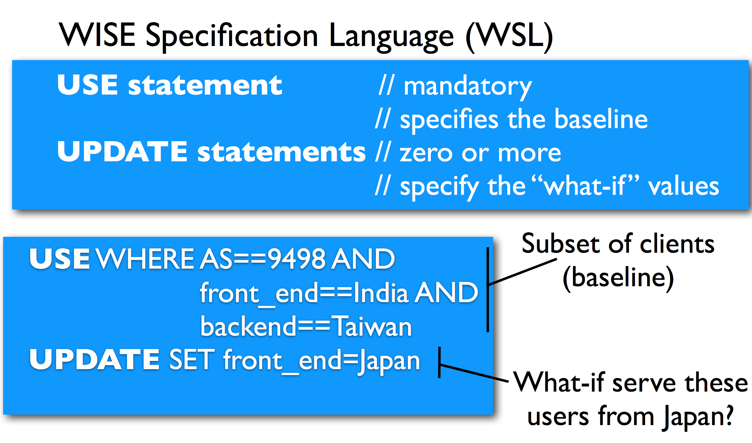
Scenario Specification

Slide 8
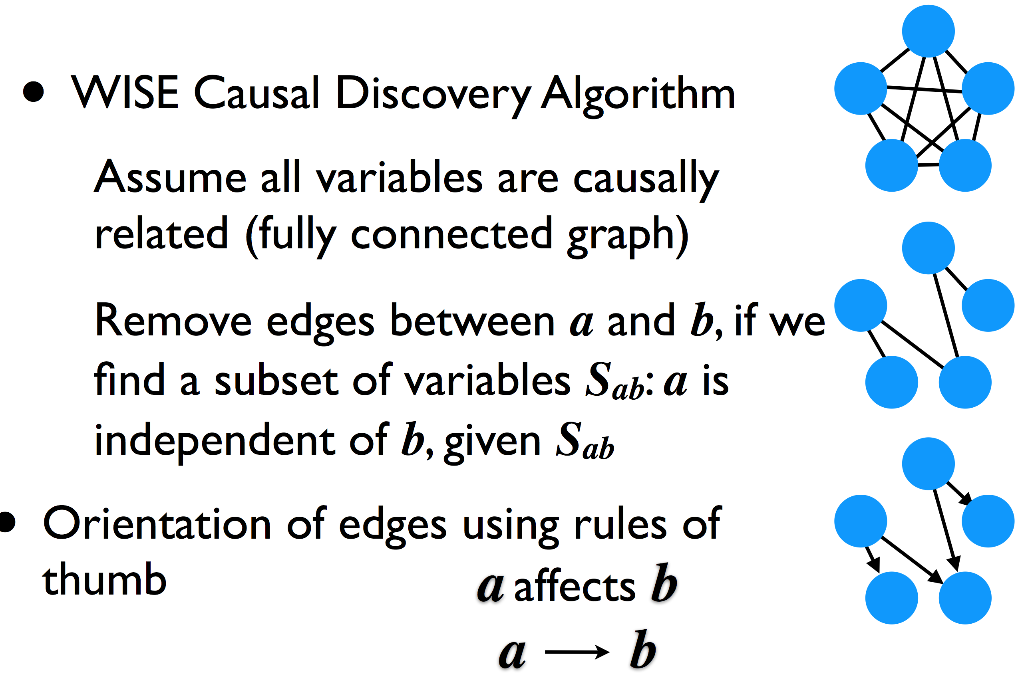
Learning Causal Structure

Slide 9
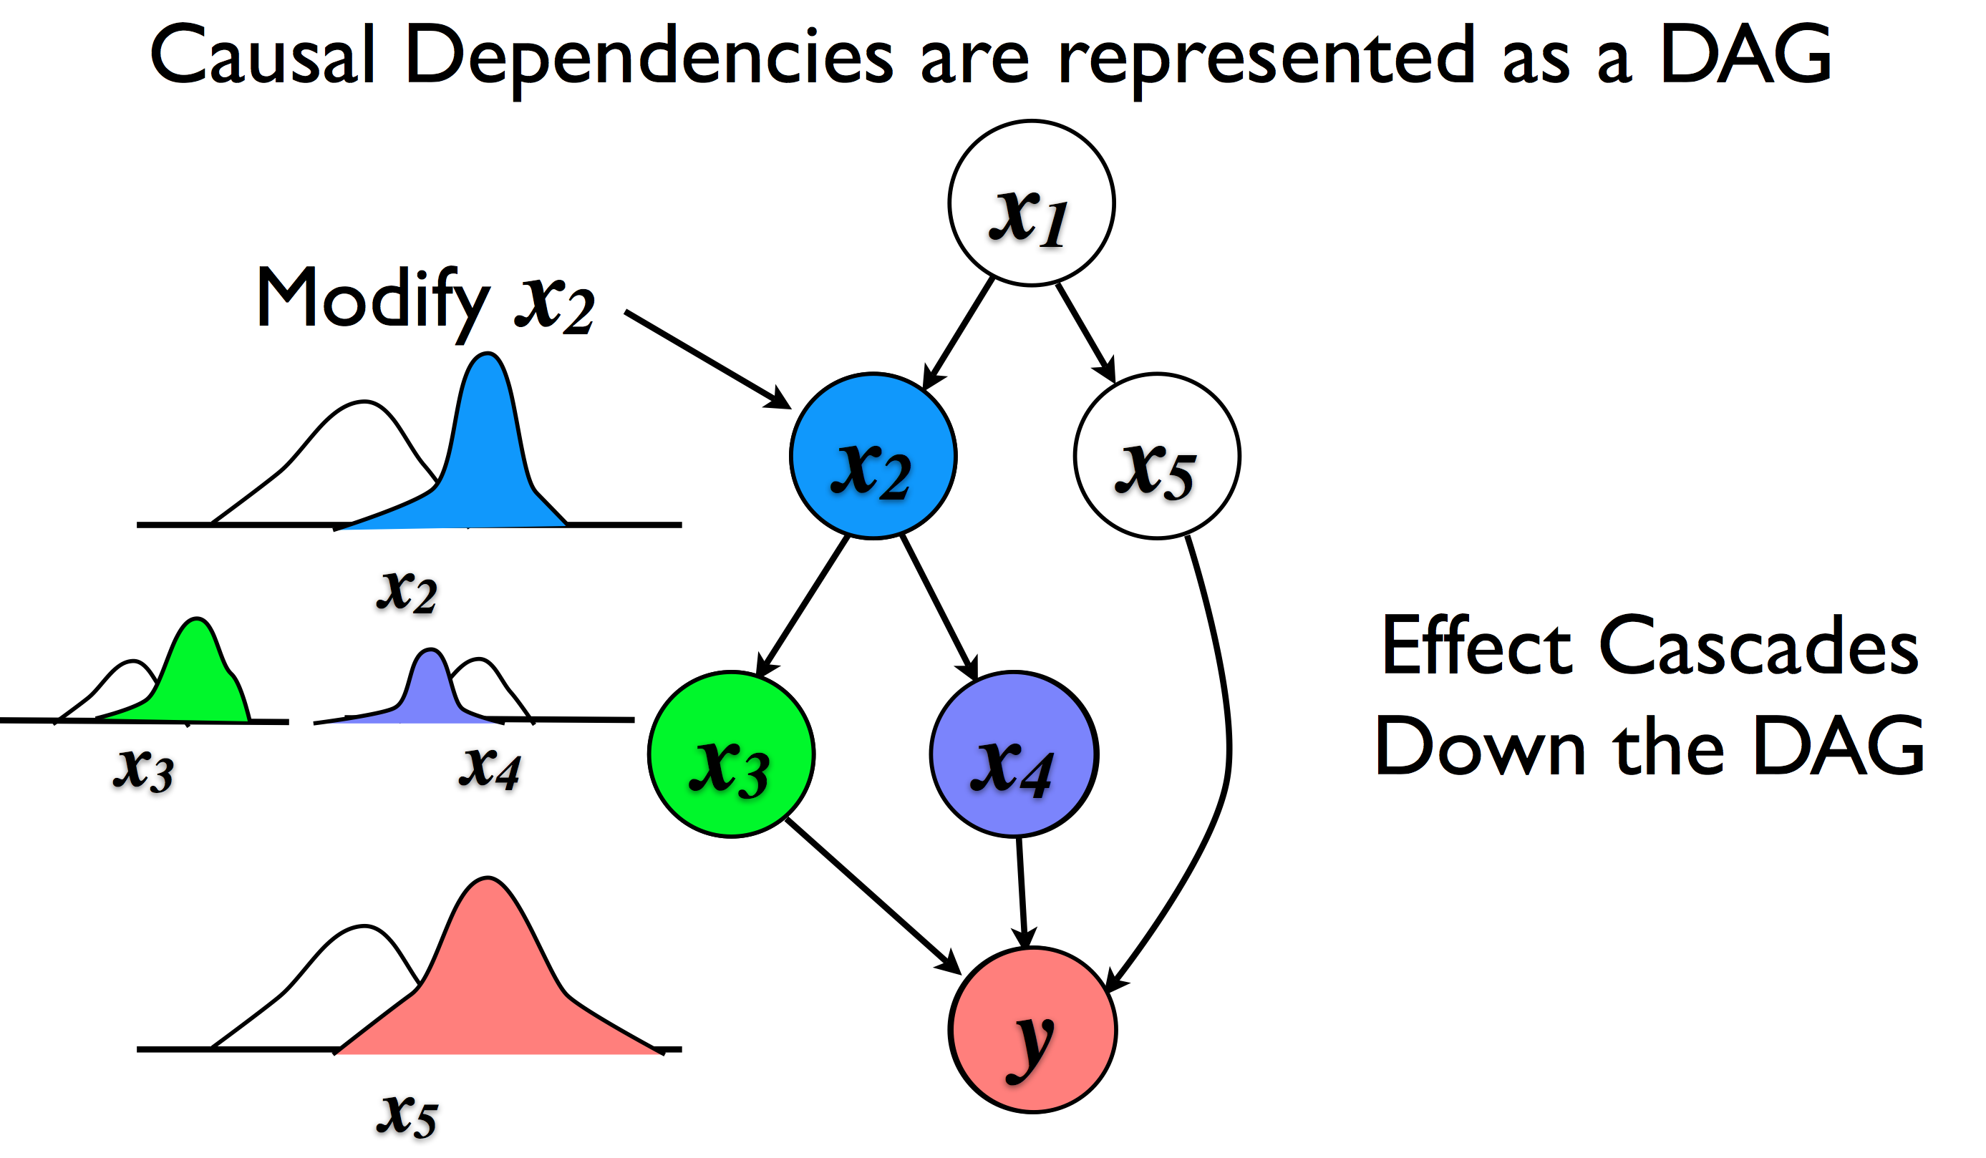
Guiding Transformation

Slide 10
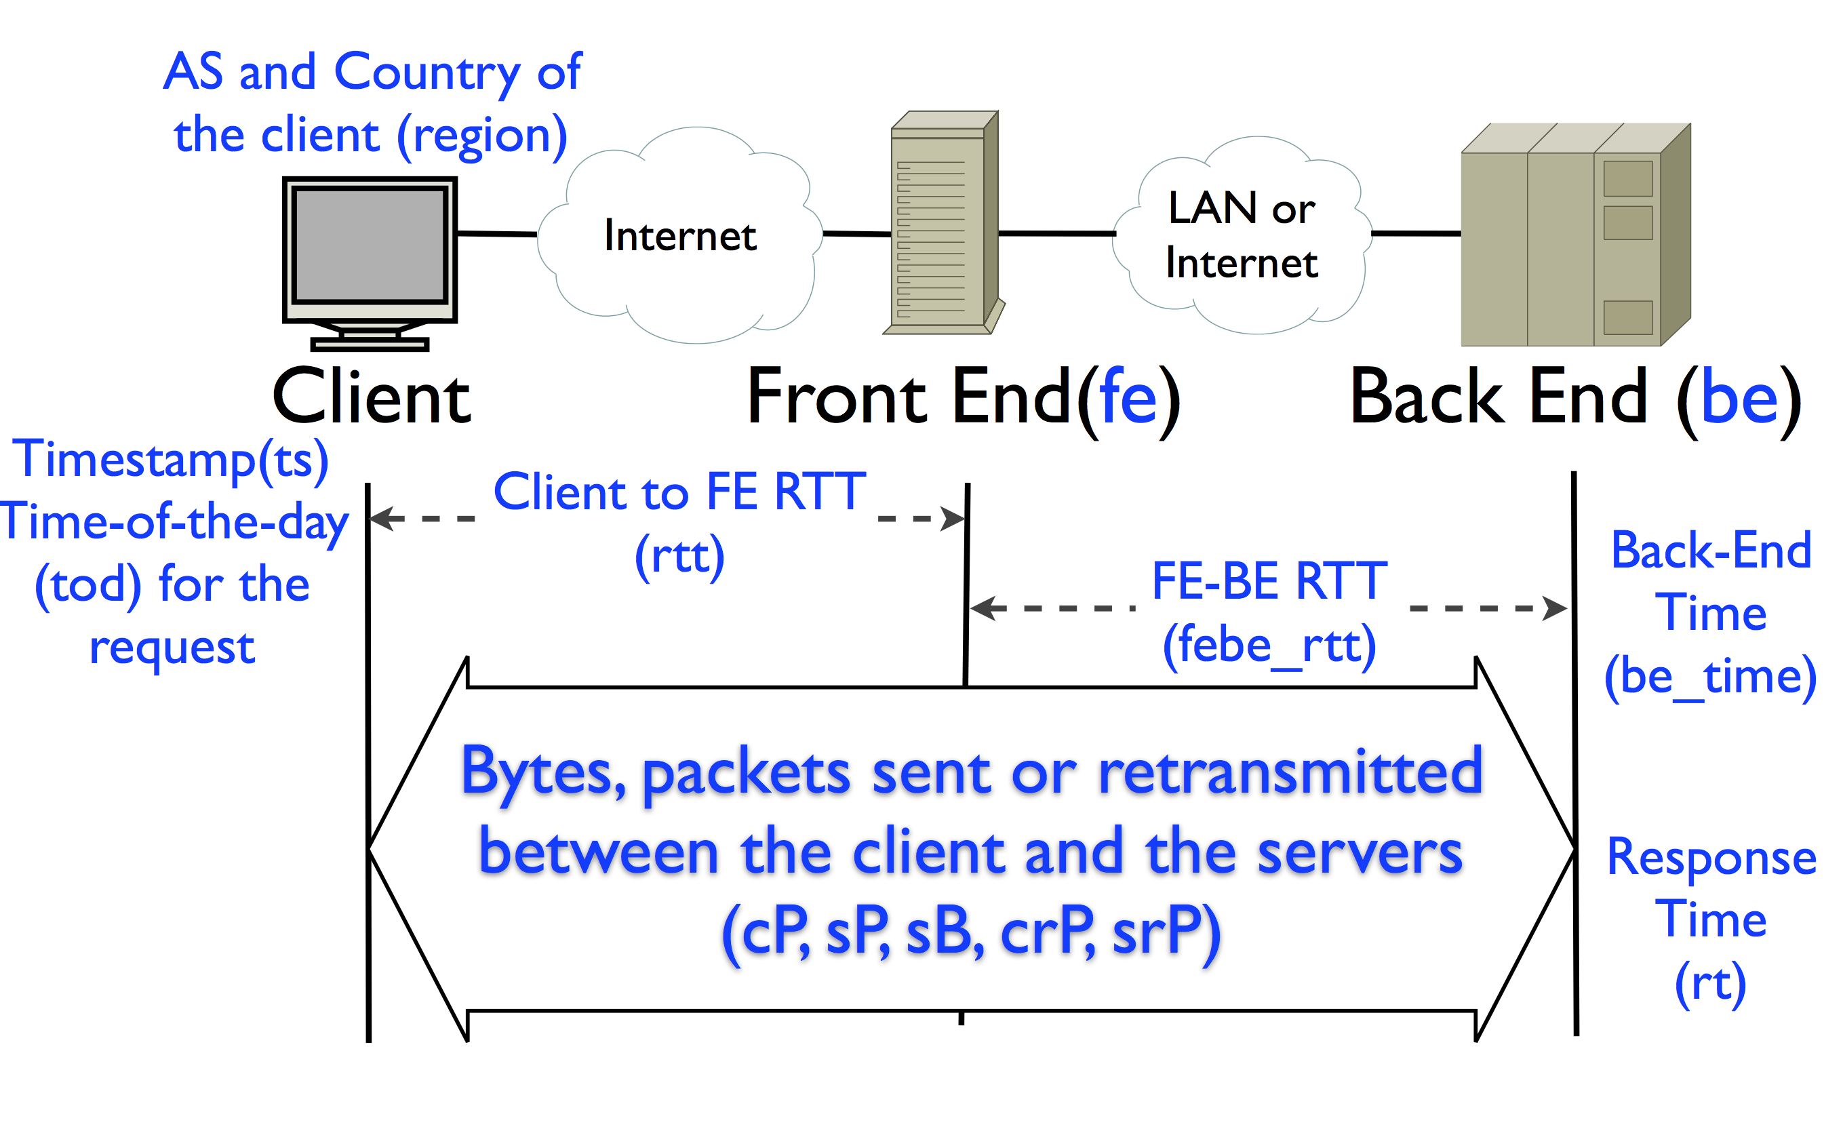
Google Web Service

Slide 11
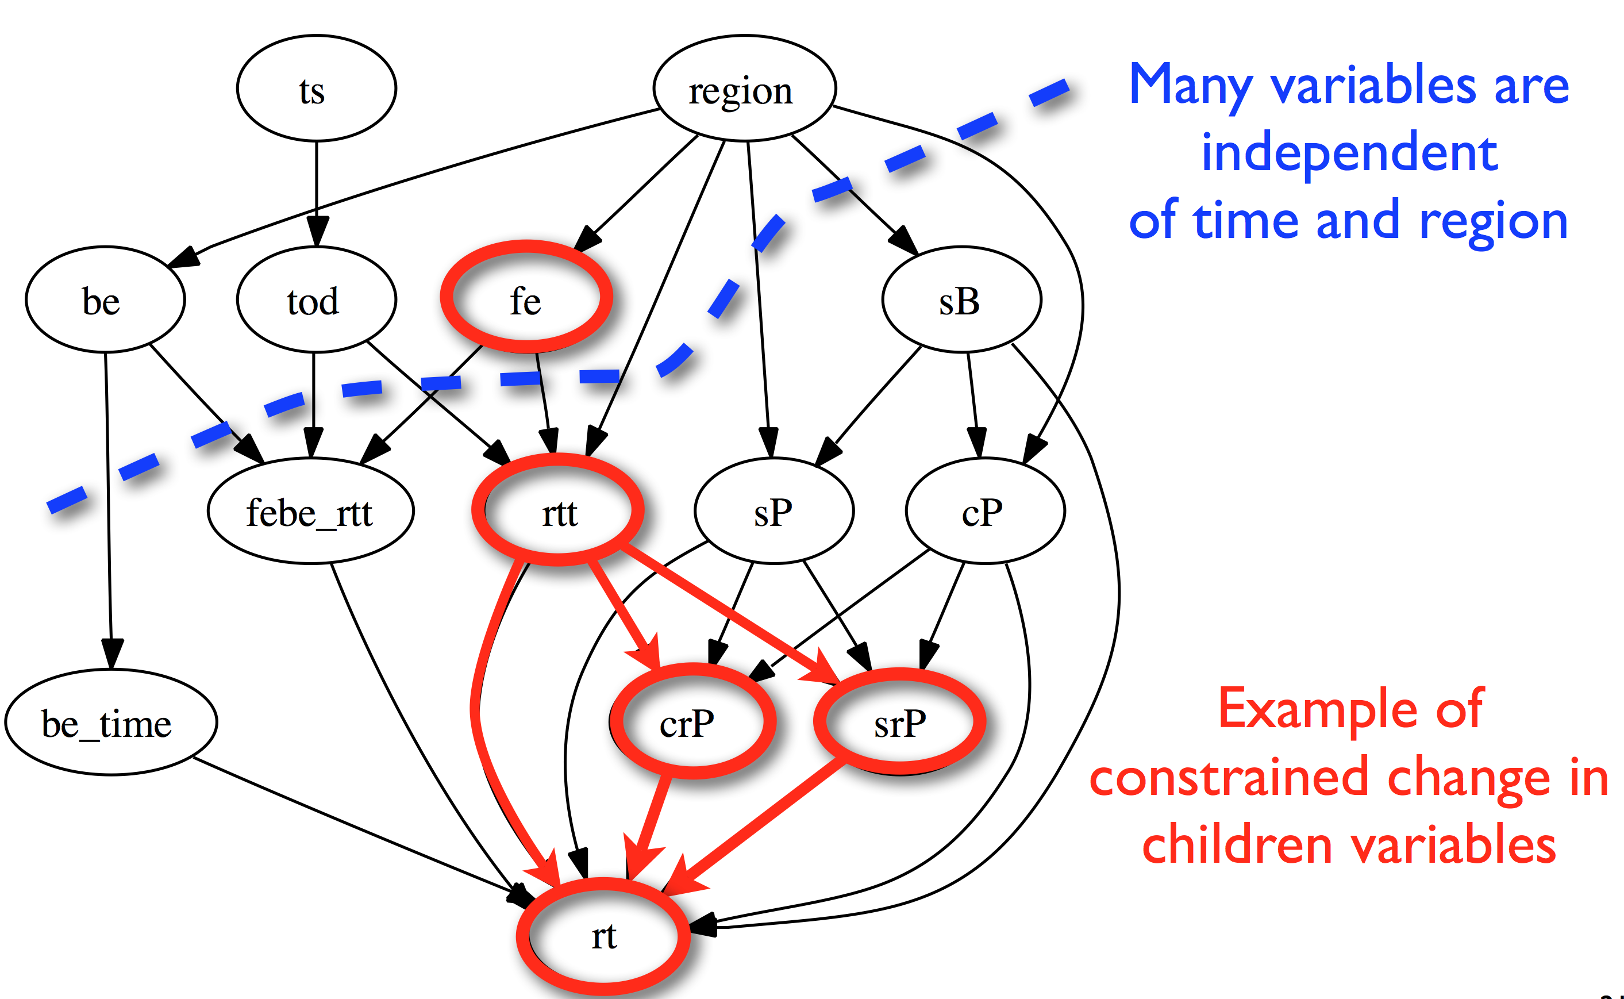
Propagating Changes

Slide 12
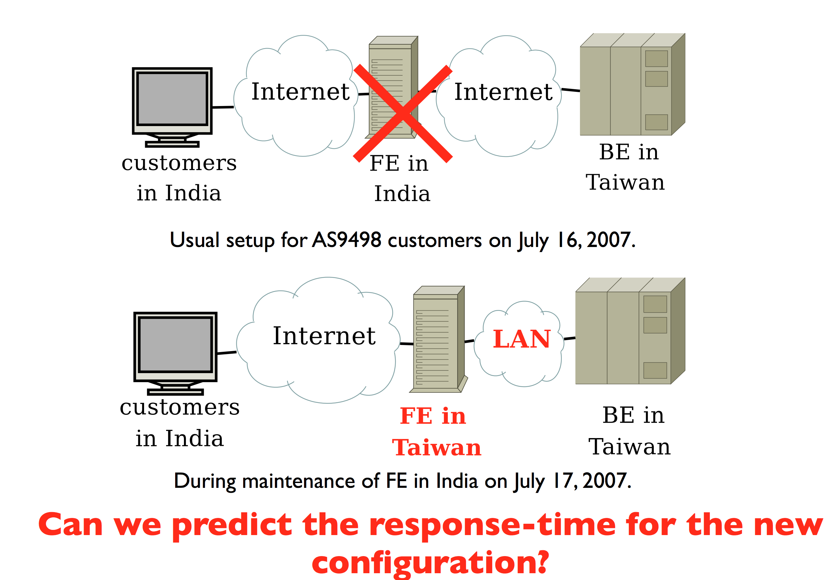
Example: “Draining” a Data Center

Slide 13
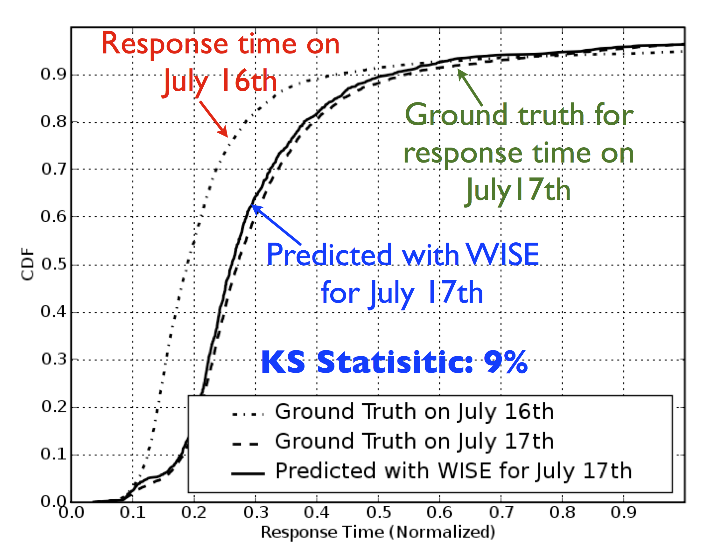
High Prediction Accuracy

Slide 14
Predicting Network Performance
WISE: A What-if Scenario Evaluator for deployment questions for large CDNs
Blackbox approach is generically applicable to many applications and networks
Frees the designer from intricate details
Yields accurate results
Key Limitation: Cannot “extrapolate”
Future: Hybrid, parametric/non-parametric

