Slide 1
Machine Learning for Computer Systems
Nick Feamster University of Chicago

Slide 2
Welcome
Brief overview of course
Motivation
Syllabus
Expectations
What you can expect from this course
To do for Thursday’s class: Install Jupyter notebook

Slide 3
Why I Wanted to Make this Course…
Many machine learning courses are geared towards the machine learning researcher (or mathematician). Most of us who use machine learning need a slightly different set of knowledge and skills.
Goal: Everything I always wanted to know about machine learning, as a “user”, or someone who applies the tools.
This describes most people who are “doing machine learning”.
Lots of things to think about…
Discussion Question: What do you want to learn about?

Slide 4
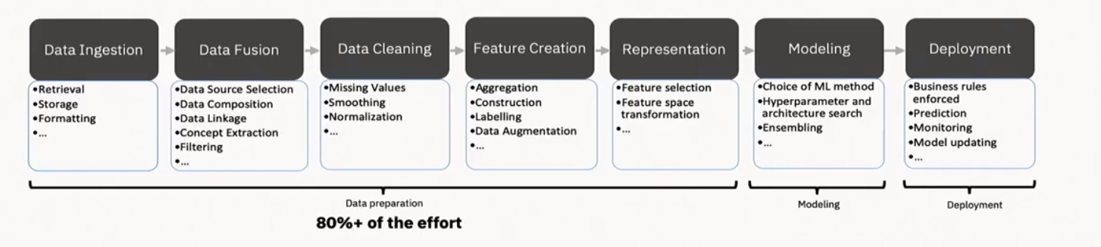
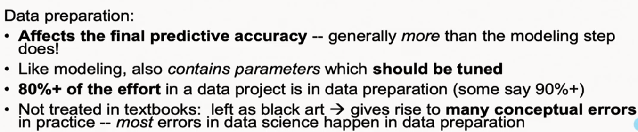
The Machine Learning Pipeline
Credit: Alex Gray

Slide 5
Learning Objectives
Learn what machine learning can (and cannot) do for a variety of practical computer systems problems.
Learn about a variety of machine learning models and how (and when) various models are appropriate.
Learn about the machine learning pipeline, and how to apply it to practical problems.
Learn about the practical challenges of deploying machine learning, from data cleaning to model deployment and maintenance.

Slide 6
How Networks Run: Measure, Model, Control
Inference/ML
Protocol modeling
Statistical inference
Network-wide
“what if” model (analytical, statistical)
Topology/
Configuration
Failures/ Attacks
Traffic Demands
Changes to
the network
measure
control
Operational Network

Slide 7
The Machine Learning Control Loop
Machine Learning
Measurement
Control
Raw traffic
Flow records
Summary statistics
User feedback

Slide 8
Inference (“Machine Learning”)
Detection of Attacks
“What-if” scenario evaluation
Performance
Provisioning
Troubleshooting
Anomaly detection
…

Slide 9
The Network Management “Cycle”
Inference
Control
Monitoring
More fine-grained and programmable
measurements
Streaming capabilities, distributed inference
Customizable
Actions
“Data Plane”
Programmable, protocol-independent data planes

Slide 10
The State of the NetML: Where We Are, Where We’d Like to Be
Inference
offline detection (security) and prediction (TE, provisioning)
…but not in real time and not coupled w/control
Control
networks are more programmable
… but not always scalable, distributed, or real time
… not always integrated across routing protocols, scheduling/shaping, job/task/cache placement, etc.
Monitoring
low-level metrics/aggregates
…but not high-level application characteristics properties (e.g., QoE)

Slide 11
Performance
Monitoring: Real-time statistics on-path
Collect network-level metrics at line rate at many places across the network (in home, on transit network), ideally on encrypted traffic
Inference: Infer properties “up the stack” (user engagement, QoE)
Combine statistics from different network vantage points and layers
Isolate performance bottlenecks (wireless, access, interconnect)
Identify application events (video rebuffering, startup time, bitrate adaptation)
Control: Automated performance-driven path selection, load balance, etc.
Transit: Automate TE/select interconnect
Edge: Channel selection / alternate path
Notes:
Example: real-time QoE

Slide 12
Security and Privacy Ideals
Monitoring: Gather only what’s needed
Use queries to drive data collection (IPFIX, packet traces, payload, DNS)
Trigger “deep dives” based on lightweight thresholds (script de-obfuscation)
Inference: Detect attacks in real-time (not just offline traces)
“Compile” machine learning-based inference models to line-rate targets
Trigger gathering of more information as needed (networking meets active learning)
Control: Automate (some) decisions
Rate limiting decisions (DNS response rate-limiting in-network)
Traffic redirection (e.g., to scrubbers, middleboxes)
On-the-fly placement of virtual middleboxes
Notes:
Example: monitoring high-level stats to trigger binary unpacking

Slide 13
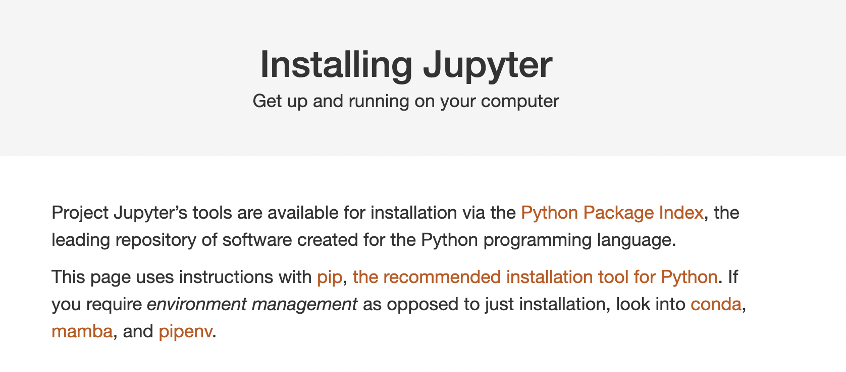

For Next Class: Jupyter Notebook Installation

Slide 14
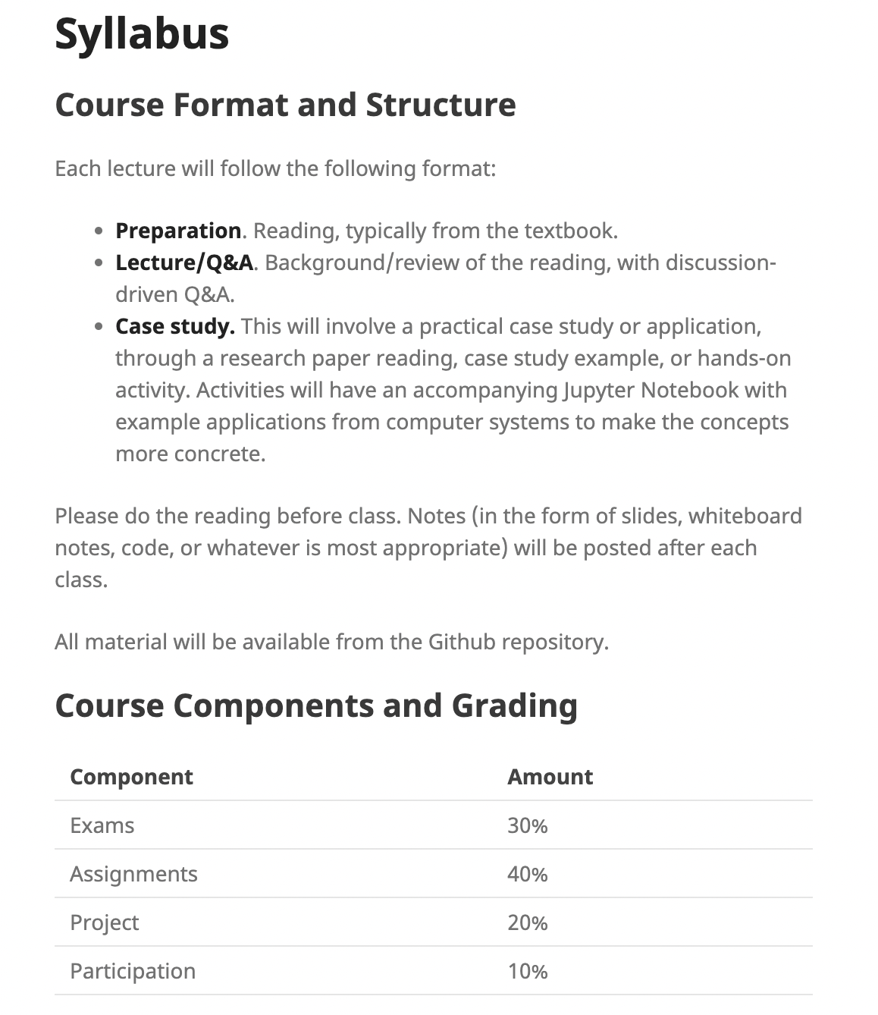
Structure and Syllabus

Slide 15
Readings
There will be reading for most classes.
There is a textbook in progress. You have a link to it from the webpage. Later chapters (as you can see) are not yet complete, but will be taking shape was we go.
There will be other readings as appropriate.
Read before class. (I am preparing…class will go better if we are all prepared.)
I will ask you to bring one question about the reading to each class.

Slide 16
Communication and Collaboration
Channels
Q&A/Communication via Slack
Announcements via Canvas/Slack
Assignments via Canvas/Gradescope
You are welcome and encouraged to work together. (on everything but the midterm and final)
There are more of you than there are of me!
Please acknowledge your collaborators, specifically
Participation credit for helping others
Before posting a question… (1) try; (2) think. We will ask you what you’ve tried.

Slide 17
Assignments
Out on Fridays, due on Fridays.
Approximately every two weeks. We will also have a warm-up assignment to test the workflow.
Predictable cadence to help you plan.
4–5 Assignments
Goal: Hands-on experience
Plan of Topics:
Setting up an ML Pipeline
Supervised Learning (classification)
Unsupervised Learning (anomaly detection)
Deployment Considerations

Slide 18
Project
Project. The course will have a small project. You will have two options for completing the project.
ML/Net Leaderboard. nPrint/pcapML; your goal will be to re-produce or extend some of the best-known machine learning results for various applications of machine learning in computer networking.
Research. You are welcome to work on an independent research project that involves machine learning and computer systems. This option is probably better suited for graduate students in computer science who are comfortable working on open-ended problems. Your project must be approved by the instructor, based on a concrete research proposal.

Slide 19
Late Policy
Don’t ask me or the course staff for extensions.
It’s not fair to other students.
It’s not fair to the instructional staffl.
You have late hours, read the syllabus.
Occasionally, there are very extenuating circumstances that may take you out of the classroom for an extended period. We will work with you, let us know. But these are rare exceptions.

Slide 20
Looking Ahead to Thursday
Course setup:
Install Jupyter notebooks
Join course Slack, Canvas, Gradescope
Do this in advance!
We will check in on Slack to see how it’s going.
Hands-On
Simple Python/Jupyter notebook
Discussion (based on reading)
What is machine learning, and how can it be used in systems?

